Slide 1
Cisco Device Hardening
Configuring AAA on Cisco Routers

Slide 2

Introduction to AAA

Slide 3
AAA Model
  Authentication:
    Who are you?
    “I am user student and my password validateme proves it.”
  Authorization:
    What can you do? What can you access?
    “User student can access host serverXYZ using Telnet.”
    “Assign an IP address and ACL to user student connecting through VPN.”
    “When user student starts an EXEC session, assign privilege level 10.”
  Accounting:
    What did you do? How long and how often did you do it?
    “User student accessed host serverXYZ using Telnet for 15 minutes.”
    “User student was connected to VPN for 25 minutes.”
    “EXEC session of user student lasted 20 minutes and only show commands were executed.”

Slide 4
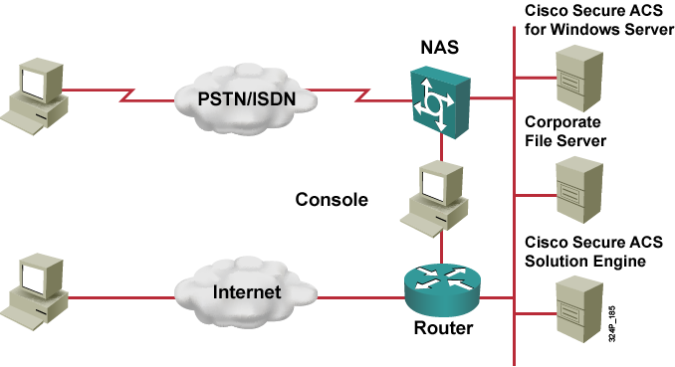
Implementing AAA
  Administrative access: Console, Telnet, and AUX access
  Remote user network access: Dialup or VPN access

Slide 5
Router Access Modes

Slide 6
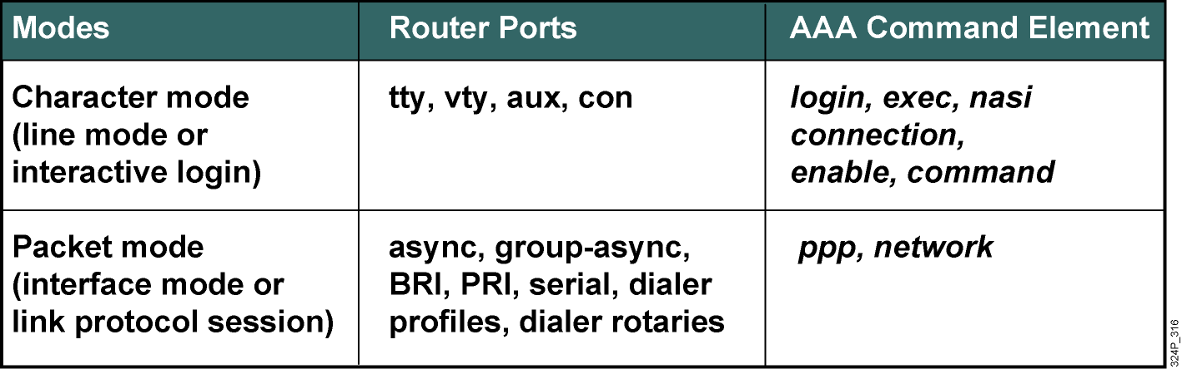
Router Access Modes

Slide 7
AAA Protocols: RADIUS and TACACS+

Slide 8
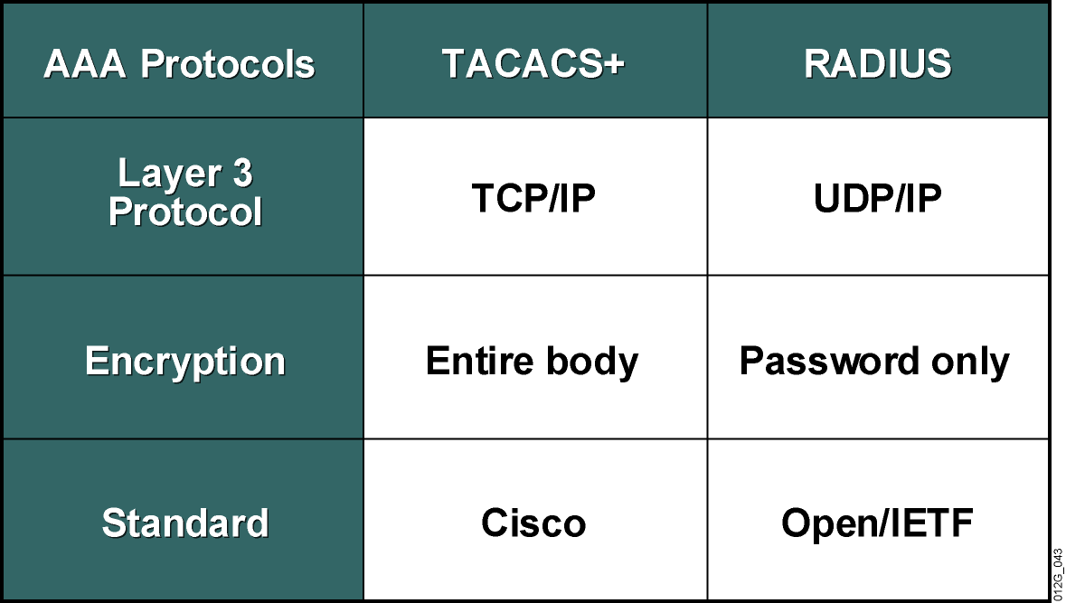
AAA Protocols: RADIUS and TACACS+

Slide 9
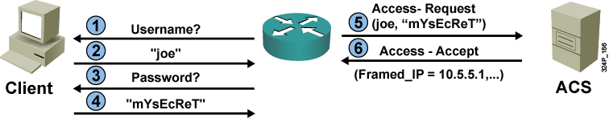
RADIUS Authentication and Authorization
  The example shows how RADIUS exchange starts once the NAS is in possession of the username and password.
  The ACS can reply with Access-Accept message, or Access-Reject if authentication is not successful.

Slide 10
RADIUS Messages
There are four types of messages:
  Access-Request
  Access-Challenge, to facilitate challenge-response authentication protocols
  Access-Accept
  Access-Reject

Slide 11
RADIUS Attributes
  RADIUS messages contain zero or more AV-pairs, for example:
    User-Name
    User-Password (this is the only encrypted entity in RADIUS)
    CHAP-Password
    Service-Type
    Framed-IP-Address
  There are approximately 50 standard-based attributes (RFC 2865).
  RADIUS allows proprietary attributes.
  Basic attributes are used for authentication purposes.
  Most other attributes are used in the authorization process.

Slide 12
RADIUS Features
  Standard protocol (RFC 2865)
  Standard attributes can be augmented by proprietary attributes:
    Vendor-specific attribute 26 allows any TACACS+ attribute to be used over RADIUS
  Uses UDP on standard port numbers (1812 and 1813; Cisco Secure ACS uses 1645 and 1646 by default)
  Includes only two security features:
    Encryption of passwords (MD5 encryption)
    Authentication of packets (MD5 fingerprinting)
  Authorization only possible as part of authentication

Slide 13
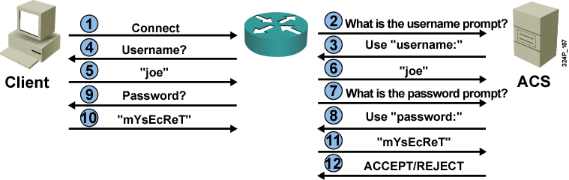
TACACS+ Authentication
  The example shows how TACACS+ exchange starts before the user is prompted for username and password.
  The prompt text can be supplied by the TACACS+ server.

Slide 14
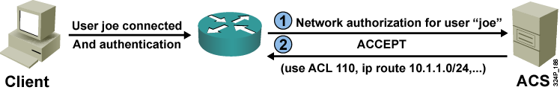
TACACS+ Network Authorization
  The example shows the process of network authorization which starts after successful authentication.

Slide 15
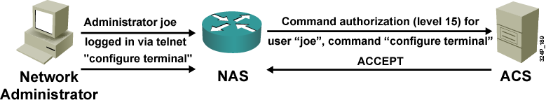
TACACS+ Command Authorization
  The example illustrates the command authorization process which is repeatedly started for every single command that requires authorization (based on command privilege level)

Slide 16
TACACS+ Attributes and Features
  TACACS+ messages also contain AV-pairs, such as these:
    ACL
    ADDR
    CMD
    Interface-Config
    Priv-Lvl
    Route
  TACACS+ uses TCP on well-known port number 49.
  TACACS+ establishes a dedicated TCP session for every AAA action.
  Cisco Secure ACS can use one persistent TCP session for all actions.
  Protocol security includes authentication and encryption of all TACACS+ datagrams.

Slide 17
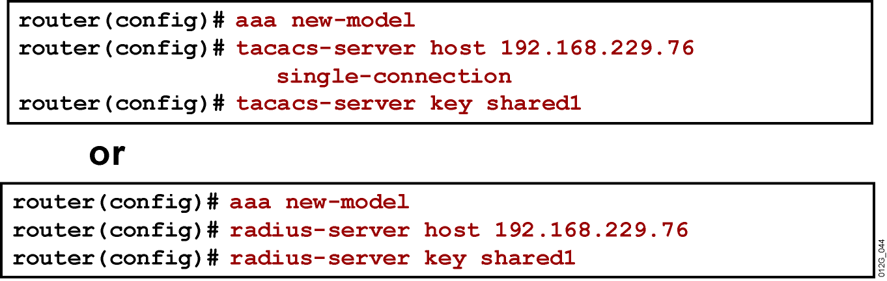
Configuring the AAA Server
TACACS+
RADIUS

Slide 18
Configure AAA Login Authentication on Cisco Routers Using CLI

Slide 19
AAA Authentication Commands
Router(config)#
aaa authentication login {default | list_name} group {group_name | tacacs+ | radius} [method2 [method3 [method4]]]
  Use this command to configure the authentication process.
Router(config)#aaa authentication login default group tacacs+ local line

Slide 20
Character Mode Login Example
Router#show running-config
...
aaa new-model
aaa authentication login default group tacacs+ local
aaa authentication login my_list group tacacs+
...
line con 0
line aux 0
line vty 0 4
login authentication my_list
  Because the authentication has not been specified for line con 0 and aux 0, the default option will be used.

Slide 21
Configure AAA Login Authentication on Cisco Routers Using SDM

Slide 22
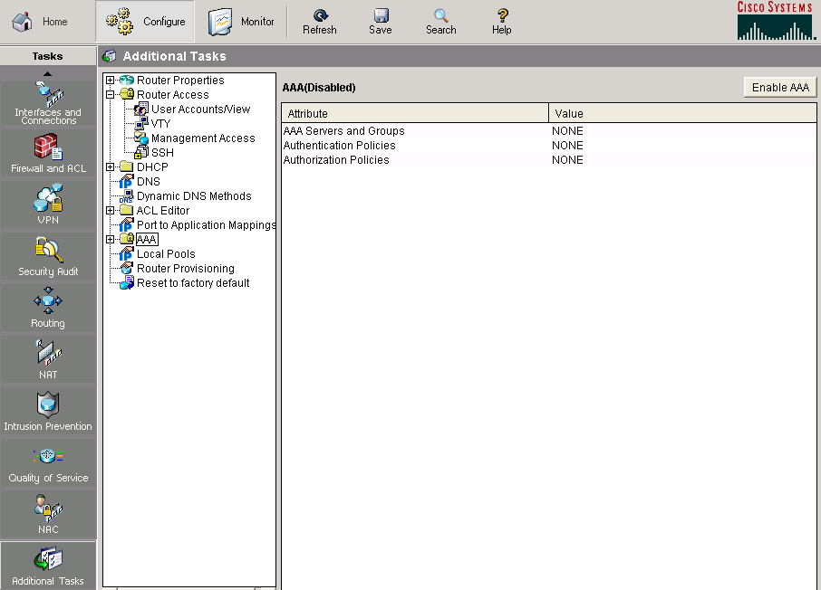
Enabling AAA in SDM

Slide 23
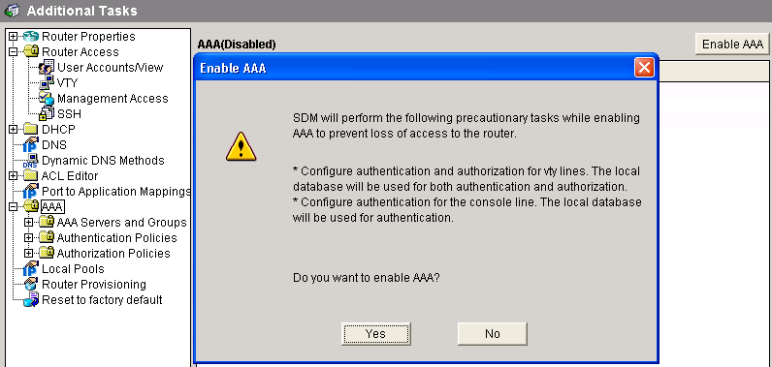
Confirming the AAA Activation

Slide 24
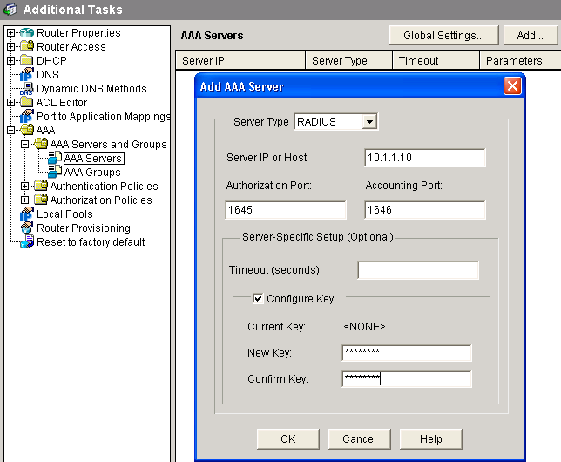
Defining RADIUS Servers

Slide 25
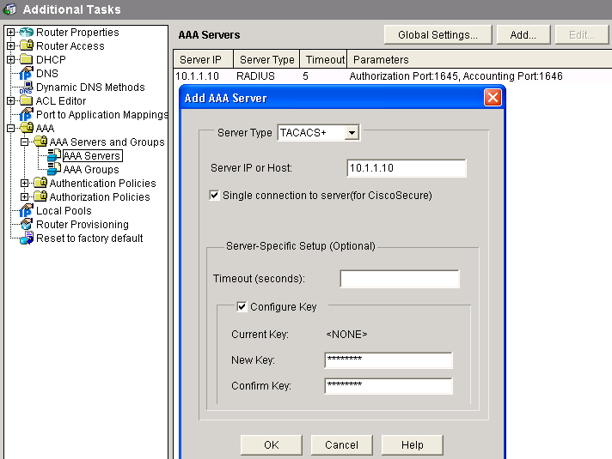
Defining TACACS+ Servers

Slide 26
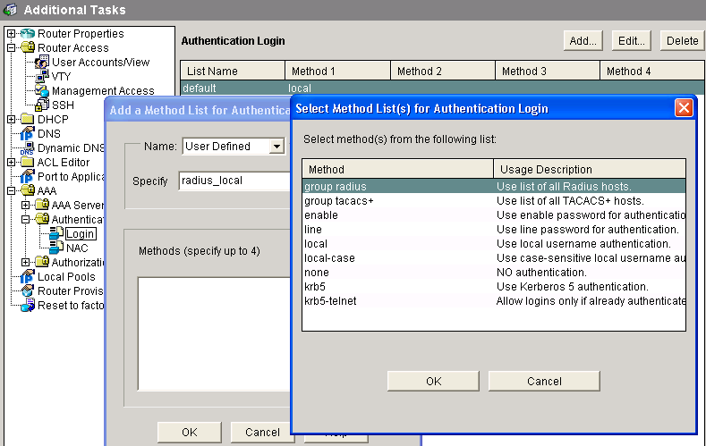
Creating a Login Authentication Policy

Slide 27
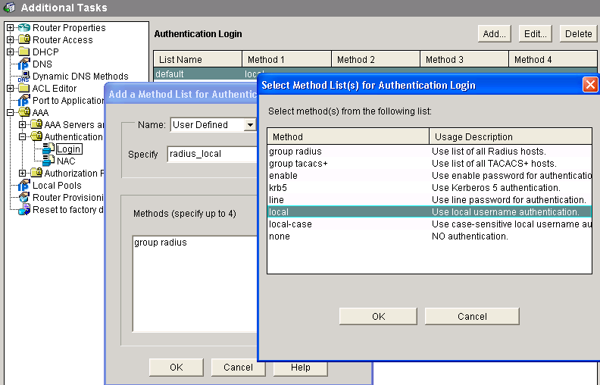
Configuring a Login Authentication Policy

Slide 28
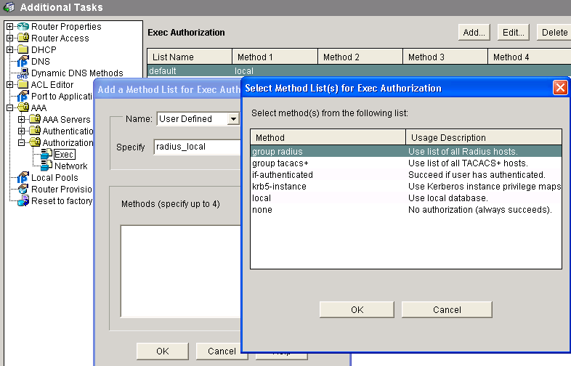
Creating an EXEC Authorization Policy

Slide 29
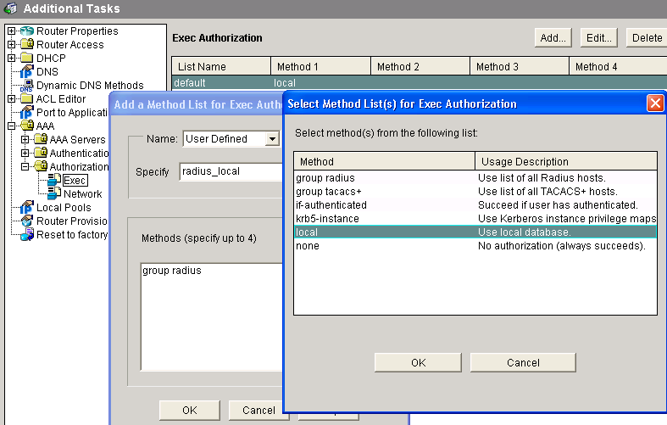
Configuring an EXEC Authorization Policy

Slide 30
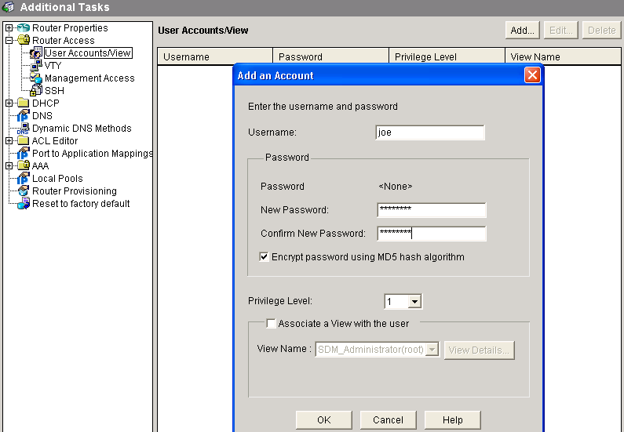
Creating Local User Accounts

Slide 31
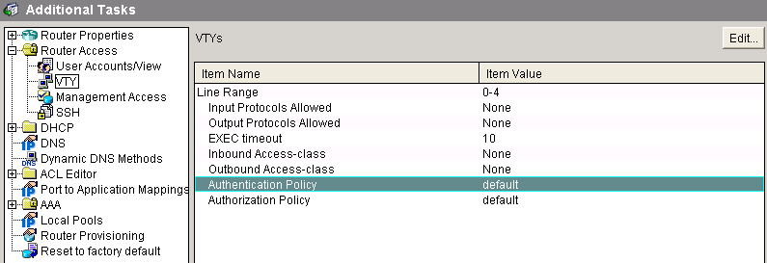
Configuring VTY Line Parameters

Slide 32
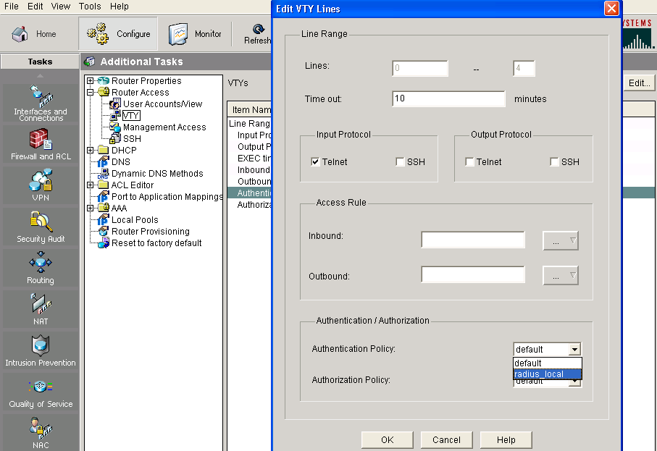
Applying Authentication Policy to VTY Lines

Slide 33

Applying Authorization Policy to VTY Lines

Slide 34
Verifying AAA Login
Authentication Commands
aaa new-model
!
aaa authentication login default local
aaa authentication login radius_local group radius group radius
aaa authorization exec default local
!
username joe secret 5 $1$SlZh$Io83V..6/8WEQYTis2SEW1
!
tacacs-server host 10.1.1.10 single-connection key secrettacacs
radius-server host 10.1.1.10 auth-port 1645 acct-port 1646 key secretradius
!
line vty 0 4
login authentication radius_local

Slide 35
Troubleshoot AAA Login Authentication on Cisco Routers

Slide 36
Troubleshoot AAA Login
Authentication on Cisco Routers
router#
debug aaa authentication
  Use this command to help troubleshoot AAA authentication problems.

Slide 37
Troubleshoot AAA Authentication Example
R2#debug aaa authentication
113123: Feb 4 10:11:19.305 CST: AAA/MEMORY: create_user (0x619C4940) user=''
ruser='' port='tty1' rem_addr='async/81560' authen_type=ASCII service=LOGIN priv=1
113124: Feb 4 10:11:19.305 CST: AAA/AUTHEN/START (2784097690): port='tty1' list=''
action=LOGIN service=LOGIN
113125: Feb 4 10:11:19.305 CST: AAA/AUTHEN/START (2784097690): using "default" list
113126: Feb 4 10:11:19.305 CST: AAA/AUTHEN/START (2784097690): Method=LOCAL
113127: Feb 4 10:11:19.305 CST: AAA/AUTHEN (2784097690): status = GETUSER
113128: Feb 4 10:11:26.305 CST: AAA/AUTHEN/CONT (2784097690): continue_login
(user='(undef)')
113129: Feb 4 10:11:26.305 CST: AAA/AUTHEN (2784097690): status = GETUSER
113130: Feb 4 10:11:26.305 CST: AAA/AUTHEN/CONT (2784097690): Method=LOCAL
113131: Feb 4 10:11:26.305 CST: AAA/AUTHEN (2784097690): status = GETPASS
113132: Feb 4 10:11:28.145 CST: AAA/AUTHEN/CONT (2784097690): continue_login
(user='diallocal')
113133: Feb 4 10:11:28.145 CST: AAA/AUTHEN (2784097690): status = GETPASS
113134: Feb 4 10:11:28.145 CST: AAA/AUTHEN/CONT (2784097690): Method=LOCAL
113135: Feb 4 10:11:28.145 CST: AAA/AUTHEN (2784097690): status = PASS

Slide 38
AAA Authorization Commands

Slide 39
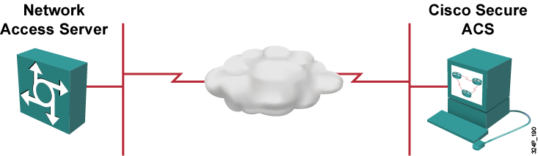
AAA Authorization Commands
router(config)#
aaa authorization {network | exec | commands level | config-commands | reverse-access} {default|list-name} method1 [method2...]
Example:
router(config)#aaa authorization exec default group radius local none

Slide 40
Authorization Example
R2#show running-config
...
aaa new-model
!
aaa authentication login default local
aaa authentication enable default group tacacs+ enable
aaa authorization exec default group tacacs+ local
aaa authorization commands 1 default group tacacs+ local
aaa authorization commands 15 default group tacacs+ local
...
username admin password 0 cisco123

Slide 41
Troubleshooting Authorization
router#
debug aaa authorization
  Use this command to help troubleshoot AAA authorization problems.
R2#debug aaa authorization
2:23:21: AAA/AUTHOR (0): user='carrel'
2:23:21: AAA/AUTHOR (0): send AV service=shell
2:23:21: AAA/AUTHOR (0): send AV cmd*
2:23:21: AAA/AUTHOR (342885561): Method=TACACS+
2:23:21: AAA/AUTHOR/TAC+ (342885561): user=carrel
2:23:21: AAA/AUTHOR/TAC+ (342885561): send AV service=shell
2:23:21: AAA/AUTHOR/TAC+ (342885561): send AV cmd*
2:23:21: AAA/AUTHOR (342885561): Post authorization status = FAIL

Slide 42
AAA Accounting Commands

Slide 43
AAA Accounting Commands
router(config)#
aaa accounting {command level | connection | exec | network | system} {default | list-name} {start-stop | stop-only | wait-start} group {tacacs+ | radius}
Example:
R2(config)#aaa accounting exec default start-stop group tacacs+

Slide 44
AAA Accounting Example
R2#show running-config | begin aaa
aaa new-model
!
aaa authentication login default group tacacs+ local
aaa authorization exec default group tacacs+ local
aaa accounting exec default start-stop group tacacs+
...
tacacs-server host 10.1.1.3
tacacs-server key SeCrEtKeY
...

Slide 45
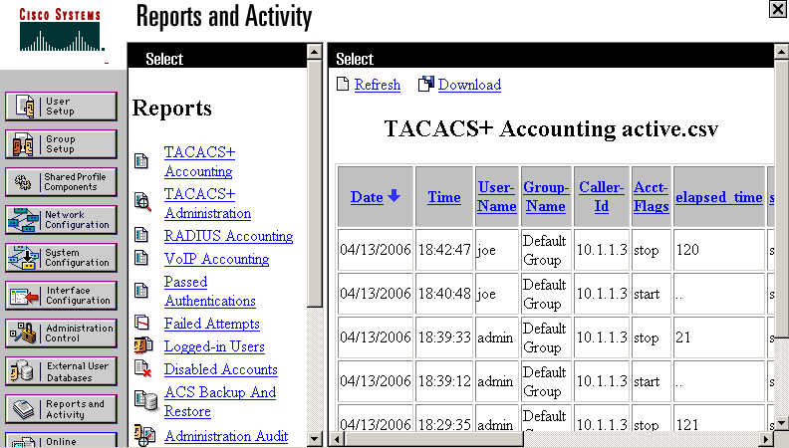
AAA Accounting Example (Cont.)

Slide 46
Troubleshooting Accounting
router#
debug aaa accounting
  Use this command to help troubleshoot AAA accounting problems.
R2#debug aaa accounting
16:49:21: AAA/ACCT: EXEC acct start, line 10
16:49:32: AAA/ACCT: Connect start, line 10, glare
16:49:47: AAA/ACCT: Connection acct stop:
task_id=70 service=exec port=10 protocol=telnet address=172.31.3.78 cmd=glare bytes_in=308 bytes_out=76 paks_in=45 paks_out=54 elapsed_time=14

Slide 47
Summary
  Authentication, authorization, and accounting are used to effectively control network access.
  The router access modes for AAA are character and packet.
  The most popular AAA protocols are TACACS+ and RADIUS.
  AAA can be configured on the router using CLI or SDM.
  SDM simplifies the AAA configuration process.
  One of the troubleshooting tools for login authentication is the debug aaa authentication command.
  The aaa authorization exec command is used for character mode while aaa authorization network command is used for packet mode access authorization.
  The aaa accounting command provides numerous options for accounting purposes.

Slide 48


