Slide 1
Describe Cisco VoIP Implementations
Introducing VoIP Networks

Slide 2

Benefits of Packet Telephony Networks

Slide 3
Benefits of Packet Telephony Networks
  More efficient use of bandwidth and equipment
  Lower transmission costs
  Consolidated network expenses
  Improved employee productivity through features provided by IP telephony:
    IP phones are complete business communication devices
      Directory lookups and database applications (XML)
      Integration of telephony into any business application
    Software-based and wireless phones offer mobility.
  Access to new communications devices
  (such as, PDAs and cable set-top boxes)

Slide 4
Packet Telephony Components

Slide 5
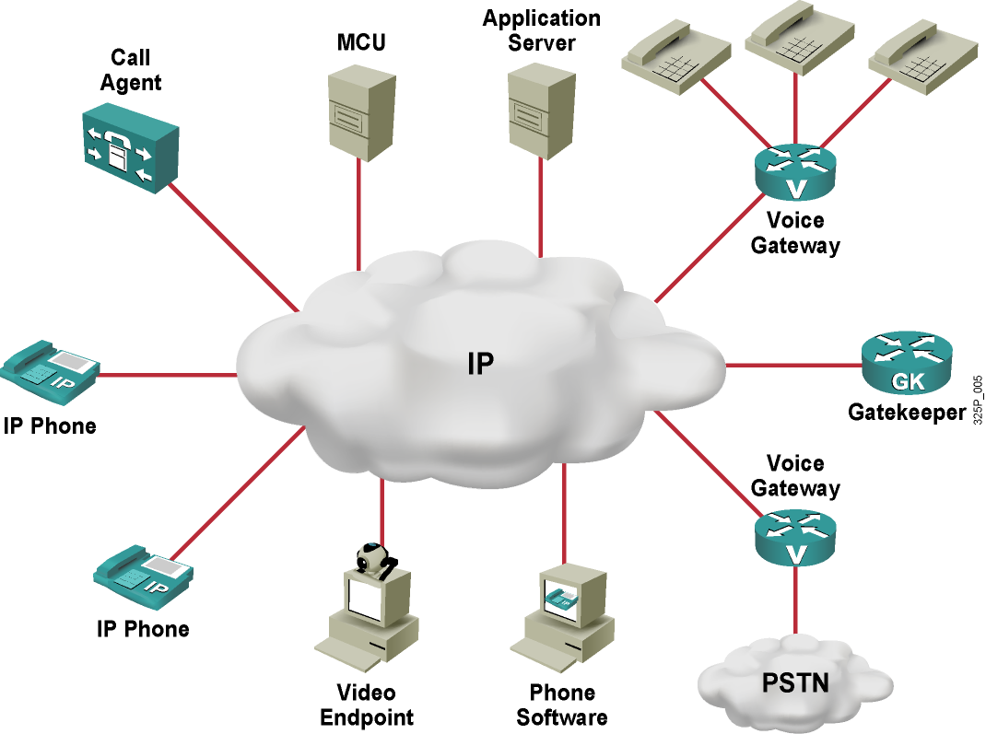
Packet Telephony Components

Slide 6
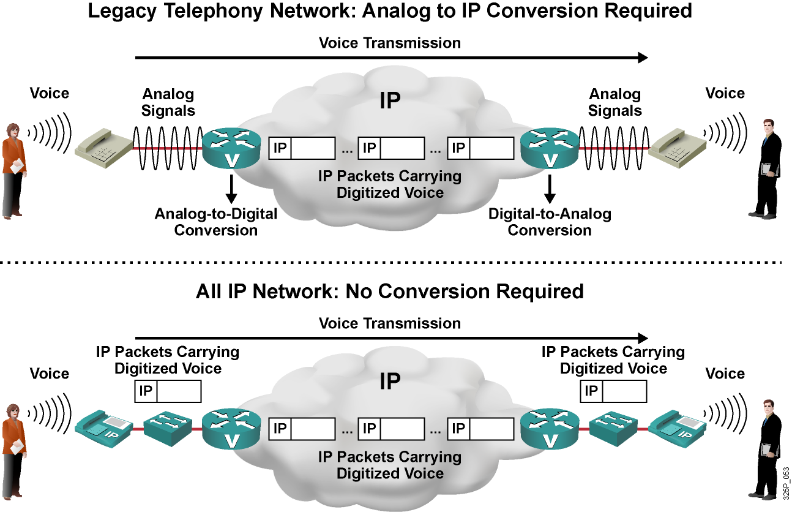
Two Basic Methods for Voice over IP

Slide 7
Analog Interfaces

Slide 8
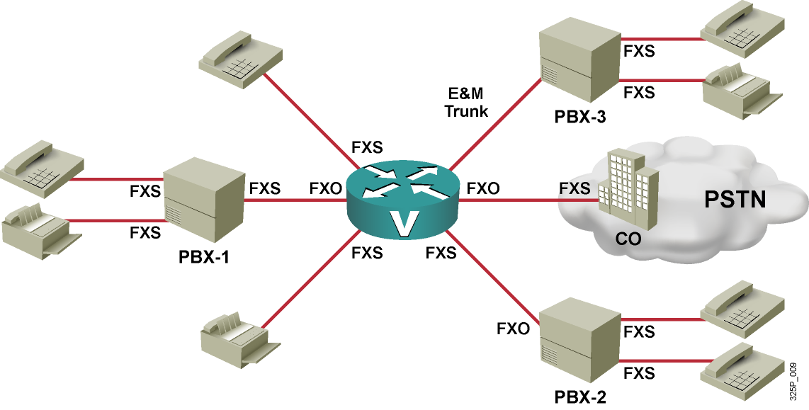
Analog Interfaces
Analog Interface Type | Description
FXS | Used by the PSTN or PBX side of an FXS–FXO connection
FXO | Used by the end device (phone) side of an FXS–FXO connection
E&M | Trunk, used between switches

Slide 9
Digital Interfaces

Slide 10
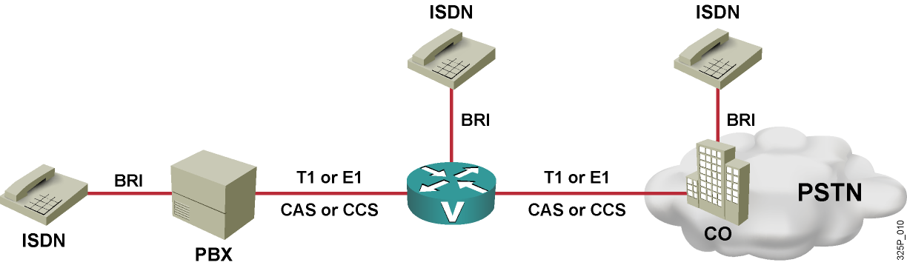
Digital Interfaces
Interface | Voice Channels (64 kbps Each) | Signaling | Framing Overhead | Total Bandwidth
BRI | 2 | 1 channel (16 kbps) | 48 kbps | 192 kbps
T1 CAS | 24 (no clean 64 kbps because of robbed-bit signaling) | in-band (robbed-bits in voice channels) | 8 kbps | 1544 kbps
T1 CCS | 23 | 1 channel (64 kbps) | 8 kbps | 1544 kbps
E1 CAS | 30 | 64 kbps | 64 kbps | 2048 kbps
E1 CCS | 30 | 1 channel (64 kbps) | 64 kbps | 2048 kbps

Slide 11
Stages of a Phone Call

Slide 12
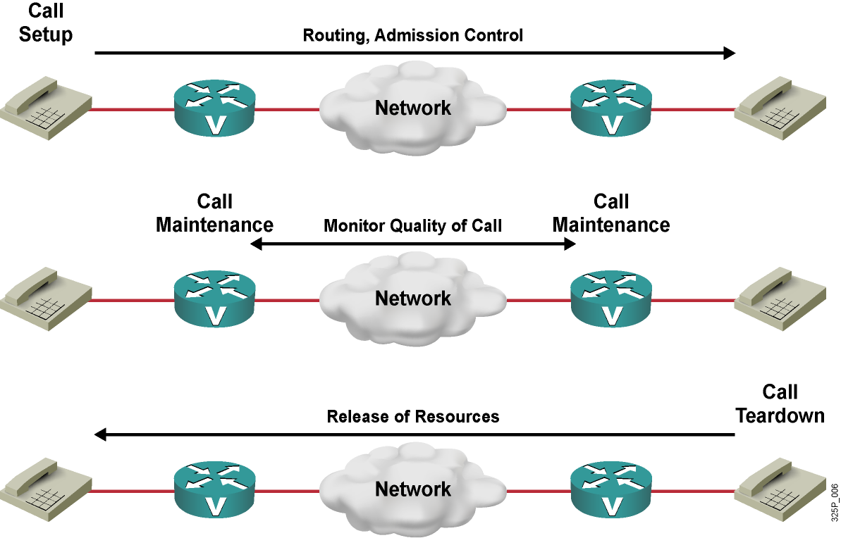
Stages of a Phone Call

Slide 13
Distributed vs. Centralized Call Control

Slide 14
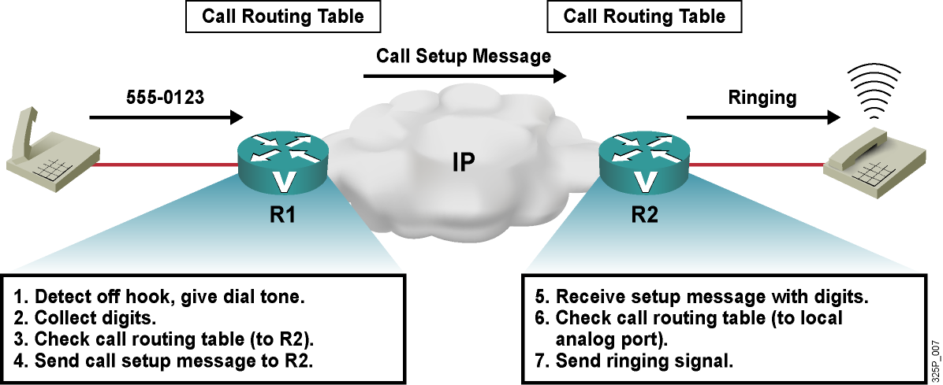
Distributed Call Control

Slide 15
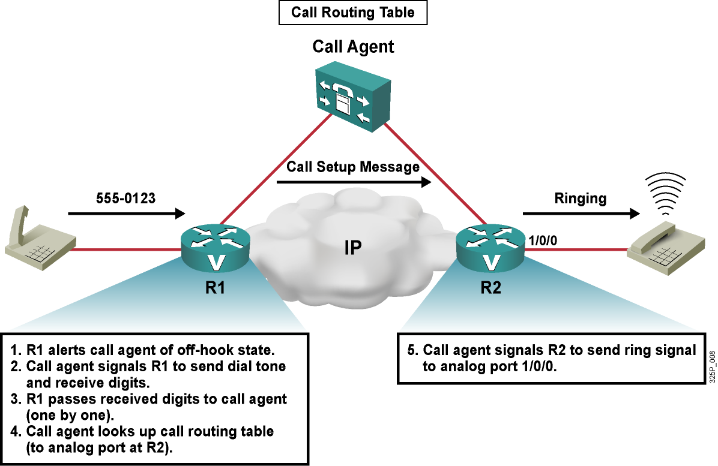
Centralized Call Control

Slide 16
Summary
  Companies can benefit from a common infrastructure that serves voice and data. Advantages of such converged networks include lower costs, more efficient use of available bandwidth, and higher productivity.
  A packet telephony network consists of endpoints (such as IP phones, software phones, and video endpoints) and voice network devices (such as gateways, gatekeepers, conference bridges, call agents, and application servers).
  A voice gateway can use FXS, FXO, and E&M interfaces to connect to analog equipment, such as phones, PBXs, or the PSTN.
  A voice gateway can use BRI, T1, and E1 interfaces to connect to digital equipment, such as ISDN phones, PBXs, or the PSTN.
  A voice call consists of three stages: call setup, call maintenance, and call teardown.
  With distributed call control, each gateway has local intelligence to route calls, while with centralized call control, a call agent makes call routing decisions on behalf of all the gateways that are controlled by the call agent.

Slide 17
