Slide 1
Describe Cisco VoIP Implementations
Digitizing and Packetizing Voice

Slide 2

Basic Voice Encoding: Converting Analog to Digital

Slide 3
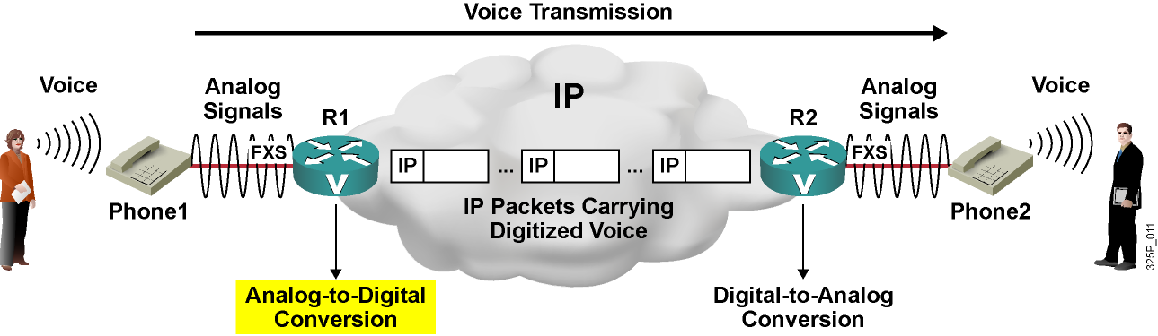
Basic Voice Encoding:
Converting Analog to Digital

Slide 4
Analog-to-Digital Conversion Steps
  Sample the analog signal.
  Quantize the samples.
  Encode the value into a binary expression.
  (Optional) Compress the samples to reduce bandwidth.

Slide 5
Basic Voice Encoding: Converting Digital to Analog

Slide 6
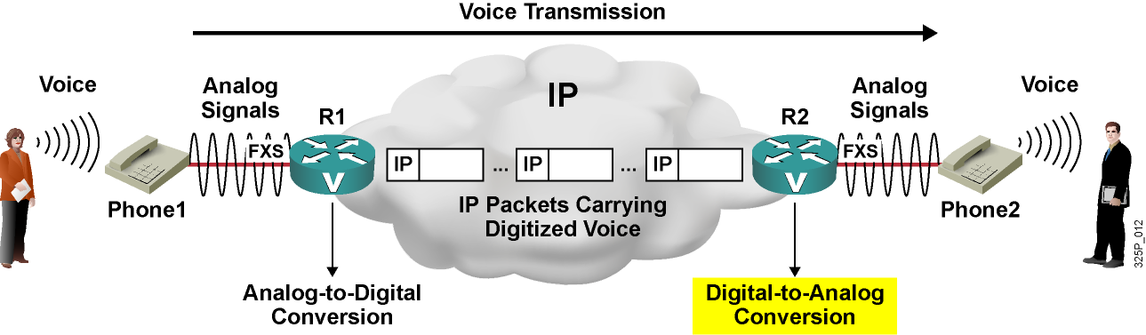
Basic Voice Encoding:
Converting Digital to Analog

Slide 7
Digital-to-Analog Conversion Steps
  Decompress the samples, if compressed.
  Decode the samples into voltage amplitudes, rebuilding the PAM signal.
  Reconstruct the analog signal from PAM signals.

Slide 8
The Nyquist Theorem

Slide 9
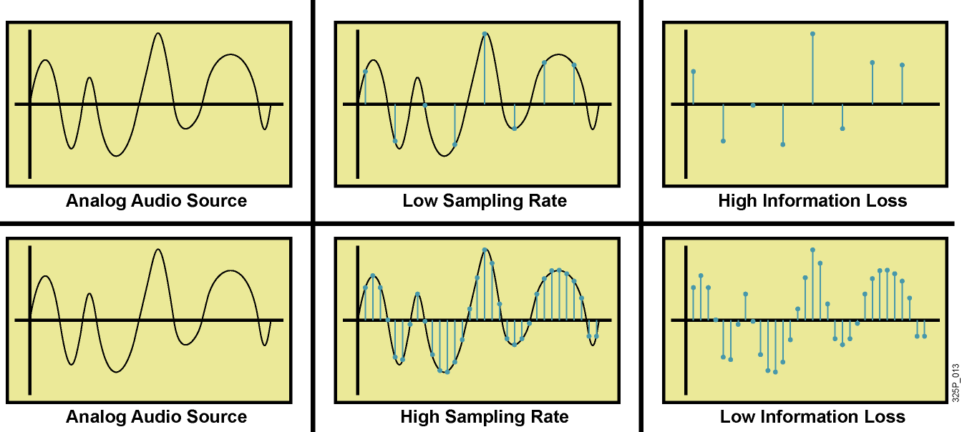
The Nyquist Theorem
  Sampling rate affects the quality of the digitized signal.
  Nyquist theorem determines the minimum sampling rate of analog signals.
  Nyquist theorem states that the sampling rate has to be at least twice the maximum frequency.

Slide 10
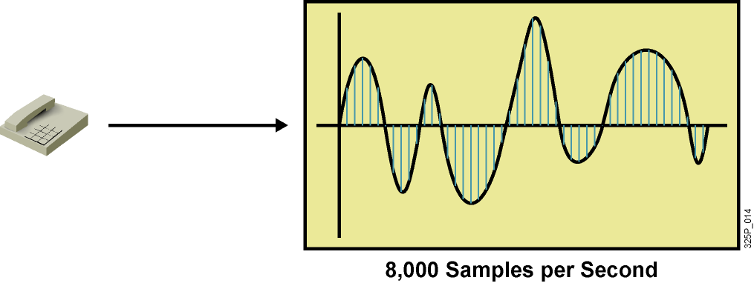
Example: Sampling of Voice
  Human speech uses 200–9,000 Hz.
  Human ear can sense 20–20,000 Hz.
  Traditional telephony systems were designed for
  300–3,400 Hz.
  Sampling rate for digitizing voice was set to 8,000 samples per second, allowing frequencies up to 4,000 Hz.

Slide 11
Quantization

Slide 12
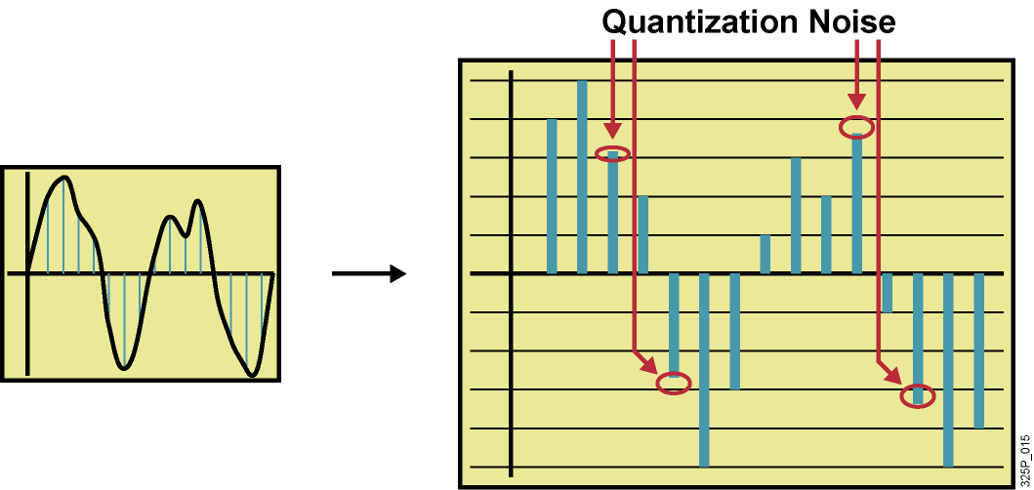
Quantization
  Quantization is the representation of amplitudes by a certain value (step).
  Scale with 256 steps is used for quantization.
  Samples are rounded up or down to closer step.
  Rounding introduces inexactness (quantization noise).

Slide 13
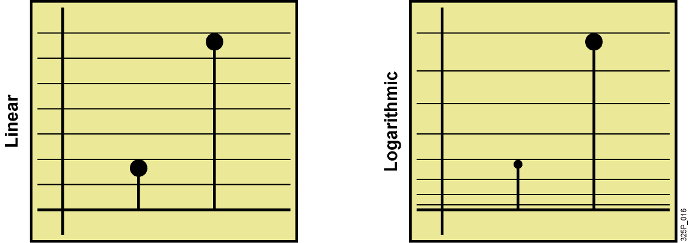
Quantization Techniques
  Linear quantization:
    Lower signal-to-noise ratio (SNR) on small signals
    Higher SNR on large signals
  Logarithmic quantization provides uniform SNR for all signals:
    Provides higher granularity for lower signals
    Corresponds to the logarithmic behavior of the human ear

Slide 14
Example: Quantization of Voice
  There are two methods of quantization:
    Mu-law, used in Canada, U.S., and Japan
    A-law, used in other countries
  Both methods use a quasi-logarithmic scale:
    Logarithmic segment sizes
    Linear step sizes (within a segment)
  Both methods have eight positive and eight negative segments, with 16 steps per segment.

Slide 15
Digital Voice Encoding
  Each sample is encoded using eight bits:
    One polarity bit
    Three segment bits
    Four step bits
  Required bandwidth for one call is 64 kbps
  (8000 samples per second, 8 bits each).
  Circuit-based telephony networks use TDM to combine multiple 64-kbps channels (DS-0) to a single physical line.

Slide 16
Compression Bandwidth Requirements

Slide 17
Voice Codec Characteristics
Standard, Codec | Bit Rate (kbps) | Voice Quality (MOS)
G.711, PCM | 64 | 4.1
G.726, ADPCM | 16, 24, 32 | 3.85 (with 32 kbps)
G.728, LDCELP | 16 | 3.61
G.729, CS-ACELP | 8 | 3.92
G.729A, CS-ACELP | 8 | 3.9

Slide 18
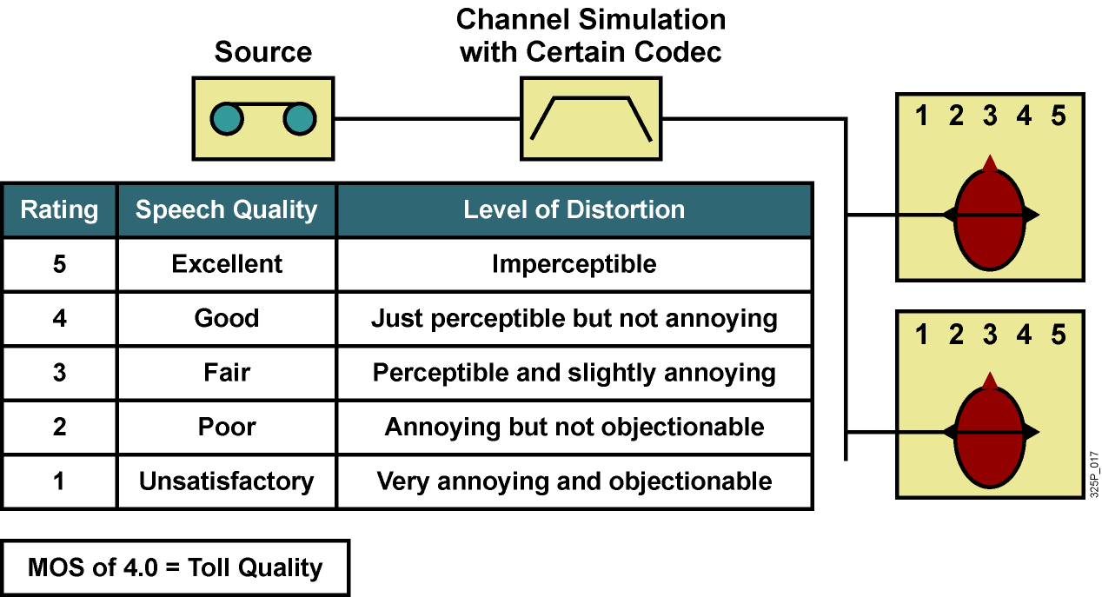
Mean Opinion Score

Slide 19
What is a DSP?

Slide 20

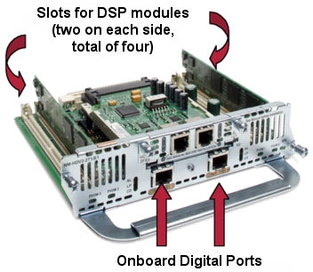
What Is a DSP?
A DSP is a specialized processor used for telephony applications:
  Voice termination:
    Converts analog voice into digital format (codec) and vice versa
    Provides compression, echo cancellation, VAD, CNG, jitter removal, and so on
  Conferencing: Mixes incoming streams from multiple parties
  Transcoding: Translates between voice streams that use different, incompatible codecs
DSP Module
Voice Network Module

Slide 21
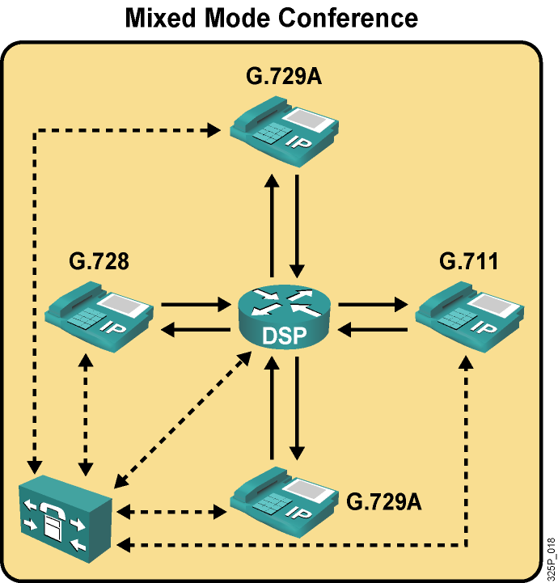
Example: DSP Used for Conferencing
  DSPs can be used in single- or mixed-mode conferences:
    Mixed mode supports different codecs.
    Single mode demands that the same codec to
    be used by all participants.
  Mixed mode has fewer conferences per DSP.

Slide 22
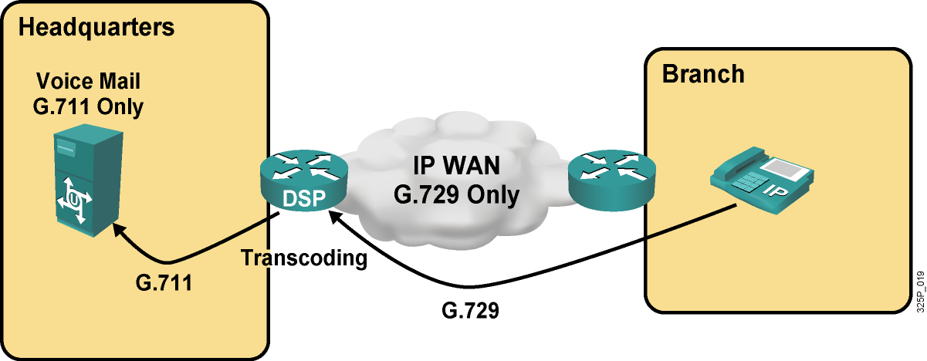
Example: DSP Used for Transcoding

Slide 23
Summary
  Whenever voice should be digitally transmitted, analog voice signals first have to be converted into digital. Conversion includes sampling, quantization, and encoding.
  Digitized voice has to be converted back to analog signals before being played out. Digital-to-analog conversion includes decoding and reconstruction of analog signals.
  The Nyquist theorem states the necessary sampling rate when converting analog signals to digital.
  Quantization is the process of representing the amplitude of a sampled signal by a binary number.
  Available codecs differ in their bandwidth requirements and voice quality.
  DSPs provide functions for call termination, conferences, and transcoding.

Slide 24
