Slide 1
Describe Cisco VoIP Implementations
Encapsulating Voice Packets for Transport

Slide 2

End-to-End Delivery of Voice Packets

Slide 3
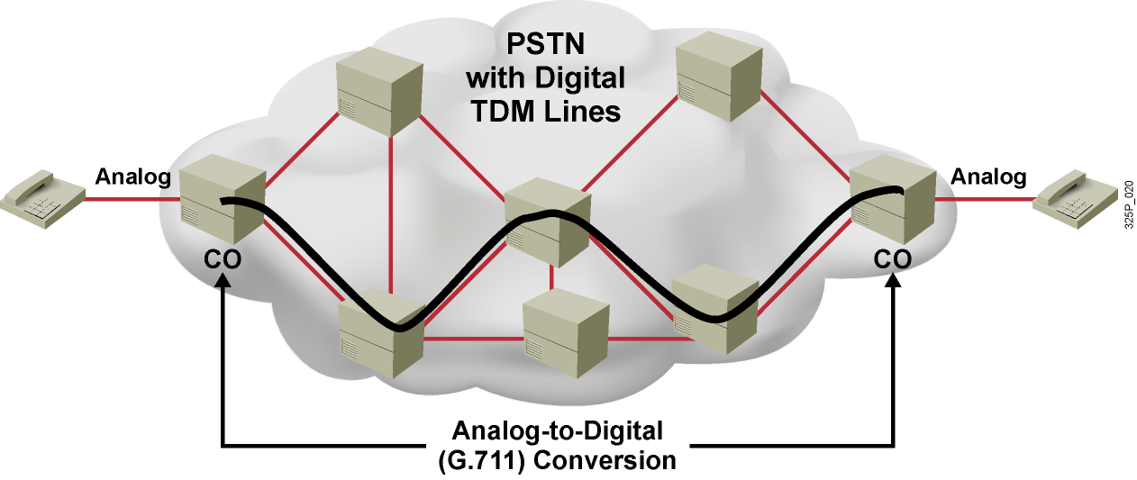
Voice Transport in Circuit-Based Networks
  Analog phones connect to CO switches.
  CO switches convert between analog and digital.
  After call is set up, PSTN provides:
    End-to-end dedicated circuit for this call (DS-0)
    Synchronous transmission with fixed bandwidth and very low, constant delay

Slide 4
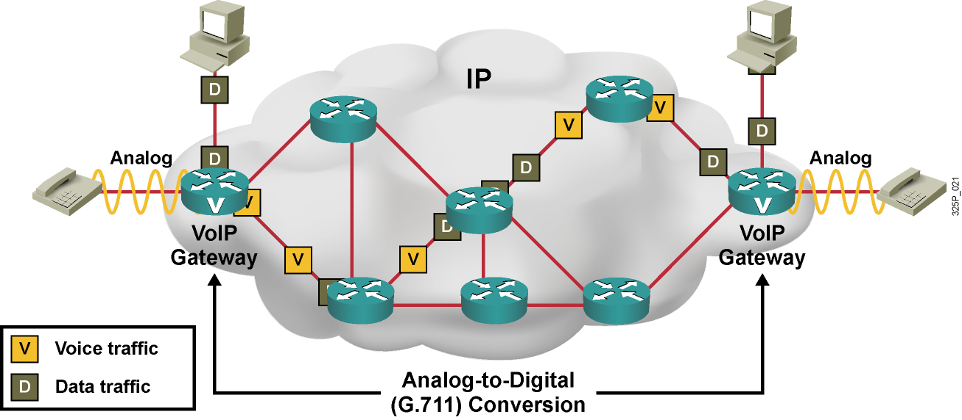
Voice Transport in IP Networks
  Analog phones connect to voice gateways.
  Voice gateways convert between analog and digital.
  After call is set up, IP network provides:
    Packet-by-packet delivery through the network
    Shared bandwidth, higher and variable delays

Slide 5
Explaining Protocols Used in Voice Encapsulation

Slide 6
Which Protocols to Use for VoIP?
Feature | Voice Needs | TCP | UDP | RTP
Reliability | No | Yes | No | No
Reordering | Yes | Yes | No | Yes
Time-stamping | Yes | No | No | Yes
Multiplexing | Yes | Yes | Yes | No

Slide 7
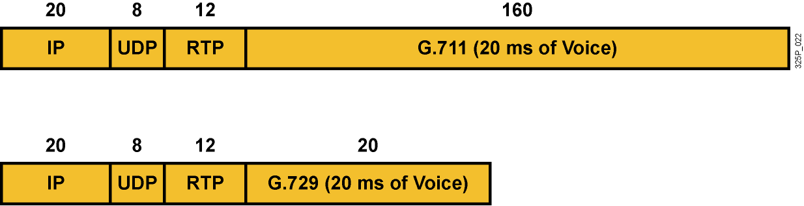
Voice Encapsulation Examples
  Digitized voice is encapsulated into RTP, UDP, and IP.
  By default, 20 ms of voice is packetized into a single IP packet.

Slide 8
Reducing Header Overhead

Slide 9
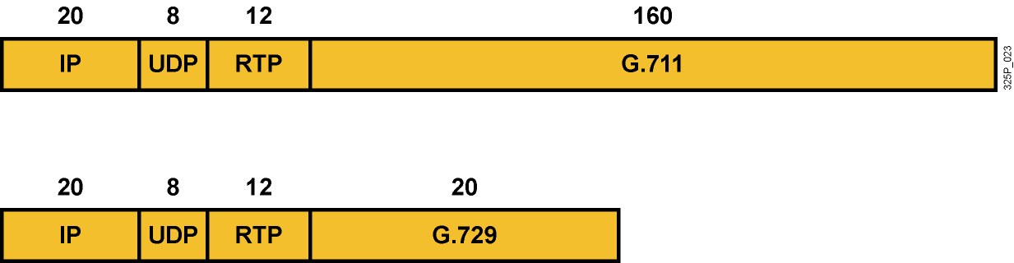
Voice Encapsulation Overhead
  Voice is sent in small packets at high packet rates.
  IP, UDP, and RTP header overheads are enormous:
    For G.729, the headers are twice the size of the payload.
    For G.711, the headers are one-fourth the size of the payload.
  Bandwidth is 24 kbps for G.729 and 80 kbps for G.711, ignoring Layer 2 overhead.

Slide 10
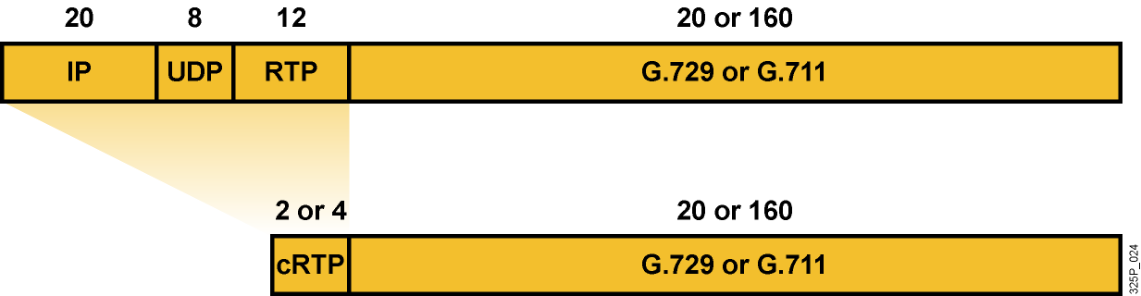
RTP Header Compression
  Compresses the IP, UDP, and RTP headers
  Is configured on a link-by-link basis
  Reduces the size of the headers substantially
  (from 40 bytes to 2 or 4 bytes):
    4 bytes if the UDP checksum is preserved
    2 bytes if the UDP checksum is not sent
  Saves a considerable amount of bandwidth

Slide 11
When to Use RTP Header Compression
  Use cRTP:
    Only on slow links (less than 2 Mbps)
    If bandwidth needs to be conserved
  Consider the disadvantages of cRTP:
    Adds to processing overhead
    Introduces additional delays
  Tune cRTP—set the number of sessions to be compressed
  (default is 16)

Slide 12
Summary
  In packet telephony, digitized voice is carried in IP packets, which are routed one by one across the IP network.
  Voice is encapsulated using RTP, UDP, and IP protocol headers.
  IP, UDP, and RTP headers can be compressed using cRTP to substantially reduce the encapsulation overhead.

Slide 13
