Slide 1
Describe Cisco VoIP Implementations
Implementing Voice Support in an Enterprise Network

Slide 2

Enterprise Voice Implementations

Slide 3
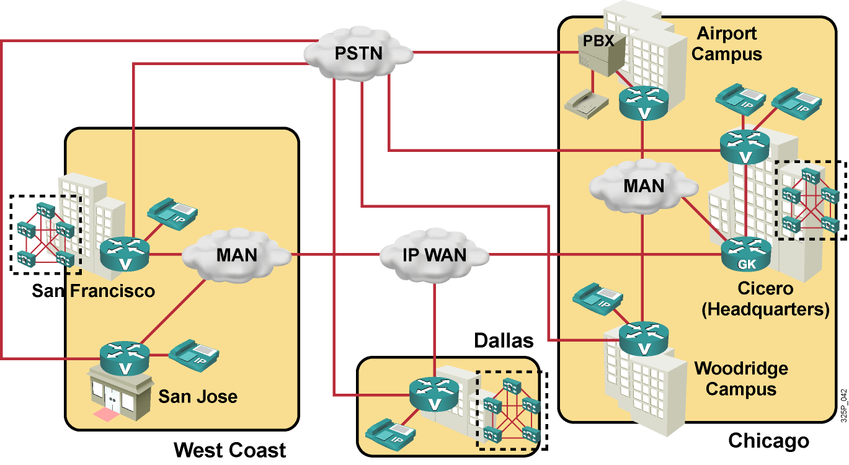
Enterprise Voice Implementations
Components of enterprise voice networks:
  Gateways and gatekeepers
  Cisco Unified CallManager and IP phones

Slide 4
Voice Gateway Functions on a Cisco Router

Slide 5

Voice Gateway Functions on a Cisco Router
  Connect traditional telephony devices to VoIP
  Convert analog signals to digital format
  Encapsulate voice into IP packets
  Perform voice compression
  Provide DSP resources for conferencing and transcoding
  Support fallback scenarios for IP phones (Cisco SRST)
  Act as a call agent for IP phones (Cisco Unified CallManager Express)
  Provide DTMF relay and fax and modem support

Slide 6
Cisco Unified CallManager Functions

Slide 7
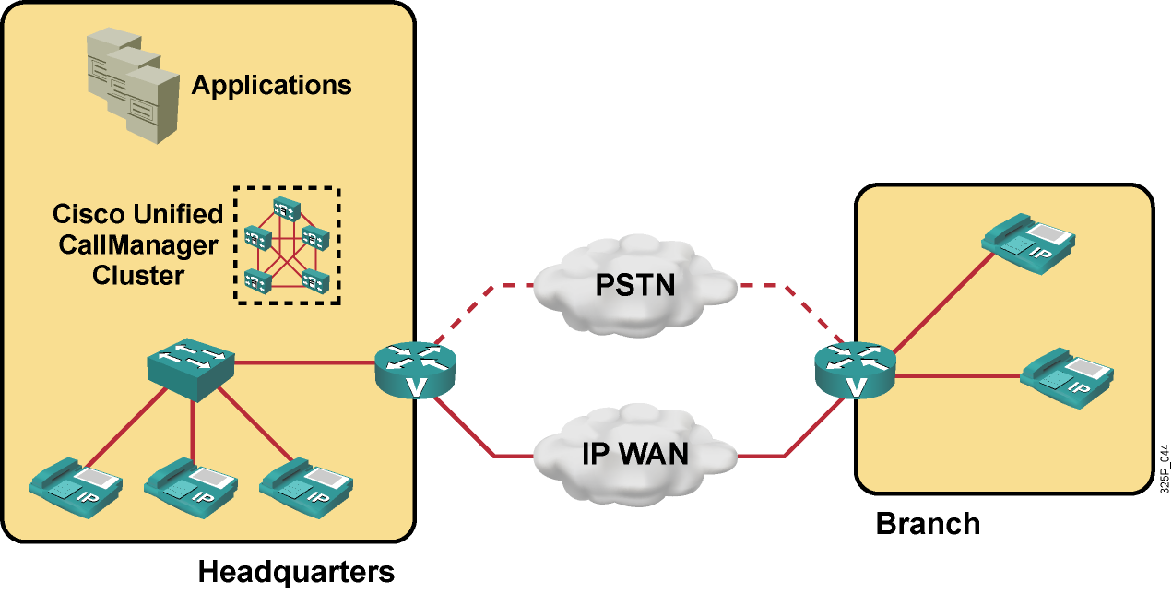
Cisco Unified CallManager Functions
  Call processing
  Dial plan administration
  Signaling and device control
  Phone feature administration
  Directory and XML services
  Programming interface to external applications

Slide 8
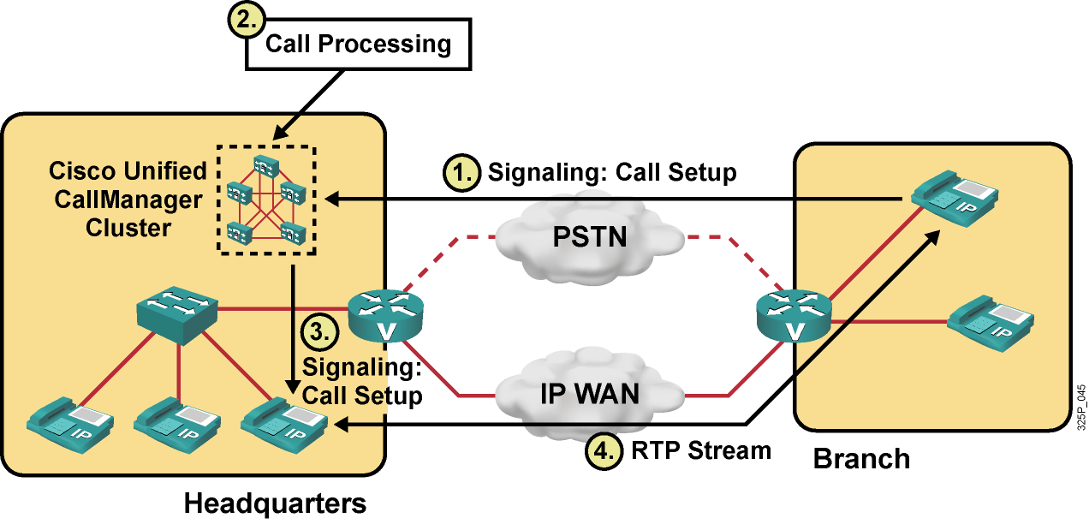
Example: Signaling and Call Processing

Slide 9
Enterprise IP Telephony Deployment Models

Slide 10
Enterprise IP Telephony
Deployment Models
Deployment Model | Characteristics
Single site | Cisco Unified CallManager cluster at the single site Local IP phones only
Multisite with centralized call processing | Cisco Unified CallManager cluster only at a single site Local and remote IP phones
Multisite with distributed call processing | Cisco Unified CallManager clusters at multiple sites Local IP phones only
Clustering over WAN | Single Cisco Unified CallManager cluster, distributed over multiple sites Usually local IP phones only Round-trip delay between any pair of servers not to exceed 40 ms

Slide 11
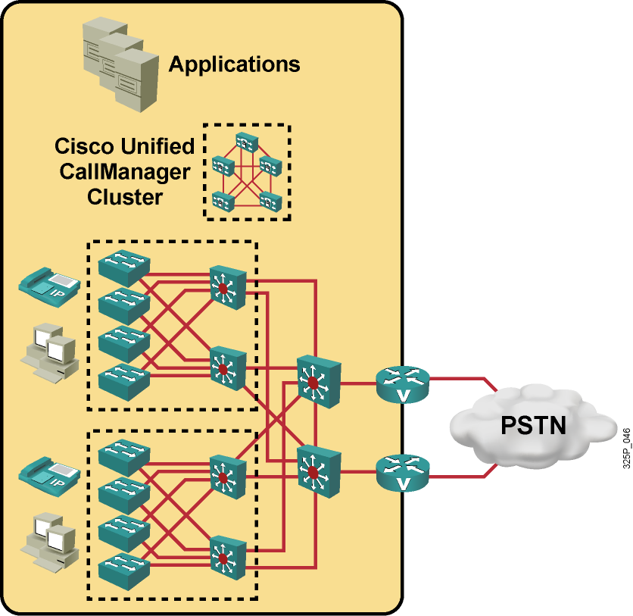
Example: Single Site
  Cisco Unified CallManager servers, applications, and DSP resources are located at the same physical location.
  IP WAN is not used for voice.
  PSTN is used for all external calls.
  Note: Cisco Unified CallManager cluster can be connected to various places depending on the topology.

Slide 12
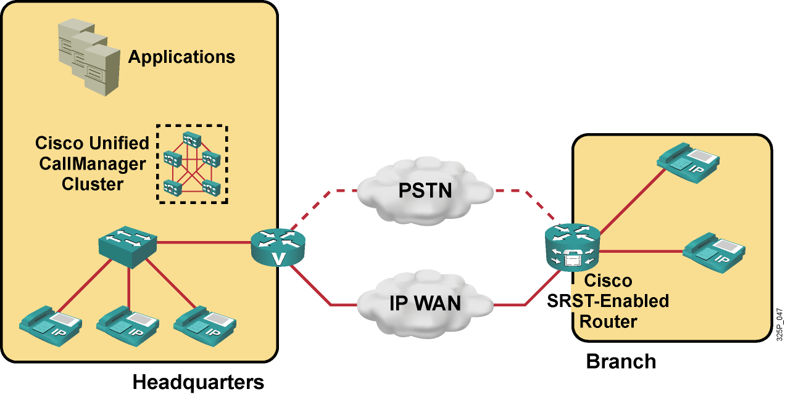
Example: Multisite with
Centralized Call Processing
  Cisco Unified CallManager servers and applications are located at the central site, while DSP resources are distributed.
  IP WAN carries data and voice (signaling for all calls, media only for intersite calls).
  PSTN access is provided at all sites.
  CAC is used to limit the number of VoIP calls, and AAR is used if WAN bandwidth is exceeded.
  Cisco SRST is located at the remote branch.
  Note: Cisco Unified CallManager cluster can be connected to various places depending on the topology.

Slide 13
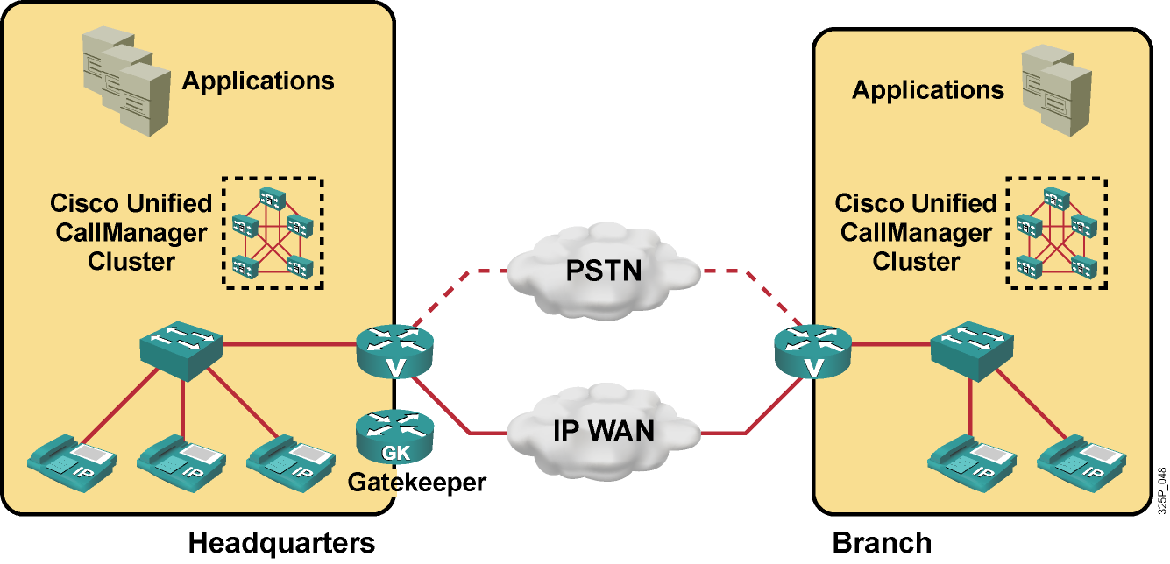
Example: Multisite with Distributed Call Processing
  Cisco Unified CallManager servers, applications, and DSP resources are located at
  each site.
  IP WAN carries data and voice for intersite calls only (signaling and media).
  PSTN access is provided at all sites; rerouting to PSTN is configured if IP WAN is down.
  CAC is used to limit the number of VoIP calls, and AAR is used if WAN bandwidth is exceeded.
  Note: Cisco Unified CallManager cluster can be connected to various places, depending on the topology.

Slide 14
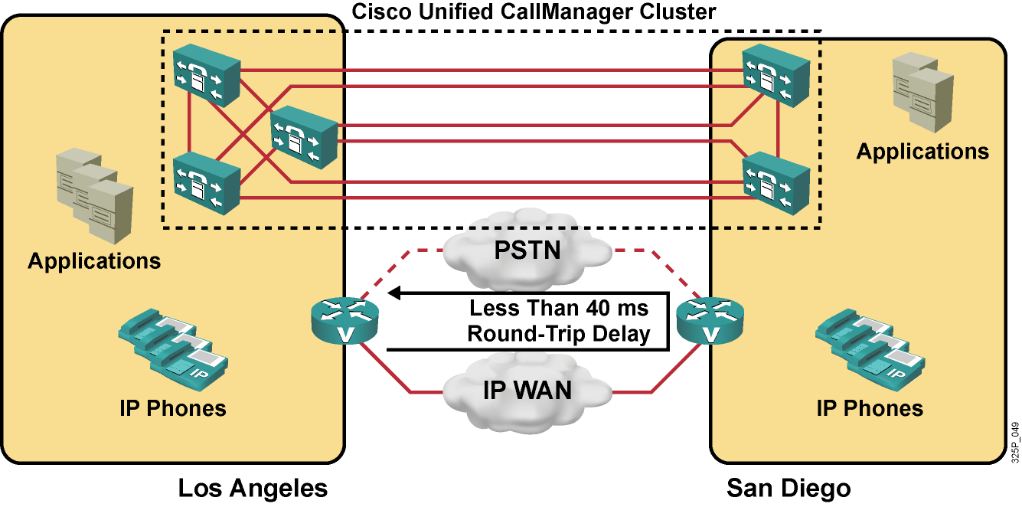
Example: Clustering over WAN
  Cisco Unified CallManager servers of a single cluster are distributed among multiple sites, while applications and DSP resources are located at each site.
  Intracluster communication (such as, database synchronization) is performed over
  the WAN.
  IP WAN carries data and voice for intersite calls only (signaling and media).
  PSTN access is provided at all sites; rerouting to PSTN is performed if IP WAN is down.
  CAC is used to limit the number of VoIP calls; AAR is used if WAN bandwidth is exceeded.
  Note: Cisco Unified CallManager cluster can be connected to various places, depending on the topology.

Slide 15
Identifying Voice Commands in IOS Configurations

Slide 16
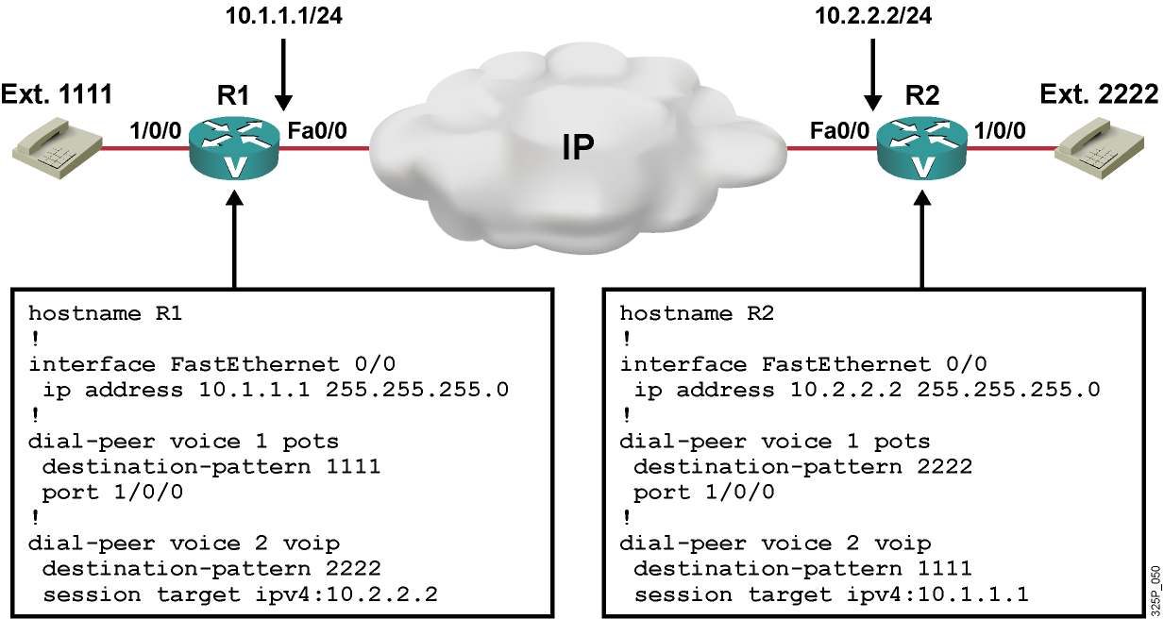
Identifying Voice Commands in
Basic Cisco IOS VoIP Configurations

Slide 17
What is CAC?

Slide 18
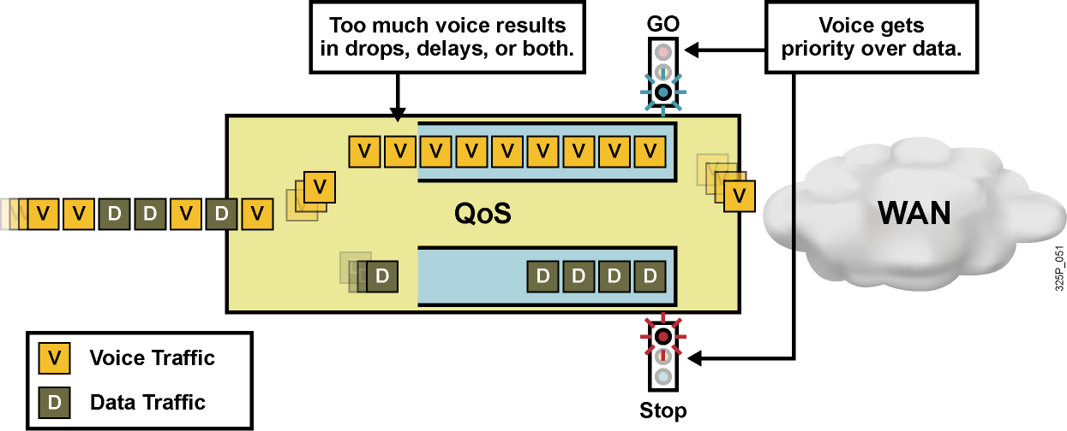
What Is CAC?
  CAC artificially limits the number of concurrent voice calls.
  CAC prevents oversubscription of WAN resources caused by too much voice traffic.
  CAC is needed because QoS cannot solve the problem of voice call oversubscription:
    QoS gives priority only to certain packet types (RTP versus data).
    QoS cannot block the setup of too many voice calls.
    Too much voice traffic results in delayed voice packets.

Slide 19
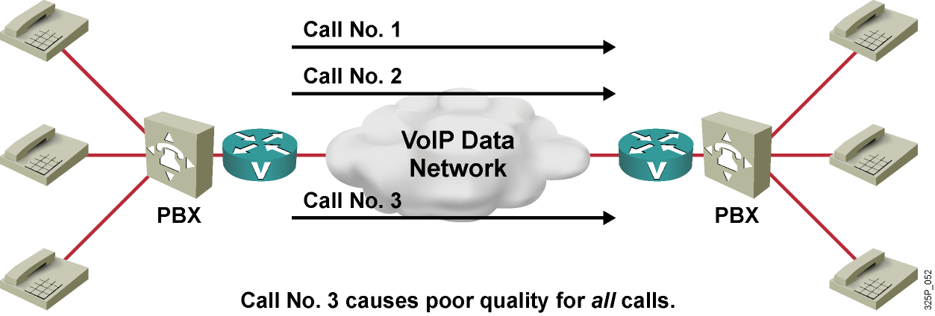
Example: CAC Deployment
  IP network (WAN) is only designed for two concurrent voice calls.
  If CAC is not deployed, a third call can be set up, causing poor quality for all calls.
  After CAC is deployed, the third call is blocked.

Slide 20
Summary
  Converged enterprise networks include components supporting VoIP, such as gateways, gatekeepers, Cisco Unified CallManager, and IP phones.
  Cisco ISRs provide voice capabilities, including gateway, call agent, and DSP functions.
  Cisco Unified CallManager provides call processing and signaling services and provides access to applications from IP phones.
  IP deployment models include single site, multisite (centralized and distributed), and clustering over WAN.
  Cisco IOS dial peers are used at the gateway to configure a local dial plan.
  CAC is a method that prevents bandwidth exhaustion caused by too many voice calls.

Slide 21


