Slide 1
Introduction to IP QoS
Introducing QoS

Slide 2

Converged Networks Quality Issues

Slide 3
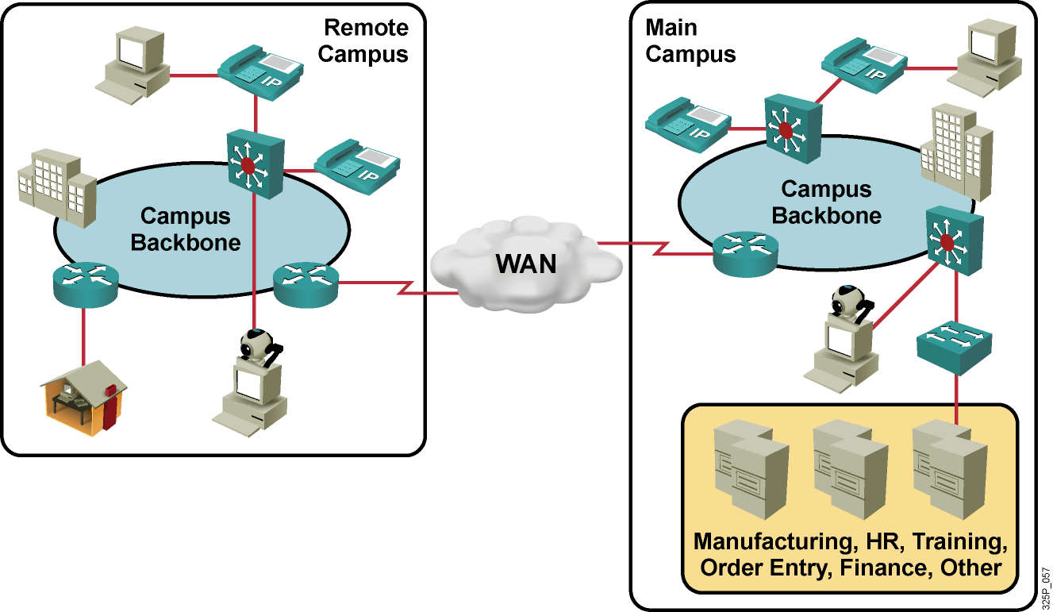
Converged Network Quality Issues
Converged traffic characteristics:
  Constant small-packet voice flow competes with bursty data flow.
  Critical traffic must get priority.
  Voice and video are time-sensitive.
  Brief outages are not acceptable.

Slide 4
Converged Network Quality Issues (Cont.)
  Lack of bandwidth: Multiple flows compete for a limited amount of bandwidth.
  End-to-end delay (fixed and variable): Packets have to traverse many network devices and links that add up to the overall delay.
  Variation of delay (jitter): Sometimes there is a lot of other traffic, which results in increased delay.
  Packet loss: Packets may have to be dropped when a link is congested.

Slide 5
Available Bandwidth

Slide 6
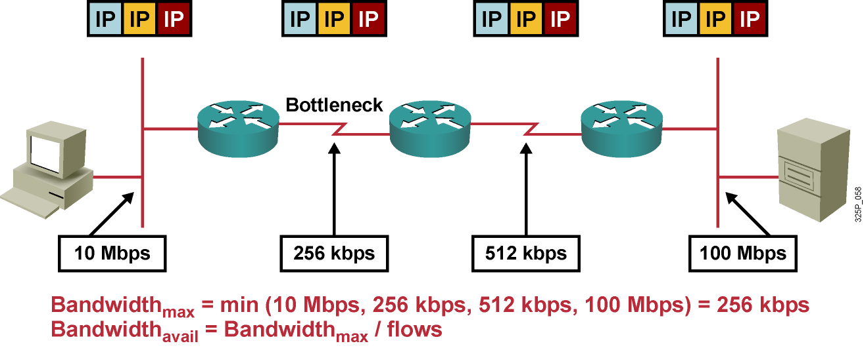
Lack of Bandwidth
  Maximum available bandwidth equals the bandwidth of the slowest link.
  Multiple flows are competing for the same bandwidth, resulting in much less bandwidth being available to one single application.
  A lack in bandwidth can have performance impacts on network applications.

Slide 7
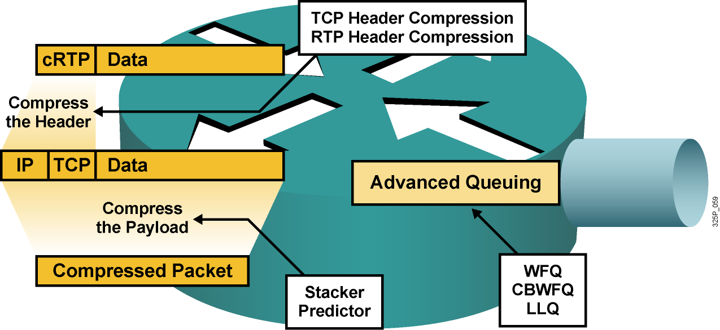
Bandwidth Availability
  Upgrade the link (the best but also the most expensive solution).
  Forward the important packets first.
  Compress the payload of Layer 2 frames (it takes time).
  Compress IP packet headers.

Slide 8
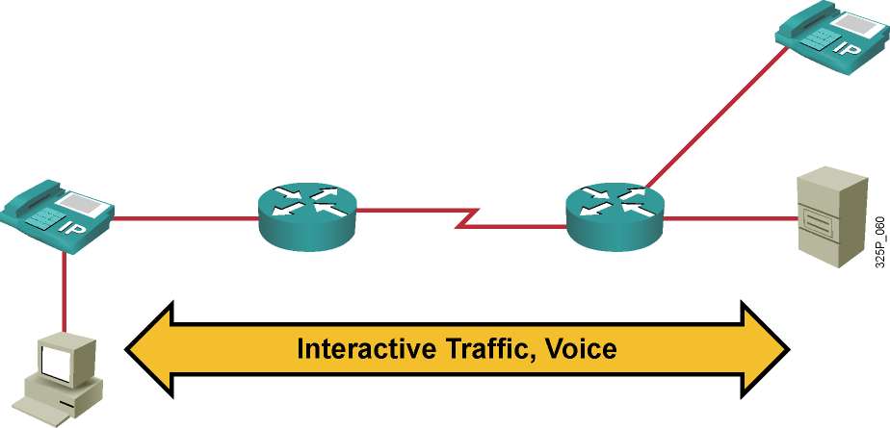
Efficient Use of Available Bandwidth
Using advanced queuing and header compression mechanisms, the available bandwidth can be used in a much more efficient way:
  Voice: LLQ and RTP header compression
  Interactive traffic: CBWFQ and TCP header compression

Slide 9
End-to-End Delay

Slide 10
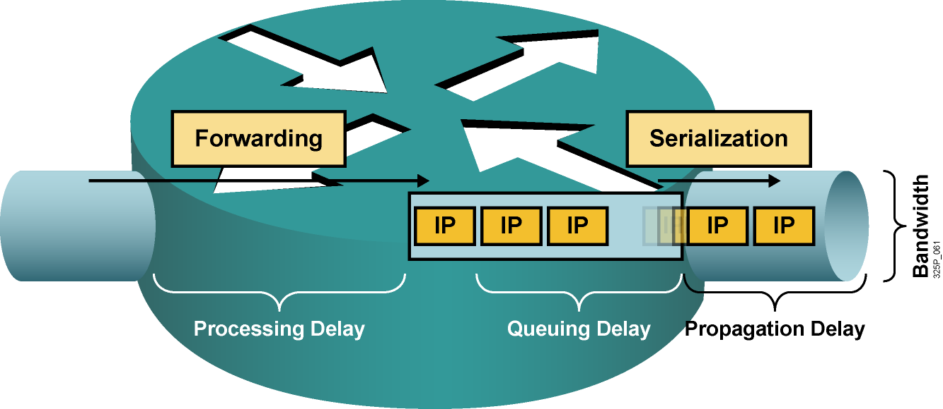
Types of Delay
  Processing delay: The time it takes for a router to take the packet from an input interface, examine it, and put it into the output queue of the output interface.
  Queuing delay: The time a packet resides in the output queue of a router.
  Serialization delay: The time it takes to place the “bits on the wire.”
  Propagation delay: The time it takes for the packet to cross the link from one end to the other.

Slide 11
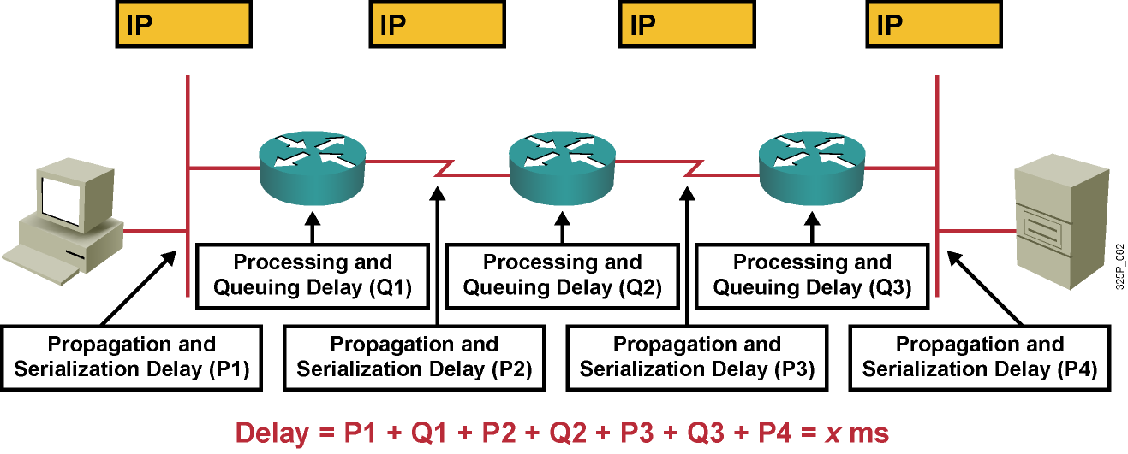
The Impact of Delay on Quality
  End-to-end delay equals the sum of all propagation, processing, serialization, and queuing delays in the path.
  Jitter defines the variation in the delay.
  In best-effort networks, propagation and serialization delays are fixed, while processing and queuing delays are unpredictable.

Slide 12
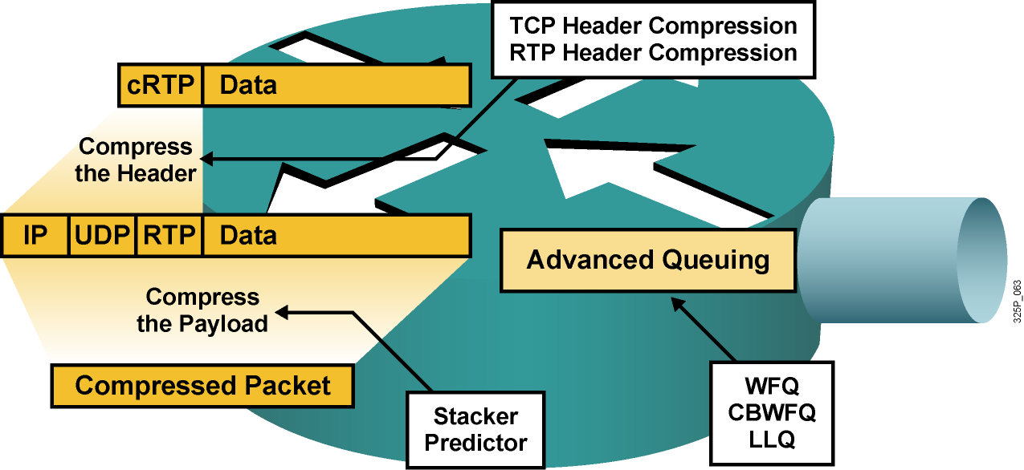
Ways to Reduce Delay
  Upgrade the link (the best solution but also the most expensive).
  Forward the important packets first.
  Enable reprioritization of important packets.
  Compress the payload of Layer 2 frames (it takes time).
  Compress IP packet headers.

Slide 13
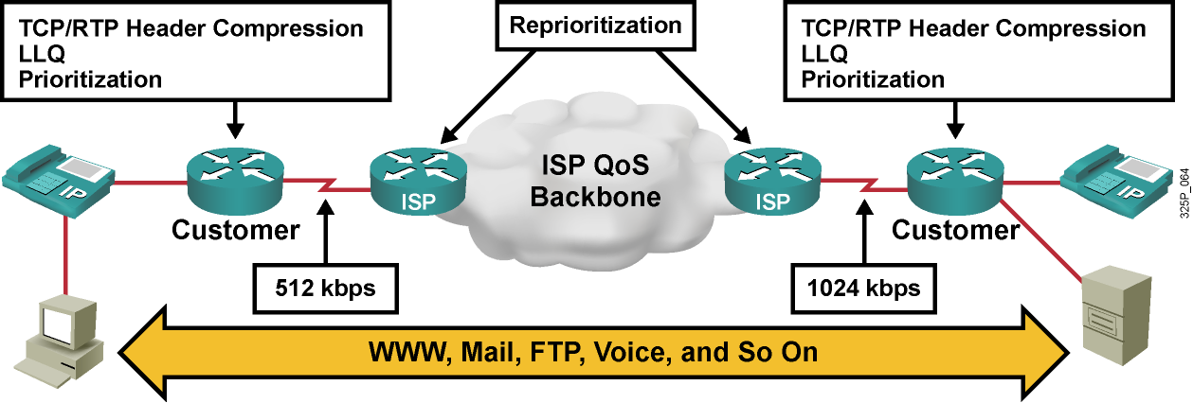
Efficient Use of Ways to Reduce Delay
  Customer routers perform:
    TCP/RTP header compression
    LLQ
    Prioritization
  ISP routers perform:
    Reprioritization according to the QoS policy

Slide 14
Packet Loss

Slide 15
Impact of Packet Loss
  Telephone call: “I cannot understand you. Your voice is breaking up.”
  Teleconferencing: “The picture is very jerky. Voice is not synchronized.”
  Publishing company: “This file is corrupted.”
  Call center: “Please hold while my screen refreshes.”

Slide 16
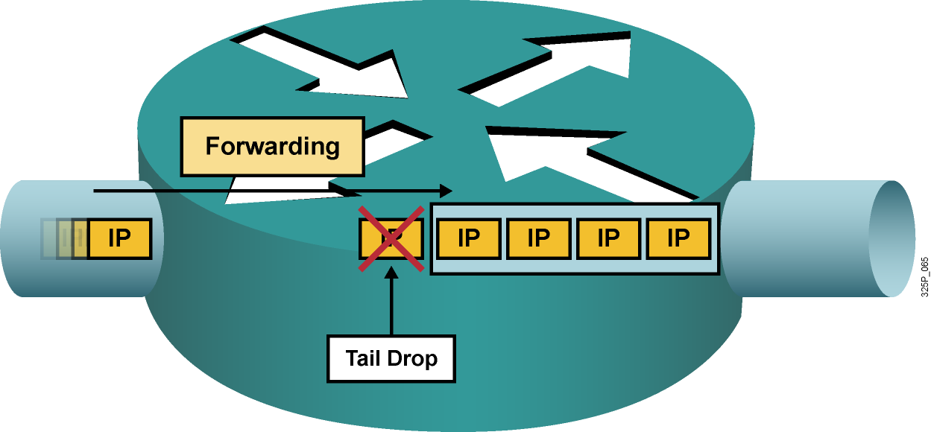
Impact of Packet Loss (Cont.)
  Tail drops occur when the output queue is full. Tail drops are common and happen when a link is congested.
  Many other types of drops occur, usually the result of router
  congestion, that are uncommon and may require a hardware upgrade (such as, input drop, ignore, overrun, frame errors).

Slide 17
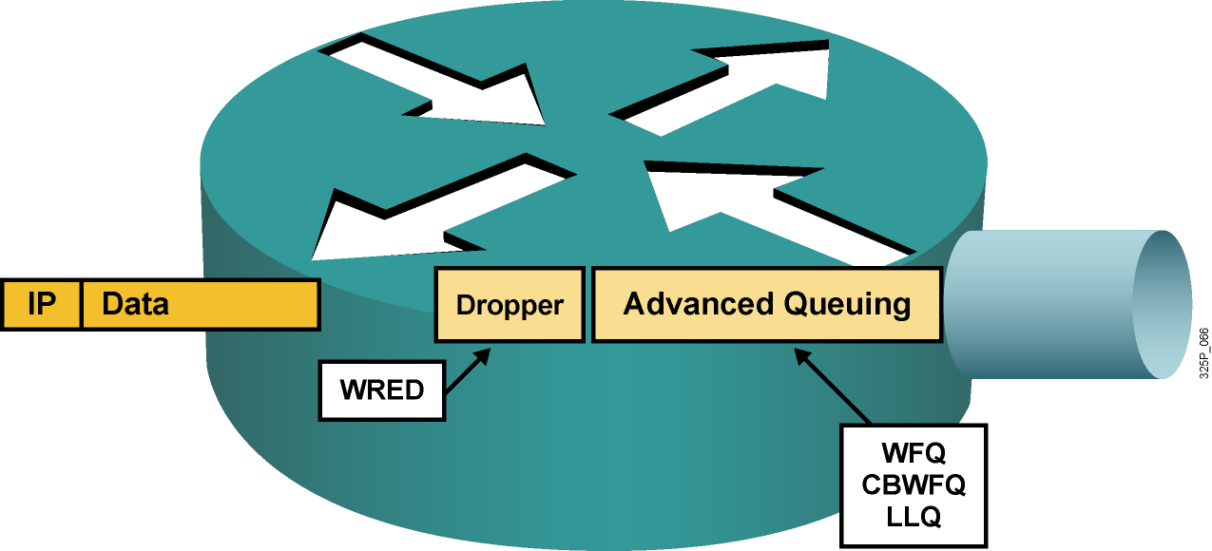
Ways to Prevent Packet Loss
  Upgrade the link (the best solution but also the most expensive).
  Guarantee enough bandwidth to sensitive packets.
  Prevent congestion by randomly dropping less important packets before congestion occurs.

Slide 18
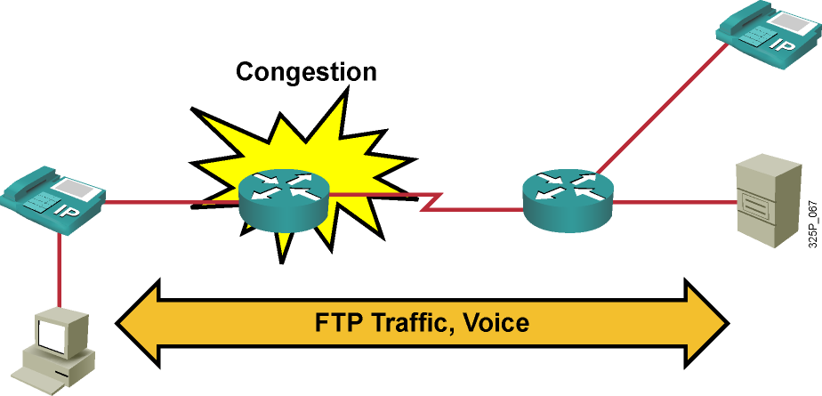
Packet Loss Solution
  Problem: Interface congestion causes TCP and voice packet drops, resulting in slowing FTP traffic and jerky speech quality.
  Conclusion: Congestion avoidance and queuing can help.
  Solution: Use WRED and LLQ.

Slide 19
QoS Defined

Slide 20
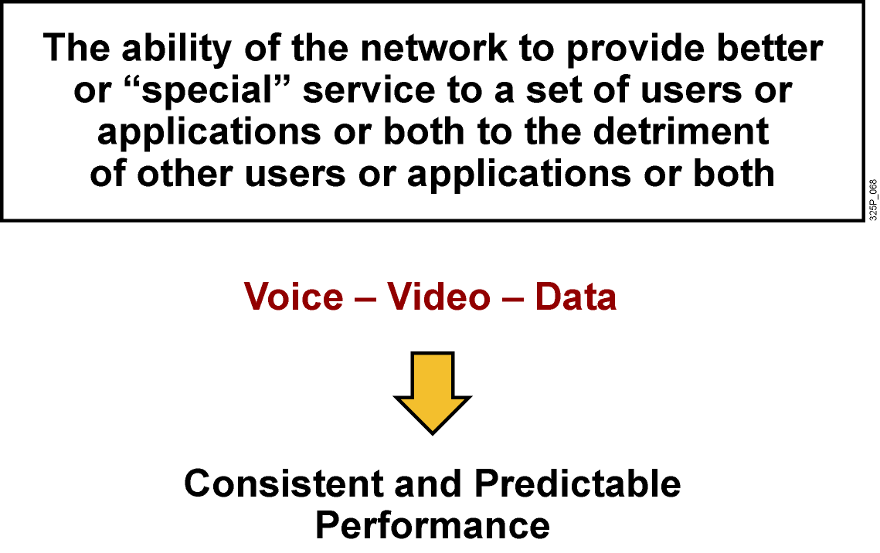
QoS Defined

Slide 21
Implementing QoS

Slide 22
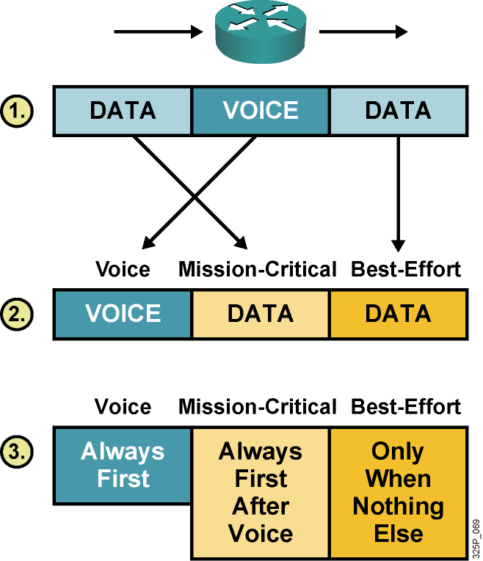
Implementing QoS
  Identify traffic and its requirements.
  Divide traffic into classes.
  Define QoS policies for each class.

Slide 23
QoS Traffic Classes—The Requirements of Different Traffic Types

Slide 24
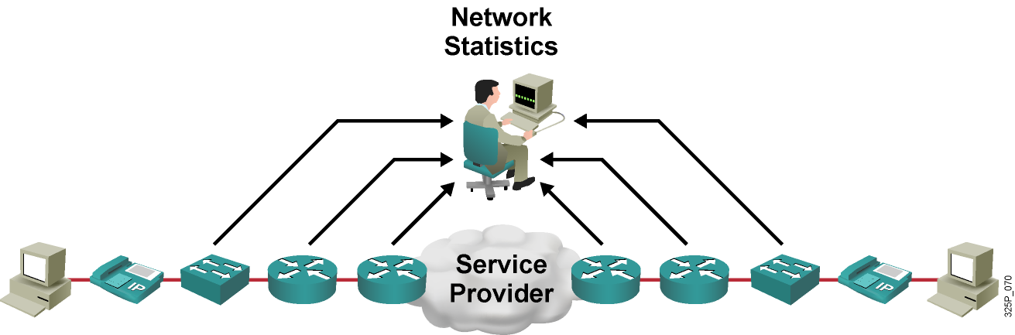
Identify Traffic and Its Requirements
  Network audit: Identify traffic on the network.
  Business audit: Determine how important each type of traffic is for business.
  Service levels required: Determine required response time.

Slide 25
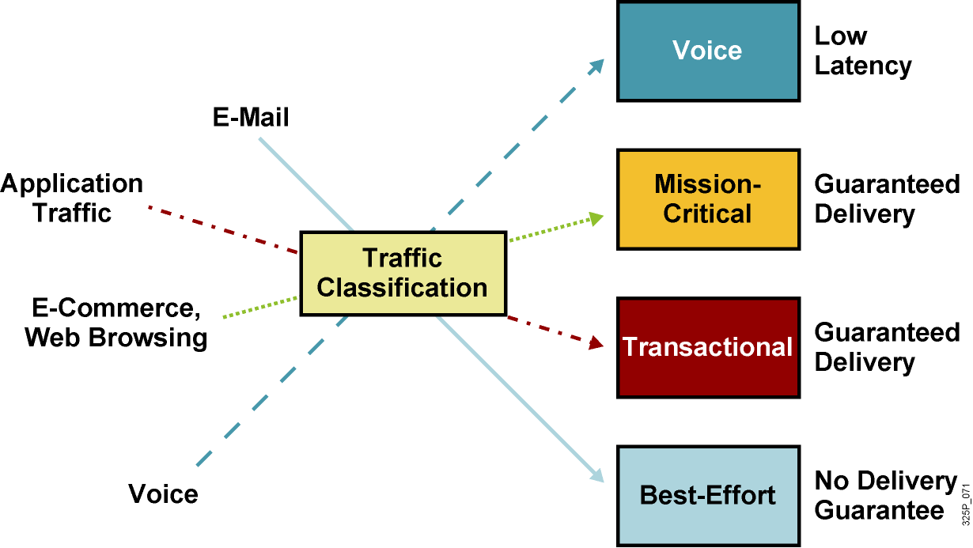
The Requirements of Different Traffic Types

Slide 26
QoS Policy

Slide 27
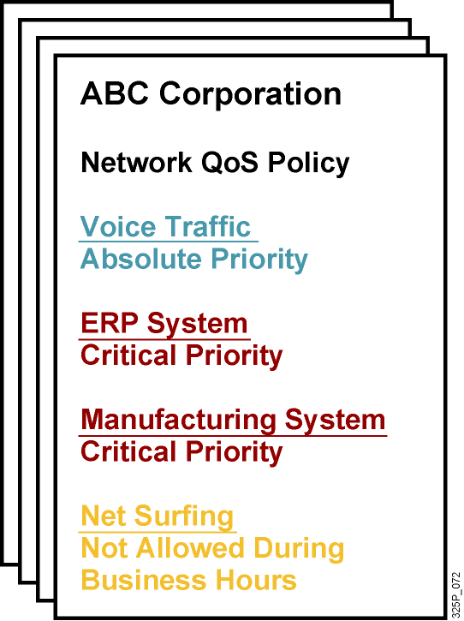
QoS Policy
  A networkwide definition of the specific levels of QoS assigned to different classes of network traffic

Slide 28
Summary
  Converged networks that support voice, video, and data create new requirements for managing network traffic. QoS meets those requirements.
  Converged networks suffer from different quality issues, including lack of adequate bandwidth, end-to-end and variable delay, and lost packets.
  Packet loss can adversely affect QoS in a network.
  QoS is a way to improve the performance of converged networks.

Slide 29
Summary (Cont.)
  Lack of recourses causes networks to experience different types of delay, including processing delay, queuing delay, serialization delay, and propagation delay.
  QoS traffic classes need to be defined to implement a QoS policy.
  Implementing QoS requires three steps: identify requirements, classify network traffic, and define
  networkwide policies for quality.
  A QoS policy is a networkwide definition of the specific levels of QoS assigned to classes of network traffic.

Slide 30
