Slide 1
Introduction to IP QoS
Identifying Models for Implementing QoS

Slide 2

QoS Models

Slide 3
QoS Models
Model | Characteristics
Best effort | No QoS is applied to packets.
IntServ | Applications signal to the network that they require certain QoS parameters.
DiffServ | The network recognizes classes that require QoS.

Slide 4
Best Effort Model

Slide 5
Best-Effort Model
  Internet was initially based on a best-effort packet delivery service.
  Best-effort is the default mode for all traffic.
  There is no differentiation among types of traffic.
  Best-effort model is similar to using standard mail—It will get there when it gets there.

Slide 6
Benefits and Drawbacks of the Best-Effort Model
  Benefits:
    Highly scalable
    No special mechanisms required
  Drawbacks:
    No service guarantees
    No service differentiation

Slide 7
IntServ Model

Slide 8
IntServ Model
  Introduction of IntServ model (RFC 1633) was driven by
  real-time applications, such as remote video and conferencing.
  IntServ end-to-end model ensures guaranteed delivery and predictable behavior of the network for applications.
  Resource Reservation Protocol (RSVP) is used as a signaling protocol.
  The requested QoS parameters are then linked to a packet stream.
  End-to-end streams are not established if the required QoS parameters are not available.

Slide 9
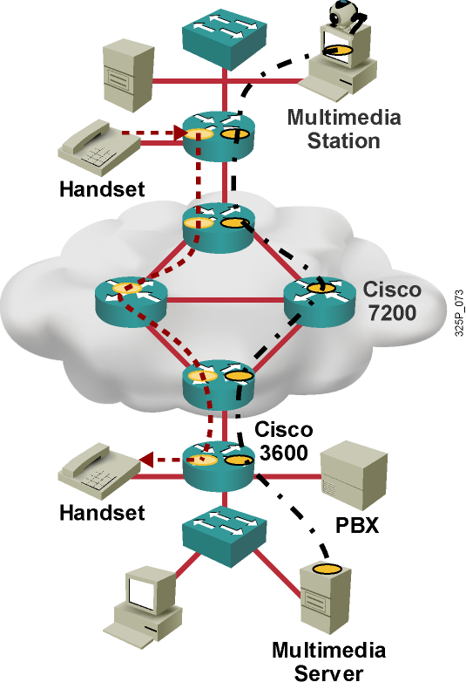
IntServ Model (Cont.)
  Provides multiple service levels
  Requests specific kind of service from the network before sending data
  Uses RSVP to reserve resources for specified QoS parameters
  Intelligent queuing mechanisms required to provide resource reservation in terms of:
    Guaranteed rate
    Controlled load (low delay, high throughput)

Slide 10
IntServ Functions
IntServ requires several functions on routers and switches along the path:
  Admission control
  Classification
  Policing
  Queuing
  Scheduling

Slide 11
Benefits and Drawbacks of the IntServ Model
  Benefits:
    Explicit resource admission control (end to end)
    Per-request policy admission control
    (authorization object, policy object)
    Signaling of dynamic port numbers (for example, H.323)
  Drawbacks:
    Continuous signaling because of stateful architecture
    Flow-based approach not scalable to large implementations, such as the public Internet (can be made more scalable when combined with elements of the DiffServ model)

Slide 12
RSVP and the IntServ QoS Model

Slide 13
Resource Reservation Protocol
  Is carried in IP—protocol ID 46
  Can use both TCP and UDP port 3455
  Is a signaling protocol and works in conjunction with existing routing protocols
  Requests QoS parameters from all devices that are between the source and the destination
  Is intended to provide divergent performance requirements for multimedia applications:
    Rate-sensitive traffic
    Delay-sensitive traffic

Slide 14
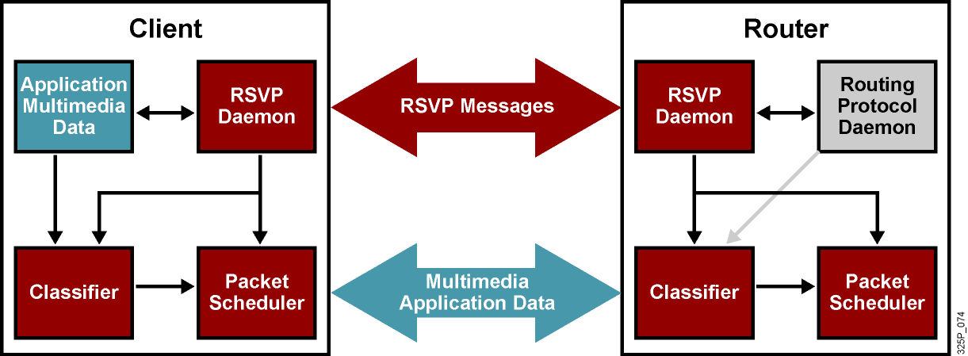
RSVP Operation

Slide 15
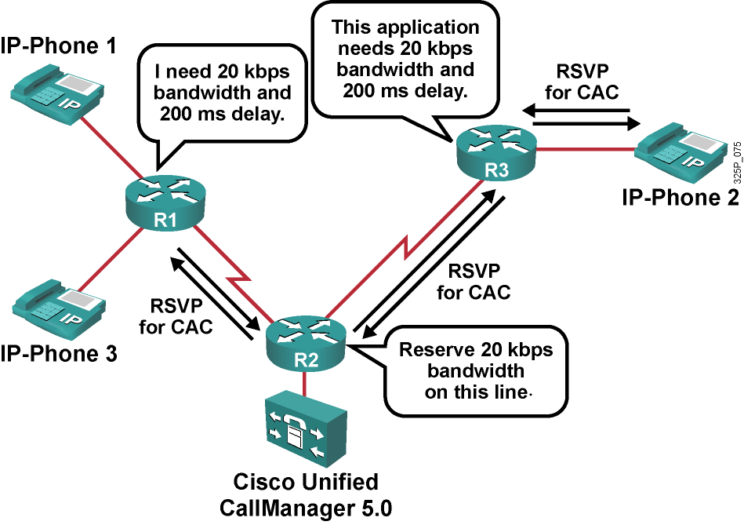
RSVP in Action
  RSVP sets up a path through the network with the requested QoS.
  RSVP is used for CAC in Cisco Unified CallManager 5.0.

Slide 16
DiffServ Model

Slide 17
DiffServ Model
  DiffServ (RFC 2474 and RFC 2475) was designed to overcome the limitations of both the best-effort and IntServ models.
  Network traffic is identified by classes.
  Network QoS policy enforces differentiated treatment of traffic classes.
  You choose level of service for each traffic class.

Slide 18
Benefits and Drawbacks of the DiffServ Model
  Benefits:
    Highly scalable
    Many levels of quality possible
  Drawbacks:
    No absolute service guarantee
    Complex mechanisms

Slide 19
Summary
  There are three models for providing QoS: best effort, IntServ, and DiffServ.
  Although the best-effort model is highly scalable, it has no provision for differentiating among types of network traffic and, as a result, does not provide QoS.
  The IntServ model offers absolute QoS guarantees by explicitly reserving bandwidth by using RSVP. Scalability is achieved in conjunction with elements of the DiffServ model.
  RSVP is not a routing protocol; thus, implementing RSVP in an existing network does not require migration to a new routing protocol.
  The DiffServ model provides the ability to classify network traffic and offer many levels of QoS while being highly scalable.

Slide 20
