Slide 1
Introduction to IP QoS
Identifying Methods for Implementing QoS

Slide 2

Methods for Implementing QoS Policy

Slide 3
Methods for Implementing QoS Policy
Method | Description
Legacy CLI | CLI Configures QoS on interface level Time-consuming
MQC | CLI Makes configurations modular Best way for QoS fine tuning
Cisco AutoQoS | Applies a possible QoS configuration to the interfaces Fastest way to implement QoS
Cisco SDM QoS wizard | Application for simple QoS configurations

Slide 4
Legacy CLI

Slide 5
Legacy CLI
  Uses the CLI via console and Telnet
  Traditional method
  Nonmodular
  Cannot separate traffic classification from policy definitions
  Time-consuming and potentially error-prone task
  Used to augment, fine-tune newer Cisco AutoQoS method

Slide 6
Legacy CLI Usage Guidelines
  Build a traffic policy:
    Identify the traffic pattern.
    Classify the traffic.
    Prioritize the traffic.
    Select a proper QoS mechanism:
      Queuing
      Compression
  Apply the traffic policy to the interface.

Slide 7
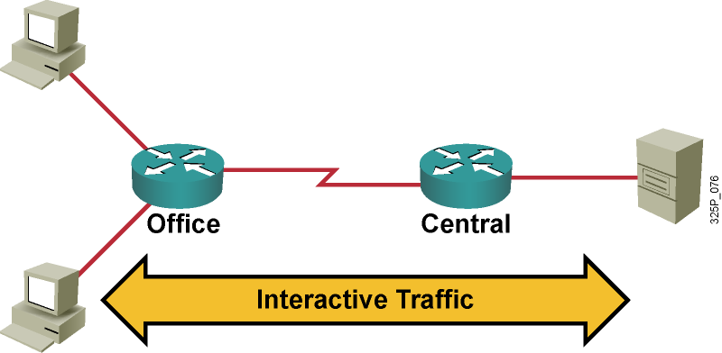
Legacy CLI Example
For interactive traffic, CQ and TCP header compression can be used.
interface multilink
ip address 10.1.61.1 255.255.255.0
load-interval 30
custom-queue-list 1
ppp multilink
ppp multilink fragment-delay 10
ppp multilink interleave
multilink-group 1
ip tcp header-compression iphc-format
!
queue-list 1 protocol ip 2 tcp 23

Slide 8
Modular QoS CLI

Slide 9
Modular QoS CLI
  A command syntax for configuring QoS policy
  Reduces configuration steps and time
  Configures policy, not “raw” per-interface commands
  Uniform CLI across major Cisco IOS platforms
  Uniform CLI structure for all QoS features
  Separates classification engine from the policy

Slide 10
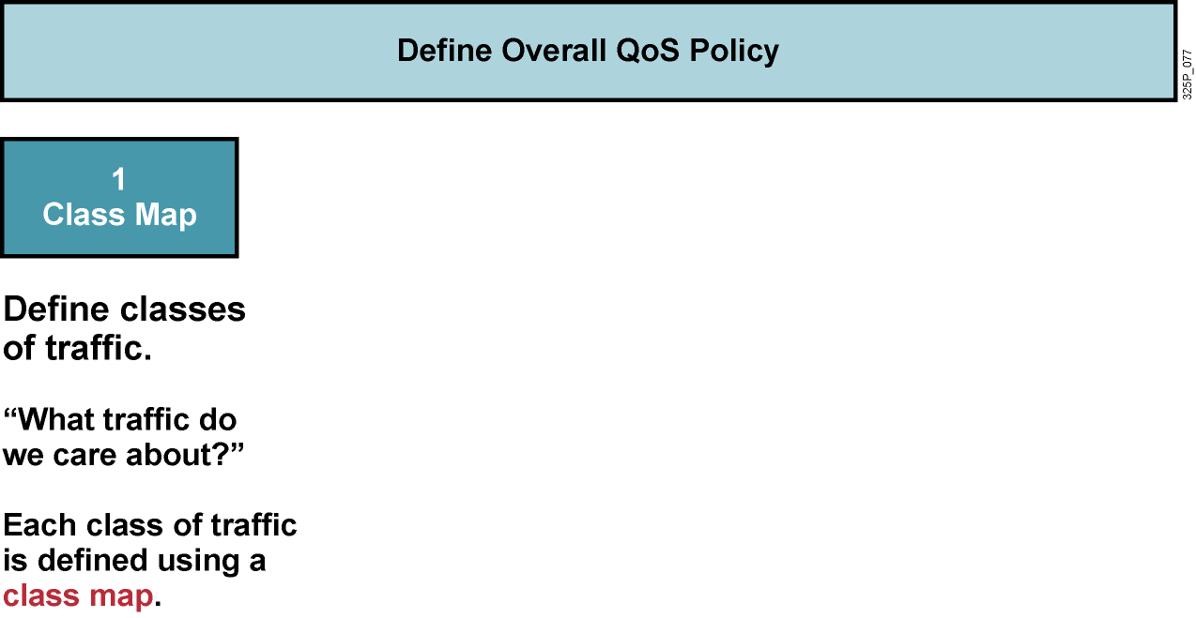
Modular QoS CLI Components

Slide 11
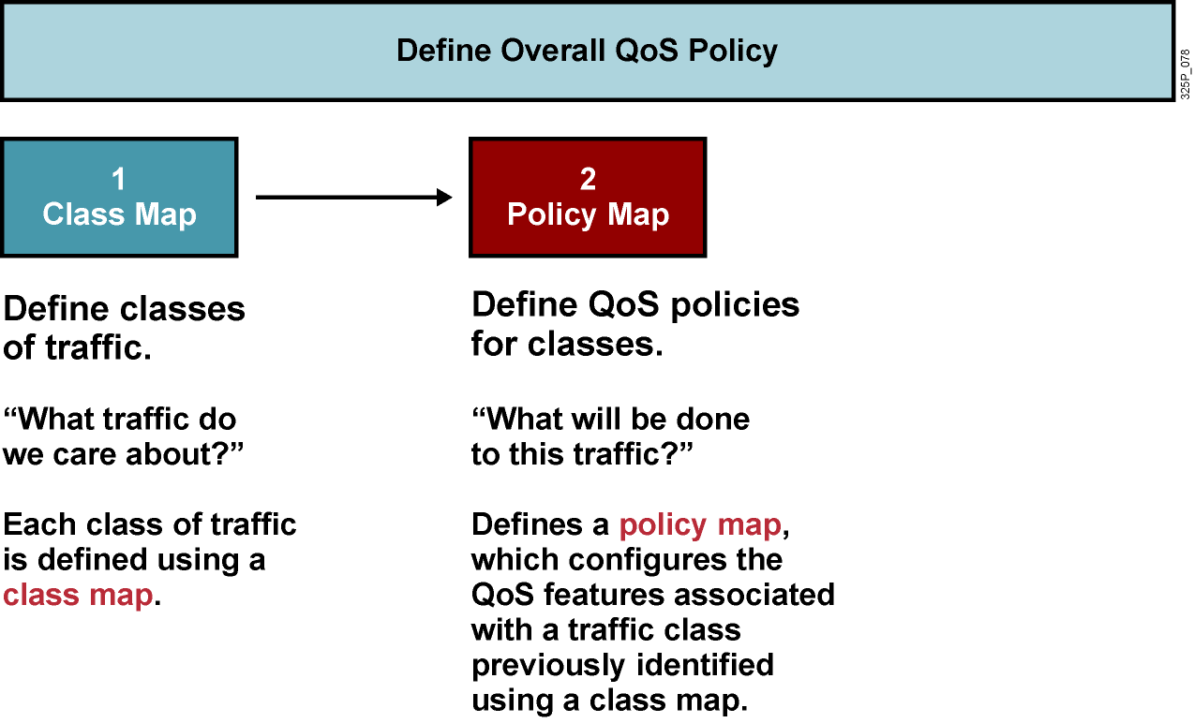
Modular QoS CLI Components

Slide 12
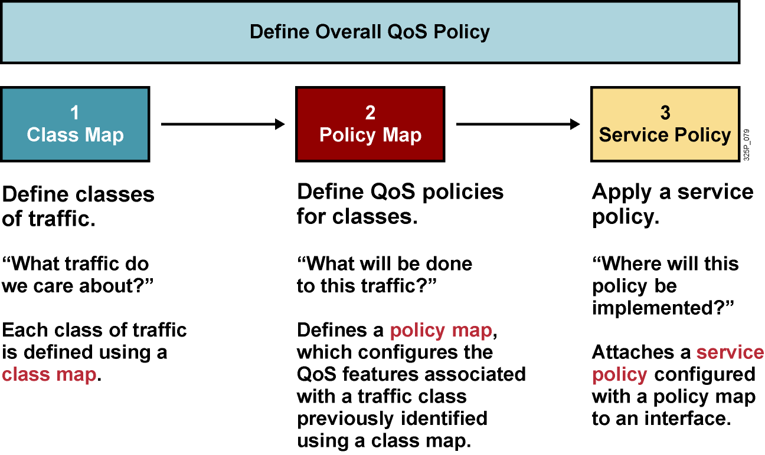
Modular QoS CLI Components

Slide 13
Class Maps
  “What traffic do we care about?”
  Each class is identified using a class map.
  A traffic class contains three major elements:
    A case-sensitive name
    A series of match commands
    An instruction on how to evaluate the match commands if more than one match command exists in the traffic class
  Class maps can operate in two modes:
    Match all: All conditions have to succeed.
    Match any: At least one condition must succeed.
  The default mode is match all.

Slide 14
Configuring Class Maps
router(config)#
class-map [match-all | match-any] class-map-name
  Enters class-map configuration mode.
  Specifies the matching strategy.
router(config-cmap)#
match any
match not match-criteria
  Use at least one condition to match packets.
router(config-cmap)#
description description
  You should use descriptions in large and complex configurations.
  The description has no operational meaning.

Slide 15
ACLs for Traffic Classification
router(config)#
access-list access-list-number {permit | deny | remark} source [mask]
  Standard ACL
router(config)#
access-list access-list-number {permit | deny} protocol source source-wildcard [operator port] destination destination-wildcard [operator port] [established] [log]
  Extended ACL
router(config-cmap)#
match access-group access-list-number
  Uses an ACL as a match criterion.

Slide 16
Policy Maps
  “What will be done to this traffic?”
  Defines a traffic policy, which configures the QoS features associated with a traffic class previously identified using a class map.
  A traffic policy contains three major elements:
    A case-sensitive name
    A traffic class
    The QoS policy associated with that traffic class
  Up to 256 traffic classes can be associated with a single traffic policy.
  Multiple policy maps can be nested to influence the sequence of QoS actions.

Slide 17
Configuring Policy Maps
router(config)#
policy-map policy-map-name
  Enters policy-map configuration mode.
  Policy maps are identified by a case-sensitive name.
router(config-pmap)#
class {class-name | class-default}
  Enters the per-class policy configuration mode by using the name of a previously configured class map.
  Use the class-default name to configure the policy for the default class.
router(config-pmap)#
class class-name condition
  Optionally, you can define a new class map by entering the condition after the name of the new class map.
  Uses the match any strategy.

Slide 18
Service Policy
  “Where will this policy be implemented?”
  Attaches a traffic policy configured with a policy map to an interface.
  Service policies can be applied to an interface for inbound or outbound packets.

Slide 19
Attaching Service Policies to Interfaces
router(config-if)#
service-policy {input | output} policy-map-name
  Attaches the specified service policy map to the input or output interface
class-map HTTP
match protocol http
!
policy-map PM
class HTTP
bandwidth 2000
class class-default
bandwidth 6000
!
interface Serial0/0
service-policy output PM

Slide 20
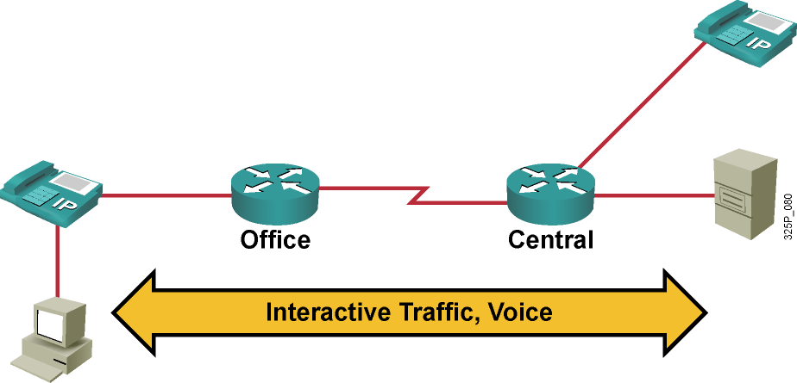
MQC Example
  Voice traffic needs priority, low delay, and constant bandwidth.
  Interactive traffic needs bandwidth and low delay.

Slide 21
MQC Example (Cont.)
hostname Office
!
class-map VoIP
match access-group 100
class-map Application
match access-group 101
!
policy-map QoS-Policy
class VoIP
priority 100
class Application
bandwidth 25
class class-default
fair-queue
!
interface Serial0/0
service-policy output QoS-Policy
!
access-list 100 permit ip any any precedence 5
access-list 100 permit ip any any dscp ef
access-list 101 permit tcp any host 10.1.10.20
access-list 101 permit tcp any host 10.1.10.40
Classification
QoS Policy
QoS Policy on Interface
Classification

Slide 22
Basic Verification Commands
router#
show class-map
  Displays the class maps
router#
show policy-map
  Displays the policy maps
router#
show policy-map interface type number
  Displays the applied policy map on the interface

Slide 23
AutoQoS

Slide 24
Cisco AutoQoS
  Automatically discovers applications and provides appropriate QoS treatment
  Automatically generates initial and ongoing QoS policies
  Provides high-level business knobs and multidevice and domain automation for QoS
  Generates intelligent, automatic alerts and summary reports
  Enables automatic, seamless interoperability among all QoS features and parameters across a network topology—LAN, MAN, and WAN

Slide 25
The Features of Cisco AutoQoS
DiffServ Function | Cisco IOS and Catalyst Software QoS Feature | Behavior
Classification | NBAR DSCP, port | Classifies VoIP based on packet attributes or port trust
Marking | Class-based marking | Sets Layer 2 and Layer 3 attributes to categorize packets into a class
Congestion management | Percentage-based LLQ, WRR | Provides Expedited Forwarding treatment to voice and best-effort treatment to data
Shaping | Class-based shaping or FRTS | Shapes to CIR to prevent burst and smooth traffic to configured rate
Link efficiency mechanism | Header compression | Reduces the VoIP bandwidth requirement
Link efficiency mechanism | Link Fragmentation and Interleaving | Reduces jitter experienced by voice packets

Slide 26
Cisco AutoQoS Usage Guidelines
  Make sure that:
    CEF is enabled.
    NBAR is enabled.
    Correct bandwidth statement is configured on the interface.
  Finally, enable Cisco AutoQoS on the interface.

Slide 27
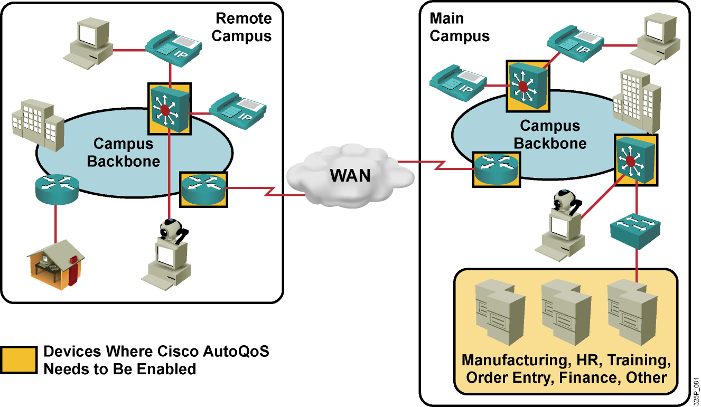
Cisco AutoQoS Example
Enable Cisco AutoQoS on relevant devices (such as LAN switches and WAN routers) that need to perform QoS.

Slide 28
Cisco AutoQoS Example (Cont.)
interface Serial1/3
ip cef
bandwidth 1540
ip address 10.10.100.1 255.255.255.0
auto qos voip
IP CEF and Bandwidth
AutoQoS for VoIP Traffic Recognized by NBAR

Slide 29
SDM QoS Wizard

Slide 30
Cisco SDM QoS Wizard
  Cisco SDM is an intuitive, web-based device management tool for easy and reliable deployment and management of Cisco IOS routers.
  Cisco SDM provides wizards for:
    Firewall and NAT
    Intrusion prevention
    IPsec VPNs
    QoS
    Routing

Slide 31
QoS Features
  Cisco SDM QoS wizard provides:
    QoS policing
    NBAR
    Traffic monitoring
  Supported and preinstalled on Cisco 850, 870, 1800, 2800, and 3800 Cisco Integrated Services Routers
  Supported on devices 830, 1700, 2600 XM, 2800, 3700, 7200 VXR, and 7301

Slide 32
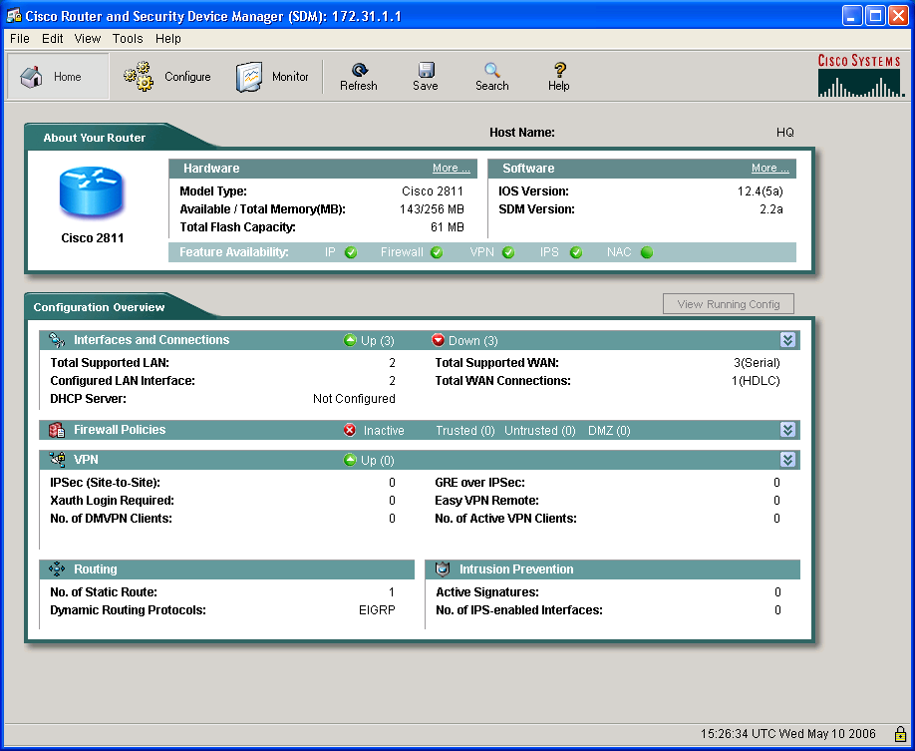
Getting Started with Cisco SDM

Slide 33
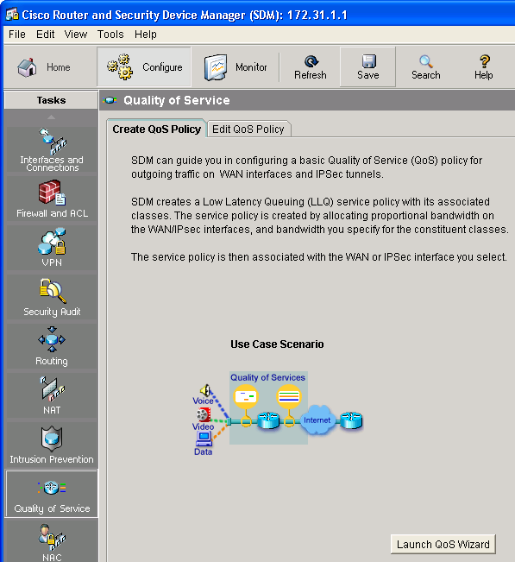
Create QoS Policy
1.
3.
2.
4.

Slide 34
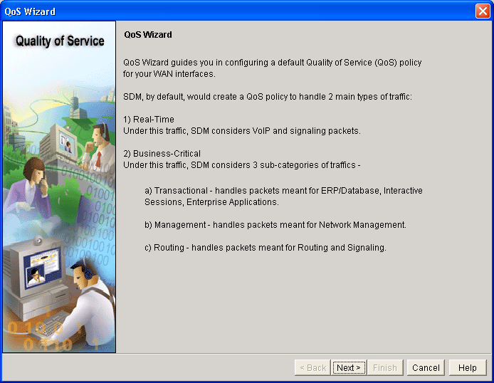
QoS Wizard

Slide 35
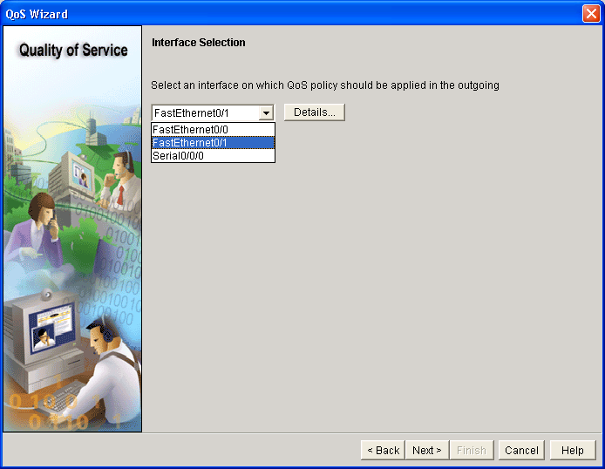
Interface Selection

Slide 36
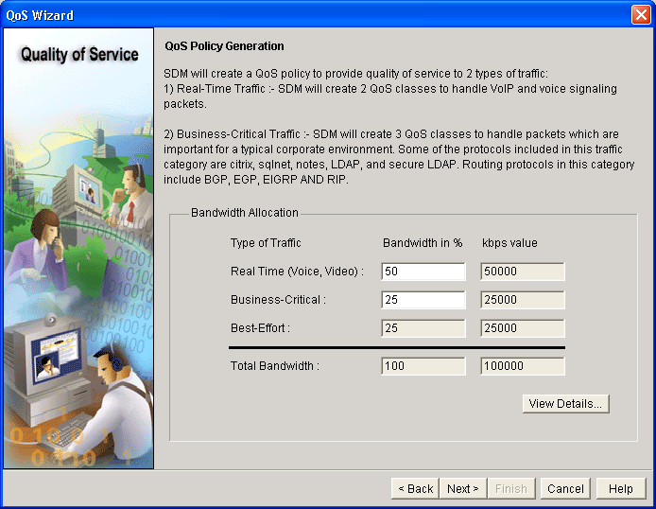
QoS Policy Generation

Slide 37
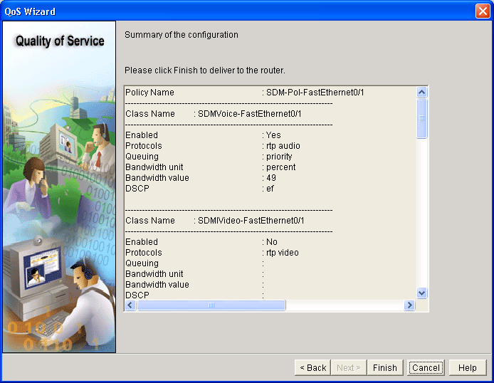
Summary

Slide 38
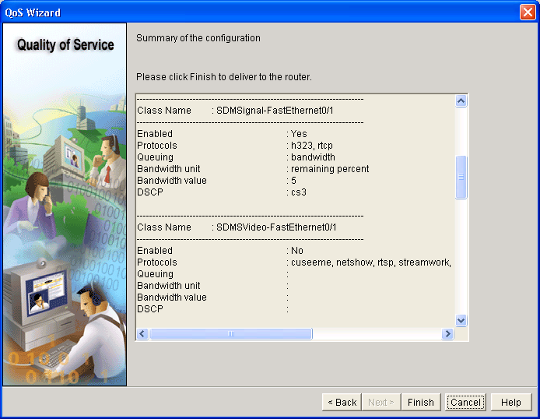
Summary (Cont.)

Slide 39

Summary (Cont.)

Slide 40

Summary (Cont.)

Slide 41

Summary (Cont.)

Slide 42
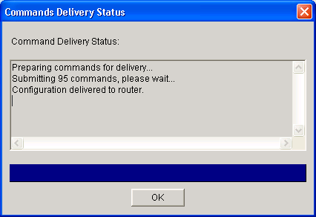
Command Delivery Status

Slide 43
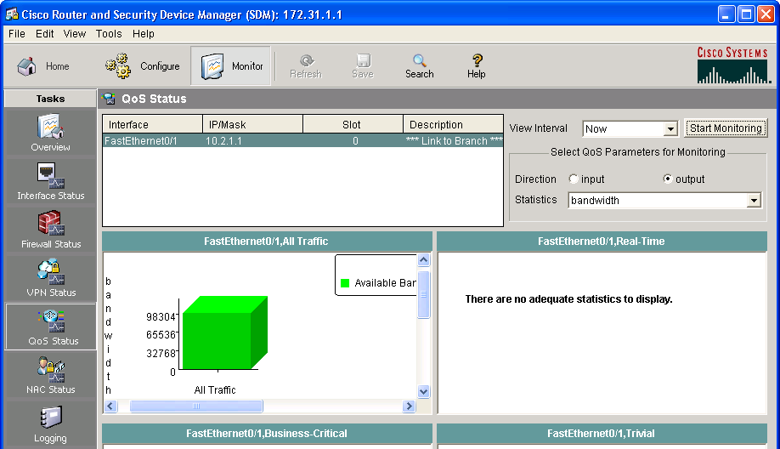
QoS Status
1.
A
B
2.

Slide 44
QoS Implementation Methods Compared

Slide 45
QoS Implementation Methods Compared
 | Legacy CLI | MQC | Cisco AutoQoS | Cisco SDM QoS Wizard
Ease of use | Poor | Easier | Simple | Simple
Ability to fine-tune | OK | Very good | Limited | Limited
Time to implement | Longest | Average | Shortest | Short
Modularity | Poor | Excellent | Excellent | Very good

Slide 46
Summary
  There are four methods for implementing QoS: legacy CLI, MQC, Cisco AutoQoS, and Cisco SDM QoS wizard.
  CLI QoS configuration can be complex and in many cases requires learning different syntax for different QoS mechanisms.
  MQC separates the classification of network traffic from the definition of the QoS policy.
  Cisco AutoQoS is used to automatically implement a set of QoS policies on a router or a switch.
  Cisco SDM QoS wizard provides a GUI to ease QoS configuration.
  MQC is the recommended manual approach to configure QoS. MQC reduces configuration steps and time compared to the legacy approach.

Slide 47


