Slide 1
Implement the DiffServ QoS Model
Introducing Classification and Marking

Slide 2

Classification

Slide 3
Classification
  Classification is the process of identifying and categorizing traffic into classes, typically based upon:
    Incoming interface
    IP precedence
    DSCP
    Source or destination address
    Application
  Classification is the most fundamental QoS building block.
  Without classification, all packets are treated the same.

Slide 4
Marking

Slide 5
Marking
  Marking is the QoS feature component that “colors” a packet (frame) so it can be identified and distinguished from other packets (frames) in QoS treatment.
  Commonly used markers:
    Link layer:
      CoS (ISL, 802.1p)
      MPLS EXP bits
      Frame Relay
    Network layer:
      DSCP
      IP precedence

Slide 6
Classification and Marking at the Link Layer

Slide 7
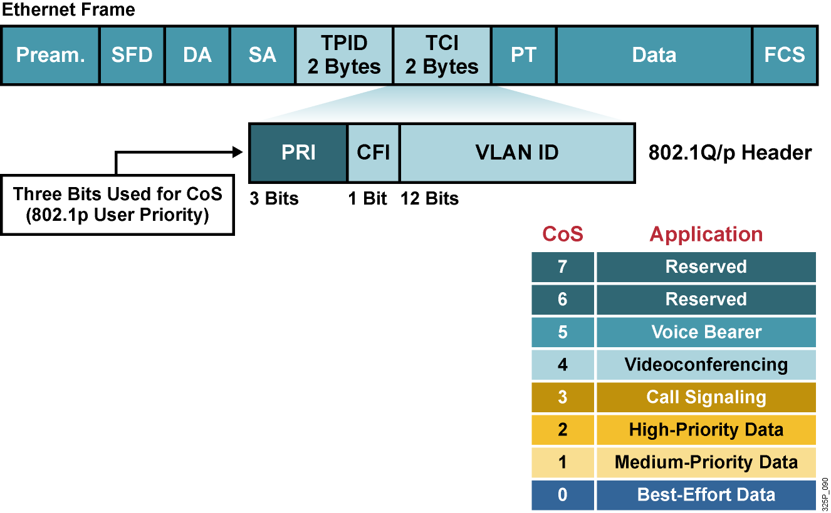
Classification and Marking in the LAN with IEEE 802.1Q
  IEEE 802.1p user priority field is also called CoS.
  IEEE 802.1p supports up to eight CoSs.
  IEEE 802.1p focuses on support for QoS over LANs and 802.1Q ports.
  IEEE 802.1p is preserved through the LAN, not end to end.

Slide 8
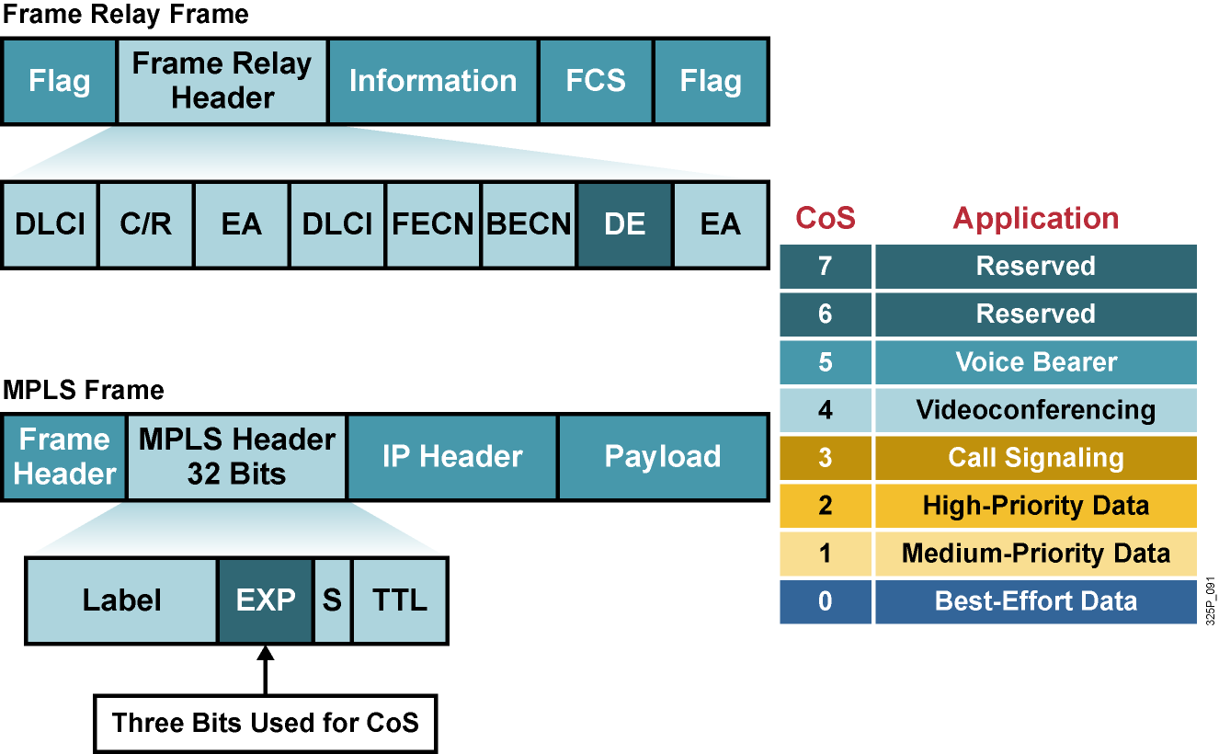
Classification and Marking in the Enterprise

Slide 9
DiffServ Model

Slide 10
DiffServ Model
  Describes services associated with traffic classes.
  Complex traffic classification and conditioning is performed at the network edge, resulting in a per-packet DSCP.
  No per-flow state in the core.
  The core only performs simple PHBs on traffic aggregates.
  The goal of the DiffServ model is scalability.
  Wide variety of services and provisioning policies.
  Decouple service and application in use.
  No application modification.
  No hop-by-hop signaling.
  Interoperability with non-DiffServ-compliant nodes.
  Incremental deployment.

Slide 11
IP Precedence and DSCP Compatibility

Slide 12
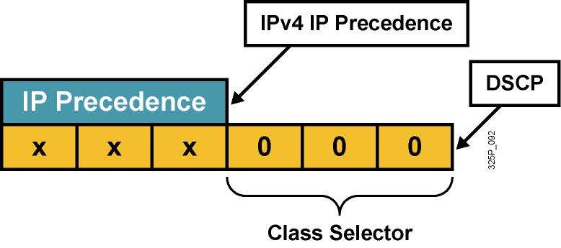
IP Precedence and DSCP Compatibility
  Compatibility with current IP precedence usage (RFC 1812)
  Differentiates probability of timely forwarding:
  (xyz000) >= (abc000) if xyz > abc
  (that is, if a packet has DSCP value of 011000, it has a greater probability of timely forwarding than a packet with DSCP value of 001000)

Slide 13
Per Hop Behaviors

Slide 14
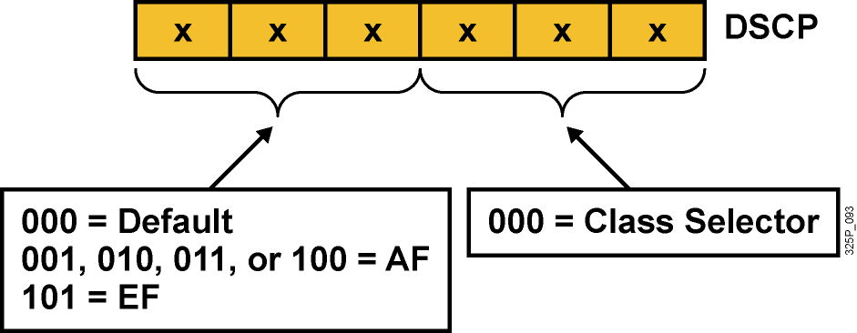
Per-Hop Behaviors
DSCP selects PHB throughout the network:
  Default PHB (FIFO, tail drop)
  EF PHB
  AF PHB
  Class-selector PHB (IP precedence)

Slide 15
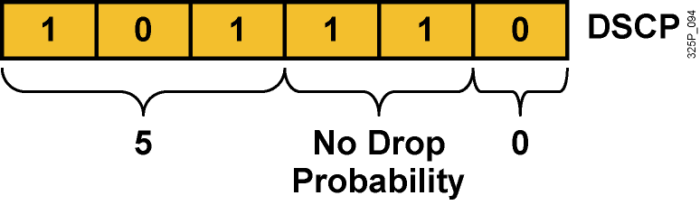
EF PHB
  EF PHB:
    Ensures a minimum departure rate
    Guarantees bandwidth—class guaranteed an amount of bandwidth with prioritized forwarding
    Polices bandwidth—class not allowed to exceed the guaranteed amount (excess traffic is dropped)
  DSCP value of 101110: Looks like IP precedence 5 to non-DiffServ-compliant devices:
    Bits 5 to 7: 101 = 5 (same 3 bits are used for IP precedence)
    Bits 3 and 4: 11 = No drop probability
    Bit 2: Just 0

Slide 16
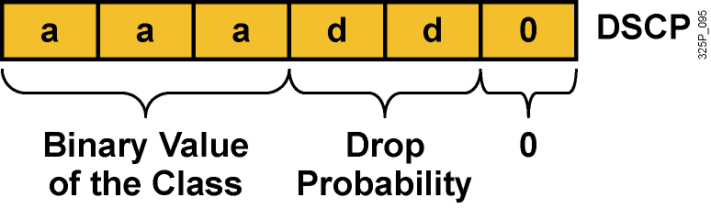
AF PHB
  AF PHB:
    Guarantees bandwidth
    Allows access to extra bandwidth, if available
  Four standard classes: AF1, AF2, AF3, and AF4
  DSCP value range of aaadd0:
    aaa is a binary value of the class
    dd is drop probability

Slide 17
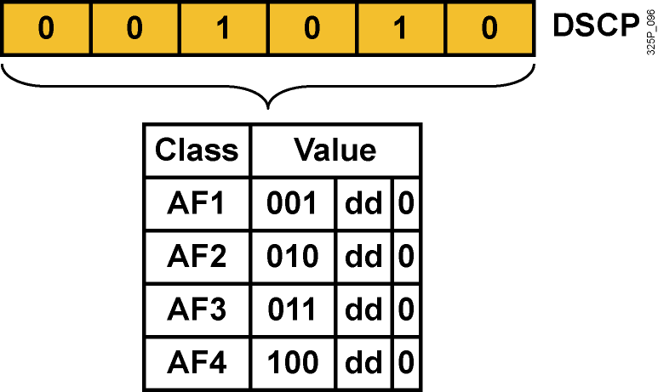
AF PHB (Cont.)
  Each AF class uses three DSCP values.
  Each AF class is independently forwarded with its guaranteed bandwidth.
  Congestion avoidance is used within each class to prevent congestion within the class.

Slide 18
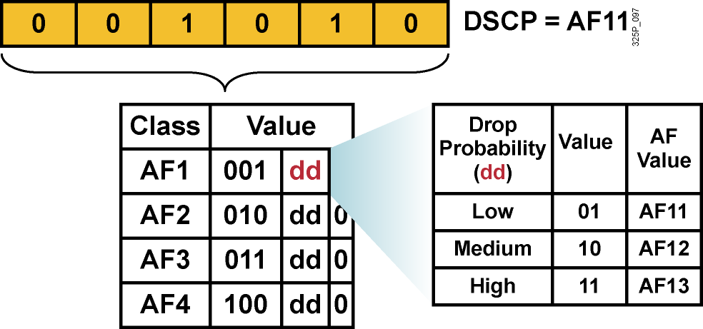
AF PHB (Cont.)
  Each AF class uses three DSCP values.
  Each AF class is independently forwarded with its guaranteed bandwidth.
  Congestion avoidance is used within each class to prevent congestion within the class.

Slide 19
DSCP Summary

Slide 20
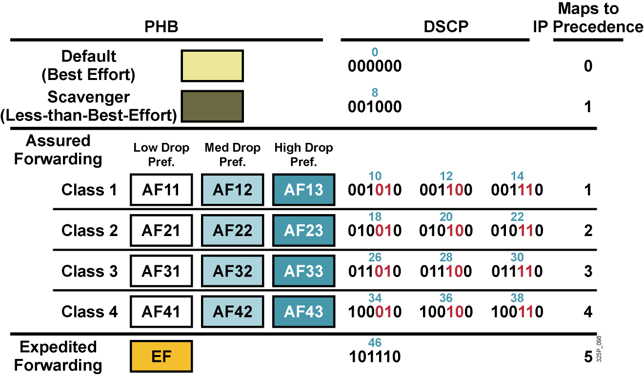
DSCP Summary

Slide 21
Mapping CoS to Network Layer QoS

Slide 22
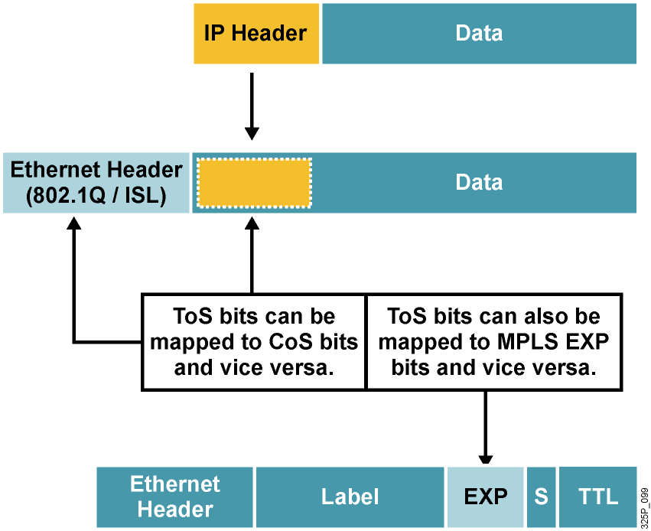
Mapping CoS to Network Layer QoS

Slide 23
QoS Service Class Defined

Slide 24
QoS Service Class
  A QoS service class is a logical grouping of packets that are to receive a similar level of applied quality.
  A QoS service class can be:
    A single user (such as, MAC address or IP address)
    A department, customer (such as, subnet or interface)
    An application (such as, port numbers or URL)
    A network destination (such as, tunnel interface or VPN)

Slide 25
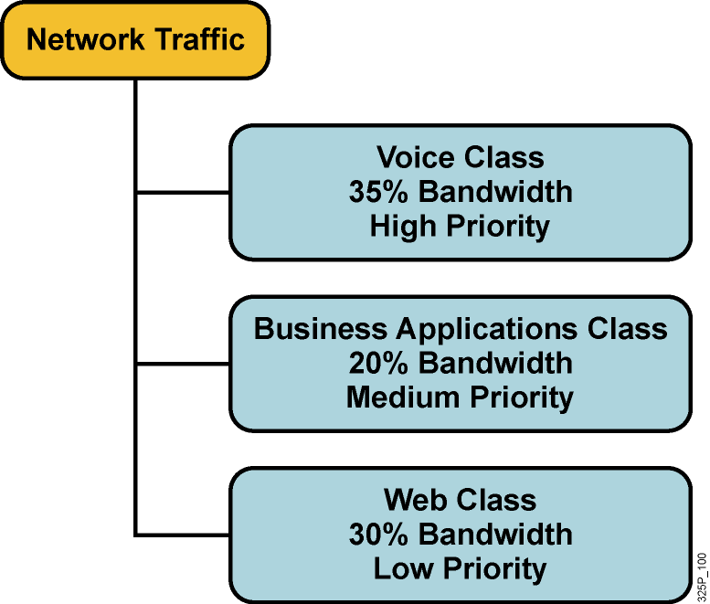
Example: Defining QoS Service Class
  Remaining 15 percent is used for management, signaling, and routing traffic.

Slide 26
Implementing QoS Policy Using a QoS Service Class

Slide 27
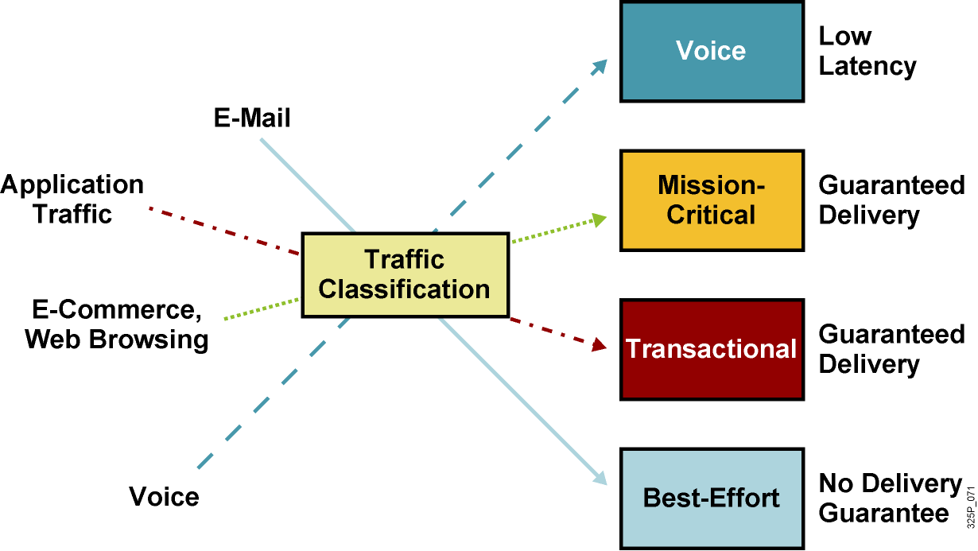
Implementing QoS Policy
Using a QoS Service Class

Slide 28
Implementing QoS Policy Using a QoS Service Class (Cont.)
  Profile applications to their basic network requirements.
  Do not overengineer provisioning; use no more than four to five traffic classes for data traffic:
    Voice applications: VoIP
    Mission-critical applications: Oracle, SAP, SNA
    Interactive applications: Telnet, TN3270
    Bulk applications: FTP, TFTP
    Best-effort applications: E-mail, WWW
    Scavenger applications: Nonorganizational streaming and video applications
  Do not assign more than three applications to mission-critical or transactional classes.
  Use proactive policies before reactive (policing) policies.
  Seek executive endorsement of relative ranking of application priority prior to rolling out QoS policies for data.

Slide 29
Example: Application Service Classes
Application | Layer 3 Classification |  |  | Layer 2 CoS
 | IPP | PHB | DSCP
Reserved | 7 | — | 56–62 | 7
Reserved | 6 | — | 48 | 6
Voice bearer | 5 | EF | 46 | 5
Video-data traffic | 4 | AF41 | 34 | 4
Mission-critical data | 3 | AF31 | 26 | 3
Transactional data | 2 | AF2x | 18, 20, 22 | 2
Scavenger | 1 | — | 8 | 1
Bulk data | 1 | AF1x | 10, 12, 14 | 1
Best-effort data | 0 | BE | 0 | 0
Less-than-best-effort data | 0 | — | 2, 4, 6 | 0

Slide 30
Trust Boundaries

Slide 31
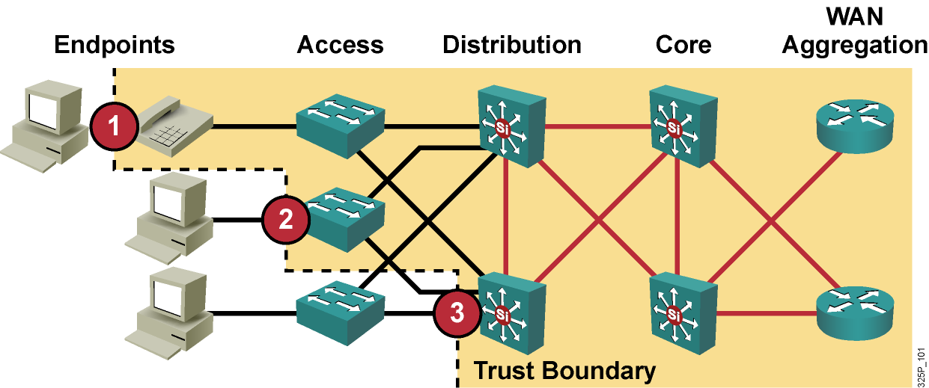
Trust Boundaries: Classify Where?
For scalability, classification should be enabled as close to the edge as possible, depending on the capabilities of the device at:
  Endpoint or end system
  Access layer
  Distribution layer

Slide 32
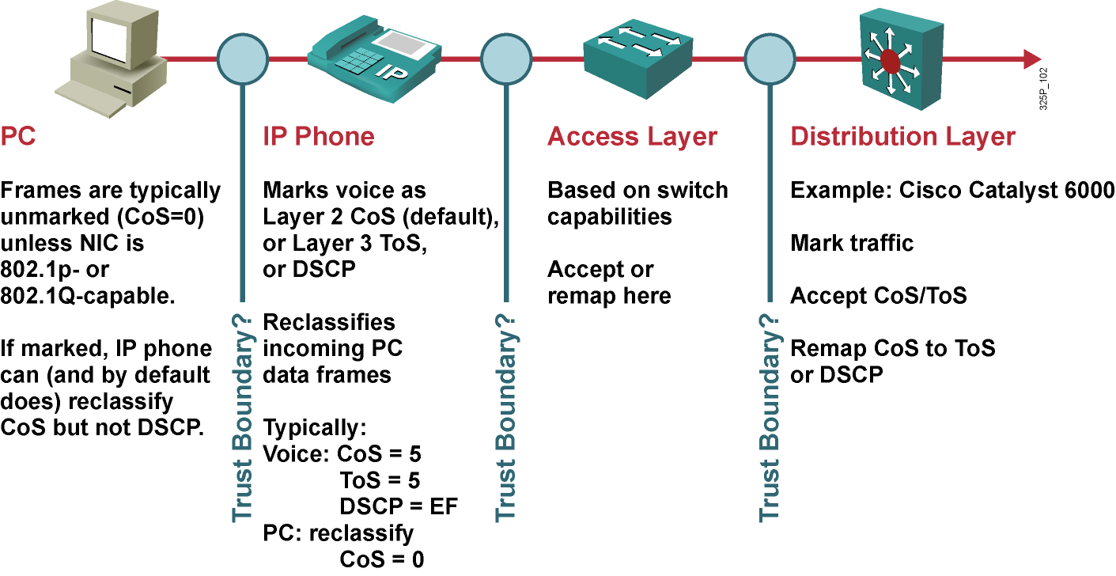
Trust Boundaries: Mark Where?
For scalability, marking should be done as close to the source as possible.

Slide 33
Summary
  Packet classification is a QoS mechanism responsible for distinguishing among traffic streams.
  Packet marking is a QoS mechanism that “identifies” a packet so it can be distinguished from other packets during the application of QoS.
  Packets can be classified and marked at the data link layer using many different mechanisms, including 802.1Q, ISL, and MPLS EXP bits.
  The DiffServ model describes services associated with traffic classes.
  Complex traffic classification and conditioning is performed at the network edge, resulting in a per-packet DSCP.
  A PHB is an externally observable forwarding behavior applied at a DiffServ-compliant node to a DiffServ BA.
  The EF PHB guarantees and polices bandwidth while ensuring a minimum departure rate.

Slide 34
Summary (Cont.)
  The AF PHB guarantees bandwidth while providing four classes, each having three DSCP values.
  The DSCP is backward-compatible with IP precedence and class-selector code point.
  The ability to map network layer QoS to link layer CoS allows service providers to offer a complete end-to-end QoS solution that does not depend on any specific link layer technology.
  A QoS service class is a logical grouping of packets that are to receive a similar level of applied quality, as defined in an administrative policy.
  An administrative policy for QoS requires that a specific set of service classes be defined. QoS mechanisms are uniformly applied to these individual service classes to meet the requirements of the administrative policy.
  It is important that a trust boundary be specified, allowing classification and marking as close to the source as possible.

Slide 35
