Slide 1
Implement the DiffServ QoS Model
Using NBAR for Classification

Slide 2

Network Based Application Recognition

Slide 3
Network-Based Application Recognition
  NBAR classifies modern client-server and web-based applications.
  NBAR functions:
    Performs identification of applications and protocols (Layer 4–7)
    Performs protocol discovery
    Provides traffic statistics
  NBAR enables downstream actions based on QoS policies via (RED), class-based queuing, and policing.
  New applications are easily supported by loading a PDLM.

Slide 4
NBAR Application Support

Slide 5
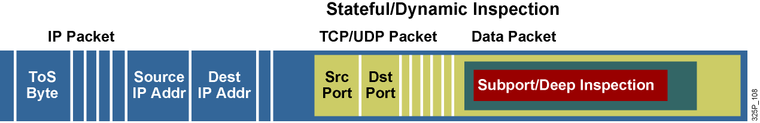
NBAR Application Support
NBAR can classify applications that use:
  Statically assigned TCP and UDP port numbers
  Non-UDP and non-TCP IP protocols
  Dynamically assigned TCP and UDP port numbers negotiated during connection establishment (requires stateful inspection)
  Subport and deep packet inspection classification

Slide 6
NBAR Application Support (Cont.)
TCP and UDP Static Port Protocols
BGP | IMAP | NNTP | RSVP | SNNTP
BOOTP | IRC | Notes | SFTP | SOCKS
CU-SeeMe | Kerberos | Novadigm | SHTTP | SQL Server
DHCP/DNS | L2TP | NTP | SIMAP | SSH
Finger | LDAP | PCAnywhere | SIRC | STELNET
Gopher | MS-PPTP | POP3 | SLDAP | Syslog
HTTP | NetBIOS | Printer | SMTP | Telnet
HTTPS | NFS | RIP | SNMP | X Window
TCP and UDP Stateful Protocols
Citrix ICA | Gnutella | R-commands | StreamWorks
Exchange | HTTP | RealAudio | Sun RPC
FastTrack | Napster | RTP | TFTP
FTP | Netshow | SQL*NET | VDOLive
Non-UDP and Non-TCP Protocols
EGP | ICMP
EIGRP | IPINIP
GRE | IPsec

Slide 7
Packet Description Language Module

Slide 8
Packet Description Language Module
  PDLMs allow NBAR to recognize new protocols matching text patterns in data packets without requiring a new Cisco IOS software image or a router reload.
  An external PDLM can be loaded at run time to extend the NBAR list of recognized protocols.
  PDLMs can also be used to enhance an existing protocol recognition capability.
  PDLMs must be produced by Cisco engineers.

Slide 9
Packet Description
Language Module (Cont.)
router(config)#
ip nbar pdlm pdlm-name
  Used to enhance the list of protocols recognized by NBAR through a PDLM.
  The filename is in the URL format (for example, flash://citrix.pdlm).
router(config)#
ip nbar port-map protocol-name [tcp | udp] port-number
  Configures NBAR to search for a protocol or protocol name using a port number other than the well-known port.
  Up to 16 additional port numbers can be specified.

Slide 10
Packet Description
Language Module (Cont.)
router#
show ip nbar port-map [protocol-name]
  Displays the current NBAR protocol-to-port mappings
router#show ip nbar port-map
port-map bgp udp 179
port-map bgp tcp 179
port-map cuseeme udp 7648 7649
port-map cuseeme tcp 7648 7649
port-map dhcp udp 67 68
port-map dhcp tcp 67 68
port-map dns udp 53
port-map dns tcp 53

Slide 11
Protocol Discovery

Slide 12
NBAR Protocol Discovery
  Analyzes application traffic patterns in real time and discovers which traffic is running on the network
  Provides bidirectional, per-interface, and per-protocol statistics
  Important monitoring tool supported by Cisco QoS management tools:
    Generates real-time application statistics
    Provides traffic distribution information at key network locations

Slide 13
Configuring and Monitoring Protocol Discovery

Slide 14
Configuring and Monitoring
Protocol Discovery
router(config-if)#
ip nbar protocol-discovery
  Configures NBAR to discover traffic for all protocols known to NBAR on a particular interface
  Requires that CEF be enabled before protocol discovery
  Can be applied with or without a service policy enabled
router#
show ip nbar protocol-discovery
  Displays the statistics for all interfaces on which protocol discovery is enabled

Slide 15
Configuring and Monitoring
Protocol Discovery (Cont.)
router#show ip nbar protocol-discovery
Ethernet0/0
Input Output
Protocol Packet Count Packet Count
Byte Count Byte Count
5 minute bit rate (bps) 5 minute bit rate (bps)
---------- ------------------------ ------------------------
realaudio 2911 3040
1678304 198406
19000 1000
http 19624 13506
14050949 2017293
0 0
<...rest of the output omitted...>

Slide 16
Configuring NBAR for Static Protocols

Slide 17
Configuring NBAR for Static Protocols
Required steps:
  Enable NBAR Protocol Discovery.
  Configure a traffic class.
  Configure a traffic policy.
  Attach the traffic policy to an interface.
  Enable PDLM if needed.

Slide 18
Configuring NBAR for Static Protocols (Cont.)
router(config-cmap)#
match protocol protocol
  Configures the match criteria for a class map on the basis of the specified protocol using the MQC configuration mode.
  Static protocols are recognized based on the well-known destination port number.
  A match not command can be used to specify a QoS policy value that is not used as a match criterion; in this case, all other values of that QoS policy become successful match criteria.

Slide 19
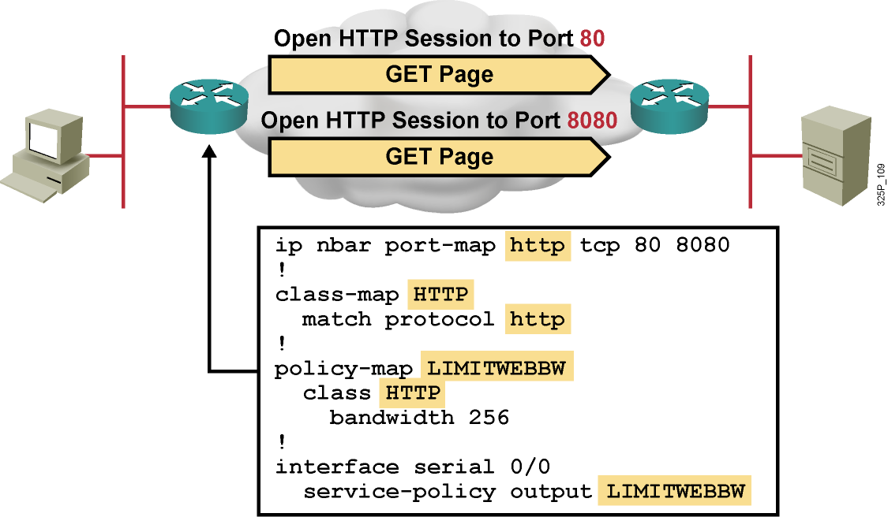
Example
  HTTP is a static protocol using a well-known port number 80. However, other port numbers may also be in use.
  The ip nbar port-map command will inform the router that other ports are also used for HTTP.

Slide 20
Configuring Stateful NBAR for Dynamic Protocols

Slide 21
Configuring Stateful NBAR for Dynamic Protocols
Required steps:
  Configure a traffic class.
  Configure a traffic policy.
  Attach the traffic policy to an interface.

Slide 22
Configuring Stateful NBAR for Dynamic Protocols (Cont.)
router(config-cmap)#
match protocol http url url-string
  Recognizes the HTTP GET packets containing the URL, and then matches all packets that are part of the HTTP GET request
  Include only the portion of the URL following the address or host name in the match statement
router(config-cmap)#
match protocol http host hostname-string
  Performs a regular expression match on the host field content inside an HTTP GET packet and classifies all packets from that host

Slide 23
Configuring Stateful NBAR for Dynamic Protocols (Cont.)
router(config-cmap)#
match protocol http mime MIME-type
  Matches a packet containing the MIME type and all subsequent packets until the next HTTP transaction for stateful protocol.
router(config-cmap)#
match protocol fasttrack file-transfer
regular-expression
  Stateful mechanism to identify a group of peer-to-peer file-sharing applications.
  Applications that use FastTrack peer-to-peer protocol include Kazaa, Grokster, Gnutella, and Morpheus.
  A Cisco IOS regular expression is used to identify specific FastTrack traffic.
  To specify that all FastTrack traffic will be identified by the traffic class, use asterisk (*) as the regular expression.

Slide 24
Configuring Stateful NBAR for Dynamic Protocols (Cont.)
router(config-cmap)#
match protocol rtp [audio | video | payload-type payload-string]
  Identifies real-time audio and video traffic in the class-map mode of MQC.
  Differentiates on the basis of audio and video codecs.
  The match protocol rtp command has these options:
    audio: Match by payload type values 0 to 23, reserved for audio traffic.
    video: Match by payload type values 24 to 33, reserved for video traffic.
    payload-type: Match by a specific payload type value; provides more granularity than the audio or video options.

Slide 25
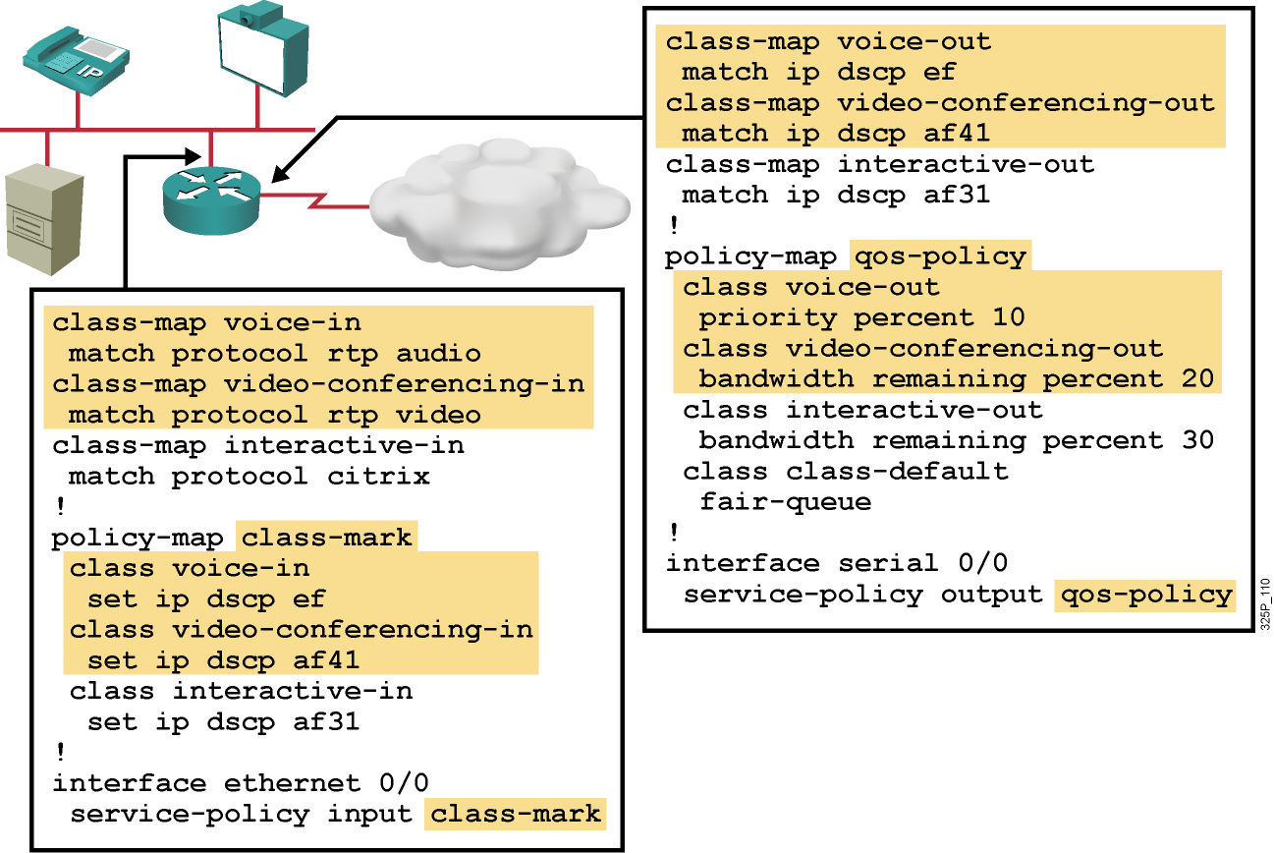
Example

Slide 26
Summary
  NBAR identifies applications and protocols (Layer 4–7), and provides traffic statistics.
  NBAR supports both statically and dynamically assigned TCP and UDP port numbers along with other means to recognize applications.
  PDLMs contain the rules that are used by NBAR to recognize an application and can be used to bring new or changed functionality to NBAR.
  NBAR Protocol Discovery analyzes application traffic patterns in real time and discovers which traffic is running on the network.

Slide 27
Summary (Cont.)
  Use the ip nbar protocol-discovery command to configure NBAR to keep traffic statistics for all protocols known to NBAR. Use the show ip nbar protocol-discovery command to display statistics gathered by the NBAR Protocol Discovery feature.
  Use the ip nbar port-map command to extend the NBAR functionality for well-known protocols to new port numbers.
  Use the match protocol command to allow static protocols to be recognized based on well-known port numbers.
  The match protocol rtp command allows identification of real-time audio and video traffic.

Slide 28


