Slide 1
Implement the DiffServ QoS Model
Introducing Queuing Implementations

Slide 2

Congestion and Queuing

Slide 3
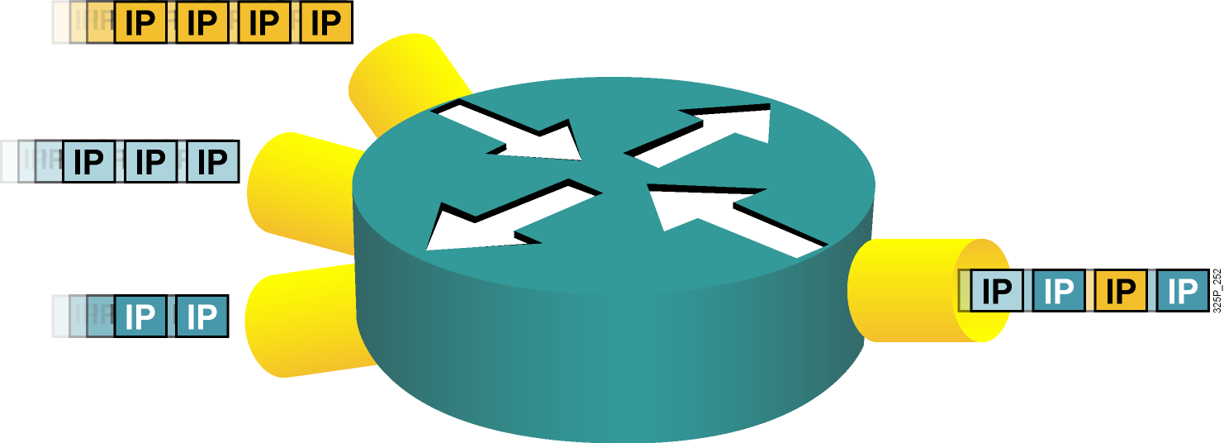
Congestion and Queuing
  Congestion can occur at any point in the network where there are points of speed mismatches or aggregation.
  Queuing manages congestion to provide bandwidth and delay guarantees.

Slide 4
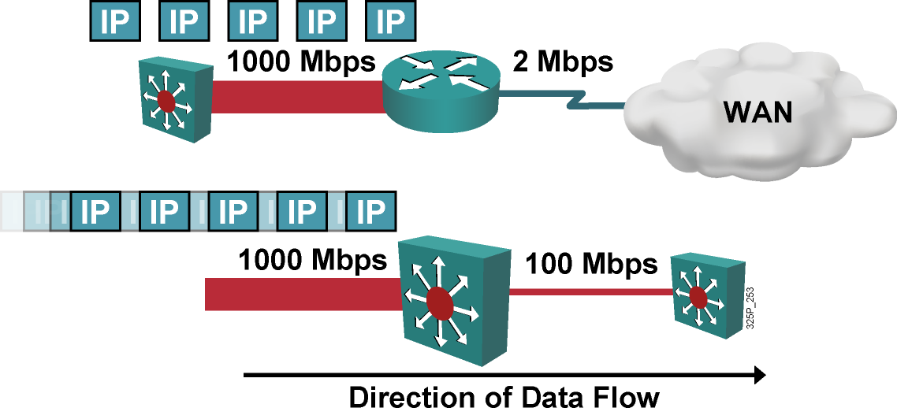
Speed Mismatch
  Speed mismatches are the most typical cause of congestion.
  Possibly persistent when going from LAN to WAN.
  Usually transient when going from LAN to LAN.

Slide 5
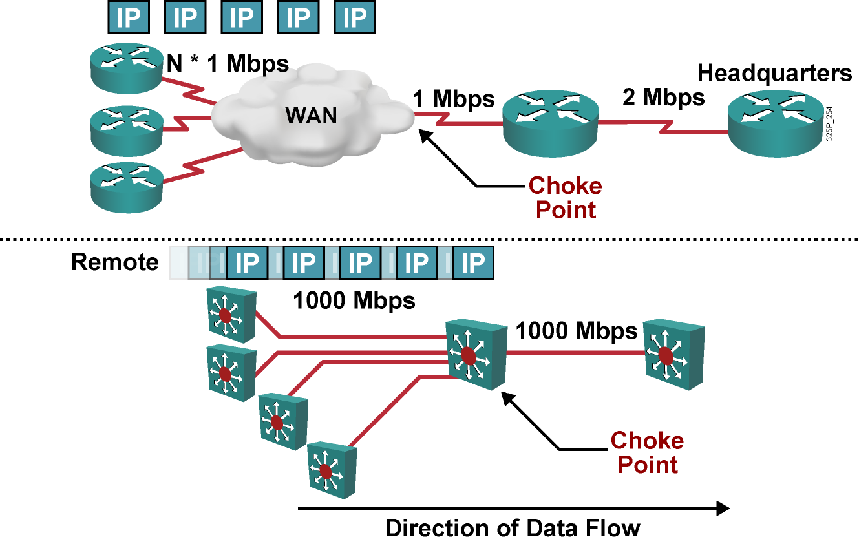
Aggregation

Slide 6
Queuing Algorithms

Slide 7
Definition
  Queuing is designed to accommodate temporary congestion on an interface of a network device by storing excess packets in buffers until bandwidth becomes available.
  Queuing is a congestion-management mechanism that allows you to control congestion on interfaces.

Slide 8
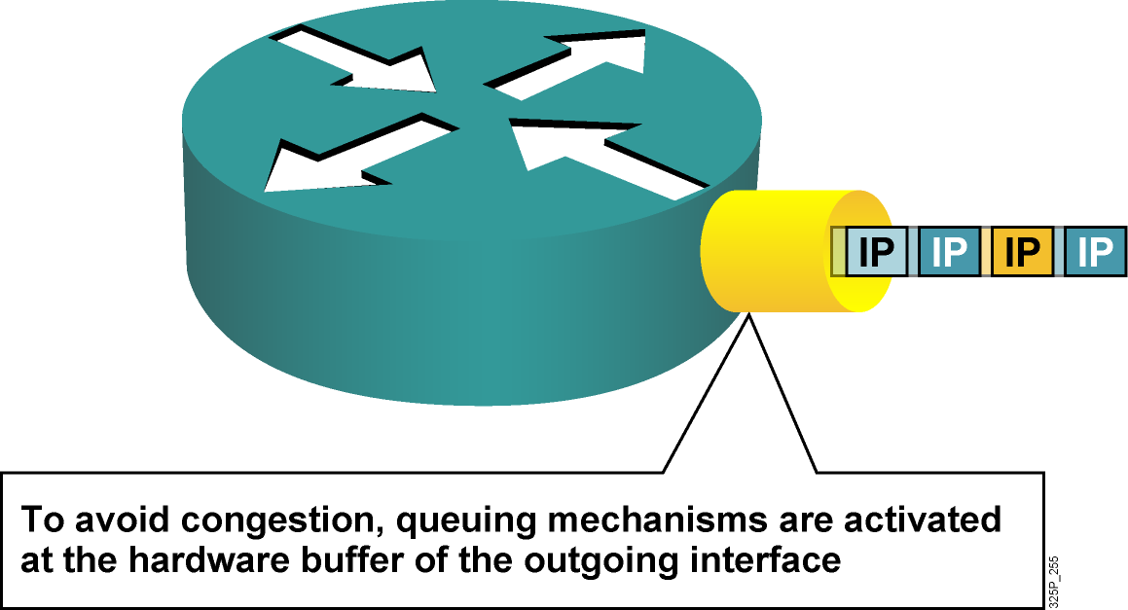
Congestion and Queuing

Slide 9
Queuing Algorithms
  First in, first out (FIFO)
  Priority queuing (PQ)
  Round robin
  Weighted round robin (WRR)

Slide 10
FIFO

Slide 11
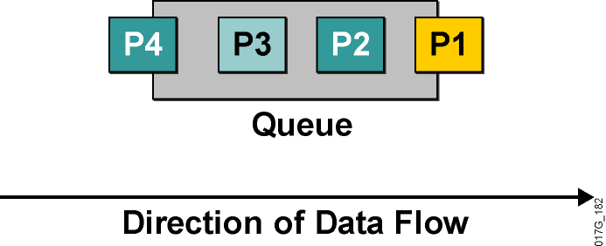
FIFO
  First packet in is first
  packet out
  Simplest of all
  One queue
  All individual queues
  are FIFO

Slide 12
Priority Queuing

Slide 13
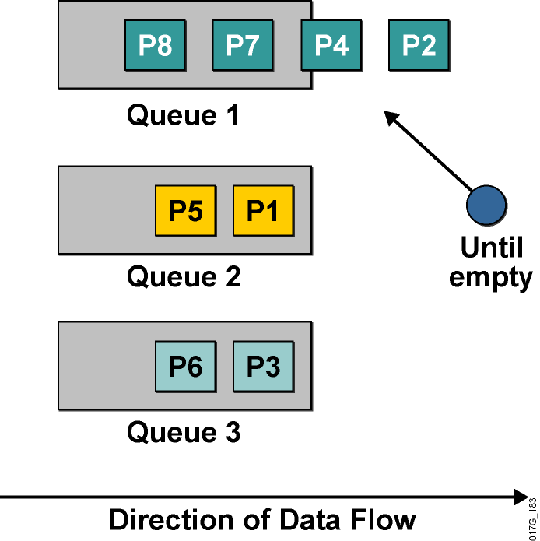
Priority Queuing
Uses multiple queues
Allows prioritization
Always empties first queue before going to the next queue:
  Empty queue No. 1.
  If queue No. 1 is empty, then dispatch one packet from queue No. 2.
  If both queue No. 1 and queue No. 2 are empty, then dispatch one packet from queue No. 3.
Queues No. 2 and No. 3 may “starve”

Slide 14
Round Robin

Slide 15
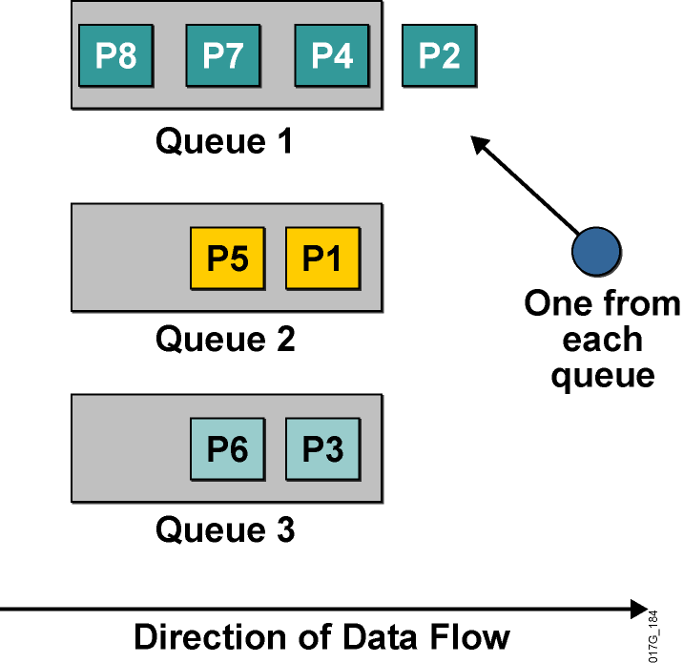
Round Robin
  Uses multiple queues
  No prioritization
  Dispatches one packet from
  each queue in each round:
    One packet from
    queue No. 1
    One packet from
    queue No. 2
    One packet from
    queue No. 3
    Then repeat

Slide 16
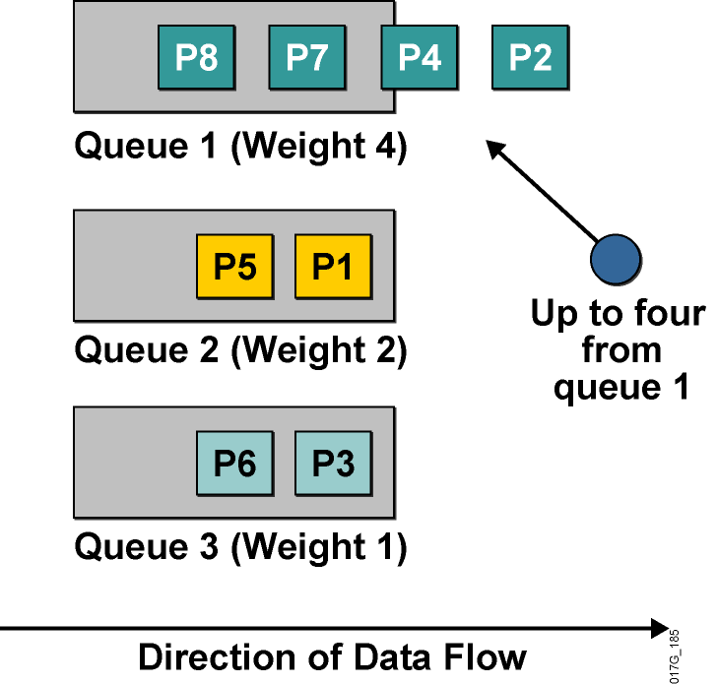
Weighted Round Robin
Allows prioritization
Assign a weight to each queue
Dispatches packets from each queue proportionately to an assigned weight:
  Dispatch up to four from
  queue No. 1.
  Dispatch up to two from
  queue No. 2.
  Dispatch 1 from
  queue No. 3.
  Go back to queue No. 1.

Slide 17
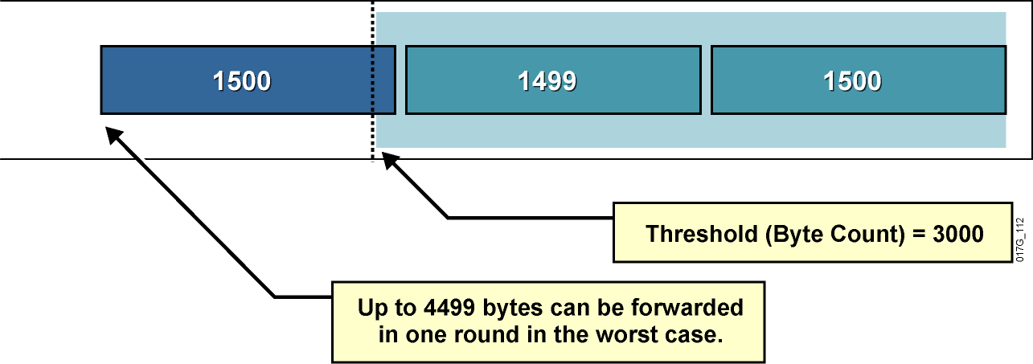
Weighted Round Robin (Cont.)
Problem with WRR:
  Some implementations of WRR dispatch a configurable number of bytes (threshold) from each queue for each round—several packets can be sent in each turn.
  The router is allowed to send the entire packet even if the sum of all bytes is more than the threshold.

Slide 18
Router Queuing Components

Slide 19
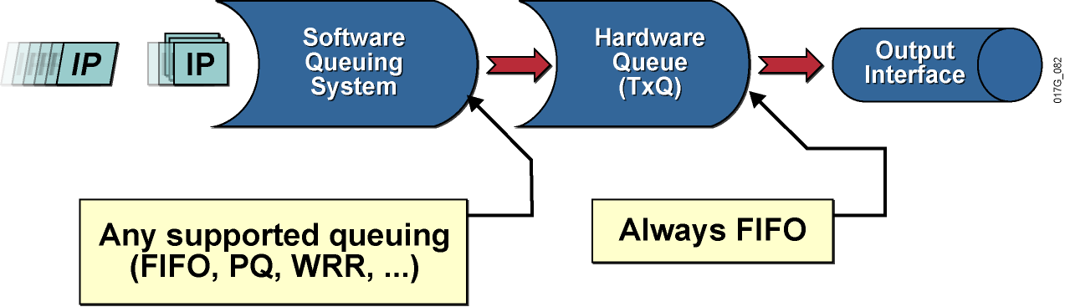
Router Queuing Components
Each physical interface has a hardware and a software queuing system.

Slide 20
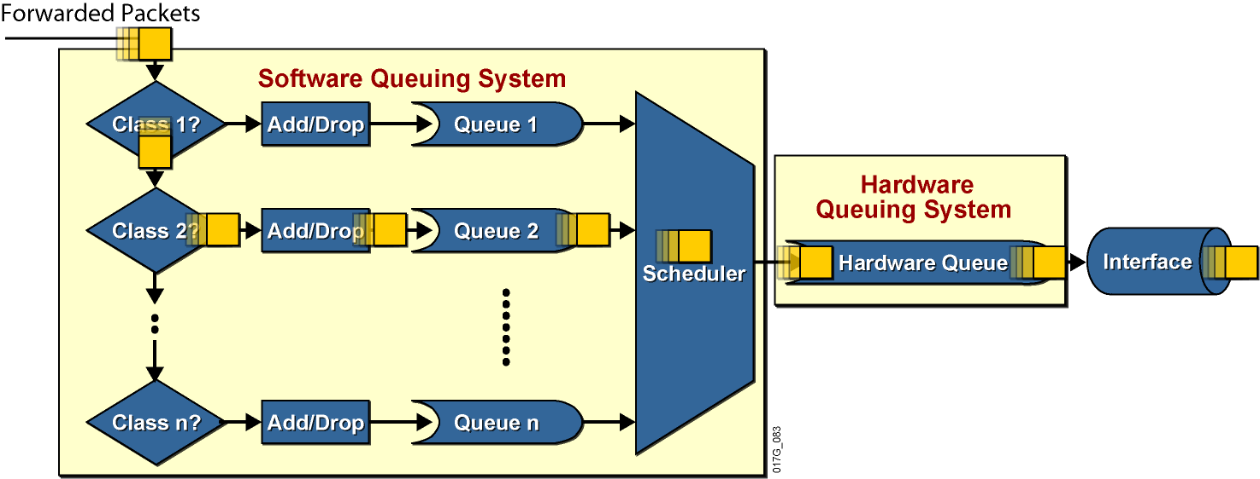
Router Queuing Components (Cont.)
  The hardware queuing system always uses FIFO queuing.
  The software queuing system can be selected and configured depending on the platform and Cisco IOS version.

Slide 21
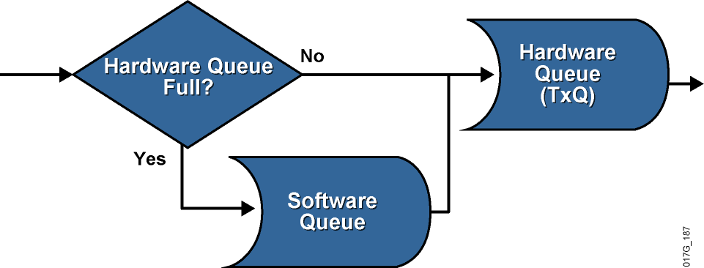
The Software Queue
  Generally, a full hardware queue indicates interface congestion, and software queuing is used to manage it.
  When a packet is being forwarded, the router will bypass
  the software queue if the hardware queue has space in it
  (no congestion).

Slide 22
The Hardware Queue
  Routers determine the length of the hardware queue based on the configured bandwidth of the interface.
  The length of the hardware queue can be adjusted with the
  tx-ring-limit command.
  Reducing the size of the hardware queue has two benefits:
    It reduces the maximum amount of time that packets wait in the FIFO queue before being transmitted.
    It accelerates the use of QoS in Cisco IOS software.
  Improper tuning of the hardware queue may produce undesirable results:
    A long transmit queue may result in poor performance of the software queuing system.
    A short transmit queue may result in a large number of interrupts, which causes high CPU utilization and low link utilization.

Slide 23
The Hardware Queue (Cont.)
The show controllers serial 0/1/0 command shows the length of the hardware queue.
R1#show controllers serial 0/1/0
Interface Serial0/1/0
Hardware is GT96K
DCE V.11 (X.21), clock rate 384000
<...part of the output omitted...>
1 sdma_rx_reserr, 0 sdma_tx_reserr
0 rx_bogus_pkts, rx_bogus_flag FALSE
0 sdma_tx_ur_processed
tx_limited = 1(2), errata19 count1 - 0, count2 - 0
Receive Ring
rxr head (27)(0x075BD090), rxr tail (0)(0x075BCEE0)
rmd(75BCEE0): nbd 75BCEF0 cmd_sts 80800000 buf_sz 06000000 buf_ptr 75CB8E0
rmd(75BCEF0): nbd 75BCF00 cmd_sts 80800000 buf_sz 06000000 buf_ptr 75CCC00
<...rest of the output omitted...>

Slide 24
Congestion on Software Interfaces
  Subinterfaces and software interfaces (dialers, tunnels, Frame Relay subinterfaces) do not have their own
  separate transmit queue.
  Subinterfaces and software interfaces congest when the transmit queue of their main hardware interface congests.
  The tx-ring state (full, not-full) is an indication of hardware interface congestion.

Slide 25
Summary
  Congestion can occur at any point in the network, but particularly at points of speed mismatches and traffic aggregation.
  Three basic queuing algorithms are used to manage congestion: FIFO, priority, and round-robin queuing.
  FIFO is the simplest queuing algorithm.
  PQ allows for the prioritization of traffic through the use of multiple queues but can starve lower-priority queues.
  RR queuing uses multiple queues to provide equal access to all queues.
  WRR offers priority access to multiple queues by assigning weights to queues, but some implementations may provide inaccurate access to some queues.

Slide 26
Summary (Cont.)
  Each physical interface has a hardware and a software queuing system. The hardware queuing system uses FIFO, while the software queuing system can be configured depending on the platform and Cisco IOS version.
  The length of the hardware queue has a significant impact on performance and can be configured on a router with the
  tx-ring-limit command.
  Software interfaces have no queues; they congest only when their hardware interface congests.

Slide 27
