Slide 1
Implement the DiffServ QoS Model
Configuring WFQ

Slide 2

Weighted Fair Queuing

Slide 3
Weighted Fair Queuing
  A queuing algorithm should share the bandwidth fairly among flows by:
    Reducing response time for interactive flows by scheduling them to the front of the queue
    Preventing high-volume flows from monopolizing an interface
  In the WFQ implementation, conversations are sorted into flows and transmitted by the order of the last bit crossing its channel.
  Unfairness is reinstated by introducing weight to give proportionately more bandwidth to flows with higher IP precedence (lower weight).

Slide 4
WFQ Architecture and Benefits

Slide 5
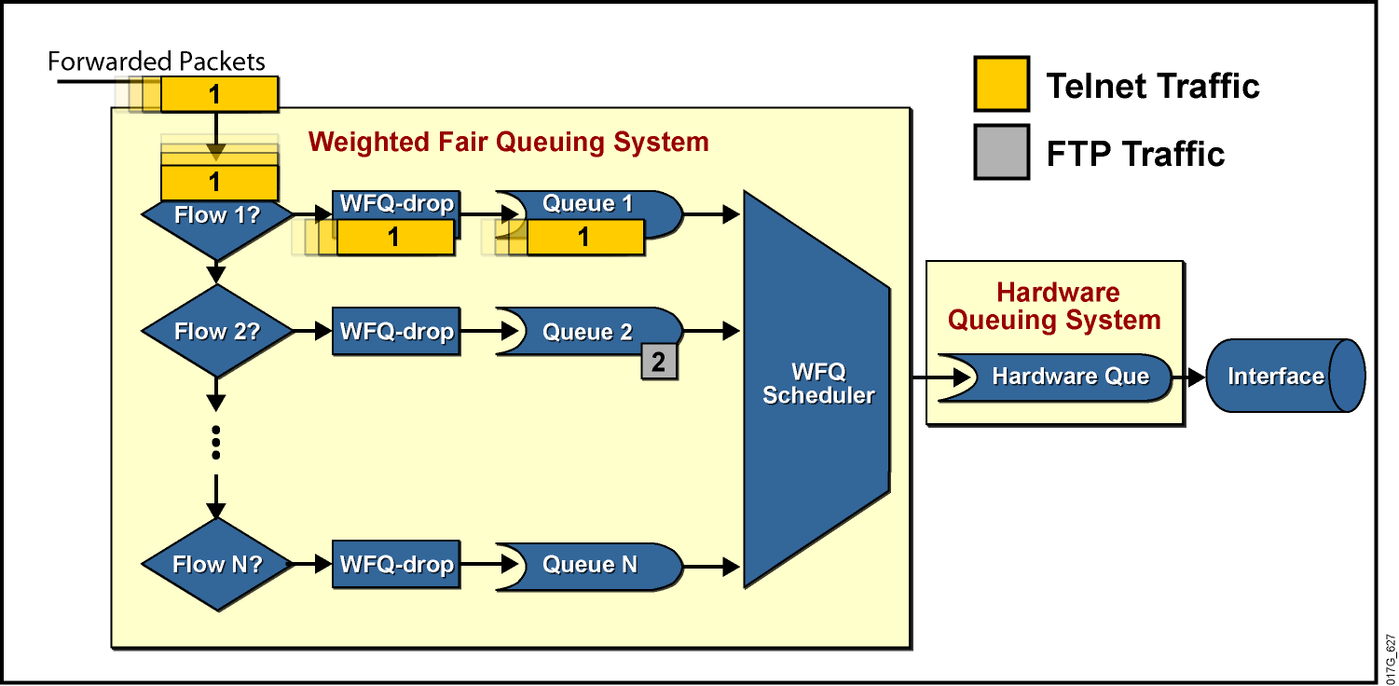
WFQ Architecture
WFQ uses per-flow FIFO queues.

Slide 6
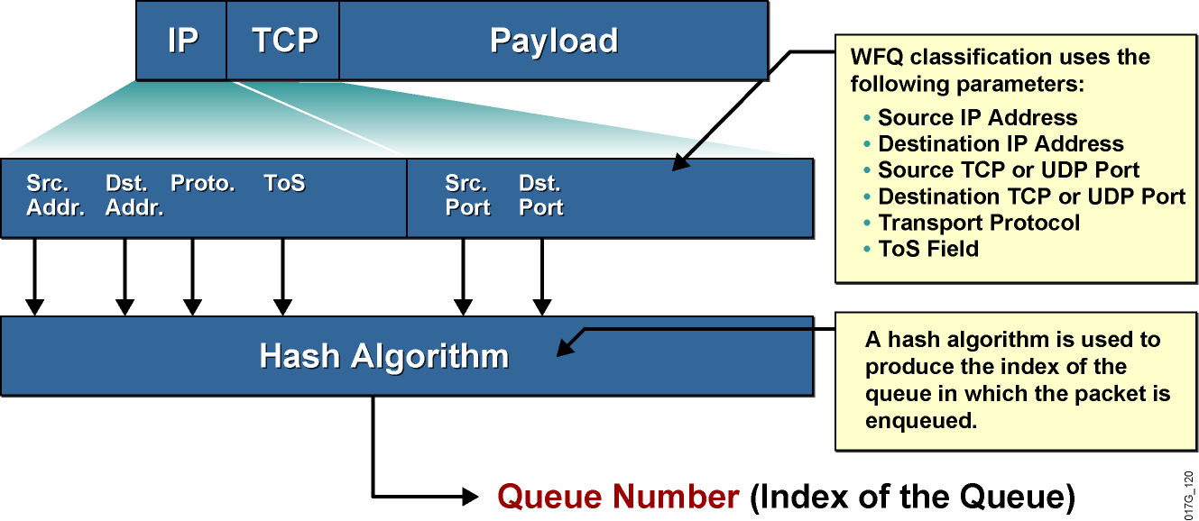
WFQ Classification
Packets of the same flow end up in the same queue.

Slide 7
WFQ Classification (Cont.)
  A fixed number of per-flow queues is configured.
  A hash function is used to translate flow parameters into a queue number.
  System packets (eight queues) and RSVP flows
  (if configured) are mapped into separate queues.
  Two or more flows could map into the same queue, resulting in lower per-flow bandwidth.
  Important: The number of queues configured has to be significantly larger than the expected number of flows.

Slide 8
WFQ Insertion and Drop Policy
  WFQ has two modes of dropping:
    Early dropping when the congestive discard threshold is reached
    Aggressive dropping when the hold-queue limit is reached
  WFQ always drops packets of the most aggressive flow.
  Drop mechanism exceptions:
    A packet classified into an empty queue is never dropped.
    The packet IP precedence has no effect on the dropping scheme.

Slide 9
Benefits and Drawbacks of WFQ
Benefits | Simple configuration (no need for classification to be configured) Guarantees throughput to all flows Drops packets of most aggressive flows Supported on most platforms Supported in most Cisco IOS versions
Drawbacks | Possibility of multiple flows ending up in one queue Lack of control over classification Supported only on links less than or equal to 2 Mb Cannot provide fixed bandwidth guarantees

Slide 10
Configuring and Monitoring WFQ

Slide 11
Configuring WFQ
router(config-if)#
fair-queue [cdt [dynamic-queues [reservable-queues]]]
  cdt: Number of messages allowed in each queue (a new threshold must be a power of 2 in the range from 16 to 4096; default is 64). When a conversation reaches this threshold, new message packets are discarded.
  dynamic-queues: Number of dynamic queues used for best-effort conversations (values are: 16, 32, 64, 128, 256, 512, 1024, 2048, and 4096; the default is 256).
  reservable-queues: Number of reservable queues used for reserved conversations in the range 0 to 1000 (used for interfaces configured for features such as RSVP—the default is 0).

Slide 12
Additional WFQ Configuration Parameters
router(config-if)#
hold-queue max-limit out
Specifies the maximum number of packets that can be in all output queues on the interface at any time.
The default value for WFQ is 1.000.
Under special circumstances, WFQ can consume a lot of buffers, which may require lowering this limit.

Slide 13
Monitoring WFQ
router>
show interface interface
Displays interface delays including the activated queuing mechanism with the summary information
Router>show interface serial 1/0
Hardware is M4T
Internet address is 20.0.0.1/8
MTU 1500 bytes, BW 19 Kbit, DLY 20000 usec, rely 255/255, load 147/255
Encapsulation HDLC, crc 16, loopback not set
Keepalive set (10 sec)
Last input 00:00:00, output 00:00:00, output hang never
Last clearing of "show interface" counters never
Input queue: 0/75/0 (size/max/drops); Total output drops: 0
Queueing strategy: weighted fair
Output queue: 0/1000/64/0 (size/max total/threshold/drops)
Conversations 0/4/256 (active/max active/max total)
Reserved Conversations 0/0 (allocated/max allocated)
5 minute input rate 18000 bits/sec, 8 packets/sec
5 minute output rate 11000 bits/sec, 9 packets/sec
... rest deleted ...

Slide 14
Monitoring WFQ (Cont.)
router>
show queue interface-name interface-number
Displays detailed information about the WFQ system of the selected interface
Router>show queue serial 1/0
Input queue: 0/75/0 (size/max/drops); Total output drops: 0
Queueing strategy: weighted fair
Output queue: 2/1000/64/0 (size/max total/threshold/drops)
Conversations 2/4/256 (active/max active/max total)
Reserved Conversations 0/0 (allocated/max allocated)
(depth/weight/discards/tail drops/interleaves) 1/4096/0/0/0
Conversation 124, linktype: ip, length: 580
source: 193.77.3.244, destination: 20.0.0.2, id: 0x0166, ttl: 254,
TOS: 0 prot: 6, source port 23, destination port 11033
(depth/weight/discards/tail drops/interleaves) 1/4096/0/0/0
Conversation 127, linktype: ip, length: 585
source: 193.77.4.111 destination: 40.0.0.2, id: 0x020D, ttl: 252,
TOS: 0 prot: 6, source port 23, destination port 11013

Slide 15
Summary
  WFQ was developed to overcome the limitations of the more basic queuing methods. Traffic is sorted into flows and transmitted by the order of the last bit crossing its channel.
  WFQ is automatically enabled on serial interfaces that have a default bandwidth of less than 2 Mbps.
  WFQ benefits include simple configuration and the dropping of packets of the most aggressive flows. However, a flow can end up in a queue of a different flow, WFQ does not allow manual classification, and if cannot provide fixed guarantees.
  WFQ is the basis for advanced queuing mechanisms like CBWFQ and LLQ.

Slide 16
