Slide 1
Implement the DiffServ QoS Model
Configuring CBWFQ and LLQ

Slide 2

Describing Advanced Queuing Mechanisms

Slide 3
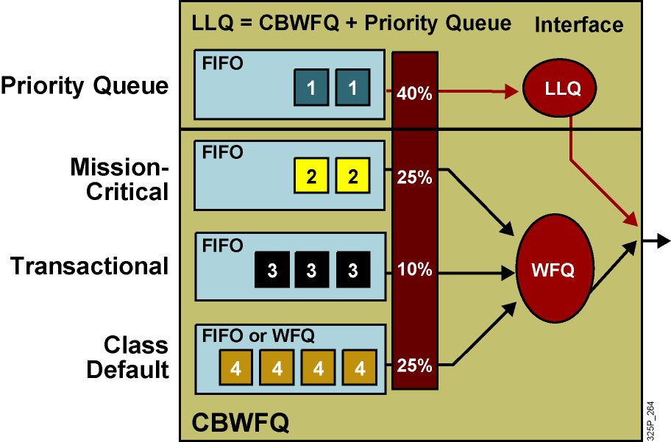
Queuing Methods Combined
Basic methods are combined to create more versatile queuing mechanisms.

Slide 4
Class-Based Weighted Fair Queuing

Slide 5
Class-Based Weighted Fair Queuing
  CBWFQ is a mechanism that is used to guarantee bandwidth to classes.
  CBWFQ extends the standard WFQ functionality to provide support for user-defined traffic classes:
    Classes are based on user-defined match criteria.
    Packets satisfying the match criteria for a class constitute the traffic for that class.
  A queue is reserved for each class, and traffic belonging to a class is directed to that class queue.

Slide 6
CBWFQ Architecture and Benefits

Slide 7
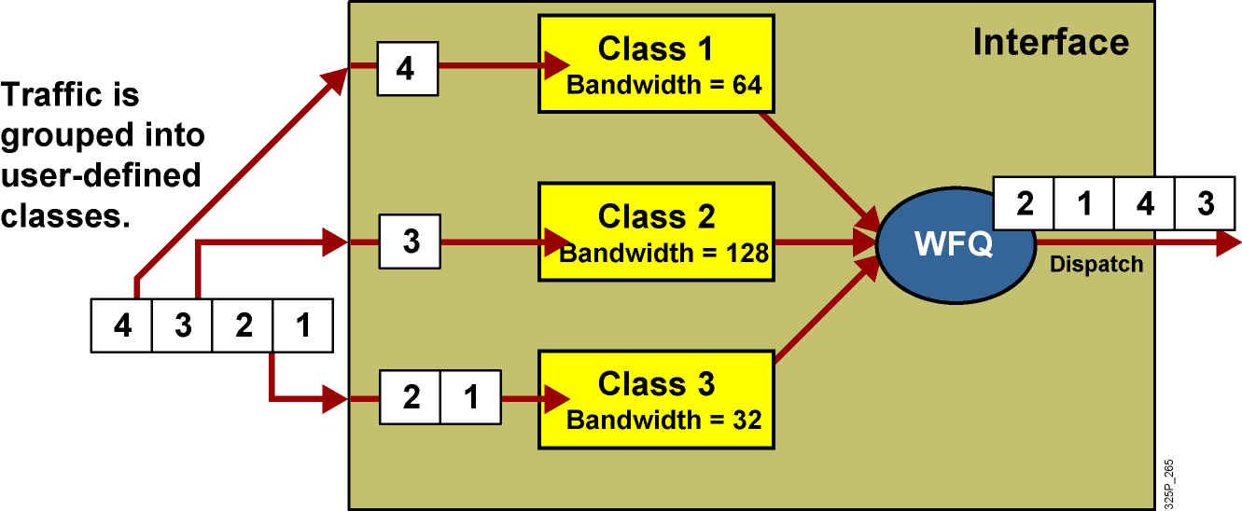
CBWFQ Architecture

Slide 8
Classification
  Classification uses class maps.
  Availability of certain classification options depends on the Cisco IOS version.
  Some classification options depend on type of interface and encapsulation where service policy is used.
  For example:
    Matching on Frame Relay discard-eligible bits can be used only on interfaces with Frame Relay encapsulation.
    Matching on MPLS experimental bits has no effect if MPLS is not enabled.
    Matching on ISL priority bits has no effect if ISL is not used.

Slide 9
Scheduling
  CBWFQ guarantees bandwidth according to weights assigned to traffic classes.
  Weights are internally calculated from bandwidth or its percentage.
  Bandwidth availability can be defined by specifying:
    Bandwidth (in kbps)
    Percentage of bandwidth (percentage of available interface bandwidth)
    Percentage of remaining available bandwidth
  One service policy can not have mixed types of weights.
  The show interface command can be used to display the available bandwidth.

Slide 10
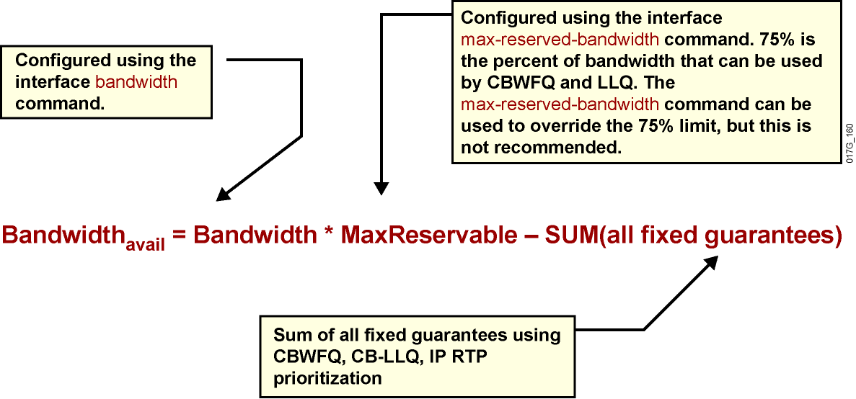
Available Bandwidth
Available bandwidth is calculated according to the following formula:

Slide 11
CBWFQ Benefits and Drawbacks
Benefits | Custom-defined classifications Minimum bandwidth allocation Finer granularity and scalability
Drawback | Voice traffic can still suffer unacceptable delay.

Slide 12
Configuring and Monitoring CBWFQ

Slide 13
Configuring CBWFQ
router(config-pmap-c)#
bandwidth bandwidth
Allocates a fixed amount of bandwidth to a class.
Sets the value in kilobits per second.
router(config-pmap-c)#
bandwidth percent percent
Allocates a percentage of bandwidth to a class.
The configured (or default) interface bandwidth is used to calculate the guaranteed bandwidth.
router(config-pmap-c)#
bandwidth remaining percent percent
Allocates a percentage of available bandwidth to a class.

Slide 14
Configuring CBWFQ (Cont.)
router(config-pmap-c)#
queue-limit queue-limit
Sets the maximum number of packets that this queue can hold.
The default maximum is 64.
router(config-pmap-c)#
fair-queue [number-of-dynamic-queues]
The class-default class can be configured to use WFQ.
The number of dynamic queues is a power of 2 in the range from 16 to 4096, specifying the number of dynamic queues.

Slide 15
Example of CBWFQ
Router(config)#access-list 101 permit udp host 10.10.10.10 host 10.10.10.20 range 16384 20000
Router(config-if)#access-list 102 permit udp host 10.10.10.10 host 10.10.10.20 range 53000 56000
Router(config)#class-map class1
Router(config-cmap)#match access-group 101
Router(config-cmap)#exit
Router(config)#class-map class2
Router(config-cmap)#match access-group 102
Router(config-cmap)#exit
Router(config)#policy-map policy1
Router(config-pmap)#class class1
Router(config-pmap-c)#bandwidth 3000
Router(config-pmap-c)#queue-limit 30
Router(config-pmap-c)#exit
Router(config-pmap)#class class2
Router(config-pmap-c)#bandwidth 2000
Router(config-pmap-c)#exit
Router(config-pmap)#class class-default
Router(config-pmap-c)#fair-queue
Router(config-pmap-c)#exit

Slide 16
Monitoring CBWFQ
router>
show policy-map interface [interface]
Displays parameters and statistics of CBWFQ
Router#show policy-map interface
FastEthernet0/0
Service-policy output: policy1
Class-map: class1 (match-all)
0 packets, 0 bytes
5 minute offered rate 0 bps, drop rate 0 bps
Match: access-group 101
Queueing
Output Queue: Conversation 265
Bandwidth 3000 (kbps) Max Threshold 30 (packets)
(pkts matched/bytes matched) 0/0
(depth/total drops/no-buffer drops) 0/0/0
<...part of the output omitted...>
Class-map: class-default (match-any)
0 packets, 0 bytes
5 minute offered rate 0 bps, drop rate 0 bps
Match: any
Queueing
Flow Based Fair Queueing
<...rest of the output omitted...>

Slide 17
Low Latency Queuing

Slide 18
Low Latency Queuing
  A priority queue is added to CBWFQ for real-time traffic.
  High-priority classes are guaranteed:
    Low-latency propagation of packets
    Bandwidth
  High-priority classes are also policed when congestion occurs—they then cannot exceed their guaranteed bandwidth.
  Lower-priority classes use CBWFQ.

Slide 19
LLQ Architecture and Benefits

Slide 20
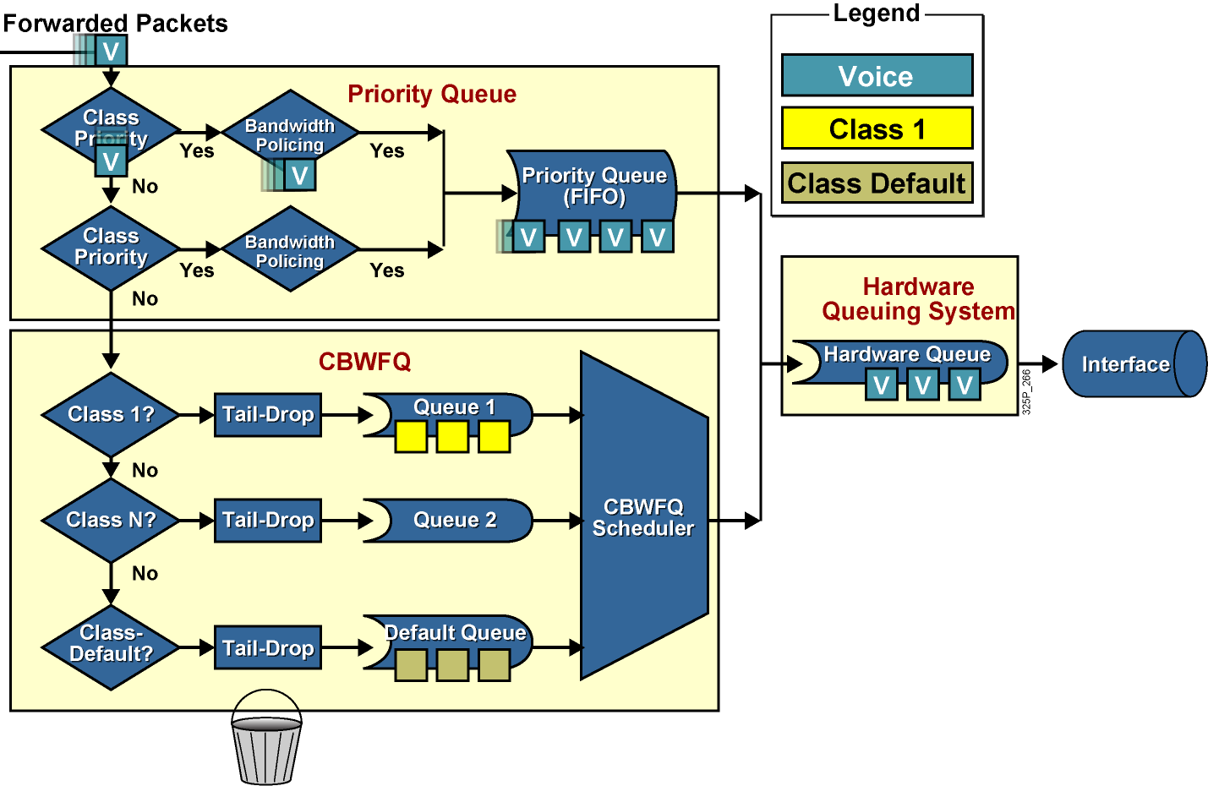
LLQ Architecture

Slide 21
LLQ Benefits
  High-priority classes are guaranteed:
    Low-latency propagation of packets
    Bandwidth
  Configuration and operation are consistent across all media types.
  Entrance criteria to a class can be defined by an ACL.
    Not limited to UDP ports as with IP RTP priority
    Defines trust boundary to ensure simple classification and entry to a queue

Slide 22
Configuring and Monitoring LLQ

Slide 23
Configuring LLQ
router(config-pmap-c)#
priority bandwidth [burst]
Allocates a fixed amount of bandwidth (in kilobits per second) to a class and ensures expedited forwarding.
Traffic exceeding the specified bandwidth is dropped if congestion exists; otherwise, policing is not used.
router(config-pmap-c)#
priority percent percentage [burst]
Allocates a percentage of configured or default interface bandwidth to a class and ensures expedited forwarding.
Traffic exceeding the specified bandwidth is dropped if congestion exists.

Slide 24
Configuring LLQ (Cont.)
class-map voip
match ip precedence 5
!
class-map mission-critical
match ip precedence 3 4
!
class-map transactional
match ip precedence 1 2
!
policy-map Policy1
class voip
priority percent 10
class mission-critical
bandwidth percent 30
class transactional
bandwidth percent 20
class class-default
fair-queue

Slide 25
Monitoring LLQ
router>
show policy-map interface interface
Displays the packet statistics of all classes that are configured for all service policies on the specified interface or subinterface
router>show policy-map interface fastethernet 0/0
FastEthernet0/0
Service-policy output: LLQ
Class-map: LLQ (match-any)
0 packets, 0 bytes
5 minute offered rate 0 bps, drop rate 0 bps
Match: any
Weighted Fair Queueing
Strict Priority
Output Queue: Conversation 264
Bandwidth 1000 (kbps) Burst 25000 (Bytes)
(pkts matched/bytes matched) 0/0
(total drops/bytes drops) 0/0
Class-map: class-default (match-any)
0 packets, 0 bytes
5 minute offered rate 0 bps, drop rate 0 bps
Match: any

Slide 26
Summary
  Basic queuing mechanisms can be used to build more advanced queuing mechanisms such as CBWFQ and LLQ.
  CBWFQ is a mechanism that is used to overcome the deficiencies of WFQ.
  CBWFQ extends the standard WFQ functionality to provide support for traffic classes. Classes are based on user-defined match criteria.
  CBWFQ provides a minimum bandwidth guarantee according to traffic classes.

Slide 27
Summary (Cont.)
  LLQ is implemented within CBWFQ by the addition of a priority queue that is serviced using a strict-priority scheduler for time-sensitive traffic such as voice and video.
  The LLQ scheduler guarantees both low latency and bandwidth for the traffic in the priority queue.
  In the event of congestion, if the priority-queue traffic exceeds the bandwidth guarantee, a congestion-aware policer is used to drop the exceeds traffic.

Slide 28


