Slide 1
Implement the DiffServ QoS Model
Introducing Congestion Avoidance

Slide 2

Managing Interface Congestion with
Tail Drop

Slide 3
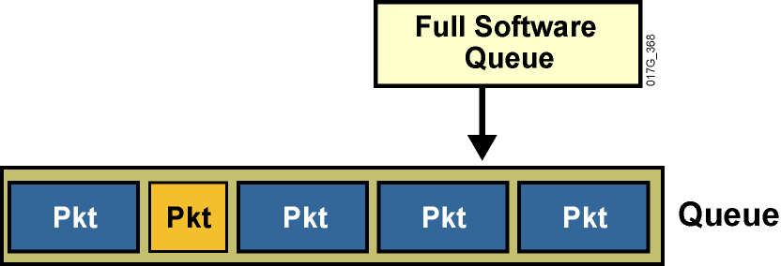
Managing Interface Congestion with Tail Drop
Router interfaces experience congestion when the output queue is full:
  Additional incoming packets are dropped.
  Dropped packets may cause significant application performance degradation.
  Tail drop has significant drawbacks.

Slide 4
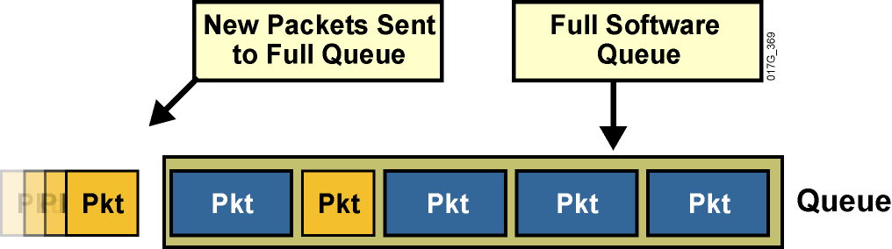
Managing Interface Congestion with Tail Drop
Router interfaces experience congestion when the output queue is full:
  Additional incoming packets are dropped.
  Dropped packets may cause significant application performance degradation.
  Tail drop has significant drawbacks.

Slide 5
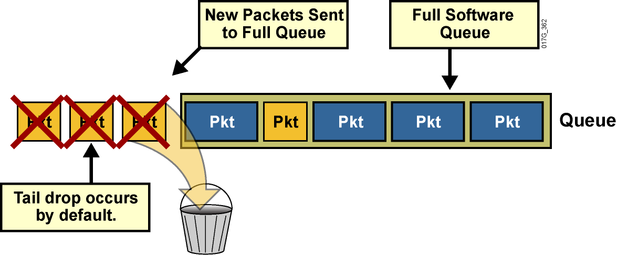
Managing Interface Congestion with Tail Drop
Router interfaces experience congestion when the output queue is full:
  Additional incoming packets are dropped.
  Dropped packets may cause significant application performance degradation.
  Tail drop has significant drawbacks.

Slide 6
Tail Drop Limitations

Slide 7
Tail Drop Limitations
Tail drop should be avoided because it contains significant flaws:
  TCP synchronization
  TCP starvation
  No differentiated drop

Slide 8
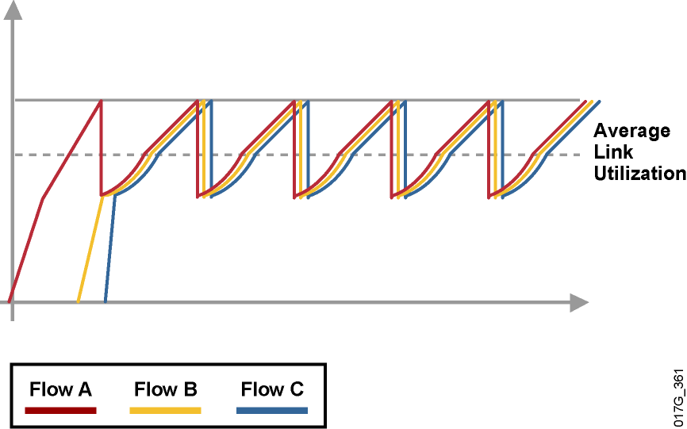
TCP Synchronization
  Multiple TCP sessions start at different times.
  TCP window sizes are increased.
  Tail drops cause many packets of many sessions to be dropped at the same time.
  TCP sessions restart at the same time (synchronized).

Slide 9
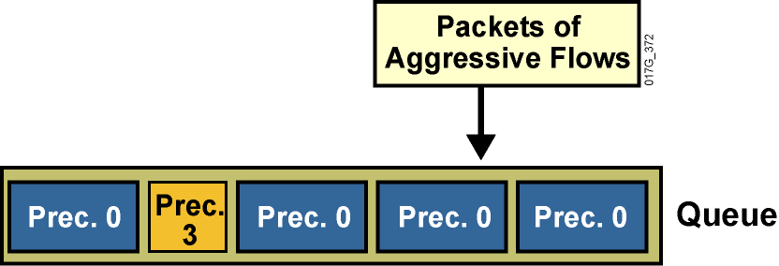
TCP Delay, Jitter, and Starvation
  Constant high buffer usage (long queue) causes delay.
  Variable buffer usage causes jitter.
  More aggressive flows can cause other flows to starve.
  No differentiated dropping occurs.

Slide 10
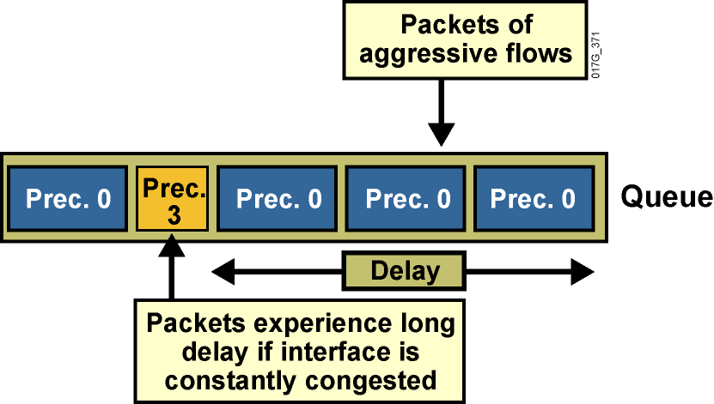
TCP Delay, Jitter, and Starvation
  Constant high buffer usage (long queue) causes delay.
  Variable buffer usage causes jitter.
  More aggressive flows can cause other flows to starve.
  No differentiated dropping occurs.

Slide 11
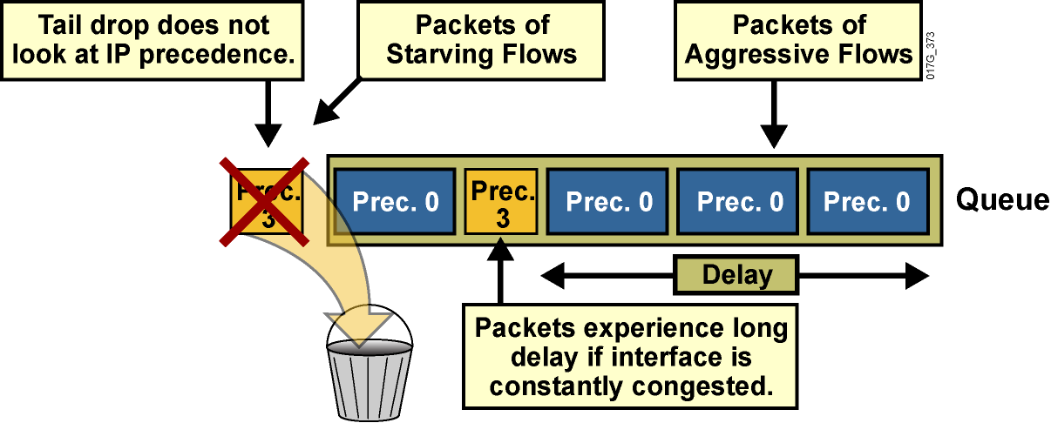
TCP Delay, Jitter, and Starvation
  Constant high buffer usage (long queue) causes delay.
  Variable buffer usage causes jitter.
  More aggressive flows can cause other flows to starve.
  No differentiated dropping occurs.

Slide 12
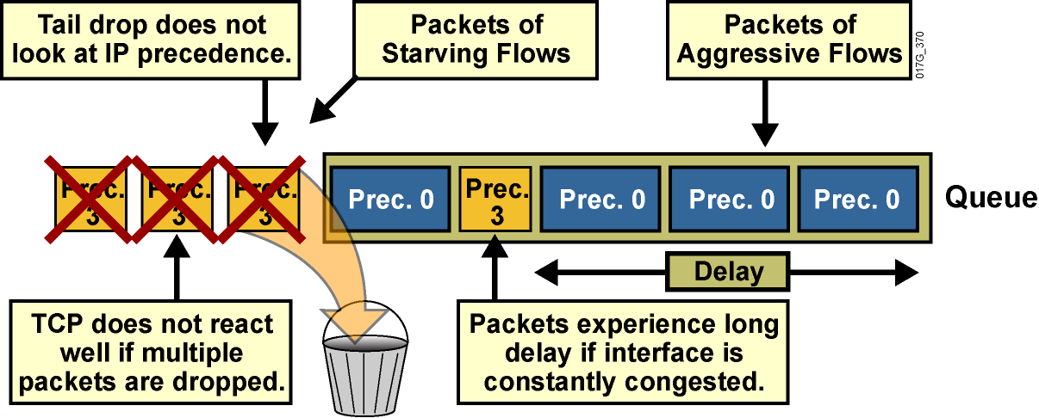
TCP Delay, Jitter, and Starvation
  Constant high buffer usage (long queue) causes delay.
  Variable buffer usage causes jitter.
  More aggressive flows can cause other flows to starve.
  No differentiated dropping occurs.

Slide 13
Random Early Detection

Slide 14
Random Early Detection
  Tail drop can be avoided if congestion is prevented.
  RED is a mechanism that randomly drops packets before a queue is full.
  RED increases drop rate as the average queue size increases.
  RED result:
    TCP sessions slow to the approximate rate of output-link bandwidth.
    Average queue size is small (much less than the
    maximum queue size).
    TCP sessions are desynchronized by random drops.

Slide 15
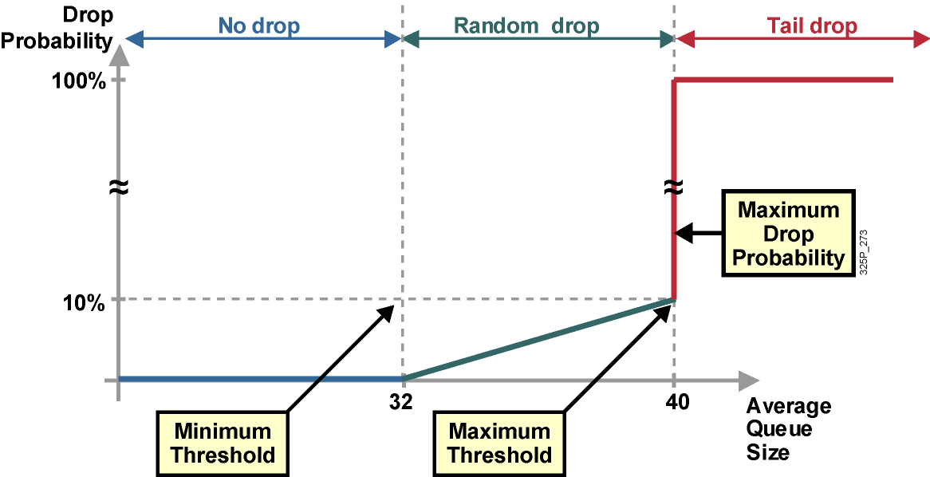
RED Profiles

Slide 16
RED Modes
  RED has three modes:
    No drop: When the average queue size is between 0 and the minimum threshold
    Random drop: When the average queue size is between the minimum and the maximum threshold
    Full drop (tail drop): When the average queue size is above the maximum threshold
  Random drop should prevent congestion (prevent tail drops).

Slide 17
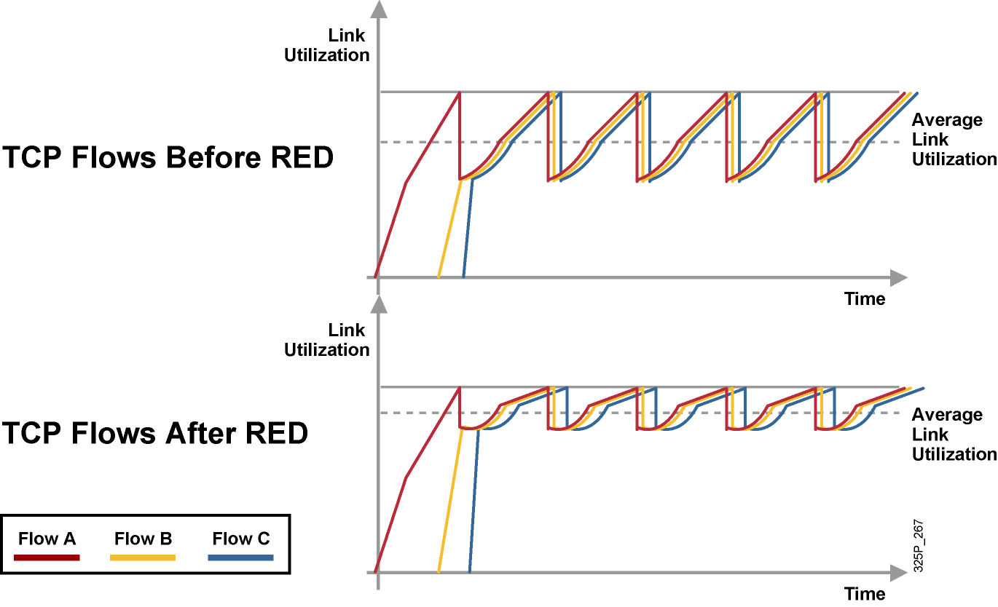
TCP Traffic Before and After RED

Slide 18
Weighted Random Early Detection

Slide 19
Weighted Random Early Detection
  WRED can use multiple different RED profiles.
  Each profile is identified by:
    Minimum threshold
    Maximum threshold
    Mark probability denominator
  WRED profile selection is based on:
    IP precedence (8 profiles)
    DSCP (64 profiles)
  WRED drops less important packets more aggressively than more important packets.
  WRED can be applied at the interface, VC, or class level.

Slide 20
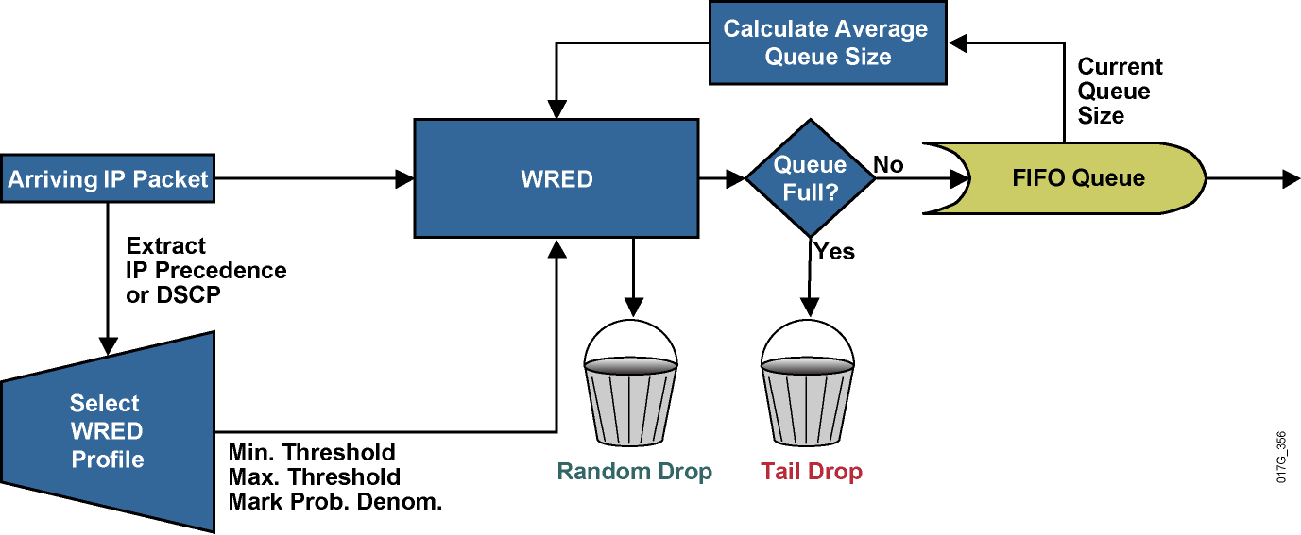
WRED Building Blocks

Slide 21
Class-Based WRED
  Class-based WRED is available when configured in combination with CBWFQ.
  Using CBWFQ with WRED allows the implementation of DiffServ assured forwarding PHB.
  Class-based configuration of WRED is identical to stand-alone WRED.

Slide 22
WRED Profiles

Slide 23
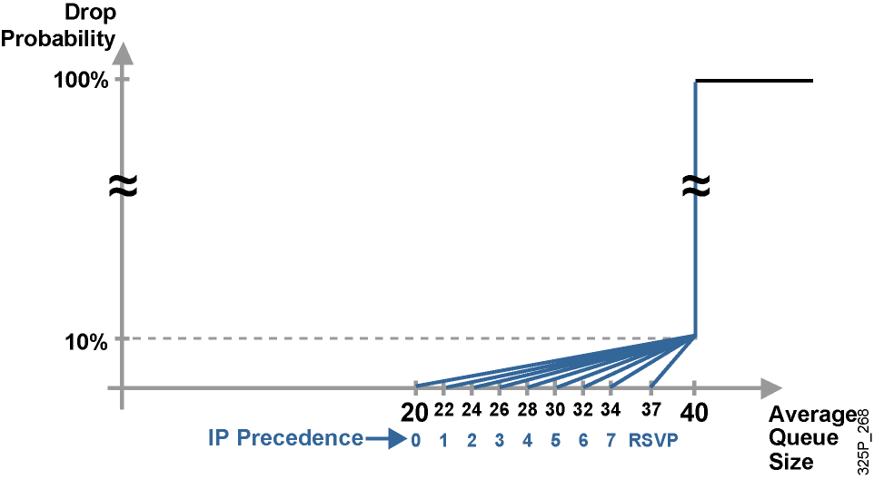
IP Precedence and Class Selector Profiles

Slide 24
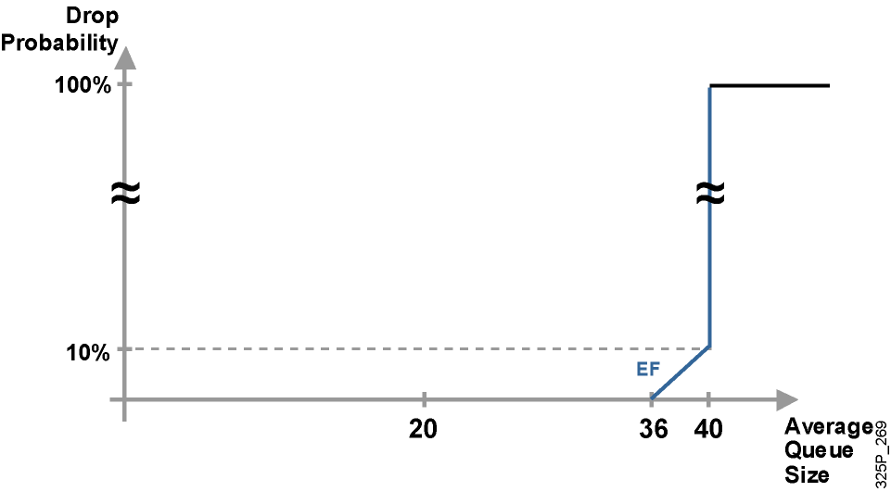
DSCP-Based WRED (Expedited Forwarding)

Slide 25
Configuring CBWRED

Slide 26
Configuring CBWRED
router(config-pmap-c)#
random-detect
Enables IP precedence-based WRED in the selected class within the service policy configuration mode.
Default service profile is used.
Command can be used at the interface, perVC (with random-detect-group), or at the class level (service policy).
Precedence-based WRED is the default mode.
WRED treats non-IP traffic as precedence 0.
policy-map Policy1
class mission-critical
bandwidth percent 30
random-detect
class transactional
bandwidth percent 20
random-detect
class class-default
fair-queue
random-detect

Slide 27
Changing the WRED Traffic Profile
router(config-pmap-c)#
random-detect precedence precedence min-threshold max-threshold mark-prob-denominator
Changes WRED profile for specified IP precedence value.
Packet drop probability at maximum threshold is:
1 / mark-prob-denominator
Nonweighted RED is achieved by using the same WRED profile for all precedence values.

Slide 28
CBWFQ Using IP Precedence with
CBWRED: Example
  Enable CBWFQ to prioritize traffic according to the following requirements:
    Class mission-critical is marked with IP precedence values 3 and 4 (3 is high drop, 4 is low drop) and should get 30% of interface bandwidth.
    Class bulk is marked with IP precedence values 1 and 2
    (1 is high drop, 2 is low drop) and should get 20% of interface bandwidth.
    All other traffic should be per-flow fair-queued.
  Use differentiated WRED to prevent congestion in all three classes.

Slide 29
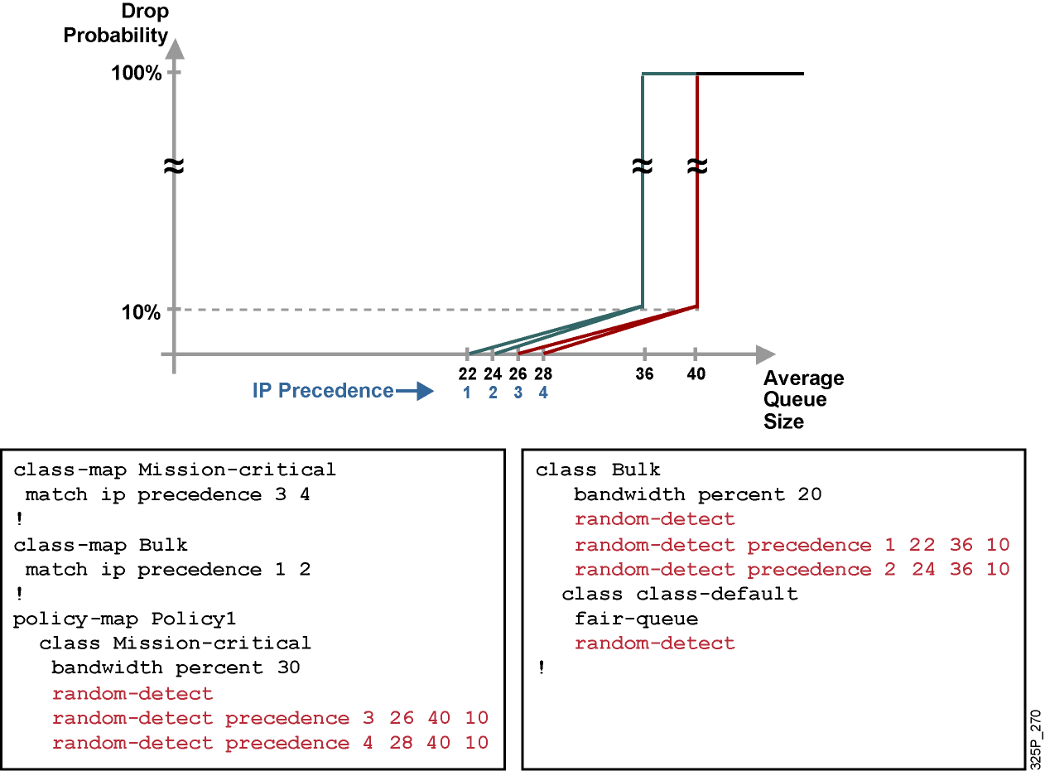
CBWFQ Using IP Precedence with
CBWRED: Example (Cont.)

Slide 30
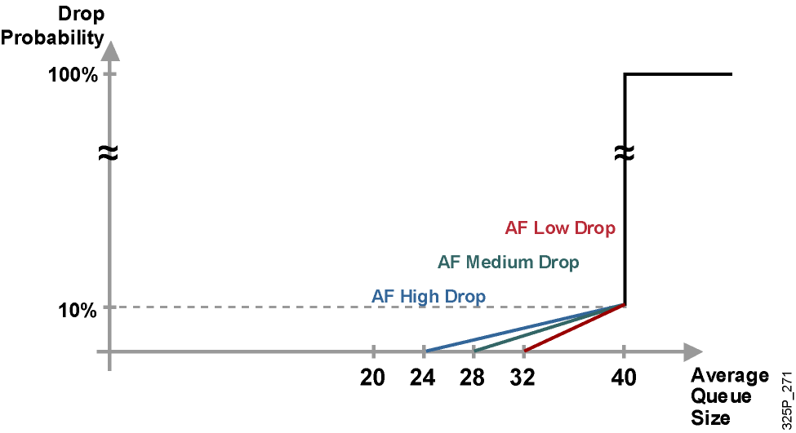
WRED Profiles: DSCP-Based
WRED (Assured Forwarding)

Slide 31
Configuring DSCP-Based CBWRED
router(config-pmap-c)#
random-detect dscp-based
  Enables DSCP-based WRED.
  Command can be used at the interface, perVC
  (with random detect group), or at the class level
  (service policy).
  Default service profile is used.
  The WRED random-detect command and the WFQ queue-limit command are mutually exclusive for class policy.

Slide 32
Changing the WRED Traffic Profile
router(config-pmap-c)#
random-detect dscp dscpvalue min-threshold max-threshold mark-prob-denominator
  Changes WRED profile for specified DSCP value
  Packet drop probability at maximum threshold is: 1 / mark-prob-denominator

Slide 33
CBWRED Using DSCP with CBWFQ: Example
  Enable CBWFQ to prioritize traffic according to the following requirements:
    Class mission-critical is marked using DSCP AF2 and should get 30% of interface bandwidth.
    Class bulk is marked using DSCP AF1 and should get 20% of interface bandwidth.
    All other traffic should be per-flow fair-queued.
  Use differentiated WRED to prevent congestion in all three classes.
  Make sure that the new configurations still conform to the design and implementation from the previous example.

Slide 34
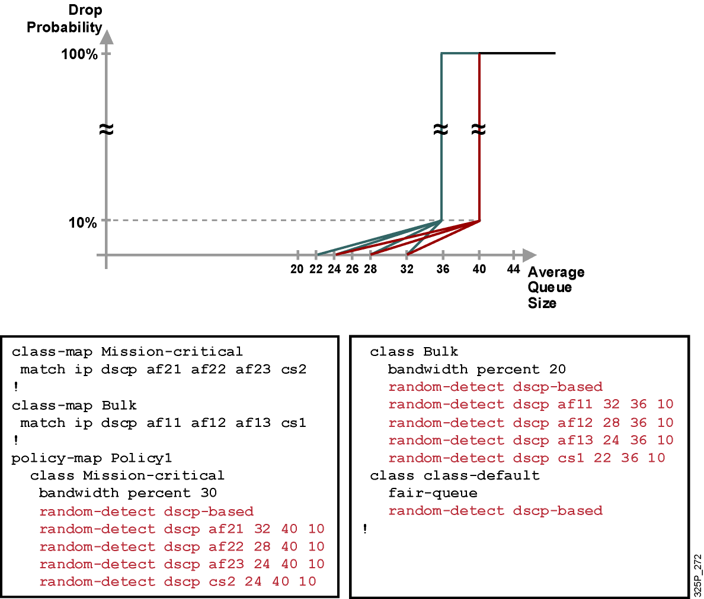
CBWRED Using DSCP with CBWFQ: Example (Cont.)

Slide 35
Monitoring CBWRED

Slide 36
Monitoring CBWRED
router#
show policy-map interface interface-name
Displays the configuration of all classes configured for all service policies on the specified interface
router#show policy-map interface Ethernet 0/0
Ethernet0/0
Service-policy output: Policy1
Class-map: Mission-critical (match-all)
0 packets, 0 bytes 5 minute offered rate 0 bps, drop rate 0 bps
Match: ip precedence 2 Match: ip dscp 18 20 22
Weighted Fair Queueing
Output Queue: Conversation 265
Bandwidth 30 (%) Bandwidth 3000 (kbps)
(pkts matched/bytes matched) 0/0
(depth/total drops/no-buffer drops) 0/0/0
exponential weight: 9
mean queue depth: 0
Dscp Transmitted Random drop Tail drop Minimum Maximum Mark
(Prec) pkts/bytes pkts/bytes pkts/bytes threshold threshold probability
0(0) 0/0 0/0 0/0 20 40 1/10
1 0/0 0/0 0/0 22 40 1/10
2 0/0 0/0 0/0 24 40 1/10

Slide 37
Summary
  TCP uses windowing and the TCP slow-start mechanism as its means of controlling congestion.
  Tail drop causes significant issues, including TCP synchronization, starvation, and delay. TCP synchronization decreases the average utilization of network links.
  RED is a mechanism that randomly drops packets before a queue is full, preventing congestion and avoiding tail drop.
  RED operates by increasing the rate at which packets are dropped from queues as the average queue size increases.

Slide 38
Summary (Cont.)
  RED has three modes of operation: no drop, random drop, and full drop (tail drop).
  With RED, TCP global synchronization is eliminated and the average link utilization increases.
  WRED combines RED with IP precedence or DSCP and performs packet dropping based on IP precedence or DSCP markings.
  Each WRED profile defines the minimum and maximum threshold and the maximum drop probability. Profiles are already defined by default for IP precedence and DSCP.

Slide 39


