Slide 1
Implement the DiffServ QoS Model
Introducing Traffic Policing and Shaping

Slide 2

Traffic Policing and Shaping Overview

Slide 3
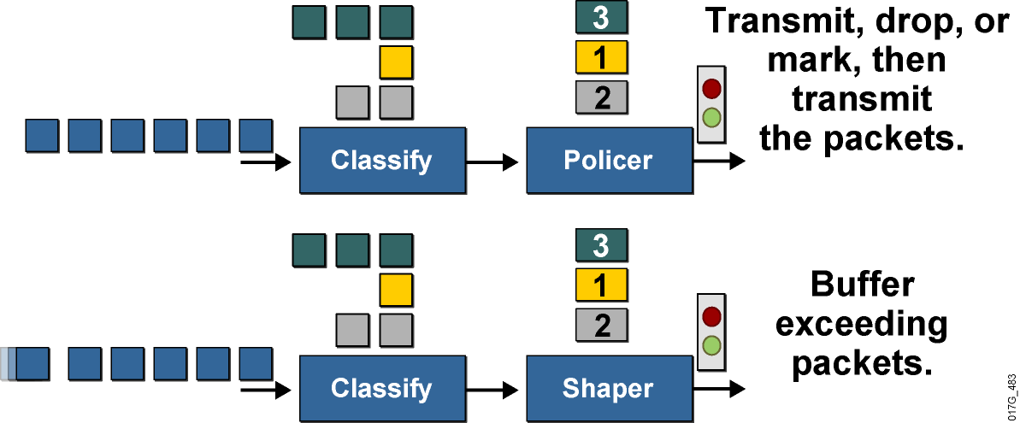
Traffic Policing and Shaping Overview
  These mechanisms must classify packets before policing or shaping the traffic rate.
  Traffic policing typically drops or marks excess traffic to stay within a traffic rate limit.
  Traffic shaping queues excess packets to stay within the desired traffic rate.

Slide 4
Why Use Policing?
  To limit access to resources when high-speed access is used but not desired (subrate access)
  To limit the traffic rate of certain applications or traffic classes
  To mark down (recolor) exceeding traffic at Layer 2 or
  Layer 3

Slide 5
Why Use Shaping?
  To prevent and manage congestion in ATM, Frame Relay, and Metro Ethernet networks, where asymmetric bandwidths are used along the traffic path
  To regulate the sending traffic rate to match the subscribed (committed) rate in ATM, Frame Relay, or Metro Ethernet networks
  To implement shaping at the network edge

Slide 6
Why Use Traffic Conditioners?

Slide 7
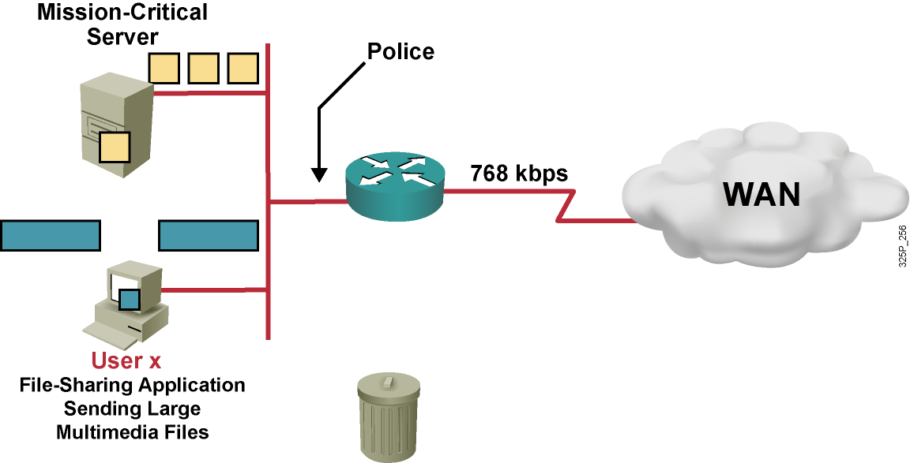
Traffic Policing Example
  Do not rate-limit traffic from mission-critical server.
  Rate-limit file-sharing application traffic to 56 kbps.

Slide 8
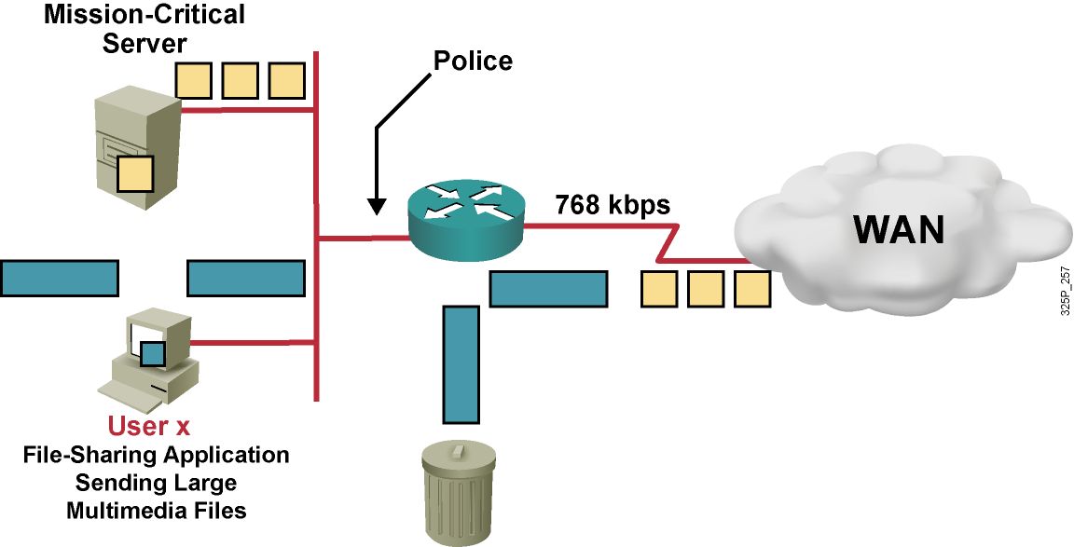
Traffic Policing Example
  Do not rate-limit traffic from mission-critical server.
  Rate-limit file-sharing application traffic to 56 kbps.

Slide 9
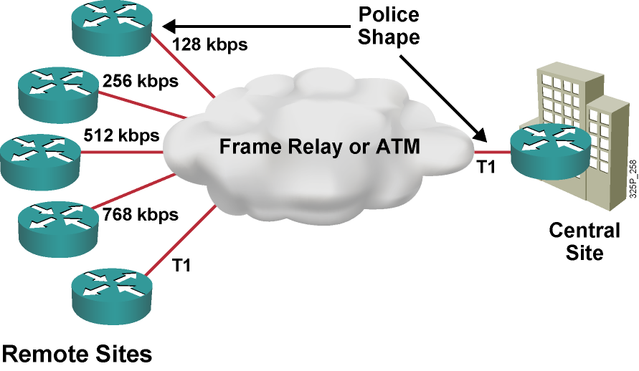
Traffic Policing and Shaping Example

Slide 10
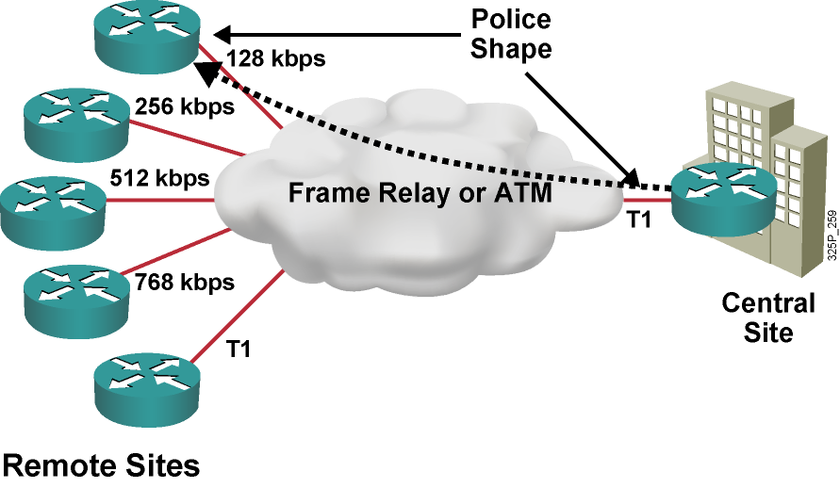
Traffic Policing and Shaping Example
  Central to remote site speed mismatch

Slide 11

Traffic Policing and Shaping Example
  Central to remote site speed mismatch
  Remote to central site oversubscription

Slide 12
Traffic Policing and Shaping Example
  Central to remote site speed mismatch
  Remote to central site oversubscription
  Both situations result in buffering and in delayed or dropped packets.

Slide 13
Policing vs. Shaping

Slide 14
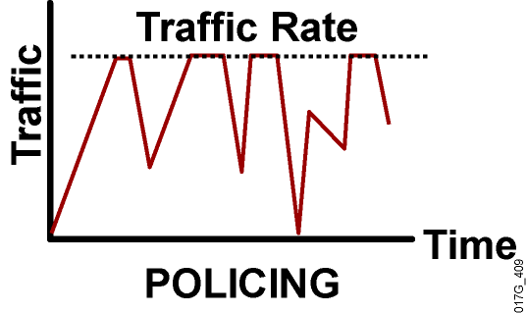
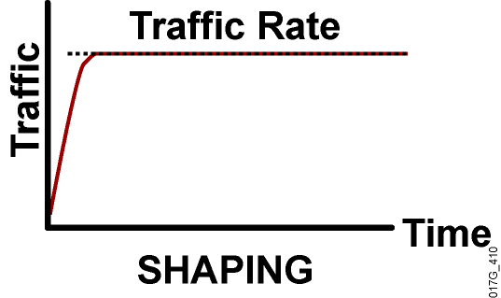
Policing vs. Shaping
  Incoming and outgoing directions.
  Out-of-profile packets are dropped.
  Dropping causes TCP retransmits.
  Policing supports packet marking or
  re-marking.
  Outgoing direction only.
  Out-of-profile packets are queued until a buffer gets full.
  Buffering minimizes TCP retransmits.
  Marking or re-marking not supported.
  Shaping supports interaction with Frame Relay congestion indication.

Slide 15
Measuring Traffic Rates

Slide 16
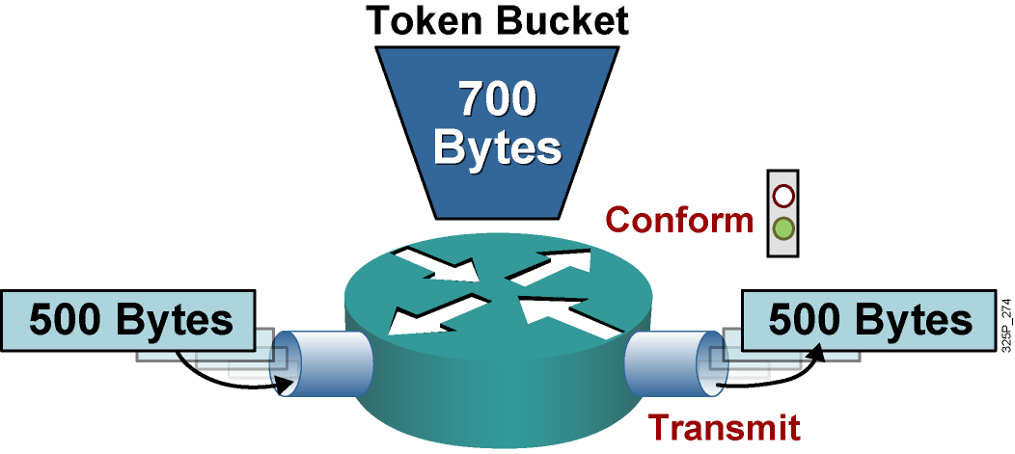
Single Token Bucket
If sufficient tokens are available (conform action):
  Tokens equivalent to the packet size are removed from the bucket.
  The packet is transmitted.

Slide 17
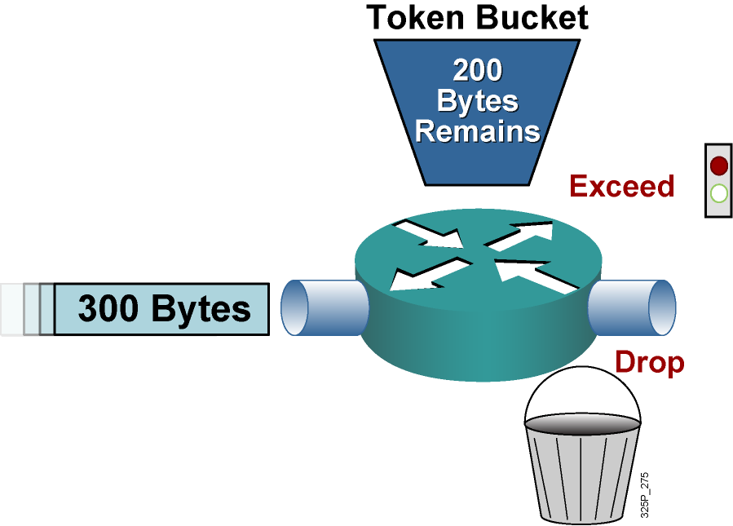
Single Token Bucket (Cont.)
If sufficient tokens are not available (exceed action):
  Drop (or mark) the packet.

Slide 18
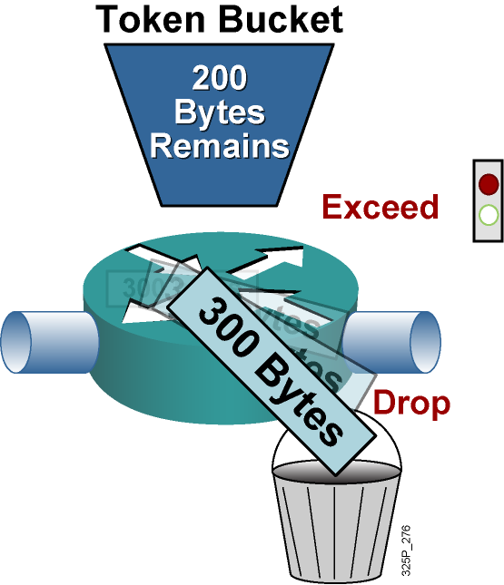
Single Token Bucket (Cont.)
If sufficient tokens are not available (exceed action):
  Drop (or mark) the packet.

Slide 19
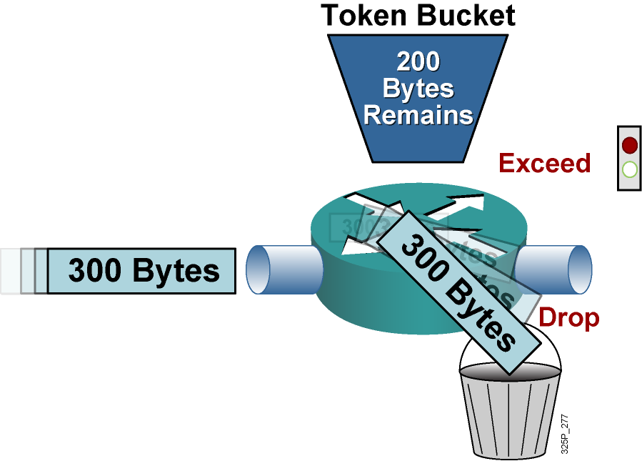
Single Token Bucket (Cont.)
If sufficient tokens are not available (exceed action):
  Drop (or mark) the packet.

Slide 20
Single Token Bucket Class-Based Policing

Slide 21
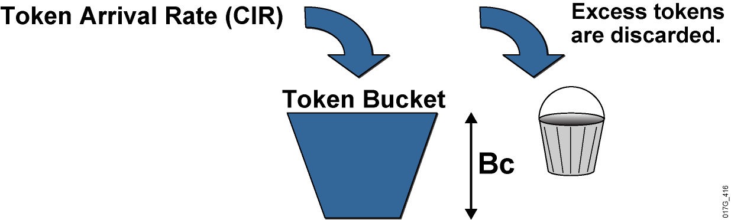
Single Token Bucket Class-Based Policing
  Bc is normal burst size.
  Tc is the time interval.
  CIR is the committed information rate.
  CIR = Bc / Tc

Slide 22
Cisco IOS Traffic Policing and Shaping Mechanisms

Slide 23
Cisco IOS Traffic Policing Mechanism
 | Class-Based Policing
Enable method | Enabled in policy map
Conditions Actions | Conform, exceed, violate Drop, set, transmit
Implementations | Single or dual token bucket, single- or dual-rate policing, multiactions

Slide 24
Cisco IOS Traffic-Shaping Mechanisms
 | Class-Based Shaping | FRTS
Restriction | Shaper for any subinterface | Shaper for Frame Relay only
Classification | Class-based | Per DLCI or subinterface
Link fragmentation and interleaving | No support for FRF.12 | Supports FRF.12
Frame Relay Support | Understands BECN and FECN | Understands BECN and FECN
Configuration | Supported via MQC | Supported via MQC

Slide 25
Applying Traffic Conditioners

Slide 26
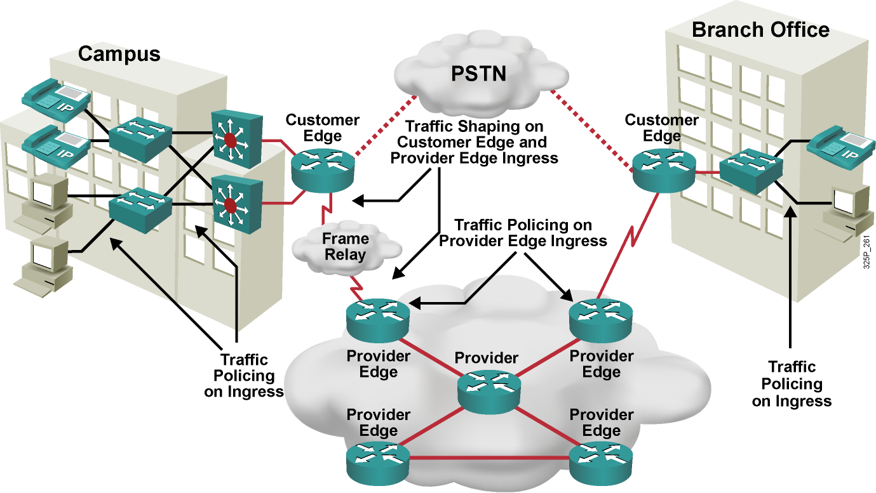
Applying Rate Limiting

Slide 27
Summary
  Traffic shaping and policing are mechanisms that use classification to limit traffic rate.
  Traffic shaping queues excess packets to stay within the contractual rate. Traffic policing typically drops excess traffic to stay within the limit; alternatively, it can re-mark, then send excess traffic.
  Both traffic policing and shaping ensure that traffic does not exceed a bandwidth limit, but they have different impacts on the traffic.
  The token bucket is a mathematical model that is used by routers and switches to regulate traffic flow.
  With a single token bucket model, the measured traffic rate can conform to or exceed the specified traffic rate.
  Class-based policing is the latest Cisco IOS traffic-policing mechanism. Class-based shaping and FRTS are two Cisco IOS traffic-shaping mechanisms.
  Policing is often implemented at the access or distribution layer, shaping is implemented at the WAN edge.

Slide 28
