Slide 1
Implement the DiffServ QoS Model
Understanding WAN Link Efficiency Mechanisms

Slide 2

Link Efficiency Mechanisms Overview

Slide 3
Compression
  Data compression works by the identification of patterns in a stream of data.
  Basic elements of compression:
    Remove redundancy as much as possible.
    There is a theoretical limit, known as Shannon's limit.
  Many compression algorithms exist, for different purposes:
    MPEG compression for video
    Huffmann compression for text and software
    LZ compression, used in Stacker compression
  Two methods of compression are used:
    Hardware compression
    Software compression

Slide 4
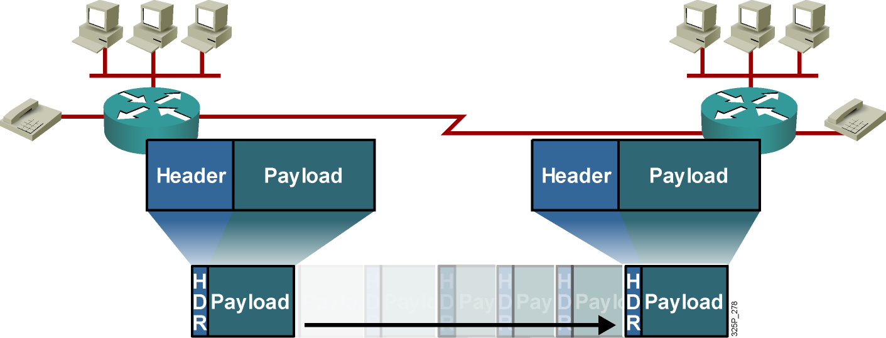
Compression (Cont.)
  Payload compression reduces the size of the payload.
  Header compression reduces the header overhead.
  Compression increases throughput and decreases latency.

Slide 5
Link Efficiency Mechanisms
  Link efficiency mechanisms are often deployed on WAN links to increase the throughput and to decrease delay and jitter.
  Cisco IOS link efficiency mechanisms include:
    Layer 2 payload compression (Stacker, Predictor, MPPC)
    Header compression (TCP, RTP, class-based TCP, and class-based RTP)
    LFI (MLP, FRF.12, and FRF.11.C)

Slide 6
Layer 2 Payload Compression

Slide 7
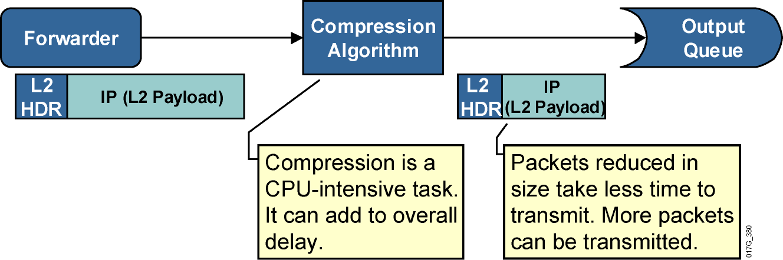
Layer 2 Payload Compression
  Layer 2 payload compression reduces the size of the frame payload.
  Entire IP packet is compressed.
  Software compression can add delay because of its complexity.
  Hardware compression reduces the compression delay.
  Serialization delay is reduced; overall latency might be reduced.

Slide 8
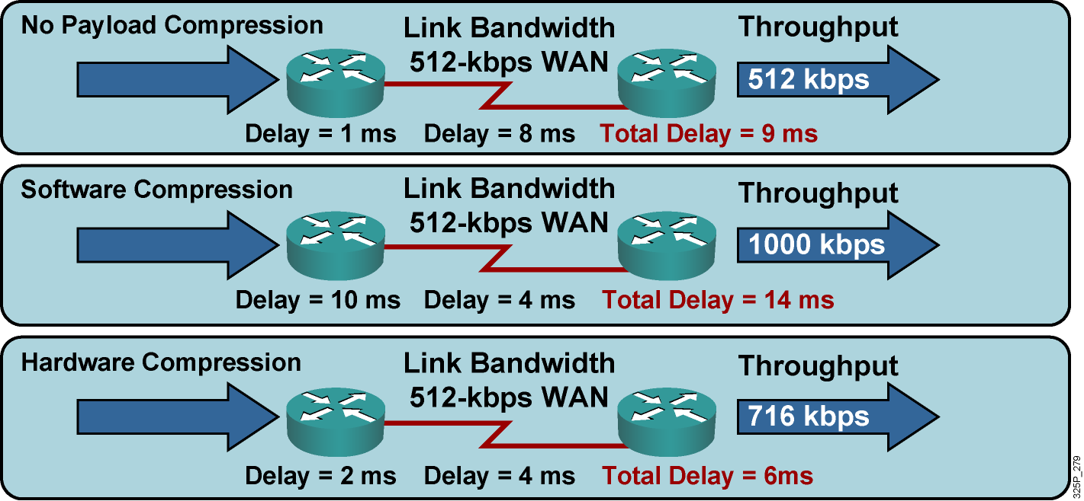
Layer 2 Payload Compression Results
  Compression increases throughput and decreases delay.
  Use hardware compression when possible.
  Examples are Stacker, Predictor, and MPPC.

Slide 9
Header Compression

Slide 10
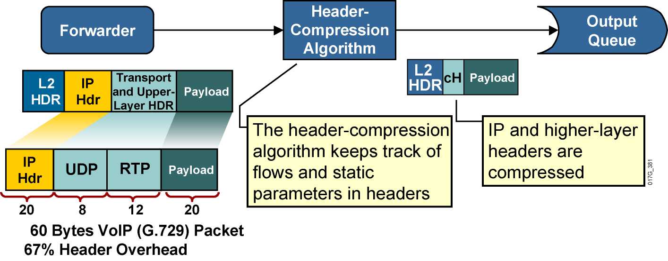
Header Compression

Slide 11
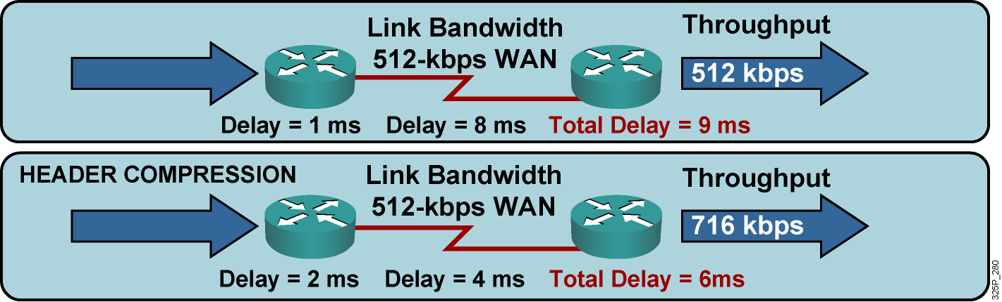
Header Compression Results
Header compression increases compression delay and reduces serialization delay.

Slide 12
Large Packets “Freeze Out” Voice on Slow WAN Links

Slide 13
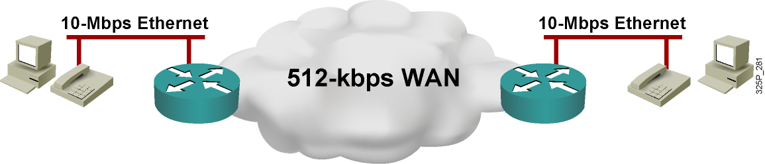
Large Packets “Freeze Out”
Voice on Slow WAN Links
Problems:
  Excessive delay due to slow link and MTU-sized (large) packets
  Jitter (variable delay) due to variable link utilization

Slide 14
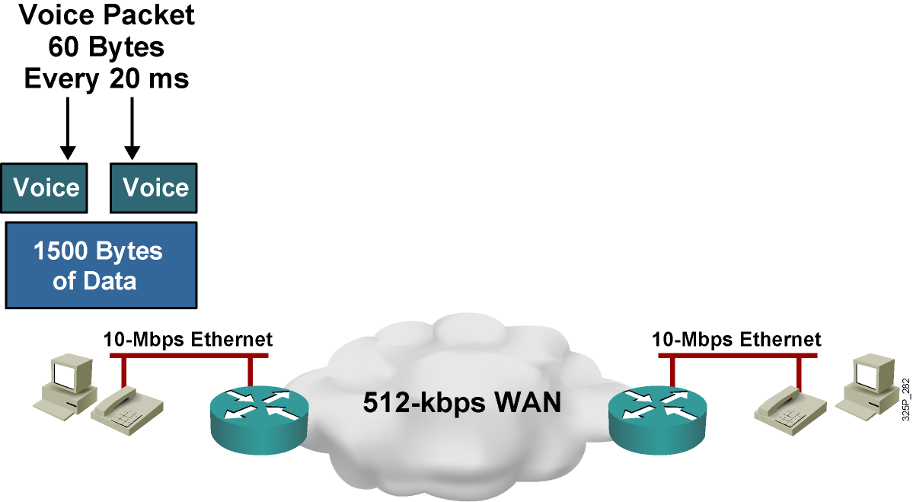
Large Packets “Freeze Out”
Voice on Slow WAN Links
Problems:
  Excessive delay due to slow link and MTU-sized (large) packets
  Jitter (variable delay) due to variable link utilization

Slide 15
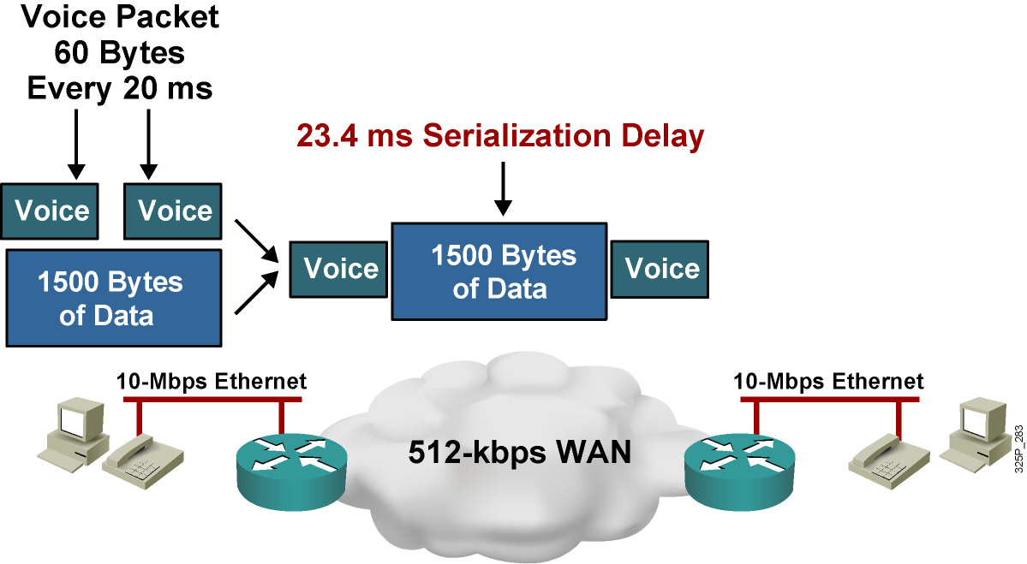
Large Packets “Freeze Out”
Voice on Slow WAN Links
Problems:
  Excessive delay due to slow link and MTU-sized (large) packets
  Jitter (variable delay) due to variable link utilization

Slide 16
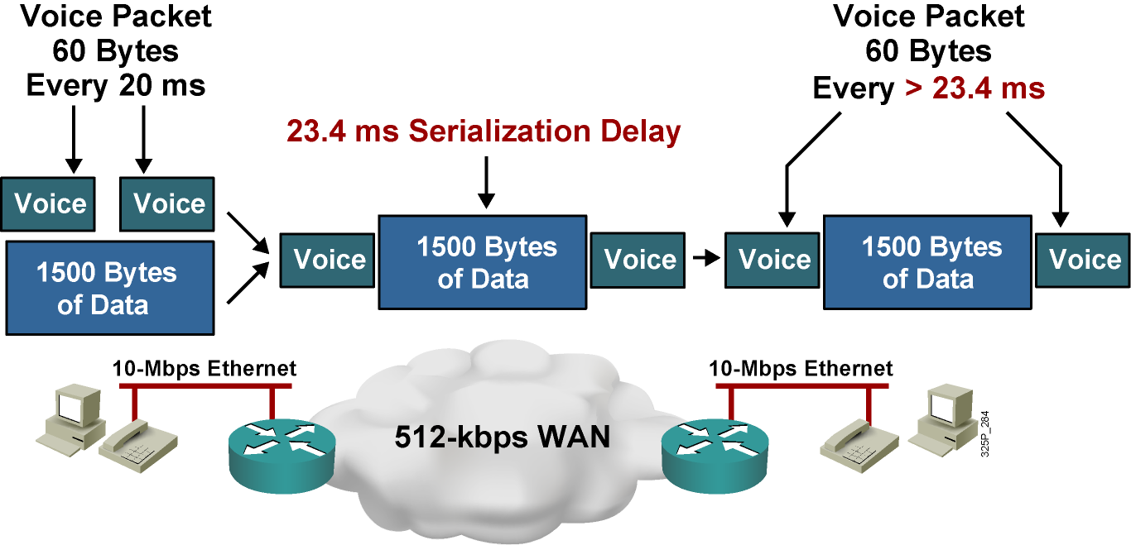
Large Packets “Freeze Out”
Voice on Slow WAN Links
Problems:
  Excessive delay due to slow link and MTU-sized (large) packets
  Jitter (variable delay) due to variable link utilization

Slide 17
Link Fragmentation and Interleaving

Slide 18
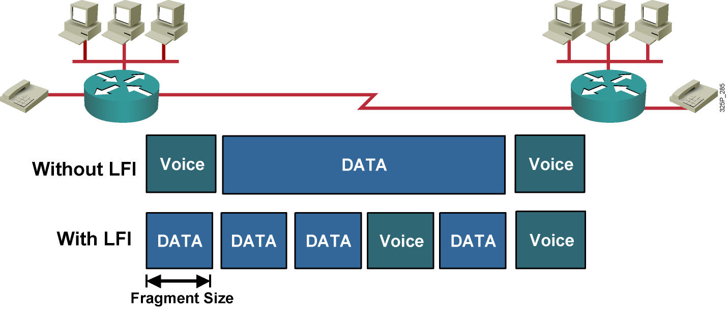
Link Fragmentation and Interleaving
LFI reduces the delay and jitter of small packets (such as VoIP).

Slide 19
Applying Link Efficiency Mechanisms

Slide 20
Applying Link Efficiency Mechanisms
  Identify bottlenecks in the network.
  Calculate Layer 2 and Layer 3 overhead.
  Decide which type of compression to use, such as TCP header compression.
  Enable compression on WAN interfaces.

Slide 21
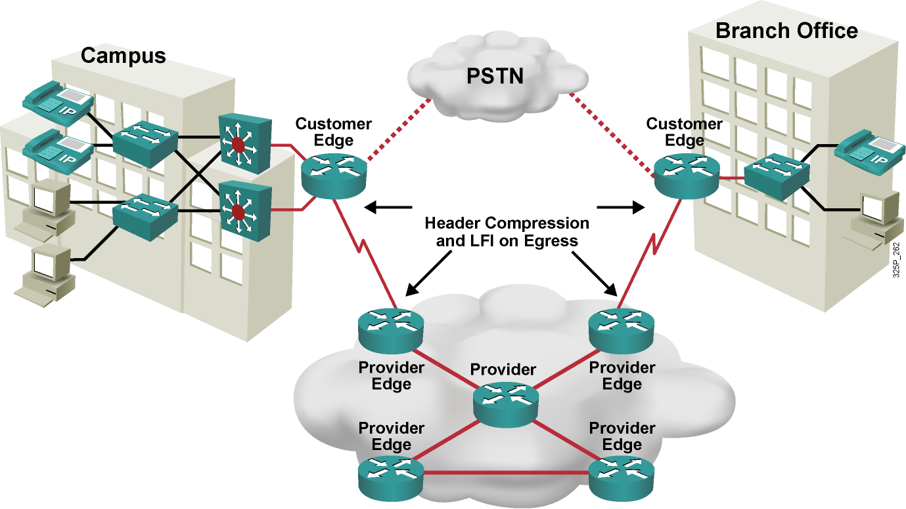
Example

Slide 22
Summary
  Data compression effectively increases bandwidth.
  Link efficiency mechanisms (including Layer 2 payload compression, header compression, and LFI) deployed on WAN links can increase throughput and decrease delay and jitter.
  Payload compression uses a compression algorithm to compress the payload of Layer 2 frames.
  Header compression reduces overhead by compressing the IP and upper-layer headers.
  A VoIP packet may be sent to the hardware TxQ, where large FTP packets may still be waiting for transmission. The VoIP packet must wait until the large packets are transmitted, producing an unacceptable delay in the voice path.

Slide 23
Summary (Cont.)
  LFI reduces delay and jitter for small packets
  (for example, VoIP) by fragmenting large packets to allow a VoIP packet to wait no more than a predefined amount of time.
  Header compression and LFI are typically configured at the WAN edge for WAN links below T1 or E1 speeds, to optimize the use of the WAN link and to prevent long serialization delay. Layer 2 payload compression is less commonly being deployed on WAN links.

Slide 24


