Slide 1
Implement the DiffServ QoS Model
Implementing QoS Preclassify

Slide 2

Virtual Private Networks

Slide 3
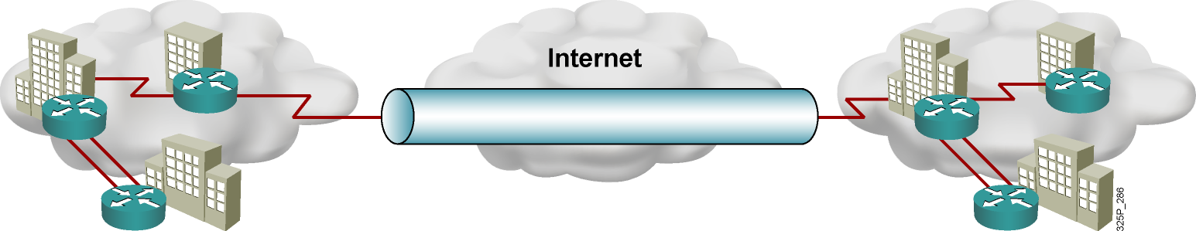
Virtual Private Networks
A VPN carries private traffic over a public network using advanced encryption and tunnels to protect:
  Confidentiality of information
  Integrity of data
  Authentication of users

Slide 4
VPN Types
  Remote access:
    Client-initiated
    Network access server
  Site-to-site:
    Intranet
    Extranet

Slide 5
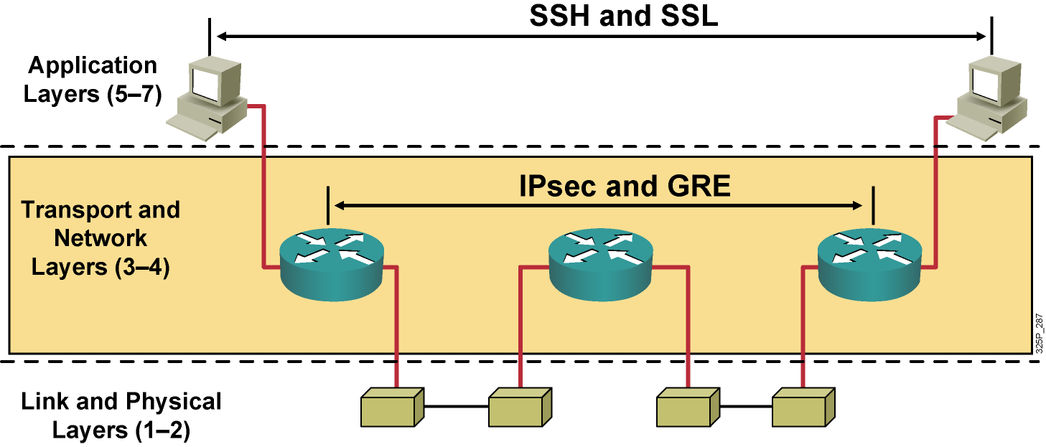
Encryption Overview

Slide 6
VPN Protocols
Protocol | Description | Standard
GRE | Generic Routing Encapsulation | RFC 1701, RFC 1702, RFC 2748
IPsec | Internet Protocol Security | RFC 4301

Slide 7
Implementing QoS with Preclassification

Slide 8
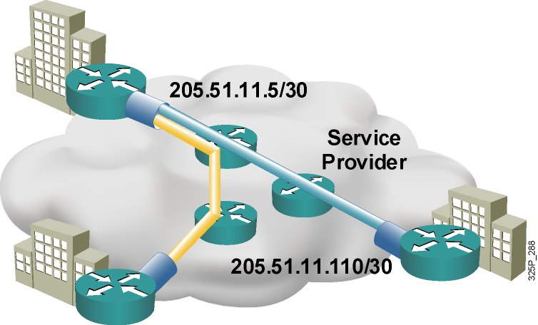
QoS Preclassify
  VPNs are growing in popularity.
  The need to classify traffic within a traffic tunnel is also gaining importance.
  QoS preclassify is a Cisco IOS feature that allows packets to be classified before tunneling and encryption occur.
  Preclassification allows traffic flows to be adjusted in congested environments.

Slide 9
QoS Preclassify Applications

Slide 10
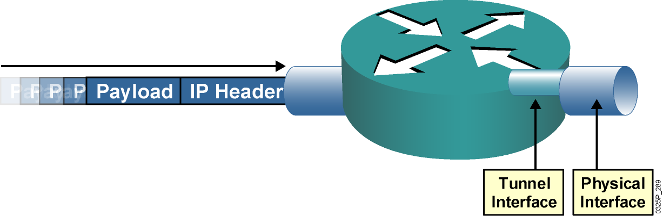
QoS Preclassify Applications
  When packets are encapsulated by tunnel or encryption headers, QoS features are unable to examine the original packet headers and correctly classify packets.
  Packets traveling across the same tunnel have the same tunnel headers, so the packets are treated identically if the physical interface is congested.

Slide 11
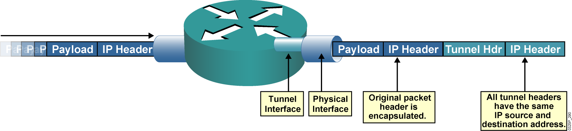
QoS Preclassify Applications
  When packets are encapsulated by tunnel or encryption headers, QoS features are unable to examine the original packet headers and correctly classify packets.
  Packets traveling across the same tunnel have the same tunnel headers, so the packets are treated identically if the physical interface is congested.

Slide 12
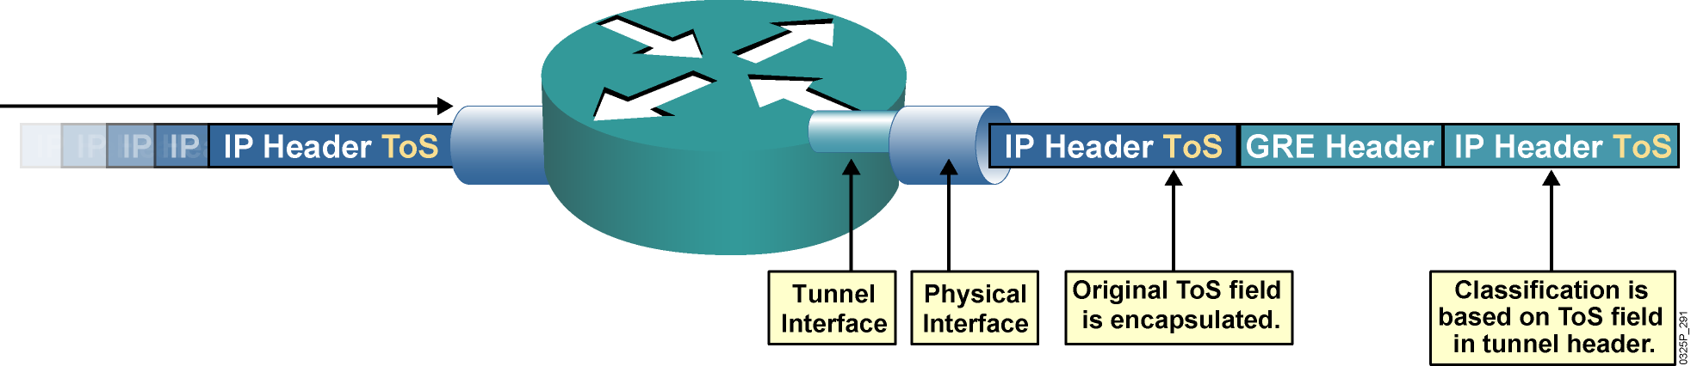
GRE Tunneling
  ToS classification of encapsulated packets is based on the tunnel header.
  By default, the ToS field of the original packet header is copied to the ToS field of the GRE tunnel header.
  GRE tunnels commonly are used to provide dynamic routing resilience over IPsec, adding a second layer of encapsulation.

Slide 13
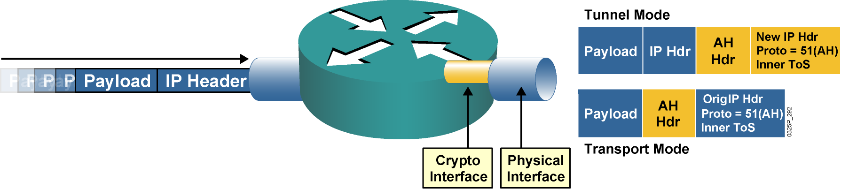
IPsec AH
  IPsec AH is for authentication only and does not perform encryption.
  With tunnel mode, the ToS byte value is copied automatically from the original IP header to the tunnel header.
  With transport mode, the original header is used, and therefore the ToS byte is accessible.

Slide 14
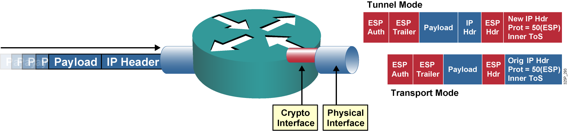
IPsec ESP
  IPsec ESP supports both authentication and encryption.
  IPsec ESP consists of an unencrypted header followed by encrypted data and an encrypted trailer.
  With tunnel mode, the ToS byte value is copied automatically from the original IP header to the tunnel header.

Slide 15
QoS Preclassification Deployment Options

Slide 16
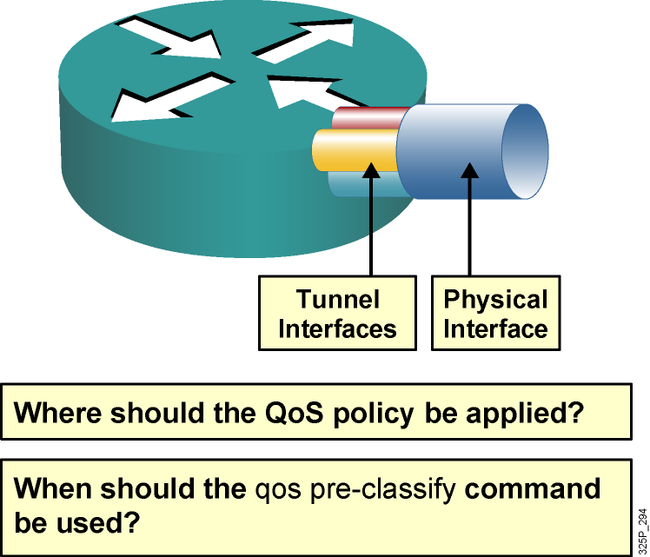
QoS Preclassification Deployment Options
  Tunnel interfaces support many of the same QoS features as physical interfaces.
  In VPN environments, a QoS service policy can be applied to the tunnel interface or to the underlying physical interface.
  The decision about
  whether to configure the qos preclassify command depends on which header is used for classification.

Slide 17
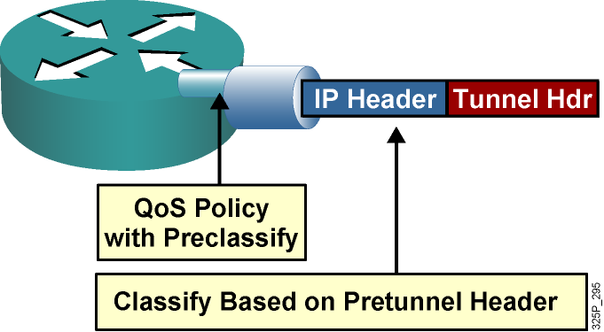
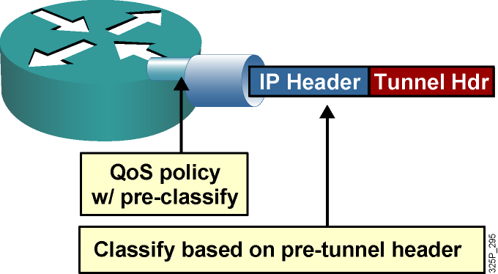
QoS Preclassification
Deployment Options (Cont.)
  QoS preclassify allows access to the original IP header values.
  QoS preclassify is not required if classification based on original ToS values as this is copied by default to new header.
IPsec and GRE configuration:
!
crypto map static-crypt 1 ipsec-isakmp
qos pre-classify
set peer ….etc
!
interface Tunnel 0
etc..
qos pre-classify
crypto map static-crypt
!
interface Ethernet 0/1
service-policy output minbwtos
crypto map static-crypt
!
Note: ToS byte copying is done by the tunneling mechanism and not by the qos pre-classify command.

Slide 18
Configuring QoS Preclassify
router(config-if)#
qos pre-classify
Enables the QoS preclassification feature.
This command is restricted to tunnel interfaces, virtual templates, and crypto maps.
GRE Tunnels
router(config)# interface tunnel0
router(config-if)# qos pre-classify
IPSec Tunnels
router(config)# crypto map secured-partner
router(config-crypto-map)# qos pre-classify

Slide 19
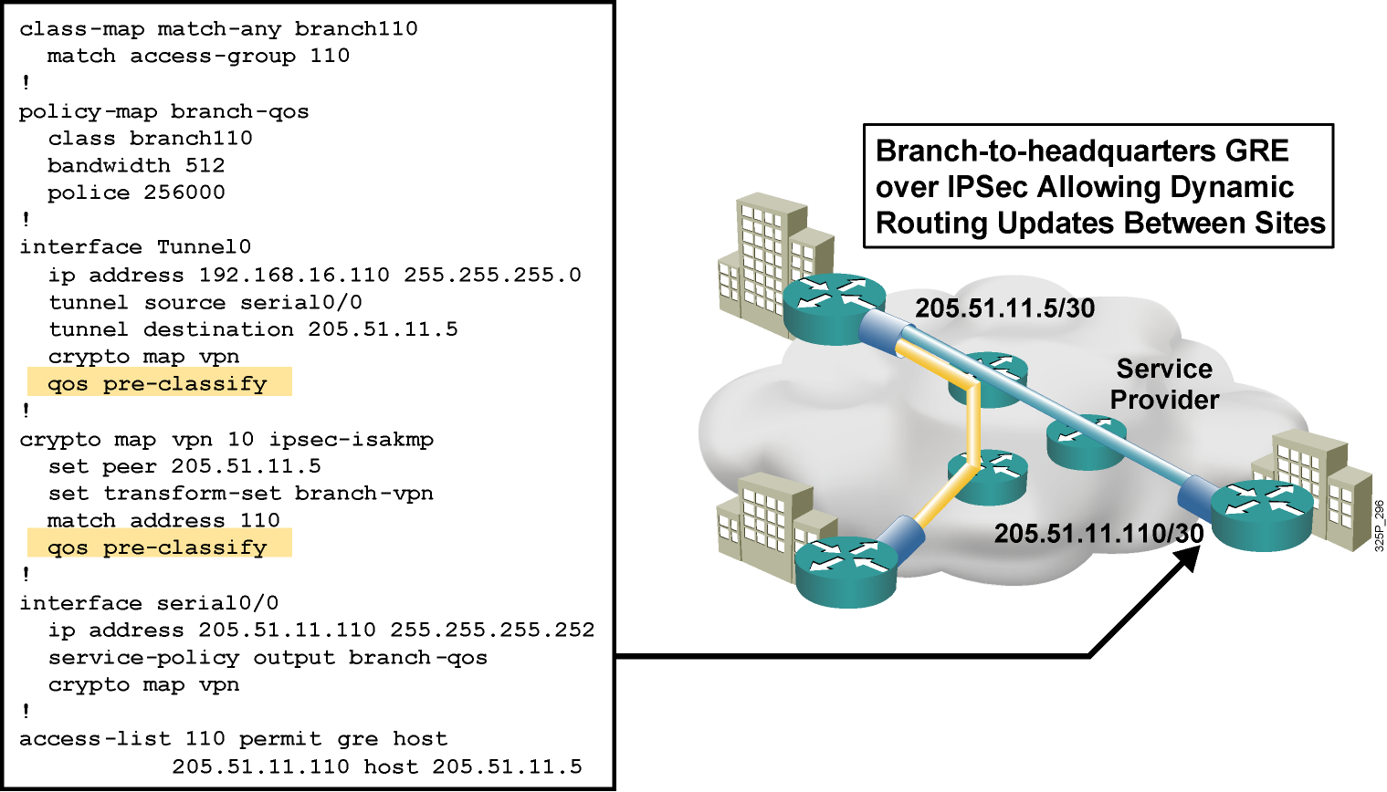
QoS Preclassify: Example

Slide 20
Summary
  A VPN is defined as network connectivity deployed on a shared infrastructure with the same policies and security as a private network, and it offers encryption, data integrity and origin authentication.
  The QoS preclassify feature is designed for tunnel interfaces.
  IPsec and GRE support QoS preclassification. When packets are encapsulated by tunnel or encryption headers, QoS features are unable to examine the original packet headers and correctly classify the packets.
  QoS preclassify is enabled by the qos pre-classify Cisco IOS software command.

Slide 21


