Slide 1
Implement the DiffServ QoS Model
Deploying End-to-End QoS

Slide 2

QoS SLAs

Slide 3
QoS SLAs
  QoS SLAs provide contractual assurance for meeting the traffic QoS requirements.
  QoS SLAs typically provide contractual assurance for parameters such as:
    Delay (fixed and variable)
    Jitter
    Packet loss
    Throughput
    Availability

Slide 4
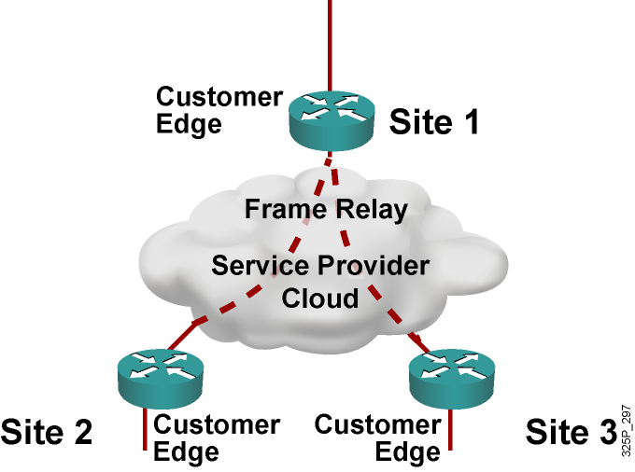
Enterprise Network with
Traditional Layer 2 Service
  Provider sells customer a Layer 2 service
  Point-to-point SLA from the provider
  Enterprise WAN likely to get congested
  IP QoS required for voice, video, data integration
  Service provider not involved in IP QoS

Slide 5
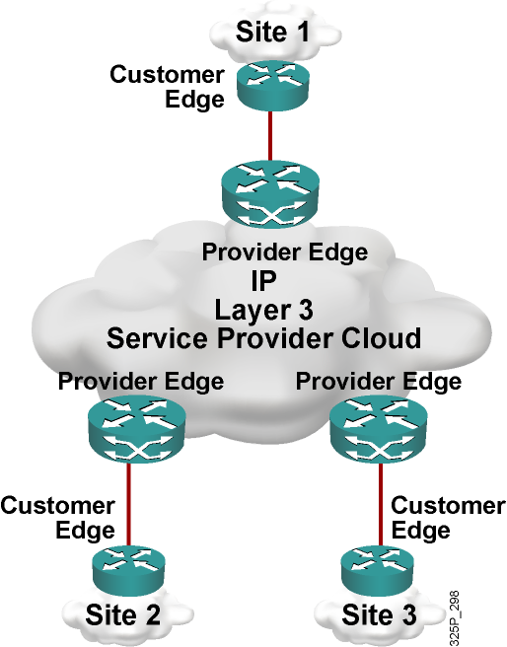
Enterprise Network with IP Service
  Customer buys Layer 3 service from provider
  Point-to-cloud SLA from provider for conforming traffic
  Enterprise WAN likely to get congested
  Service provider involved in IP QoS

Slide 6
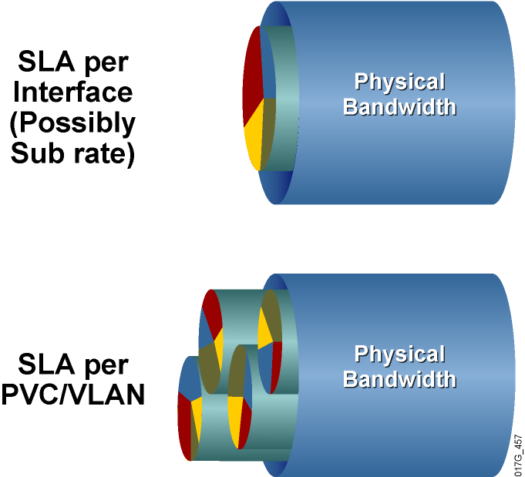
Know the SLA Offered by Your
Service Provider
  SLA typically includes between three and five classes.
  Real-time traffic gets fixed bandwidth allocation.
  Data traffic gets variable bandwidth allocation with minimum guarantee.

Slide 7
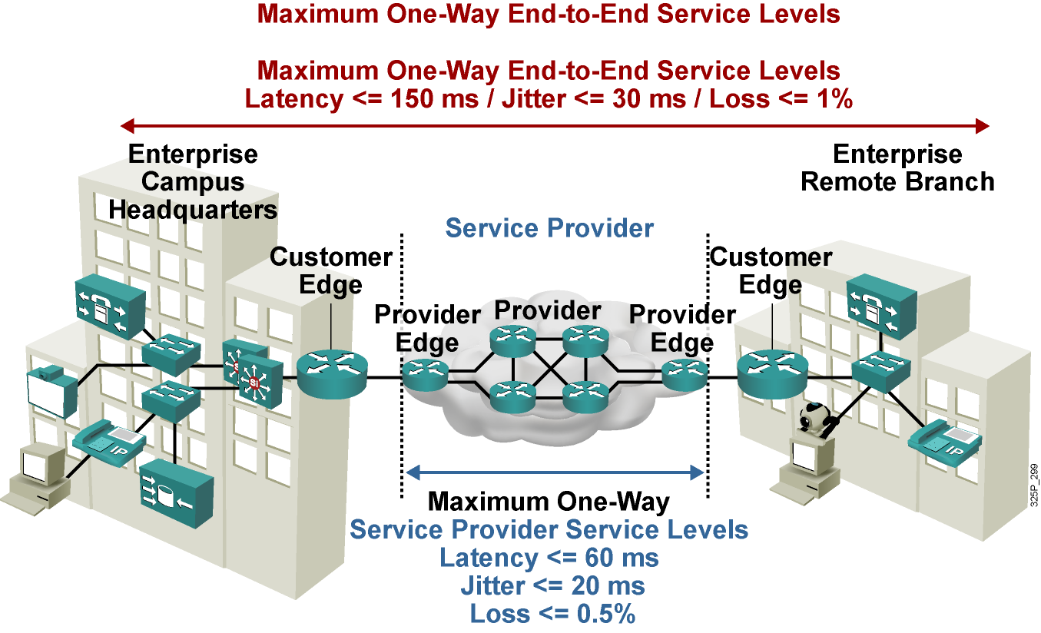
Typical SLA Requirements for Voice

Slide 8
Deploying
End-to-End QoS

Slide 9
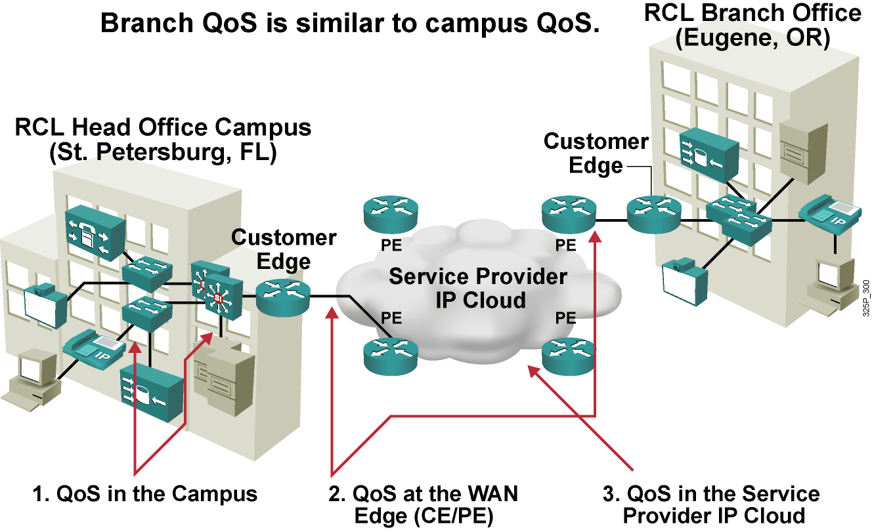
Deploying End-to-End QoS

Slide 10
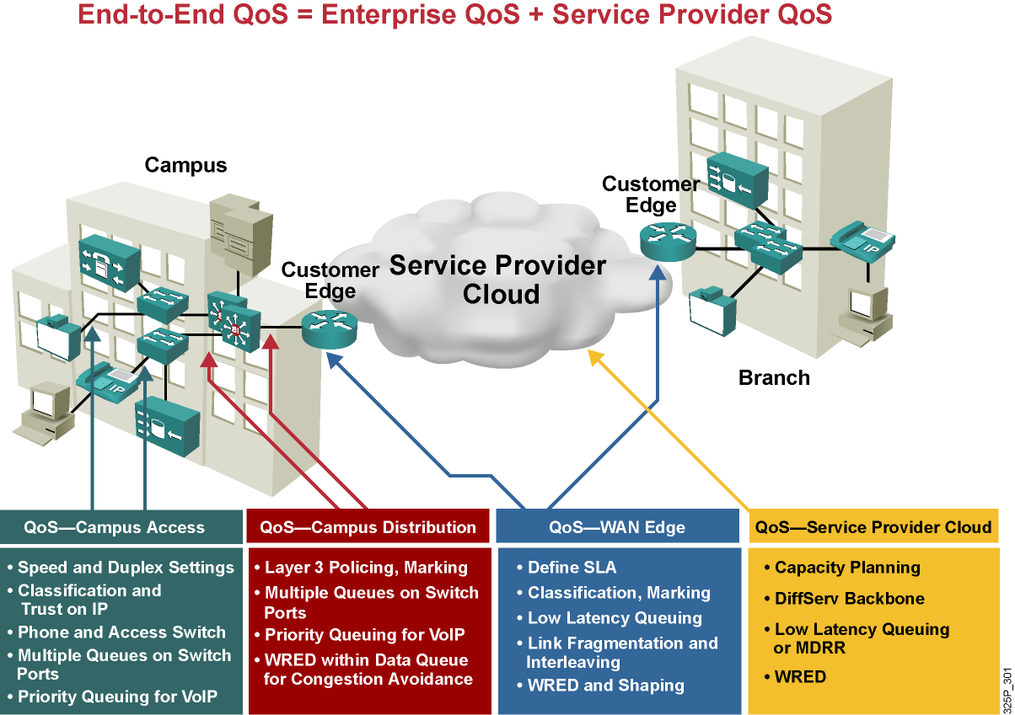
Deploying End-to-End QoS (Cont.)

Slide 11
Enterprise Campus QoS Implementations

Slide 12
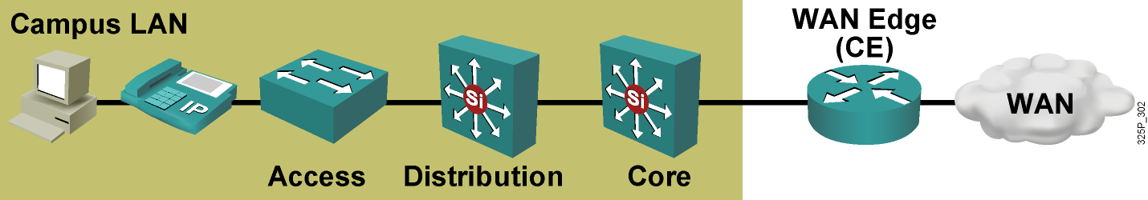
Campus QoS General Guidelines
  Multiple queues are required on all interfaces to prevent transmit queue congestion and drops.
  Voice traffic should always go into the highest-priority queue.
  Trust the Cisco IP phone CoS setting but not the PC CoS setting.
  Classify and mark traffic as close to the source as possible.
  Use class-based policing to rate-limit certain unwanted excess traffic.

Slide 13
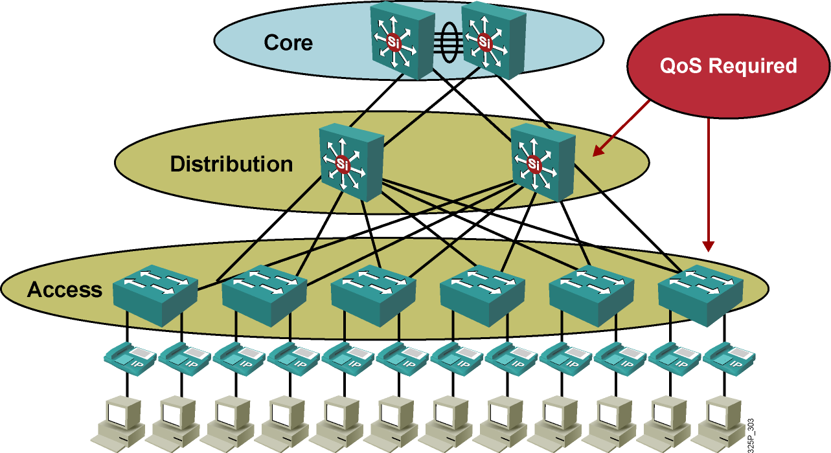
Campus Access and Distribution
Layer QoS Implementation

Slide 14
WAN Edge QoS Implementations

Slide 15
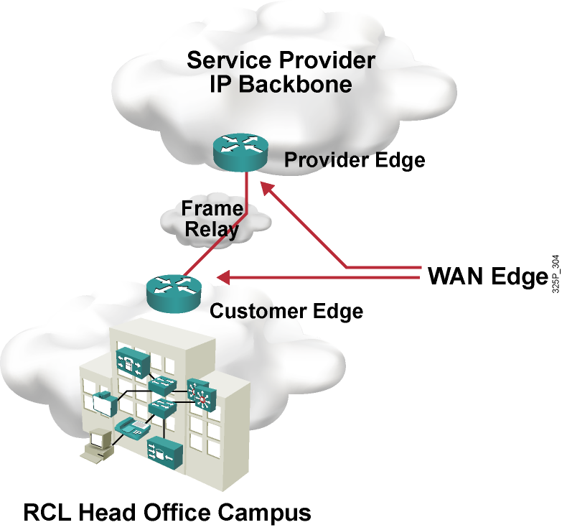
WAN Edge QoS Implementation

Slide 16
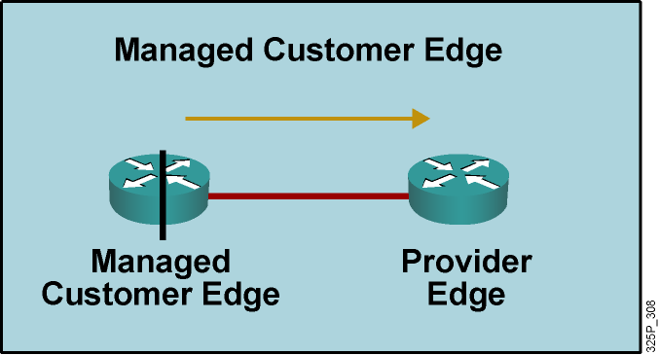
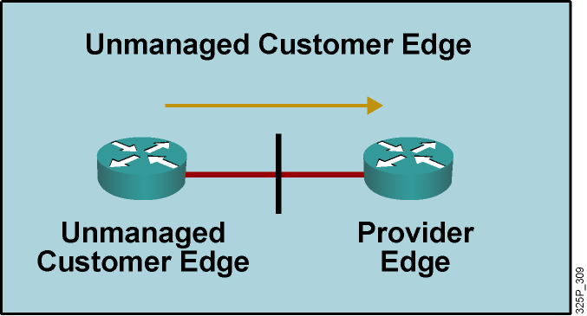
Traffic Leaving Enterprise Network
  Output QoS policy on Customer Edge controlled by service provider.
  Service provider enforces SLA using the output QoS policy on Customer Edge.
  Output policy uses queuing, dropping, and possibly shaping.
  Elaborate traffic classification or mapping of existing markings.
  May require LFI or cRTP.
  Output QoS policy on Customer Edge not controlled by service provider.
  Service provider enforces SLA using input QoS policy on Provider Edge.
  Input policy uses policing and marking.
  Elaborate traffic classification or mapping of existing markings on Provider Edge.

Slide 17
Traffic Leaving Enterprise
Network (Cont.)
Customer Edge
Output Policy
Classification, Marking, and Mapping
LLQ
WRED
[Shaping]
[LFI or cRTP]
Provider Edge
Input Policy
<Not required>
Customer Edge
Output Policy
<Irrelevant>
Provider Edge
Input Policy
Classification, Marking, and Mapping
Policing

Slide 18
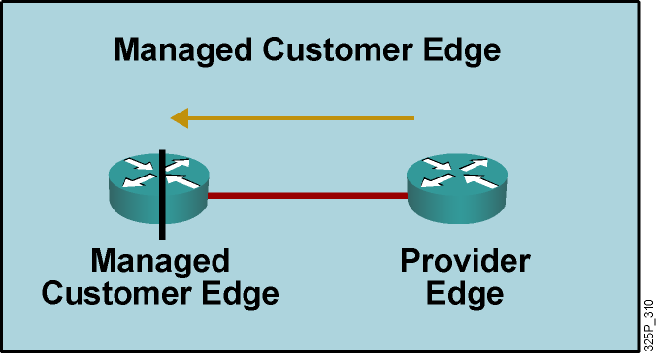
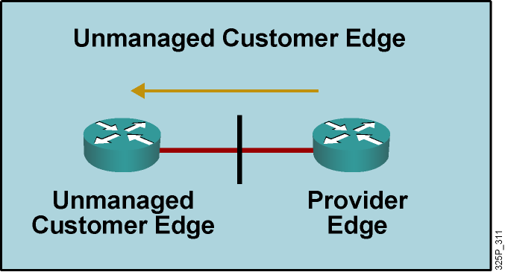
Traffic Leaving Service Provider Network
  Service provider enforces SLA using the output QoS policy on Provider Edge.
  Output policy uses queuing, dropping, and, optionally, shaping.
  May require LFI or cRTP.
  No input QoS policy on Customer Edge needed.
  Service provider enforces SLA using the output QoS policy on Provider Edge.
  Output policy uses queuing, dropping, and, optionally, shaping.
  May require LFI or cRTP.
  Input QoS policy on Customer Edge irrelevant.

Slide 19
Traffic Leaving Service Provider
Network (Cont.)
Customer Edge
Input Policy
<Not needed>
Provider Edge
Output Policy
LLQ
WRED
[Shaping]
[LFI or cRTP]
Customer Edge
Input Policy
<Irrelevant>
Provider Edge
Output Policy
LLQ
WRED
[Shaping]
[LFI or cRTP]

Slide 20
Managed Customer Edge with Three Service Classes: Example
  The service provider in this example is offering managed customer edge service with three service classes:
    Real-time (VoIP, interactive video, call signaling): Maximum bandwidth guarantee, low latency, no loss
    Critical data (routing, mission-critical data, transactional data, and network management): Minimum bandwidth guarantee, low loss
    Best-effort: No guarantees (best effort)
  Most DiffServ deployments use a proportional differentiation model:
    Rather than allocate absolute bandwidths to each class, service provider adjusts relative bandwidth ratios between classes to achieve SLA differentiation.

Slide 21
WAN Edge Design
Class | Parameters
Real-time (VoIP) | Packet marked EF class and sent to LLQ Maximum bandwidth = 35% of CIR, policed Excess dropped
Real-time (call-signaling) | VoIP signaling (5%) shares the LLQ with VoIP traffic
Critical Data | Allocated 40% of remaining bandwidth after LLQ has been serviced Exceeding or violating traffic re-marked WRED configured to optimize TCP throughput
Best-effort | Best-effort class sent to CBWFQ Allocated 23% of remaining bandwidth after LLQ has been serviced WRED configured to optimize TCP throughput
Scavenger | Best-effort class sent to CBWFQ Whatever is left = 2% of remaining bandwidth

Slide 22
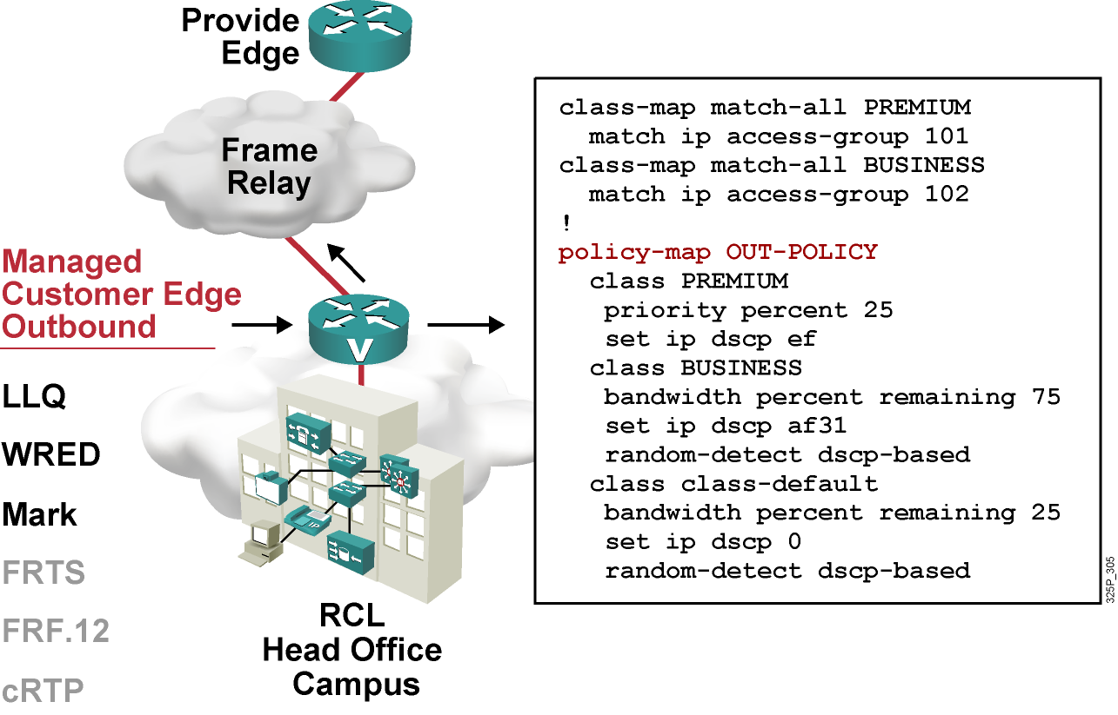
Customer Edge-to-Provider Edge QoS for Frame Relay Access Customer Edge Outbound

Slide 23
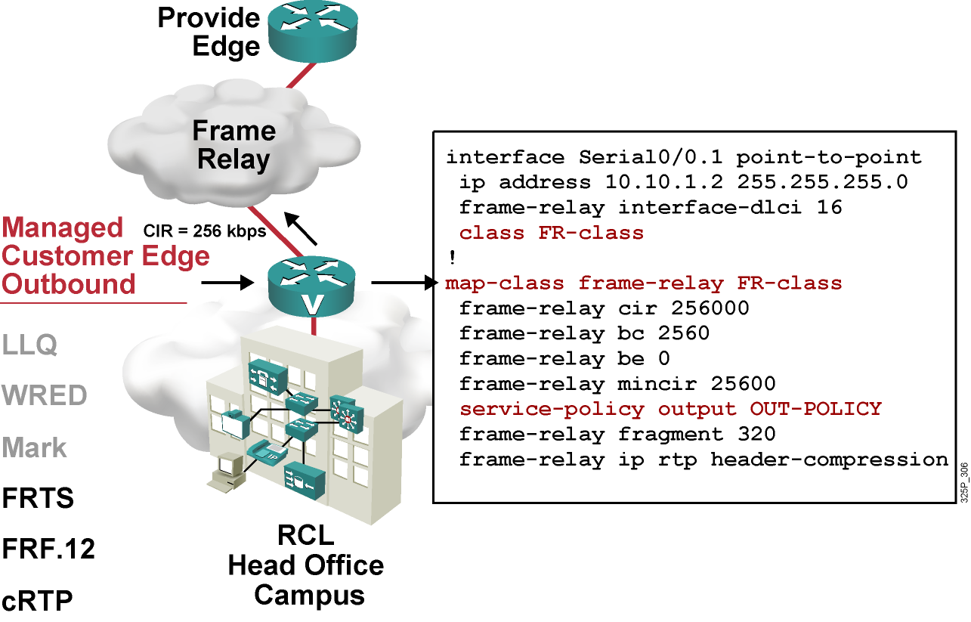
Customer Edge-to-Provider Edge QoS for Frame Relay Access Customer Edge Outbound (Cont.)

Slide 24
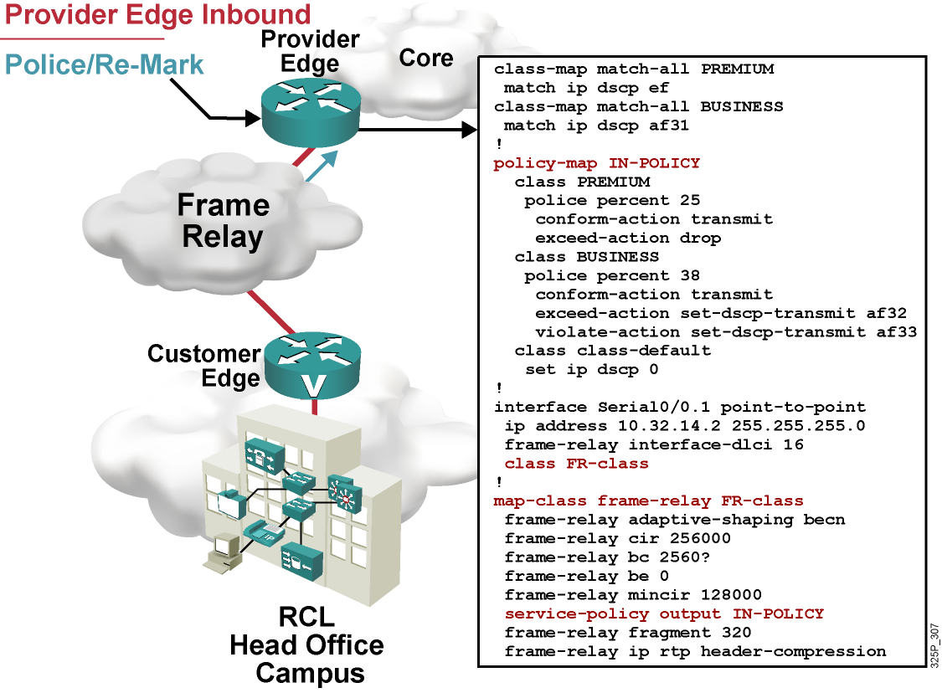
Customer Edge-to-Provider Edge QoS for Frame Relay Access Provider Edge Inbound

Slide 25
What Is CoPP?

Slide 26
What Is CoPP?
  The CoPP feature allows users to configure a QoS filter that manages the traffic flow of control plane packets to protect the control plane against DoS attacks.
  CoPP has been available since Cisco IOS Software Release 12.2(18)S.

Slide 27
Cisco Router Planes
  A Cisco router is divided into four functional planes:
    Data plane
    Management plane
    Control plane
    Service plane
  Any service disruption to the route processor or the control and management planes can result in business-impacting network outages.

Slide 28
CoPP Deployment
  To deploy CoPP, take the following steps:
    Define a packet classification criteria.
    Define a service policy.
    Enter control-plane configuration mode.
    Apply QoS policy.
  Use MQC for configuring CoPP.

Slide 29
CoPP Example
access-list 140 deny tcp host 10.1.1.1 any eq telnet
access-list 140 deny tcp host 10.1.1.2 any eq telnet
access-list 140 permit tcp any any eq telnet
!
class-map telnet-class
match access-group 140
!
policy-map control-plane-in
class telnet-class
police 80000 conform transmit exceed drop
!
control-plane slot 1
service-policy input control-plane-in

Slide 30
Summary
  An SLA stipulates the delivery and pricing of numerous service levels. SLAs cover an assortment of data services, such as Frame Relay, leased lines, Internet access, web hosting, and
  so on.
  There are QoS requirements for different traffic types. Both the enterprise and the service provider must implement the proper IP QoS mechanisms to provide end-to-end QoS.
  General guidelines for enterprise QoS implementations are as follows:
    Use robust switching design.
    Use buffer management.
    Use multiple queues.
    Ensure that voice traffic always gets the highest priority.
    Trust the Cisco IP phone CoS setting.
    Classify and mark traffic as close to the source as possible.
    Use class-based policing.

Slide 31
Summary (Cont.)
  On a Customer Edge-to-Provider Edge WAN link, LLQ or CBWFQ, traffic shaping, cRTP, and LFI are typically required.
  CoPP is a hardware-independent mechanism for defining and implementing sophisticated router protection schemes.
  CoPP is easily deployed by leveraging the existing MQC infrastructure.

Slide 32
