Slide 1
Implement Cisco AutoQoS
Introducing Cisco AutoQoS

Slide 2

Cisco AutoQoS

Slide 3
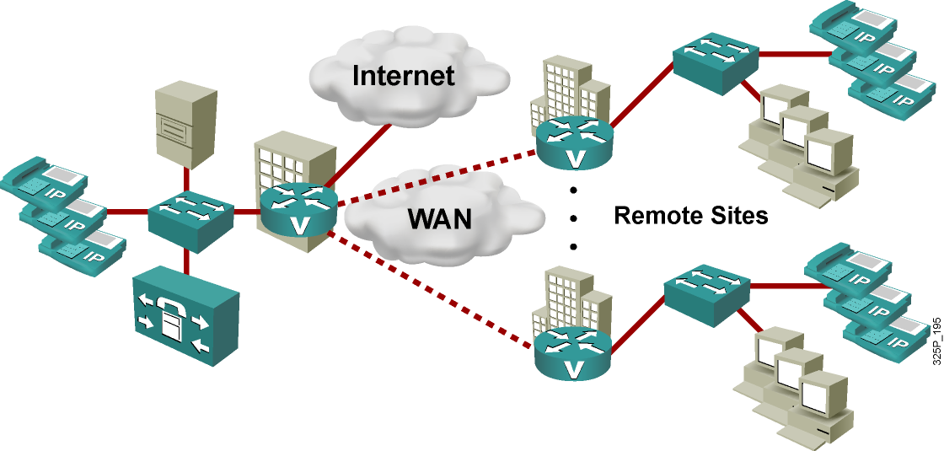
Enterprise QoS Challenges
  Enterprise networks work with new traffic types:
    IP telephony spreads quickly and requires QoS.
    Mission-critical applications need guaranteed bandwidth.
  QoS implementation requires significant “challenging” knowledge:
    Simple networks require a simple QoS solution that works instantly.
    QoS deployment should be cheaper and faster.

Slide 4
Cisco AutoQoS: Automating the Delivery of Network QoS
Cisco AutoQoS—QoS for voice, video, and data:
  Uses Cisco IOS built-in intelligence to automate QoS delivery for most common business scenarios
  Protects business-critical data applications in the enterprise
  Simplifies QoS deployment for real-time traffic
  Reduces configuration errors
  Makes QoS deployments simpler, cheaper, and faster
  Follows DiffServ model and other standards in QoS
  Allows customers to retain complete control over their QoS configuration

Slide 5
Cisco AutoQoS Evolution
  Cisco AutoQoS VoIP:
    First phase addressed IP telephony.
    One command provisions all basic QoS required.
    Support is provided across broad range of platforms
    (switches and routers).
  Cisco AutoQoS for Enterprise:
    Second phase extends capabilities (routers only) for data, voice, and video.
    Two QoS deployment stages:
      Discovers traffic types, load, and generates policy (NBAR)
      Implements the generated policy

Slide 6
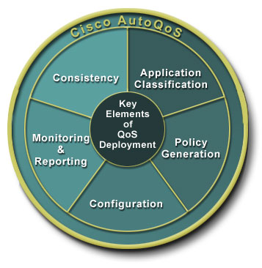
Cisco AutoQoS: Automating the
Key Elements of QoS Deployment
  Application classification: Discovers applications and provides appropriate QoS treatment
  Policy generation: Autogenerates initial and ongoing QoS policies
  Configuration: Provides high-level business knobs, and automates QoS in multidevice domain
  Monitoring and reporting: Generates intelligent, automatic alerts and summary reports
  Consistency: Enables automatic, seamless interoperability among all QoS features and parameters

Slide 7
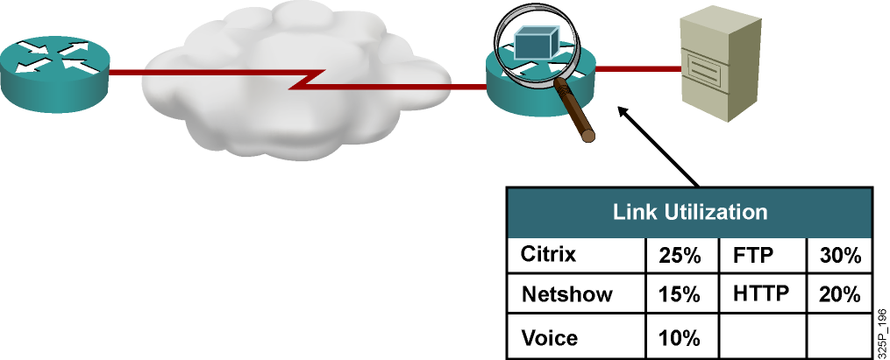
Protocol Discovery with NBAR
  Analyzes application traffic patterns in real time and discovers which traffic is running on the network
  Identifies Layer 4–7 applications and protocols using stateful and deep packet inspection
  Provides bidirectional, per-interface, and per-protocol statistics:
    5-minute bit rate (bps)
    Packet counts
    Byte counts
  Currently supports almost 100 protocols and applications

Slide 8
Cisco AutoQoS Enterprise: Router Deployment Restrictions

Slide 9
Cisco AutoQoS on Enterprise: Router Deployment Restrictions
 | Restrictions
General restrictions | Supports PPP, HDLC, Frame Relay, and ATM PVC only Interface or PVC must have an IP address
Serial interface restrictions | Must be configured on both ends of the link Must have the bandwidth configured to the same value on both ends
Frame Relay DLCI restrictions | Cannot be configured on a DLCI if a map class or virtual template is attached to the DLCI Cannot be configured if DLCI is already assigned to a subinterface
ATM PVC restrictions | Cannot be configured if a virtual template is already attached to the low-speed PVC (less than 768 kbps)

Slide 10
Cisco AutoQoS: Router
Design Considerations
 | Considerations
General QoS requirements | Considers interface type and the bandwidth configured Uses the bandwidth configured to determine the resulting configuration
Bandwidth implications | Uses the bandwidth that is allocated at the time the feature is enabled Does not respond to later bandwidth changes
Fragmentation for Frame Relay networks | For Frame Relay networks, configures LFI based on G.729 using delay of 10 ms and minimum fragment size of 60 bytes—manual adjustment needed if G.711 codec with 220-byte fragment length is required

Slide 11
Configuring Cisco AutoQoS:
Router Prerequisites
  It cannot be configured if a QoS policy (service policy) is attached to the interface.
  CEF must be enabled at the interface or ATM PVC.
  It classifies an interface as low speed (less than or equal to 768 kbps) or high speed (more than 768 kbps):
    Correct bandwidth must be configured on all interfaces
    If low speed, an IP address must be configured on the interface

Slide 12
Deploying Cisco AutoQoS for Enterprise on Routers: A Two-Phase Approach
  Profile the traffic with autodiscovery:
    Collects data from the offered traffic for several days (default is 3 days)
    Uses NBAR for protocol discovery and statistical analysis
  Generate and deploy MQC-based QoS policies:
    Maps applications to their corresponding DiffServ classes
    Assigns appropriate bandwidth and scheduling parameters

Slide 13
Configuring Cisco AutoQoS: Traffic Profiling on Routers with Autodiscovery
router(config-if)#
auto discovery qos [trust]
  Process begins discovering and collecting data for Cisco AutoQoS for Enterprise only.
  Autodiscovery is enabled on the interface of interest.
  Optional trust keyword is used to trust (rely on) the DSCP markings; if unspecified, NBAR will be used.
  Default value is untrusted.
  Discovery results can be seen with the show auto discovery qos command.

Slide 14
Configuring Cisco AutoQoS: Configuring QoS Policies on Routers
router(config-if)#
auto qos [voip [trust] [fr-atm]]
  It generates and installs the QoS policy based on the
  autodiscovery results (AutoQoS for Enterprise).
  The optional voip keyword configures Cisco AutoQoS VoIP.
  Optional trust keyword is used to trust (rely on) the DSCP markings for VoIP classification; if unspecified, NBAR will
  be used.
  Default value is untrusted.
  Optional fr-atm keyword enables Cisco AutoQoS VoIP for the low-speed Frame Relay-to-ATM links.

Slide 15
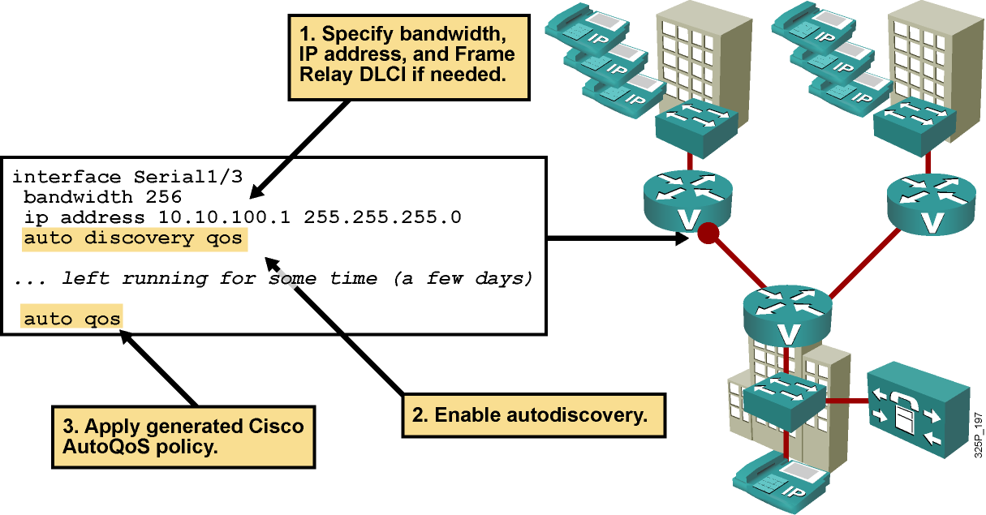
Cisco AutoQoS for Enterprise:
Router Configuration Example

Slide 16
Deploying Cisco AutoQoS
VoIP on Switches
  Commands at the interface level configure Cisco AutoQoS VoIP:
    Support for Cisco IP phone and Cisco SoftPhone
    Support for Cisco SoftPhone currently only on Cisco Catalyst 6500 Series
    Trust boundary disabled when Cisco IP phone is moved
  Buffer allocation and egress queuing depend on interface type (Gigabit Ethernet or Fast Ethernet).
  It is supported on static, dynamic-access, voice VLAN access, and trunk ports.
  CDP must be enabled for Cisco AutoQoS VoIP to function properly.

Slide 17
Configuring Cisco AutoQoS on Cisco Catalyst 2950 (EI) and 3550 Switches
switch(config-if)#
auto qos voip trust
  Used for trusted connections.
  Used to trust the ingress VoIP packet marking.
  Use if the uplink is connected to a trusted switch or router only.
switch(config-if)#
auto qos voip cisco-phone
  Used for Cisco IP Phone connections.p
  Enables the trusted boundary feature.
  Uses CDP to detect the presence or absence of a Cisco IP Phone.
  QoS markings of incoming packets are trusted only when the Cisco IP phone is detected.

Slide 18
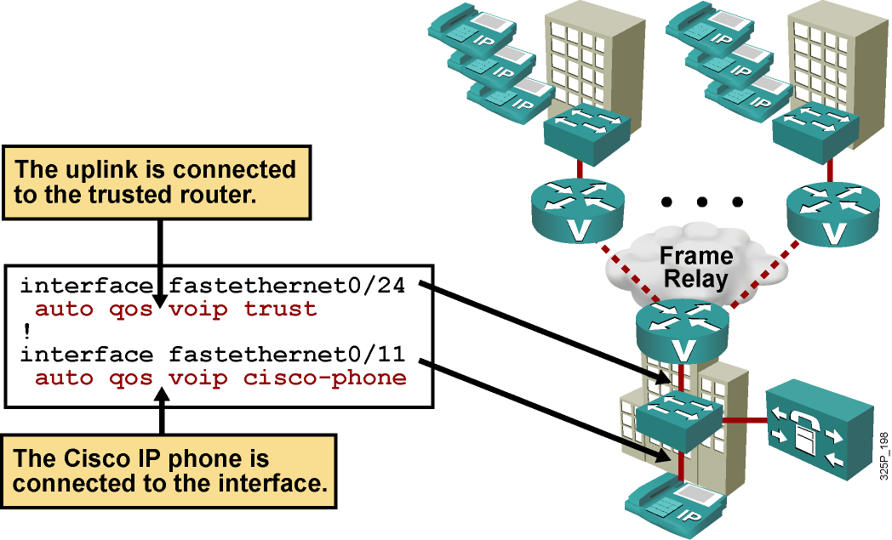
Cisco AutoQoS VoIP Switch
Configuration Example

Slide 19
Verifying AutoQoS

Slide 20
How to Verify Cisco AutoQoS
 |  | Routers | Switches
E n t e r p r i s e |  | Examine autodiscovery results: show auto discovery qos
 | V o I P | Examine Cisco AutoQoS templates and initial configuration: show auto qos | Examine Cisco AutoQoS templates and initial configuration: show auto qos
 |  | Explore interface statistics for autogenerated policy: show policy-map interface | Explore interface-level autogenerated QoS parameters: show policy-map interface
 |  |  | Examine CoS-to-DSCP maps: show mls qos maps
P
r
o
c
e
d
u
r
e
F
l
o
w

Slide 21
Monitoring Cisco AutoQoS on Routers
router#
show auto discovery qos [interface [interface type]]
  Displays the results of the data collected during the
  autodiscovery phase for a specific interface or all interfaces
router#show auto discovery qos
Serial2/1.1
AutoQoS Discovery enabled for applications
Discovery up time: 2 hours, 42 minutes
AutoQoS Class information:
Class Voice:
Recommended Minimum Bandwidth: 517 Kbps/50% (PeakRate).
Detected applications and data:
Application/ AverageRate PeakRate Total
Protocol (kbps/%) (kbps/%) (bytes)
----------- ----------- -------- --------
rtp audio 2/<1 517/50 703104
<...rest of the output deleted...>

Slide 22
Monitoring Cisco AutoQoS on Routers (Cont.)
router#
show auto qos [interface interface type]
  Displays the Cisco AutoQoS templates (policy maps, class maps, and ACLs) created for a specific interface or all interfaces
router#show auto qos
!
policy-map AutoQoS-Policy-Se2/1.1
class AutoQoS-Voice-Se2/1.1
priority percent 70
set dscp ef
class AutoQoS-Inter-Video-Se2/1.1
bandwidth remaining percent 10
set dscp af41
class AutoQoS-Stream-Video-Se2/1.1
bandwidth remaining percent 5
set dscp cs4
class AutoQoS-Transactional-Se2/1.1
bandwidth remaining percent 5
<...rest of the output deleted...>

Slide 23
Monitoring Cisco AutoQoS on Routers (Cont.)
router#
show policy-map interface [interface type]
  Displays the packet statistics of all classes that are configured for all service policies on the specified interface, subinterface, or PVC
router#show policy-map interface FastEthernet0/0.1
FastEthernet0/0.1
Service-policy output: voice_traffic
Class-map: dscp46 (match-any)
0 packets, 0 bytes
5 minute offered rate 0 bps, drop rate 0 bps
Match: ip dscp 46
0 packets, 0 bytes
5 minute rate 0 bps
Traffic Shaping
Target Byte Sustain Excess Interval Increment Adapt
Rate Limit bits/int bits/int (ms) (bytes) Active
2500 10000 10000 333 1250 -
<...rest of the output deleted...>

Slide 24
Monitoring Cisco AutoQoS on Switches
switch#
show auto qos [interface interface-id]
  Displays the Cisco AutoQoS VoIP configuration that was initially applied
  Does not display any user changes to the configuration that might be in effect
switch#show auto qos
Initial configuration applied by AutoQoS:
wrr-queue bandwidth 20 1 80 0
no wrr-queue cos-map
wrr-queue cos 1 0 1 2 4
wrr-queue cos 3 3 6 7
wrr-queue cos 4 5
mls qos map cos-dscp 0 8 16 26 32 46 48 56
!
interface FastEthernet0/3
mls qos trust device cisco-phone
mls qos trust cos

Slide 25
Monitoring Cisco AutoQoS on Switches (Cont.)
switch#
show mls qos interface [interface-id | vlan vlan-id] [buffers | policers | queueing | statistics]
  Displays QoS information at the interface level
switch#show mls qos interface gigabitethernet0/1 statistics
Ingress
dscp: incoming no_change classified policed dropped (in bytes)
1 : 0 0 0 0 0
Others: 203216935 24234242 178982693 0 0
Egress
dscp: incoming no_change classified policed dropped (in bytes)
1 : 0 n/a n/a 0 0
WRED drop counts:
qid thresh1 thresh2 FreeQ
1 : 0 0 1024
2 : 0 0 1024
<...rest of the output omitted...>

Slide 26
Monitoring Cisco AutoQoS on Switches (Cont.)
switch#
show mls qos maps [cos-dscp | dscp-cos]
  Displays the maps that are used to generate an internal DSCP value, to represent the priority of the traffic
switch#show mls qos maps dscp-cos
Dscp-cos map:
dscp: 0 8 10 16 18 24 26 32 34 40 46 48 56
-----------------------------------------------
cos: 0 1 1 2 2 3 7 4 4 5 5 7 7

Slide 27
Summary
  Cisco AutoQoS significantly simplifies QoS deployments.
  Cisco AutoQoS allows for initial, faster, cheaper, and flawless QoS implementation.
  Cisco AutoQoS for the Enterprise is deployed in two steps:
    Autodiscovery is used to generate policy.
    Implementation of the generated policy follows.
  Cisco AutoQoS allows you to retain complete control over the QoS configuration:
    Verification is performed with standard show commands.
    Generated results are further tunable with MQC.

Slide 28


