Slide 1
Implement Cisco AutoQoS
Mitigating Common Cisco AutoQoS Issues

Slide 2

Automation with Cisco AutoQoS

Slide 3
QoS Mechanisms Enabled Must Meet
Major Enterprise QoS Requirements
  Trust boundary definition
  Identification of applications, protocols of interest
  (number of classes), and their QoS requirements
  Determination of classification options
  Determination of traffic-marking options
  Determination of queue mechanisms and optimal parameters per class
  Definition of port- and interface-specific transport features
  Designation of bandwidth efficiency mechanisms for low-speed links
  Identification of efficient alarm and event-monitoring options

Slide 4
DiffServ QoS Mechanisms
Enabled by Cisco AutoQoS
DiffServ functions are automated and simplified to expedite deployment of QoS features for voice, video, and data.
DiffServ Function | Cisco IOS QoS Features | Behavior
Classification | NBAR and IP precedence DSCP and CoS | Classify voice, video, and data traffic based on packet attributes; up to 10 classes
Marking | Class-based marking | Set Layer 2 and Layer 3 attributes to separate packets into classes
Congestion management | Percentage-based LLQ and CBWFQ WRR | Provide EF treatment for voice, AF treatment for video and data, and best-effort treatment as default
Shaping | Class-based shaping or FRTS | Shape to CIR to prevent bursts and smooth traffic to configured rate
Congestion avoidance | WRED | Make intelligent packet drop decisions to prevent tail drops across multiple TCP sessions
Link efficiency | Header compression and link fragmentation and interleaving | Reduce VoIP bandwidth requirement and jitter experienced by voice packets

Slide 5
Automated Cisco AutoQoS
DiffServ Class Provisioning
Traffic Class | DSCP | CoS
IP routing | CS6 | 6
Interactive voice | EF | 5
Interactive video | AF41 | 4
Streaming video | CS4 | 4
Telephony signaling | CS3 | 3
Transactional-interactive | AF21 | 2
Network management | CS2 | 2
Bulk data | AF11 | 1
Scavenger | CS1 | 1
Best effort | 0 | 0

Slide 6
Common AutoQoS Problems

Slide 7
Common Cisco AutoQoS Issues
Issue | Solution
Cisco AutoQoS generates up to 10 classes, but most enterprise networks deploy 3–6 classes today. | Manual consolidation of similar classes to meet the final number of classes actually needed
Cisco AutoQoS does not adapt to changing traffic conditions automatically. | Running Cisco AutoQoS discovery on a periodic basis followed by re-enabling of Cisco AutoQoS
Cisco AutoQoS does not handle all possible scenarios that may occur and might not fit specific classification or policies. | Manual fine-tuning of the configuration generated, adding new matching criteria to fit the specific situation

Slide 8
Interpreting AutoQoS Configurations

Slide 9
Interpreting Generated Cisco
AutoQoS Configuration
Generated Cisco AutoQoS configuration is examined using show auto qos command, answering these questions:
  How many classes were identified (class maps)?
  Which traffic classification (class map) options were selected?
  Which traffic marking options were selected (policy maps)?
  Which queuing mechanisms and parameters were designated (policy maps)?
  Which other QoS mechanisms were appointed per class
  (policy maps)?
  Were any traffic parameters suggested?
  Where was the autogenerated policy applied
  (interface, DLCI, or PVC)?

Slide 10
How to Interpret the show auto qos
Command Output
router#show auto qos
!
policy-map AutoQoS-Policy-Se2/1.1
class AutoQoS-Voice-Se2/1.1
priority percent 50
set dscp ef
class AutoQoS-Inter-Video-Se2/1.1
bandwidth remaining percent 10
set dscp af41
class AutoQoS-Transactional-Se2/1.1
bandwidth remaining percent 5
set dscp af21
<...part of the output deleted...>
!
policy-map AutoQoS-Policy-Se2/1.1-Parent
class class-default
shape average 1024000
service-policy AutoQoS-Policy-Se2/1.1
!
class-map match-any AutoQoS-Voice-Se2/1.1
match protocol rtp audio
!
class-map match-any AutoQoS-Transactional-Se2/1.1
match protocol sqlnet
<...part of the output deleted...>
<...continues on the next slide...>
LLQ
Class-Based
Marking
Nested Policy Map
(Frame Relay)
CBWFQ
Class-Based
Shaping
Parent Policy Map
(Frame Relay)
NBAR
Classification

Slide 11
How to Interpret the show auto qos
Command Output (Cont.)
RMON Traps for Voice Packet Drops
rmon event 33333 log trap AutoQoS description "AutoQoS SNMP traps for Voice Drops" owner AutoQoS
Serial2/1.1: DLCI 58 -
!
interface Serial2/1.1 point-to-point
frame-relay interface-dlci 58
class AutoQoS-FR-Serial2/1-58
!
map-class frame-relay AutoQoS-FR-Serial2/1-58
frame-relay cir 1024000
frame-relay bc 10240
frame-relay be 0
frame-relay mincir 1024000
service-policy output AutoQoS-Policy-Se2/1.1-Parent
Applying all to the DLCI
(or Policy Map to the Serial in Non-Frame Relay)
Frame Relay Traffic Parameters

Slide 12
Modifying the Active AutoQoS Configuration with MQC

Slide 13
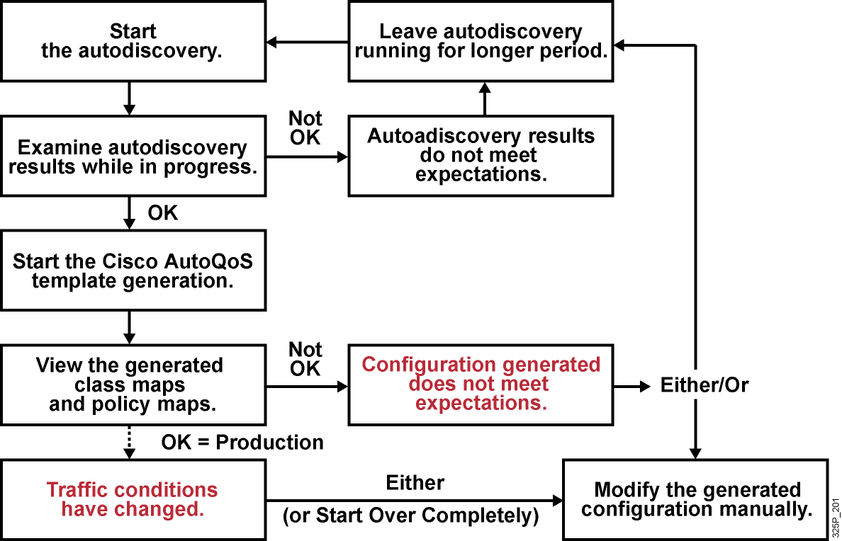
When Is Manual Modification of
AutoQoS Configuration Required?

Slide 14
Classification
  Generated Cisco AutoQoS classification uses NBAR and ACLs.
  Any MQC classification mechanism can manually tune the generated classification:
    Start the autodiscovery and review the generated results (or take the active classification if Cisco AutoQoS is already activated).
    Copy the generated classification and modify it offline.
    Apply the modified classification to a router.
class-map match-any AutoQoS-Voice-Se2/1.1
match protocol rtp audio
!
class-map match-any AutoQoS-Signaling-Se2/1.1
match access-group 101
match protocol rtcp
!
class-map match-any AutoQoS-Transactional-Se2/1.1
match protocol sqlnet
match protocol citrix
!
access-list 101 permit tcp any any eq 1719
access-list 101 permit tcp any any eq 1720
access-list 101 permit udp any any eq 2427
access-list 101 permit udp any any eq 2428
H.323
MGCP

Slide 15
Classification (Cont.)
router(config-cmap)#
match input-interface interface-name
match cos cos-value [cos-value cos-value cos-value]
match ip precedence ip-prec-value [ip-prec ...]
match ip dscp ip-dscp-value [ip-dscp-value ...]
match ip rtp starting-port-number port-range
  Besides NBAR and ACLs, these major MQC classification options can be used for tuning.
  These classification options can be used in any combination as needed to meet specific classification requirements.

Slide 16
Policy
Generated Cisco AutoQoS policy uses:
  Scheduling: LLQ and CBWFQ (both percentage based) and WRR
  Marking: Class-based Marking to re-mark the packets based on their class membership
  Shaping: Class-based Shaping and FRTS
  Link efficiency: cRTP and LFI
  Congestion avoidance: WRED
policy-map AutoQoS-Policy-Se4/0
class AutoQoS-Voice-Se4/0
priority percent 70
compress header ip
set dscp ef
class AutoQoS-Inter-Video-Se4/0
bandwidth remaining percent 10
set dscp af41
class AutoQoS-Transactional-Se4/0
bandwidth remaining percent 1
set dscp af21
class class-default
fair-queue
Any MQC policy mechanism can manually tune the generated policy with the same procedure used for classification.

Slide 17
Summary
  Cisco AutoQoS employs the DiffServ QoS mechanisms of
  Cisco IOS software.
  DiffServ functions are automated and simplified to expedite deployment of QoS features.
  Cisco AutoQoS configures QoS parameters and optimal voice performance based upon Cisco best-practice recommendations.
  Cisco AutoQoS generates up to 10 DiffServ classes.
  The show auto qos command displays the Cisco AutoQoS templates.
  Cisco AutoQoS templates can be reviewed and fine-tuned with any MQC classification or policy mechanism.

Slide 18


