Slide 1
Implement Wireless Scalability
Implementing WLAN QoS

Slide 2
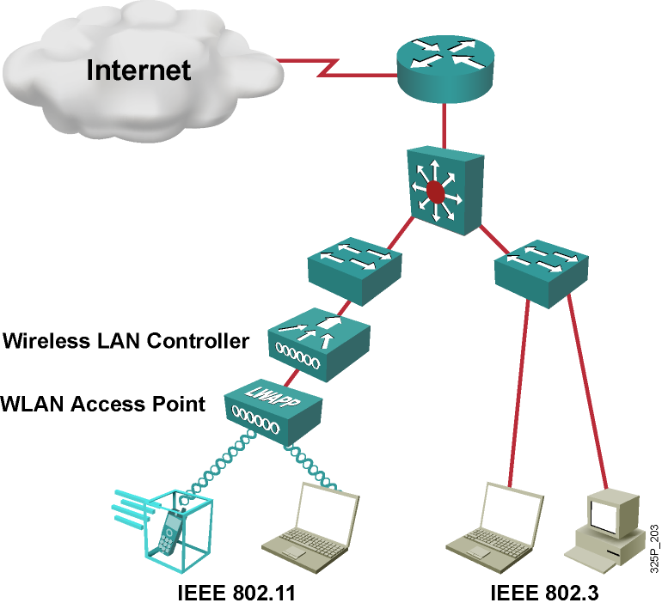
WLAN and LAN
Wireless LAN (WLAN) as an extension to wired LAN

Slide 3

The Need for
WLAN QoS

Slide 4
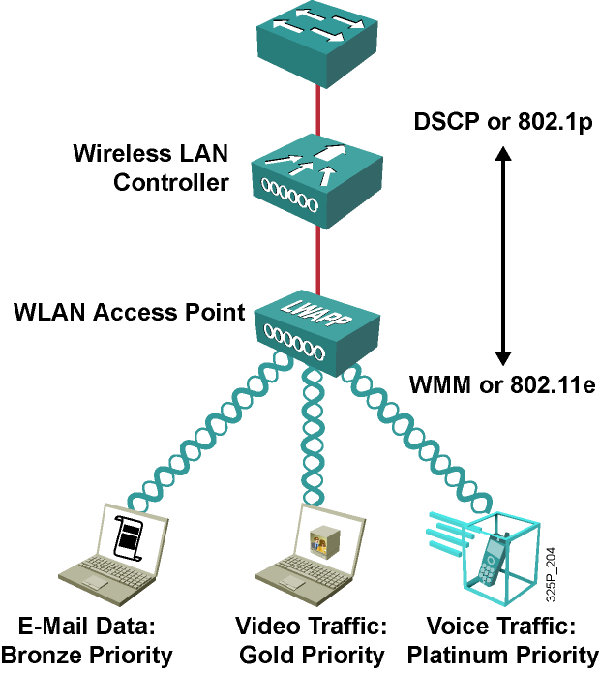
The Need for QoS Wireless
QoS extension to 802.11 to provide more consistent and quality RF transmission for:
  Voice
  Video

Slide 5
WLAN QoS Description

Slide 6
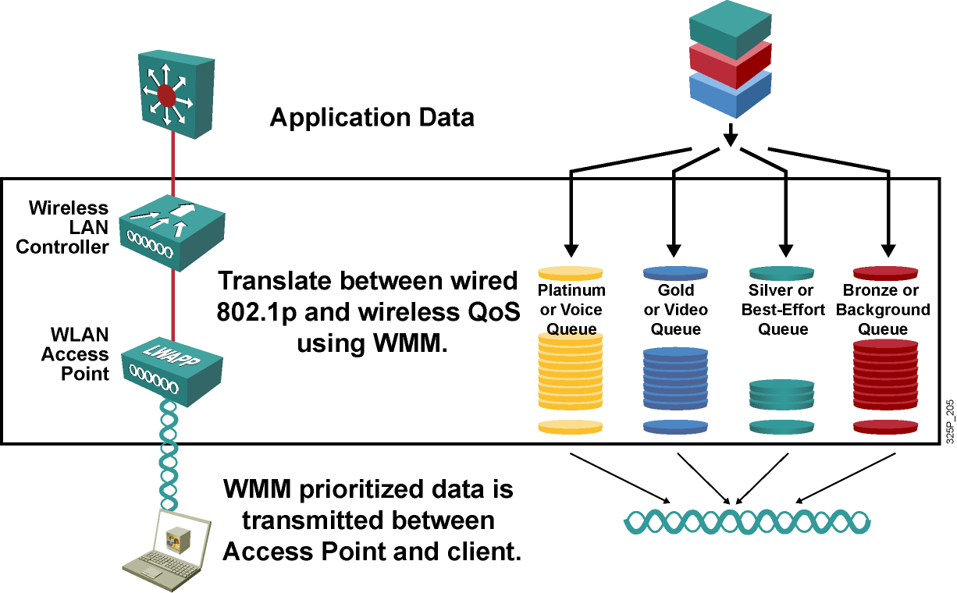
WLAN QoS Queuing Overview

Slide 7
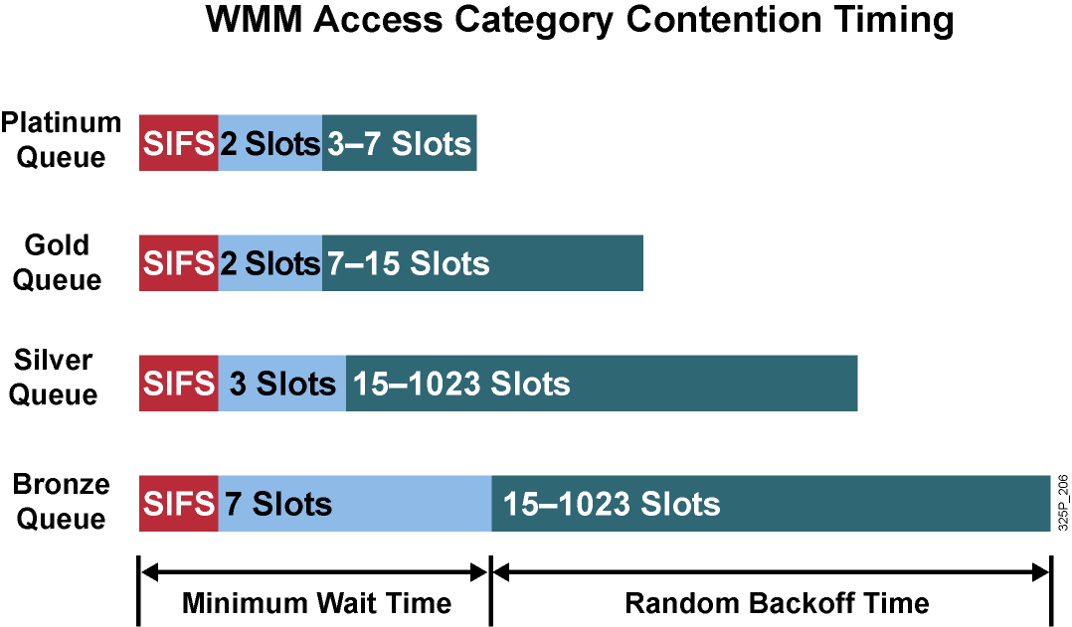
WLAN QoS RF Backoff Timing

Slide 8
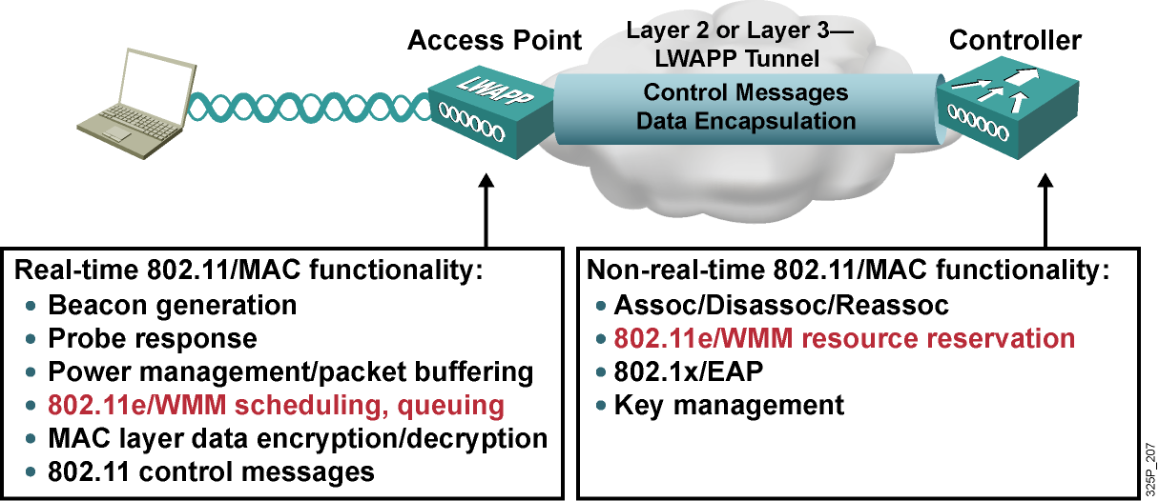
Lightweight Access Point—Split MAC Architecture

Slide 9
QoS WLAN Deployment Issues
  Wireless RF is a Layer 2 technology and therefore based on 802.11e or WMM, versus Layer 3 DSCP.
  Layer 2 marking will be lost in end-to-end transient, losing QoS information.
  Access points connect to switches as access ports versus trunks and lack 802.1p trunk tagging.
  The goal is to utilize the Layer 3 DSCP information to preserve end-to-end QoS in the absence of Layer 2 QoS information.

Slide 10
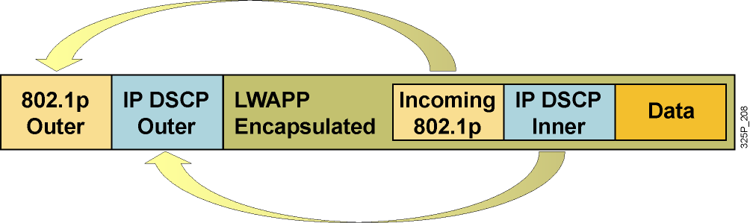
QoS Description
  WLAN data is tunneled between the access point and WLAN controller via LWAPP.
  QoS settings of the encapsulated data packet are mapped to the Layer 2 (802.1p) and Layer 3 (IP DSCP) fields of the outer tunnel packet.

Slide 11
WLAN QoS Implementation

Slide 12
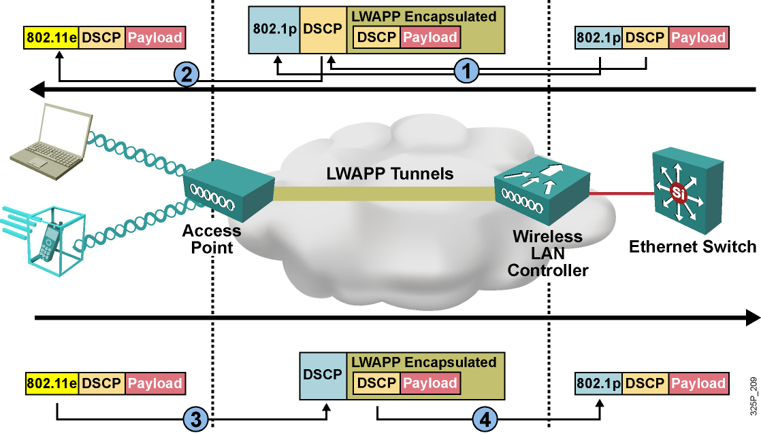
QoS Implementation Overview

Slide 13
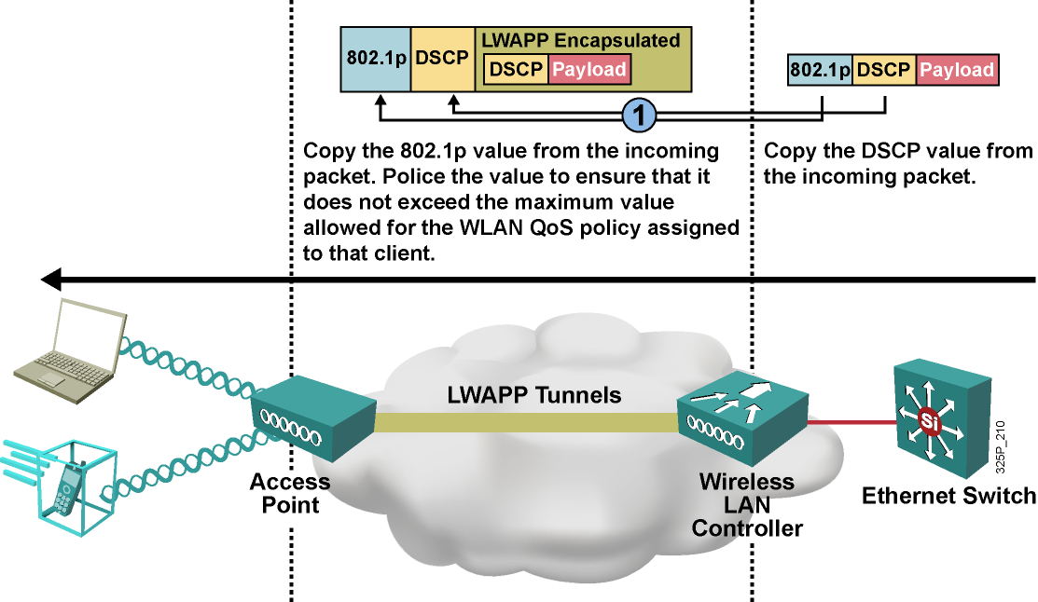
QoS Implementation—
Ethernet to Controller

Slide 14
Feature: QoS Packet-Marking Translations
Cisco 802.1p Priority-Based Traffic Type | DSCP Priority | 802.1p Priority | IEEE 802.11e Priority
Reserved | 56–62 | 7 | 7
IP routing | 48 | 6 | 7
Voice | 46 (EF) | 5 | 6
Video | 34 (AF41) | 4 | 5
Voice control | 26 (AF 31) | 3 | 4
Background gold | 18 AF21) | 2 | 2
Background silver | 10 (AF11) | 1 | 1
Best effort | 0 (BE) | 0 | 0 or 3

Slide 15
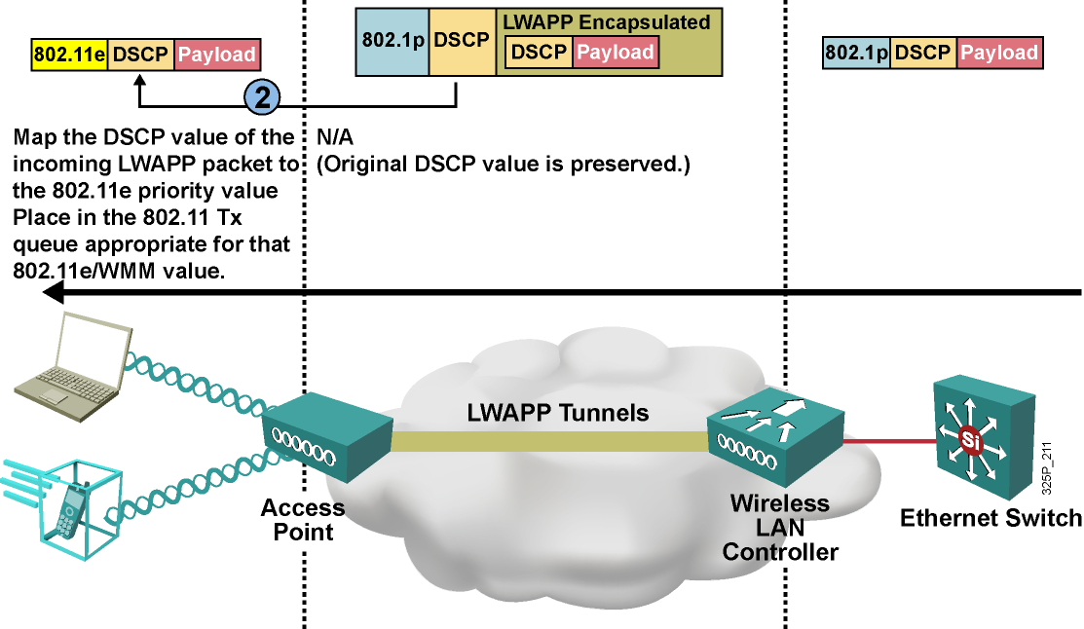
From Access Point to Wireless Client

Slide 16
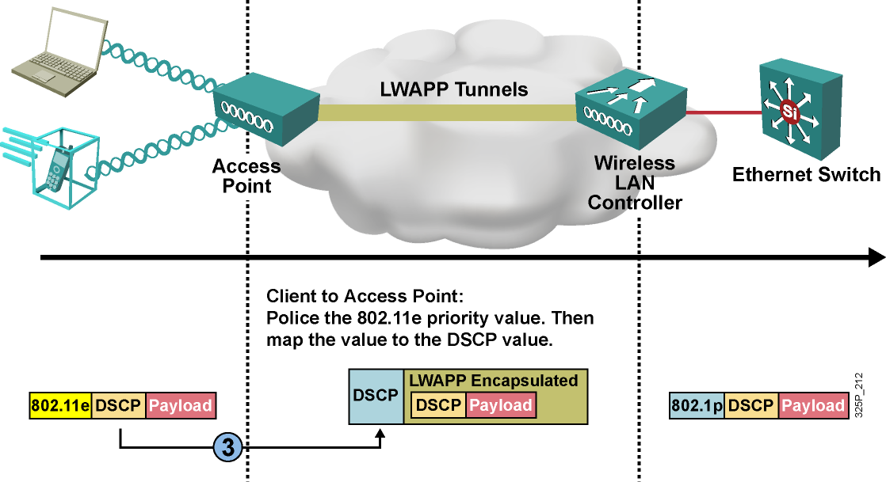
From Client to Access Point

Slide 17
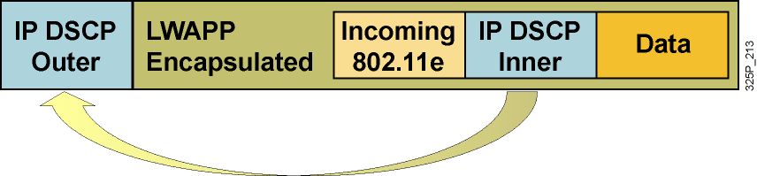
Traffic from Access Point to Controller
The access point will not send tagged packets on a nontrunk port destined for the controller; therefore, the access point will not copy the 802.11e client incoming priority value to the 802.1p (outer) destined for the switch.

Slide 18
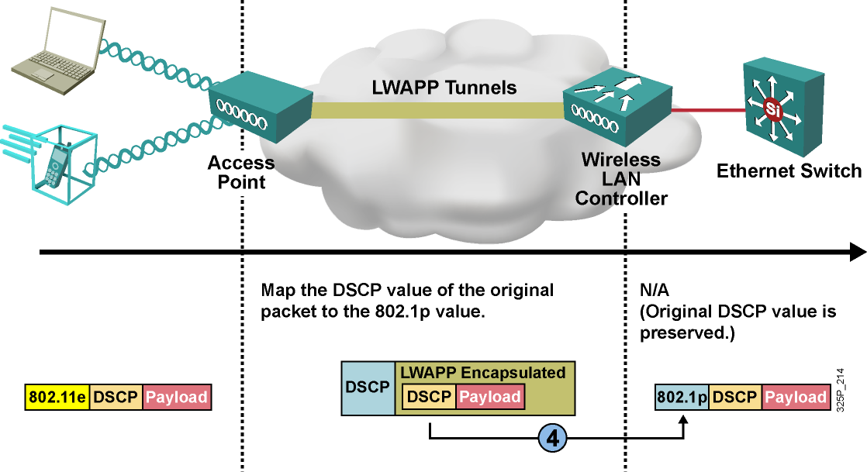
From Controller to Ethernet Switch

Slide 19
QoS Implementation
  802.1p or DSCP-tagged packets received from LAN:
    Tag is propagated to LWAPP frame.
    WLAN ID-configured QoS takes priority for assigned access category; if tag is lower than configured QoS,
    access point will queue packet at lower access category.
    AAA override can be applied to Cisco IBNS WLAN clients.
  Untagged packets received from LAN:
    WLAN ID-configured QoS will be applied for access category.
    AAA override can be applied to Cisco IBNS WLAN clients.

Slide 20
QoS Implementation (Cont.)
  802.11e QoS packets received from WLAN:
    Tag is propagated to LWAPP frame.
    WLAN ID-configured QoS takes priority for assigned 802.1p tag; if 802.11e access category is lower than configured QoS, lower 802.1p tag will be applied.
    802.11e QoS packets received from WLAN will be
    802.1p-tagged when transmitted on the LAN by the controller.
  Non-QoS packets received from WLAN will be best effort (default silver) when transmitted on the LAN by the controller.

Slide 21
WLAN QoS Configuration

Slide 22
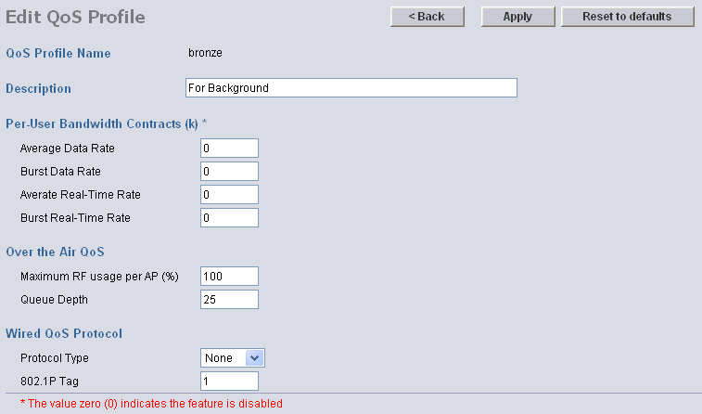
QoS-Configurable Profiles
Each level has a configurable per-bandwidth contract rate:
  Per-user data bandwidth contract—Configurable peak and average data rate enforcement for non-UDP traffic
  Per-user real-time bandwidth contract—Configurable peak and average data rate enforcement for UDP traffic

Slide 23
QoS-Configurable Profiles (Cont.)
Each level has configurable “over the air” QoS rates:
  Maximum RF usage per access point (%)—Defined maximum percentage of air bandwidth given to an access category
  Queue depth—Defined depth of queue for a particular user level that will cause packets in excess of the defined value to be dropped

Slide 24
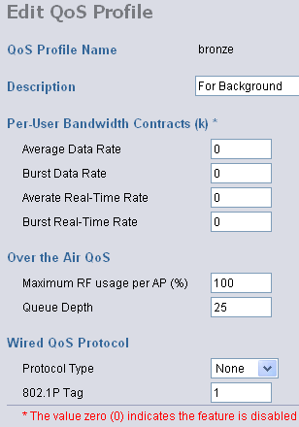
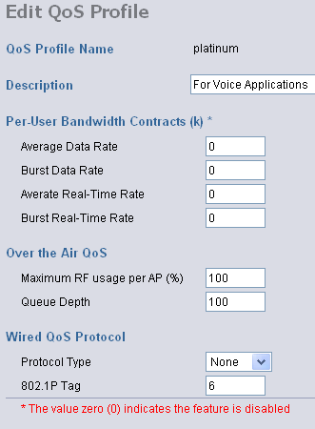
QoS-Configurable Profiles (Cont.)
The 802.1p tag is applied to the wired side to allow proper precedence to be applied to traffic across the entire network infrastructure.

Slide 25
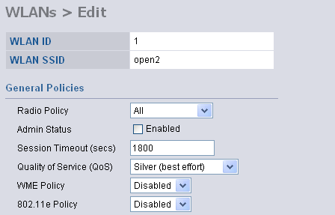


Configuring WLAN IDs for QoS

Slide 26
Summary
  Video and voice applications are used with wireless clients as well as date applications, and QoS is required for them.
  802.11e or WMM scheduling and queuing is implemented on access points.
  DCSP and 802.1p tagging is used to tag different types of traffic inside LWAPP tunnels.
  QoS policies and types of traffic are defined for each WLAN ID in the Wireless LAN Controller.

Slide 27


