Slide 1
Implement Wireless Scalability
Introducing 802.1x

Slide 2

The Need for WLAN Security

Slide 3
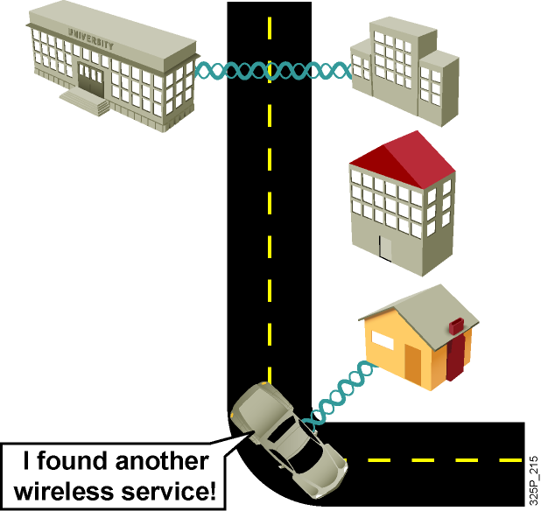
The Need for WLAN Security
  IEEE 802.11 equipment is widely available and inexpensive.
  The 802.11 standard is designed for ease of use and deployment.
  Many sniffers are available.
  Statistics on WLAN security are not encouraging.
  Media reports about hot spots, WLAN hacking, and war driving are frequent.
  Encryption is not optimally implemented in standard WEP.
  Authentication is vulnerable.

Slide 4
Security Methods—Authentication and Encryption

Slide 5
Security Methods—Authentication and Encryption
  Authentication: Proves that you belong on the network
  Encryption: Protects the data traversing the network
  Both authentication and encryption are needed and mandated by standards.

Slide 6
WLAN Security Issues
  Rogue access points
  Weakness of older forms of security:
    Service set identifier (SSID)
    Authentication controlled by MAC
    Static WEP keys
    Nonmutual authentication—one way only

Slide 7
WEP Attacks
  Weak, static WEP key
  Passive or weak initialization vector (IV) attack details
  Active or “bit flipping” and replay attack
  Authentication dictionary attacks

Slide 8
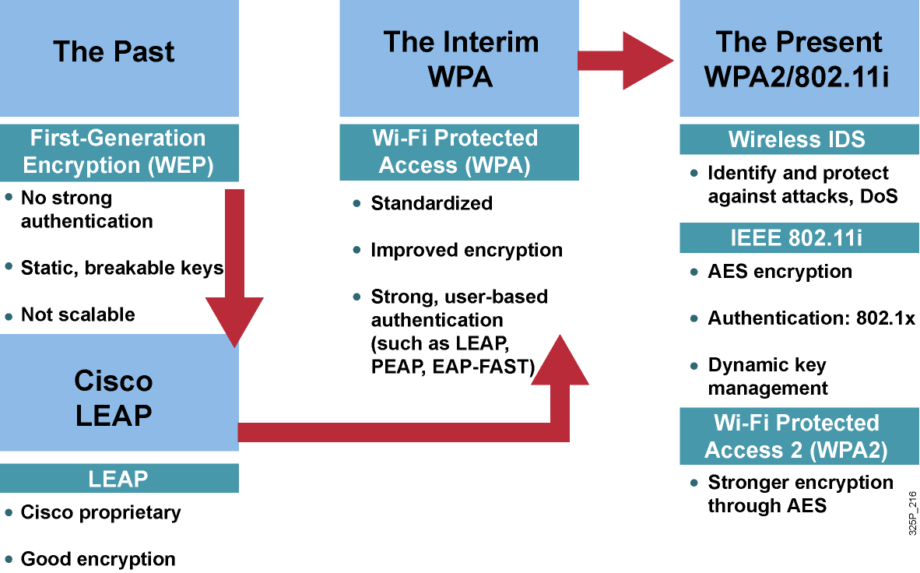
Overview of WLAN Security

Slide 9
802.11 WEP
  IEEE standard for encryption
  Uses RC4 algorithm—known vulnerabilities
  Keys can be static and shared among many clients
  Or keys can be dynamic and unique for each client
  (as with 802.1x) per session

Slide 10
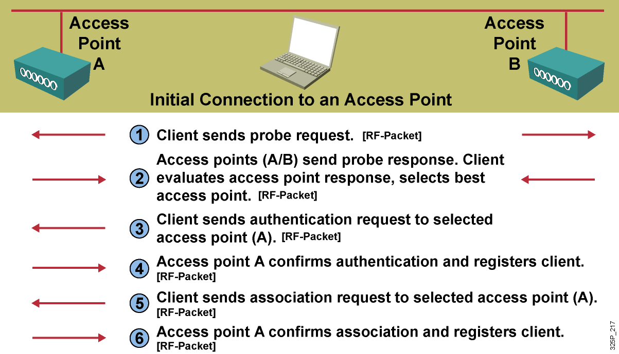
802.11 Open Authentication

Slide 11
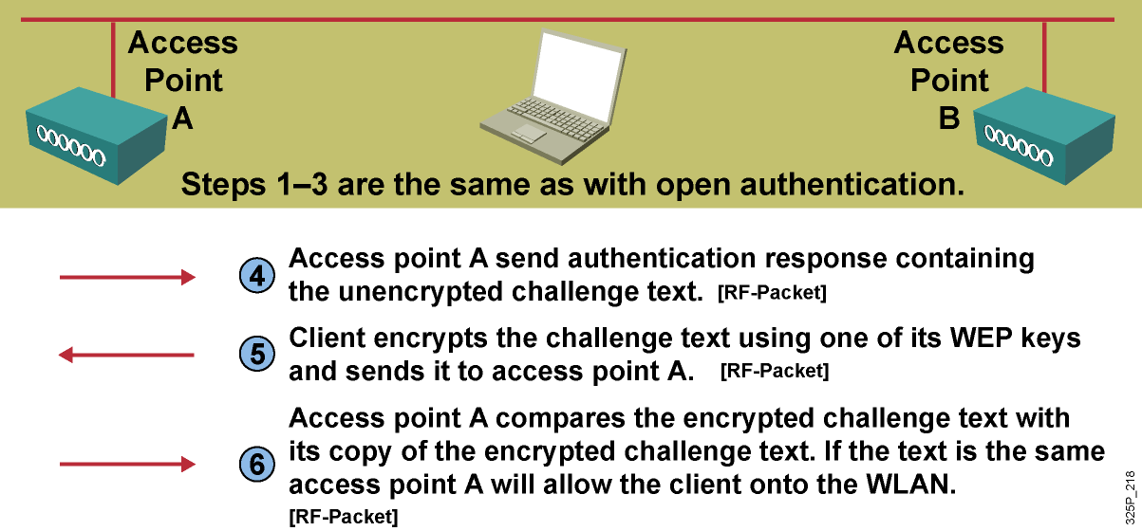
802.11 Shared Key Authentication

Slide 12
Cisco Enhanced 802.11 WEP Security

Slide 13
Cisco Enhanced 802.11 WEP Security
  Cisco Prestandard enhancements
  Implemented in 2001 and 2002
  Authentication:
    802.1x and Extensible Authentication Protocol (EAP) protocols
    User, token, machine credentials
    Dynamic encryption key generation
  Encryption:
    Cisco Key Integrity Protocol (CKIP)
    Cisco Message Integrity Check (CMIC)

Slide 14
Enhanced 802.11 Security
  Encryption:
    Temporal Key Integrity Protocol and Message Integrity Check
    Wi-Fi Protected Access (WPA)—TKIP encryption
    WPA2—Advanced Encryption Standard (AES)
  Authentication:
    802.1x and Extensible Authentication Protocol (EAP) protocols
    User, token, machine credentials
    Dynamic encryption key generation
    IEEE 802.11i

Slide 15
Encryption—TKIP and MIC
  Enhancements to RC4-based WEP:
    Key hashing for unique seed values per packet
    MIC from Michael algorithm
    Broadcast key rotation
  Key hashing protects against WEP initialization vector vulnerabilities, whereas MIC protects against man-in-the-middle or replay attacks.

Slide 16
Encryption—AES
  Specified in 802.11i
  128-bit block cipher—cryptographically more robust
  than RC4
  Part of WPA2
  Requires new radio cards on clients and access points because more CPU power is required

Slide 17
802.1x Overview

Slide 18
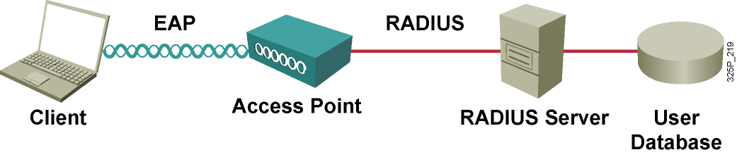
802.1x Authentication Overview
  Extensible and Interoperable supports:
    Different EAP authentication methods or types
    May be used with multiple encryption algorithms
    Depends on client capability
  Supported by Cisco since December 2000.

Slide 19
802.1x Authentication Key Benefits
  Mutual authentication between client and authentication (RADIUS) server
  Encryption keys derived after authentication
  Centralized policy control

Slide 20
802.1x and EAP Authentication Protocols
  Lightweight Extensible Authentication Protocol
  (LEAP)—EAP Cisco Wireless
  EAP-Flexible Authentication via Secure Tunneling
  (EAP-FAST)
  EAP-Transport Layer Security (EAP-TLS)
  Protected EAP (PEAP):
    PEAP-GTC
    PEAP-MSCHAPv2

Slide 21
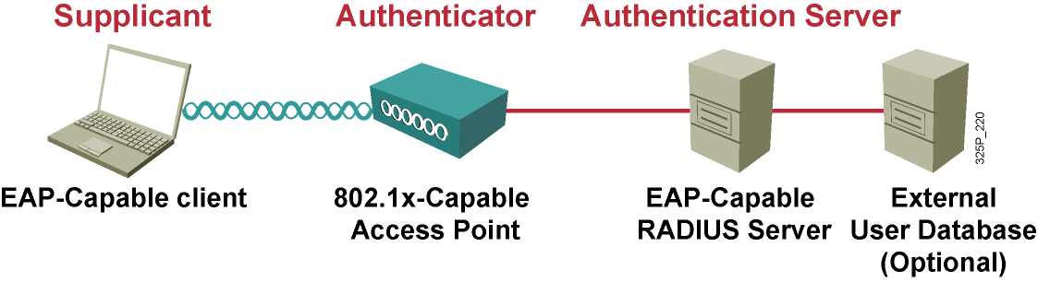
Components Required for 802.1x Authentication
  Authentication server = EAP-capable RADIUS server:
    Cisco Secure ACS, Microsoft IAS, Meetinghouse Aegis
    Local authentication service on Cisco IOS access point
    May use either local RADIUS database or an external database server such as Microsoft Active Directory or RSA SecurID
  Authenticator = 802.1x-capable access point
  Supplicant = EAP-capable client:
    Requires 802.1x-capable driver
    Requires an EAP supplicant—either available with client card, native in operating system, or from third-party software

Slide 22
EAP-Cisco Wireless

Slide 23
Cisco LEAP
  Client support:
    Windows 98-XP, Windows CE, Macintosh OS 9.X or 10.X, and Linux Kernel 2.2 or 2.4
    Cisco Compatible Extensions Clients (CCXv1)
  RADIUS server:
    Cisco Secure ACS and Cisco Access Registrar
    Meetinghouse Aegis
    Interlink Merit
  Microsoft domain or Active Directory (optional) for back-end authentication (must be Microsoft format database)
  Device support:
    Cisco autonomous access points and bridges
    Cisco lightweight access points and WLAN controllers
    Cisco Unified Wireless IP Phone 7920 (VoIP) handset

Slide 24
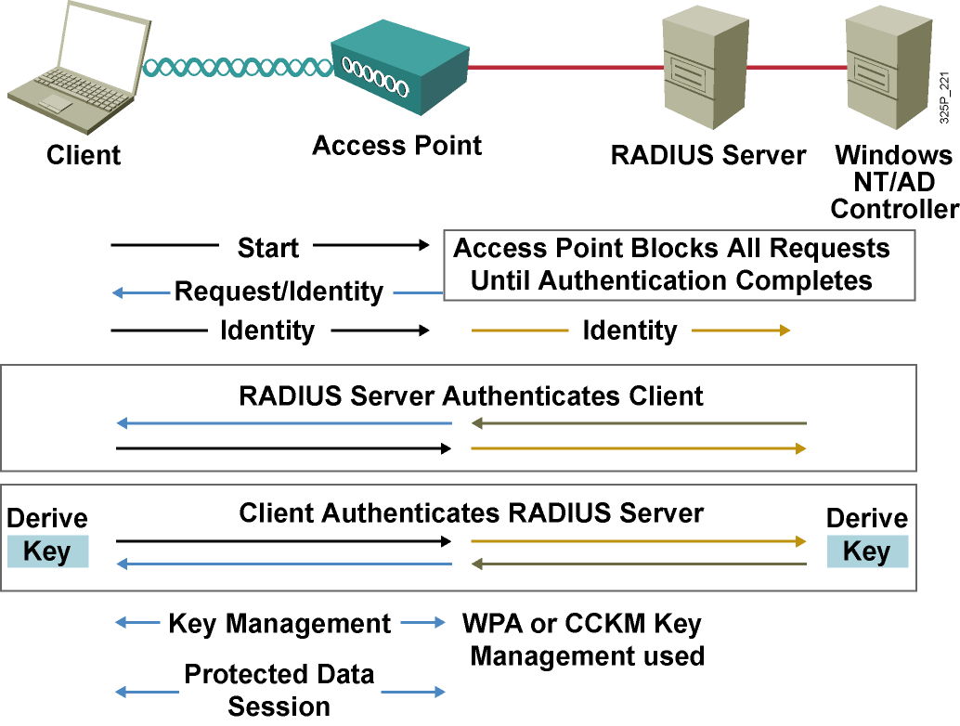
Cisco LEAP Authentication

Slide 25
EAP-FAST

Slide 26
EAP-FAST: Flexible Authentication via Secure Tunneling
Considered in three phases:
  Protected access credential is generated in phase 0 (Dynamic PAC provisioning)
    Unique shared credential used to mutually authenticate client and server
    Associated with a specific user ID and an authority ID
    Removes the need for PKI
  A secure tunnel is established in phase 1
  Client is authenticated via the secure tunnel in phase 2

Slide 27
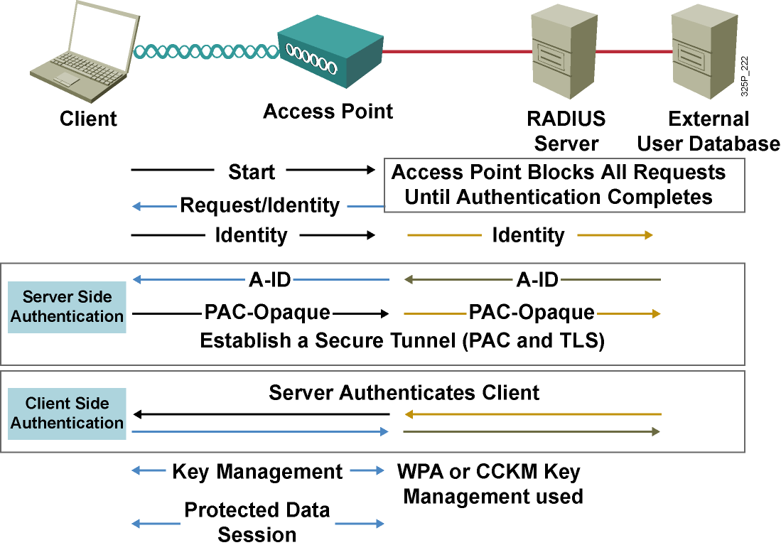
EAP-FAST Authentication

Slide 28
EAP-TLS

Slide 29
EAP-TLS
  Client support:
    Windows 2000, XP, and Windows CE (natively supported)
    Non-Windows platforms: Third-party supplicants (Meetinghouse)
    User certificate required for each client
  Infrastructure requirements:
    EAP-TLS supported RADIUS server
      Cisco Secure ACS, Cisco Access Registrar, Microsoft IAS, Aegis, Interlink
    RADIUS server requires a server certificate
    Certificate authority server (PKI)
  Certificate management:
    Both client and RADIUS server certificates to be managed

Slide 30
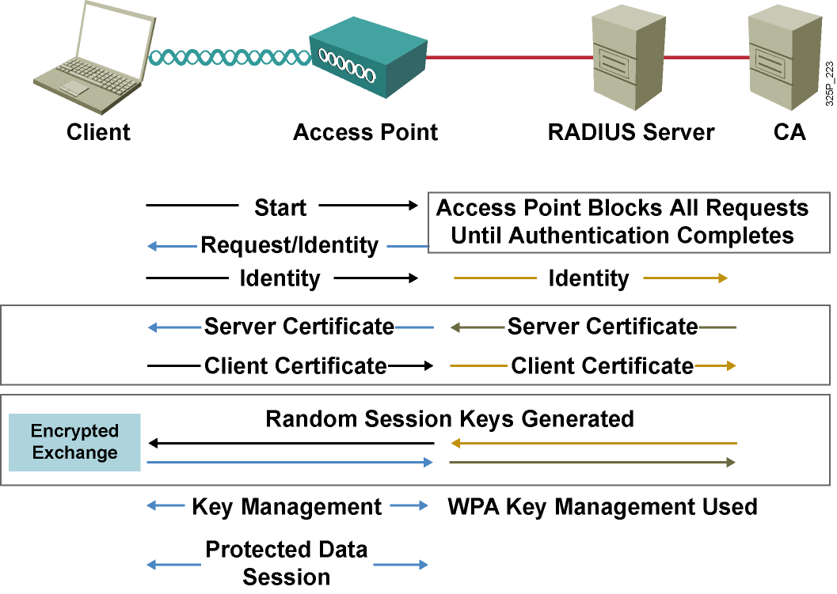
EAP-TLS Authentication

Slide 31
EAP-PEAP

Slide 32
EAP-PEAP
  Hybrid authentication method:
    Server-side authentication with TLS
    Client-side authentication with EAP authentication types
      EAP-GTC
      EAP-MSCHAPv2
  Clients do not require certificates.
  RADIUS server requires a server certificate:
    RADIUS server has self-issuing certificate capability.
    Purchase a server certificate per server from PKI entity.
    Set up a simple PKI server to issue server certificates.
  Allows for one-way authentication types to be used:
    One-time passwords
    Proxy to LDAP, Unix, Microsoft Windows NT and Active Directory, Kerberos

Slide 33
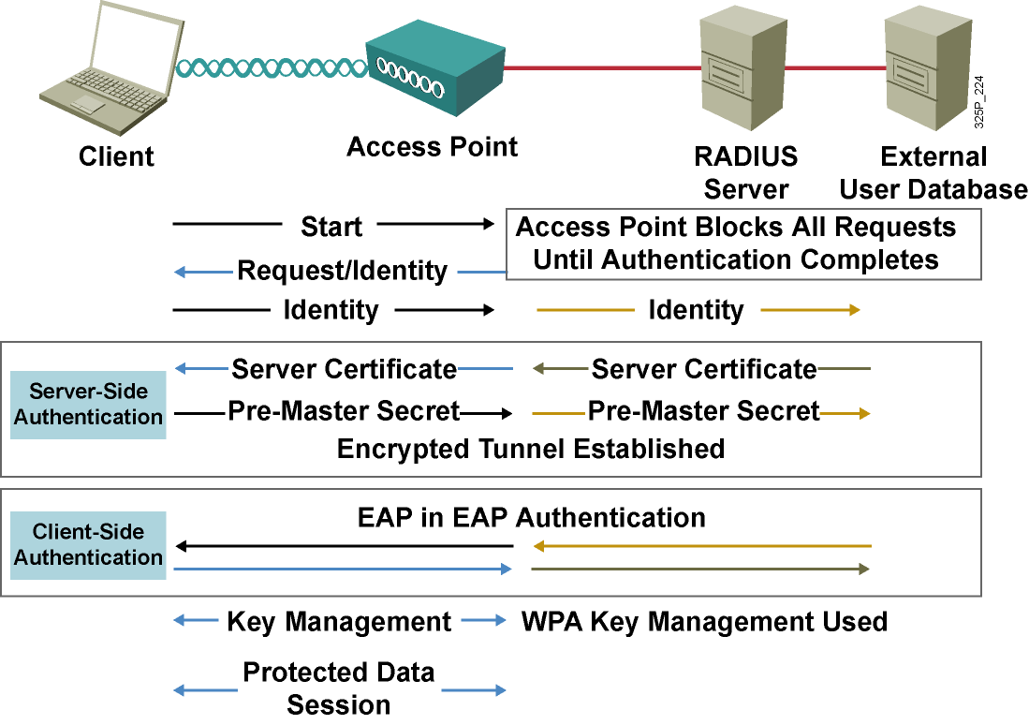
EAP-PEAP Authentication

Slide 34
Wi-Fi Protected Access

Slide 35
Wi-Fi Protected Access
  WPA introduced in late 2003
  Prestandard implementation of IEEE 802.11i WLAN security
  Addresses currently known security problems with WEP
  Allows software upgrade on deployed 802.11 equipment to improve security
  Components of WPA:
    Authenticated key management using 802.1x: EAP authentication and preshared key authentication
    Unicast and broadcast key management
    Standardized Temporal Key Integrity Protocol (TKIP) per-packet keying and message integrity check (MIC) protocol
    Initialization vector space expansion: 48-bit initialization vectors
    Migration mode—coexistence of WPA and non-WPA devices (optional implementation that is not required for WPA certification)

Slide 36
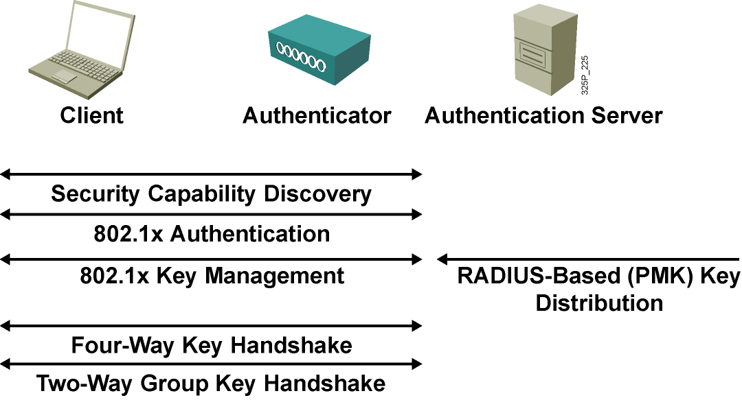
802.11i and WPA Authentication and Key Management Overview

Slide 37
WPA Issues
  WPA uses TKIP, which uses the same base encryption algorithm—RC4—as WEP.
  WPA cannot avoid the design flaws of WEP entirely.
  WPA, is in the end, a compromise solution.
  Software upgrade is required for clients and access points, which gives no guarantee that all vendors will support the solution.
  Operating system support or a supplicant client is required.
  WPA is susceptible to a new type of DoS attack.
  WPA is susceptible to a recently discovered weakness when preshared keys are used.

Slide 38
IEEE 802.11i—WPA2
  802.11i:
    Ratified in June 2004
    Standardizes:
      802.1x for authentication
      AES encryption—Facilitates U.S. government FIPS 140-2 compliance
      Key management
  WPA2:
    Supplement to WPA “version 1”—Wi-Fi Alliance interoperable implementation of 802.11i
    Provides for AES encryption to be used
    Proactive Key Caching
    Third-party testing and certification for WLAN device compatibility

Slide 39
Wireless Intrusion Detection Systems
  Address RF-related vulnerabilities:
    Detect, locate, mitigate rogue devices
    Detect and manage RF interference
    Detect reconnaissance if possible
  Address standards-based vulnerabilities:
    Detect management frame and hijacking style attacks
    Enforce security configuration policies
  Complementary functionality:
    Forensic analysis
    Compliance reporting

Slide 40
WPA and WPA2 Modes
 | WPA | WPA2
Enterprise mode (business, education, government) | Authentication: IEEE 802.1x/EAP Encryption: TKIP/MIC | Authentication: IEEE 802.1x/EAP Encryption: AES-CCMP
Personal mode (SOHO, home/personal) | Authentication: PSK Encryption: TKIP/MIC | Authentication: PSK Encryption: AES-CCMP

Slide 41
WPA2 Issues
Client (supplicant) must have a WPA2 driver that supports EAP.
RADIUS server must understand EAP.
PEAP carries EAP types within a channel secured by TLS and so requires a server certificate.
WPA2 is more compute-intensive with optional AES encryption.
WPA2 may require new WLAN hardware to support AES encryption.

Slide 42
Summary
  Authentication and encryption are the two primary facilities for securing the WLAN.
  Encryption is the method of ensuring that data remains uncorrupted throughout the sending and receiving process.
  Encryption using static WEP keys is very vulnerable.
  EAP and the 802.1x standards are designed to leverage existing standards.
  The LEAP authentication process is mutual because the client needs to authenticate the server and the server needs to authenticate the client.

Slide 43
Summary (Cont.)
  With EAP-FAST, the wireless client associates with access point using open authentication.
  EAP-TLS uses authentication derived from digital certificates for user and server authentication.
  PEAP uses user authentication with OTP or static password.
  WPA has two different modes: Enterprise and Personal. Both modes provide encryption support and user authentication.
  WPA2 is similar to WPA but supports AES encryption.

Slide 44
