Slide 1
Implement Wireless Scalability
Configuring Encryption and Authentication on Lightweight Access Points

Slide 2

Open Authentication

Slide 3
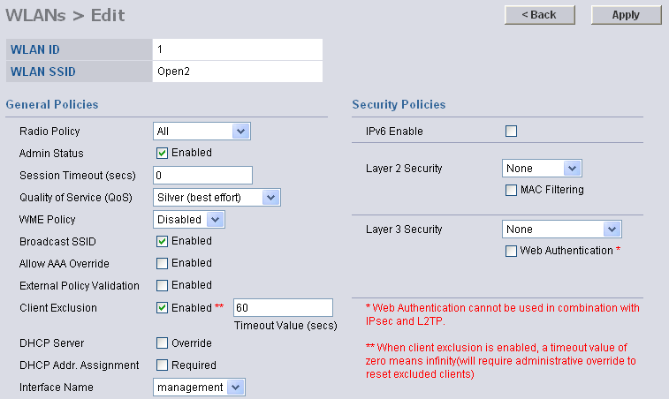
Open Authentication

Slide 4
Static WEP Key Authentication

Slide 5
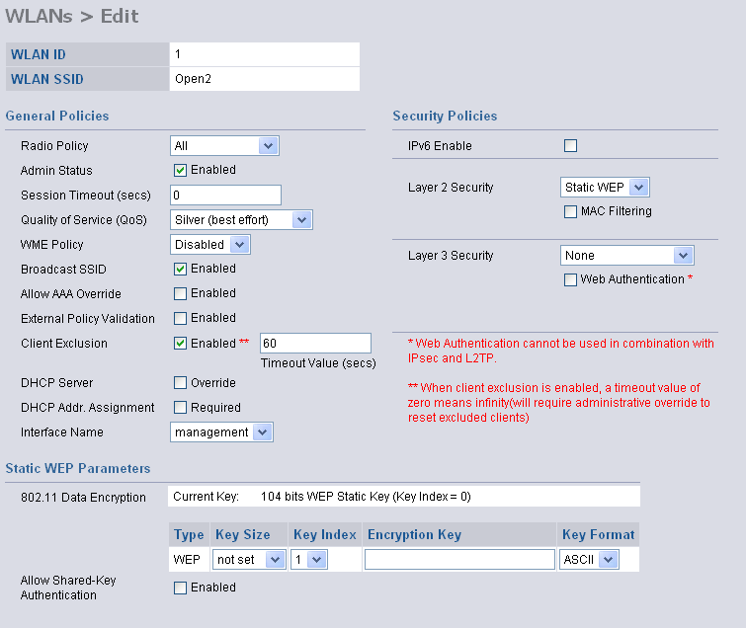


Static WEP Key

Slide 6
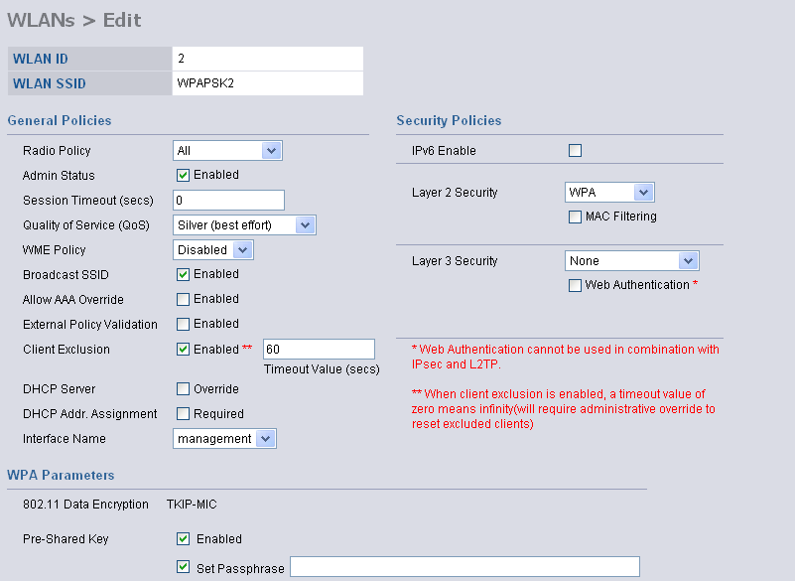
WPA Preshared Key
This example shows WPA
preshared key

Slide 7
Web Authentication

Slide 8
Web Authentication
  Users authenticate via a web browser interface.
  Clients using HTTP are automatically directed to a
  login page:
    Customizable for logos and text
    Maximum simultaneous authentication requests—21
    Maximum local web authentication users—2500
  Generally used for guest access:
    Data is not secure between the access point and the client.

Slide 9
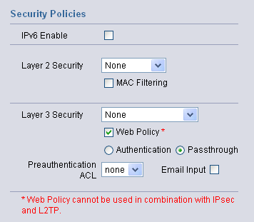
Web Authentication (Cont.)

Slide 10
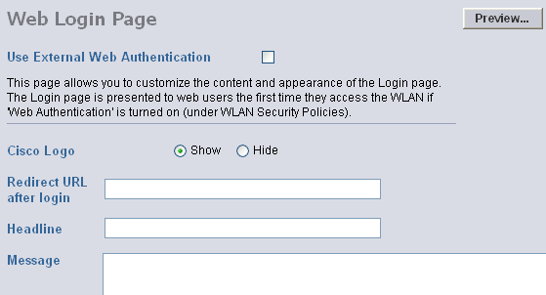
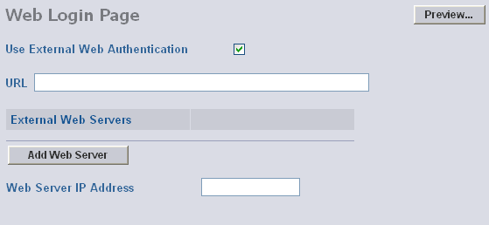
Web Authentication (Cont.)

Slide 11
802.1x Authentication

Slide 12
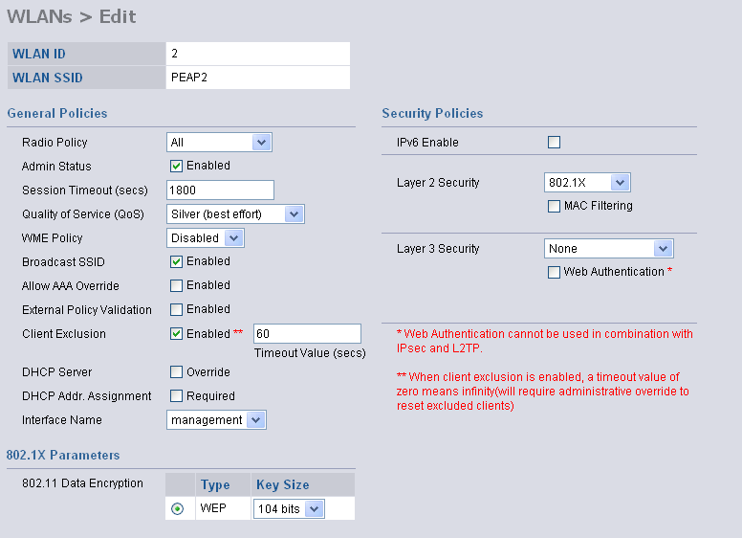
802.1x Authentication
Microsoft Windows XP clients support only 40-bit or 104-bit dynamic WEP keys.

Slide 13
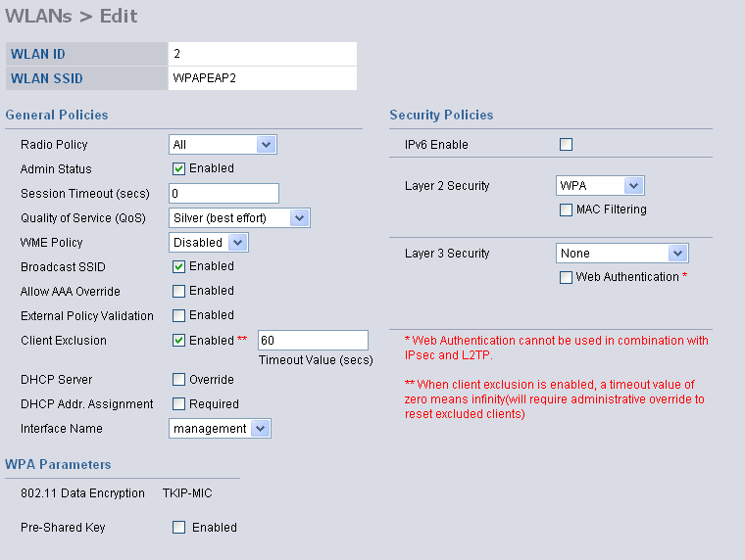
WPA with 802.1x
This example shows WPA with dynamic keys.

Slide 14
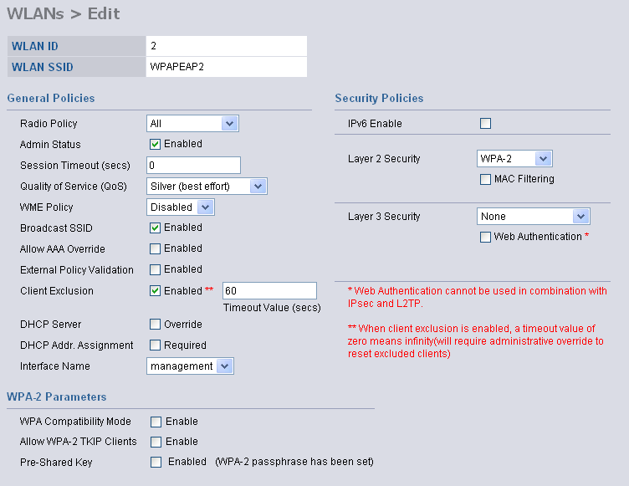
WPA2
This example shows WPA2 with dynamic keys.

Slide 15
Summary
  Configuration is done using a GUI.
  Guest or hot-spot access can deploy open or web authentication.
  Basic security can be implemented with static WEP.
  Improved security results when you use WPA or WPA2 using preshared keys or dynamic 802.1x.

Slide 16


