Slide 1

What is hosting?
Hosting is like renting an office.
A server dedicated to hosting a service or services for users.
Hosting servers can be shared among many clients (shared hosting servers) or dedicated to a single client (dedicated servers)

Slide 2


The type of hosting?
Shared Hosting :
Good | Bad
Cheap Do not config Easy to manage | Limit resources Easy down

Slide 3

The type of hosting?
Collocated hosting :
- Full control | To expensive Difficult to manage

Slide 4

The type of hosting?
Dedicated Server: look similar Collocated hosting

Slide 5
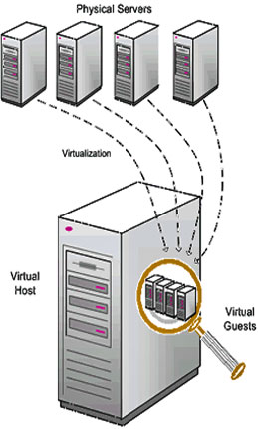
The type of hosting?
Virtual private server or Virtual Dedicated Server , and many types of hosting else : Reseller hosting, email hosting,video hosting, image hosting, file hosting, adult hosting(DENIES IN VIETNAM)

