Slide 1
Wideband Code Division Multiple Access (WCDMA) for UMTS
Kari Aho
Senior Research Scientist
kari.aho@magister.fi

Slide 2
Disclaimer
Effort has been put to make these slides as correct as possible, however it is still suggested that reader confirms the latest information from official sources like 3GPP specs (http://www.3gpp.org/Specification-Numbering)
Material represents the views and opinions of the author and not necessarily the views of their employers
Use/reproduction of this material is forbidden without a permission from the author

Slide 3
Readings related to the subject
General readings
  WCDMA for UMTS – H. Holma, A. Toskala
  HSDPA/HSUPA for UMTS – H. Holma, A. Toskala
  3G Evolution - HSPA and LTE for Mobile Broadband - E. Dahlman, S. Parkvall, J. Sköld and P. Beming,
Network planning oriented
  Radio Network Planning and Optimisation for UMTS – J. Laiho, A. Wacker, T. Novosad
  UMTS Radio Network Planning, Optimization and QoS Management For Practical Engineering Tasks – J. Lempiäinen, M. Manninen

Slide 4
Outline
Background
Wideband Code Division Multiple Access (WCDMA)
WCDMA Performance Enhancements
  Multimedia Broadcast Multicast Service (MBMS)
  Femtocells
Conclusions

Slide 5
Background
Why new radio access for UMTS
Frequency Allocations
Standardization
WCDMA background and evolution
Evolution of Mobile standards
Current WCDMA markets

Slide 6
Why new radio access system for UMTS (1/2)
Need for universal standard
  Universal Mobile Technology System (UMTS)
Support for packet data services
  IP data in the core network
  IP radio access
New services in mobile multimedia need higher data rates and flexible utilization of the spectrum

Slide 7
Why new radio access system for UMTS (2/2)
FDMA and TDMA are not efficient enough
  TDMA wastes time resources
  FDMA wastes frequency resource
  CDMA can exploit the whole bandwidth constantly
WCDMA was selected for a radio access system for UMTS (1997)

Slide 8
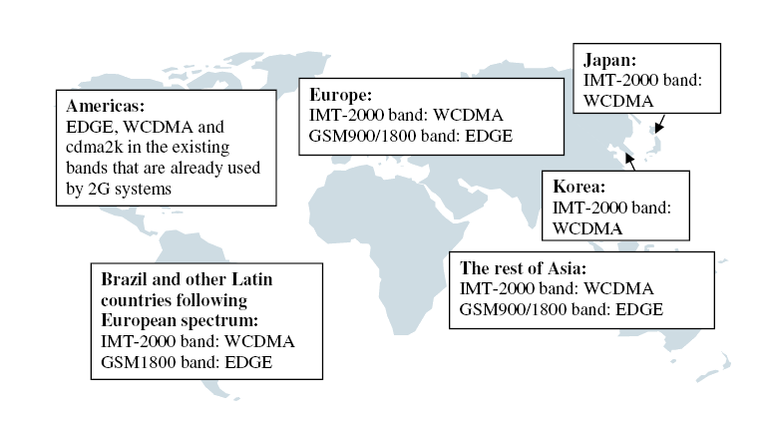
Frequency allocations for UMTS
Frequency plans of Europe, Japan and Korea are harmonized
US plan is incompatible
  Spectrum is currently used for the US 2G standards
IMT-2000 in Europe:
  FDD 2x60MHz
Expected air interfaces and spectrums, source: “WCDMA for UMTS”

Slide 9
Standardization (1/2)
WCDMA was studied in various research programs in the industry and universities
WCDMA was chosen besides ETSI also in other forums like ARIB (Japan) as 3G technology in late 1997/early 1998.
During 1998 parallel work proceeded in ETSI and ARIB (mainly), with commonality but also differences
  Resource consuming for companies with global presence and not likely to arrive to identical specifications globally
  The same discussion e.g. in ETSI and ARIB sometimes ended up to different conclusions
  Work was also on-going in USA and Korea

Slide 10

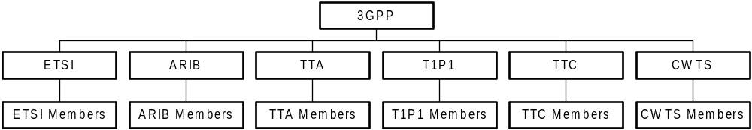
Standardization (2/2)
At end of 1998 different standardization organization got together and created 3GPP, 3rd Generation Partnership Project.
  5 Founding members: ETSI, ARIB+TTC (Japan), TTA (Korea), T1P1 (USA)
  CWTS (China) joined later.
Different companies are members through their respective standardization organization.

Slide 11
WCDMA Background and Evolution (1/2)
First major milestone was Release -99, 12/99
  Full set of specifications by 3GPP
  Targeted mainly on access part of the network
Release 4, 03/01 (markets went from Rel 99 -> Rel 5)
  Core network was extended
Release 5, 03/02
  High Speed Downlink Packet Access (HSDPA)
Release 6, end of 04/beginning of 05
  High Speed Uplink Packet Access (HSUPA)
Release 7, 06/07
  Continuous Packet connectivity (improvement for e.g. VoIP), MIMO, Higher order modulation

Slide 12
WCDMA Background and Evolution (2/2)
3GPP Rel -99
12/99
3GPP Rel 4
03/01
3GPP Rel 5
03/02
3GPP Rel 6
2H/04
3GPP Rel 7
06/07
Further Releases
2000
2001
2002
2003
2004
2005
2006
2007
Japan
Europe
(pre-commercial)
Europe
(commercial)
HSDPA (commercial)
HSUPA (commercial)

Slide 13

Evolution of Mobile standards
EDGE
WCDMA
FDD
HSDPA/
HSUPA
GSM
HSCSD
GPRS
LTE
TD-CDMA
TDD HCR
HSDPA/
HSUPA
TD-SCDMA
TDD LCR
cdma2000
1XEV - DO
cdmaOne
(IS-95)
cdma2000
cdma2000
1XEV - DV

Slide 14
Current WCDMA markets (1/2)
According to http://www.umts-forum.org/ and https://www.wirelessintelligence.com
  More than 340 million WCDMA subscribers
  Around 100 million HSDPA subscribers
  Around 260 WCDMA networks in over 105 countries
  Around 230 HSDPA networks around the world in over 90 countries

Slide 15
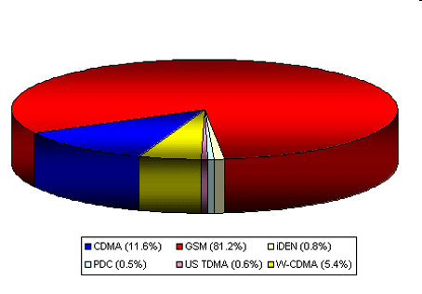
Current WCDMA markets (2/2)
GSM+WCDMA share currently over 86%
CDMA share decreasing every year
source: http://www.wcisdata.com/

Slide 16
Questions
Why new radio access system?
Why USA does not follow the same spectrum allocation that Europe follows?
Why 3GPP was founded?

Slide 17
Wideband Code Division Multiple Access (WCDMA)
Overview
Codes
UMTS Architecture
Radio propagation, fading and receivers
Diversity
Power Control
Handovers
Channels

Slide 18
WCDMA System (1/3)
WCDMA is the most common radio interface for UMTS systems
Wide bandwidth, 3.84 Mcps (Megachips per second)
  Maps to 5 MHz due to pulse shaping and small guard bands between the carriers
Users share the same 5 MHz frequency band and time
  UL and DL have separate 5 MHz frequency bands
  Users are separated from each other with codes and thus frequency reuse factor equals to 1
High bit rates
  With Release ’99 theoretically 2 Mbps
  The higher implemented is however 384 kbps

Slide 19
WCDMA System (2/3)
Fast power control (PC)
  Reduces the impact of channel fading and minimizes the interference
Soft handover
  Improves coverage, decreases interference
Robust and low complexity RAKE receiver
  Introduces multipath diversity
Support for flexible bit rates

Slide 20
WCDMA System (3/3)
Multiplexing of different services on a single physical connection
  Simultaneous support of services with different QoS requirements:
    Real-time, (voice, video telephony)
    Streaming (video and audio)
    Interactive (web-browsing)
    Background (e-mail download)

Slide 21
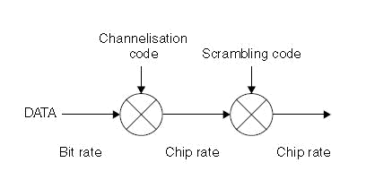
Codes in WCDMA (1/4)
Channelization Codes (=short codes)
  Defines how many chips are used to spread a single information bit and thus determines the end bit rate
    Length is referred as spreading factor
  Used for:
    Downlink: Separation of downlink connections to different users within one cell
    Uplink: Separation of data and control channels from same terminal
  Same channelization codes in every cell / mobiles
    additional scrambling code is needed

Slide 22
Codes in WCDMA (2/4)
Scrambling codes (=long codes)
  Very long (38400 chips), many codes available
  Does not spread the signal
  Used for
    Downlink: to separate different cells/sectors
    Uplink: to separate different mobiles
  The correlation between two codes (two mobiles/NodeBs) is low

Slide 23

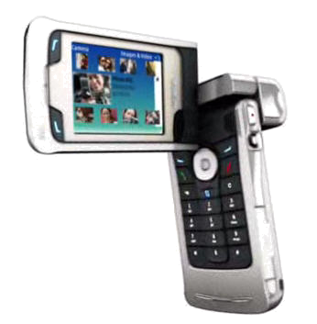
Codes in WCDMA (3/4)
Channelization codes separate data/control channels
Channelization codes separate different connection
Scrambling codes separate cells/sectors
Channelization codes separate different mobiles
Downlink
Uplink

Slide 24
Codes in WCDMA (4/4)
Symbol_rate =
Chip_rate/SF
Bit_rate =
Symbol_rate*2
Control channel
(DPCCH) overhead
User_bit_rate =
Channel_bit_rate/2
Spreading
Channel
Channel
DPDCH
Maximum user
Factor (SF)
symbol
bit rate
channel bit
data rate with ½-
rate
(kbps)
rate range
rate coding
(kbps)
(kbps)
(approx.)
512
7.5
15
3–6
1–3 kbps
Half rate speech
256
15
30
12–24
6–12 kbps
Full rate speech
128
30
60
42–51
20–24 kbps
64
60
120
90
45 kbps
32
120
240
210
105 kbps
144 kbps
16
240
480
432
215 kbps
384 kbps
8
480
960
912
456 kbps
4
960
1920
1872
936 kbps
4, with 3
2880
5760
5616
2.3 Mbps
2 Mbps
parallel
codes

Slide 25
Questions
To what purpose channelization codes are used in the downlink?
To what purpose scrambling codes are used in the uplink?

Slide 26

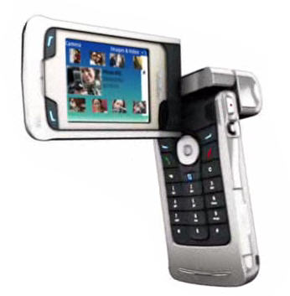
UMTS Terrestrial Radio Access Network (UTRAN) Architecture (1/3)
Uu interface
Iub interface
New Radio Access network needed mainly due to new radio access technology
Core Network (CN) is based on GSM/GPRS
Radio Network Controller (RNC) corresponds roughly to the Base Station Controller (BSC) in GSM
Node B corresponds roughly to the Base Station in GSM
RNC
UE
NodeB
CN
NodeB
UE
Iur interface
RNC
NodeB
UTRAN

Slide 27
UMTS Terrestrial Radio Access Network (UTRAN) Architecture (2/3)
RNC
  Owns and controls the radio resources in its domain
  Radio resource management (RRM) tasks include e.g. the following
    Mapping of QoS Parameters into the air interface
    Air interface scheduling
    Handover control
    Outer loop power control
    Admission Control
    Initial power and SIR setting
    Radio resource reservation
    Code allocation
    Load Control

Slide 28
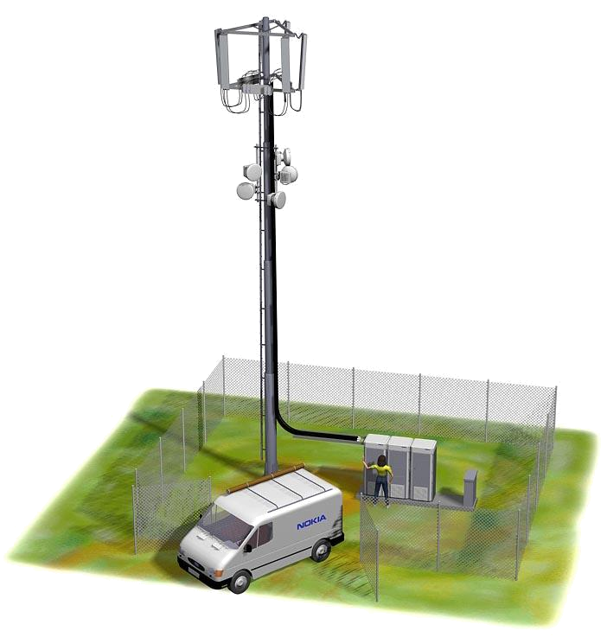
UMTS Terrestrial Radio Access Network (UTRAN) Architecture (3/3)
Node B
  Main function to convert the data flow between Uu and Iub interfaces
  Some RRM tasks:
    Measurements
    Innerloop power control

Slide 29
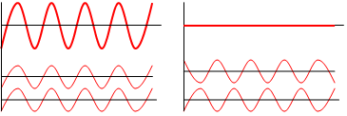
Radio propagation, fading and receivers (1/4)
When transmitted radio signal travels in the air interface it is altered in many ways before it reaches the receiver
  reflections, diffractions, attenuation of the signal energy, etc.
These different multipath components of the transmitted signal arrive at different times to the receiver and can cause either destructive or constructive addition to the arriving plane waves

Slide 30
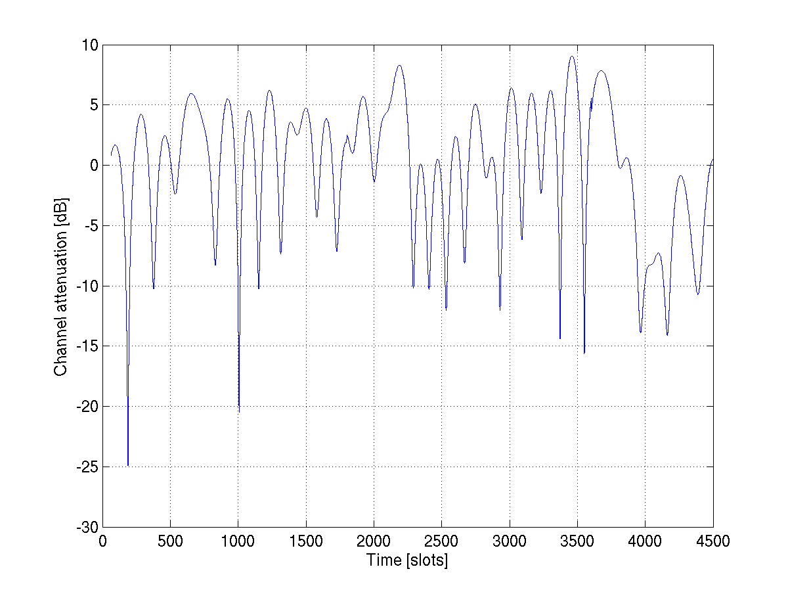
Radio propagation, fading and receivers (2/4)
Fast changes of the radio channel conditions caused by the fading channel conditions (destructive and constructive addition) is called fast fading
Example of the fast fading channel in the function of time is in the right hand figure
  Illustrates, for instance, deep fades in the channel that power control would need to react to

Slide 31
Radio propagation, fading and receivers (3/4)
The most commonly used receiver is so called Rake receiver
  Especially designed to compensate the effects of fading
  Every multipath component arriving at the receiver more than one chip time (0.26 μs) apart can be distinguished by the RAKE receiver
Compensating is done by using several ’sub-receivers’ referred as fingers
  Each of those fingers can receive individual multipath components
Each component is then decoded independently and after that combined in order to make the most use of the different multipath components and thus reduce the effect of fading
  This kind of combining method is so called Maximum Ratio Combining (MRC)

Slide 32
Radio propagation, fading and receivers (4/4)
Transmitted symbol
Received symbol at each time slot
Phase modified using the channel estimate
Combined symbol
Finger #1
Finger #2
Finger #3

Slide 33
Diversity (1/2)
Different components of the transmitted signal can be used to enhance the end quality of the received signal
Components differ from each other by their amplitudes and delays
There exists different types diversity which can be used to improve the quality, e.g.:
  Multipath
    Reflections, diffractions, attenuation of the signal energy, etc.
  Macro
    Different basestations or NodeBs send the same information
  Site Selection Diversity Transmission (SSTD)
    Maintain a list of available basestations and choose the best one, from which the transmission is received and tell the others not to transmit

Slide 34
Diversity (2/2)
  Time
    Same information is transmitted in different times
  Receiver
    Transmission is received with multiple antennas
  Transmit
    Transmission is sent with multiple antennas

Slide 35
Questions
What does RNC stand for and what it is responsible for?
What is Rake and how it improves the signal quality?

Slide 36
Power Control in WCDMA (1/4)
The purpose of power control (PC) is to ensure that each user receives and transmits just enough energy to prevent:
  Blocking of distant users (near-far-effect)
  Exceeding reasonable interference levels
Without PC received power levels would be unequal
UE1
UE2
UE3
UE1
UE2
In theory with PC received power levels would be equal
UE1
UE2
UE3
UE3

Slide 37
Power Control in WCDMA (2/4)
Power control can be divided into two parts:
  Open loop power control (slow power control)
    Used to compensate e.g. free-space loss in the beginning of the call
    Based on distance attenuation estimation from the downlink pilot signal
  Closed loop power control (fast power control)
    Used to eliminate the effect of fast fading
    Applied 1500 times per second

Slide 38
Power Control in WCDMA (3/4)
Closed loop power control can also be divided into two parts:
  Innerloop power control
    Measures the signal levels and compares this to the target value and if the value is higher than target then power is lowered otherwise power is increased
  Outerloop power control
    Adjusts the target value for innerloop power control
    Can be used to control e.g. the Quality of Service (QoS)

Slide 39
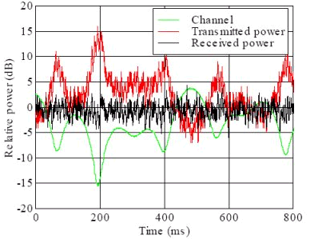
Power Control in WCDMA (4/4)
Example of inner loop power control behavior:
With higher velocities channel fading is more rapid and 1500 Hz power control may not be sufficient

Slide 40
WCDMA Handovers (1/7)
WCDMA handovers can be categorized into three different types which support different handover modes
  Intra-frequency handover
    WCDMA handover within the same frequency and system. Soft, softer and hard handover supported
  Inter-frequency handover
    Handover between different frequencies but within the same system. Only hard handover supported
  Inter-system handover
    Handover to the another system, e.g. from WCDMA to GSM. Only hard handover supported

Slide 41
WCDMA Handovers (2/7)
Soft handover
  Handover between different base stations
  Connected simultaneously to multiple base stations
    The transition between them should be seamless
    Downlink: Several Node Bs transmit the same signal to the UE which combines the transmissions
    Uplink: Several Node Bs receive the UE transmissions and it is required that only one of them receives the transmission correctly
UE1
BS 1
BS 2

Slide 42
WCDMA Handovers (3/7)
Softer handover
  Handover within the coverage area of one base station but between different sectors
  Procedure similar to soft handover
UE1
BS 1
BS 2

Slide 43
WCDMA Handovers (4/7)
Hard handover
  The source is released first and then new one is added
  Short interruption time
Terminology
  Active set (AS), represents the number of links that UE is connected to
  Neighbor set (NS), represents the links that UE monitors which are not already in active set

Slide 44
WCDMA Handovers (5/7)
Handover parameters
  Add window
    Represents a value of how much worse a new signal can be compared to the best one in the current active set in order to be added into the set
    Adding link to combining set can be done only if maximum number of links is not full yet (defined with parameter).
    Moreover a new link is added to the active set only if the difference between the best and the new is still at least as good after the ‘add timer’ is expired. Timer is started when the signal first reaches the desired level.
  Drop window
    Represents a value of how much poorer the worst signal can be when compared to the best one in the active set before it is dropped out
    Similarly to adding, signal which is to be dropped needs to fulfill the drop condition after the corresponding drop timer is expired.

Slide 45
WCDMA Handovers (6/7)
  Replace window
    Represents a value for how much better a new signal has to be compared to the poorest one in the current active set in order to replace its place
    Replace event takes place only if active set is full as otherwise add event would be applied
    Similarly to add and drop events, also with replace event there exist a replace timer

Slide 46
WCDMA Handovers (7/7)
Exercises:
  Replace ‘Threshold_1’, ‘Triggering time_1’, etc with correct handover parameter names.
  Which event is missing from the example?
BS1
Triggering time_1
Triggering time_2
Received
signal
strength
Threshold_1
Threshold_2
BS2
BS3
BS1 dropped from the AS
BS2 from the NS reaches the threshold to be added to the AS
BS1 from the AS reaches the threshold to be dropped from the AS

Slide 47
Questions
To which parts can the fast i.e. closed loop power control be dived into?
To how many base stations UE is connected to when it makes a hard handover?

Slide 48
WCDMA Channels (1/6)
In WCDMA there exists two types of transport channels:
  Dedicated Channels (DCHs)
    Resources are reserved for a single user only (continuous and independent from the DCHs of other UEs)
  Common channels
    Resources are shared between users
The main transport channels used for packet data transmissions in WCDMA are called
  DCH
  Forward Access Channel (FACH)

Slide 49
WCDMA Channels (2/6)
DCH is used to carry
  User data
  All higher layer control information, such as handover commands
DCH is characterized by features such as
  Fast power control
  Soft handover
  Fast data rate change on a frame-by-frame basis is supported in the uplink
  In the downlink data rate variation is taken care of either with a rate-matching operation or with Discontinuous Transmission (DTX) instead of varying spreading factor frame-by-frame basis

Slide 50
WCDMA Channels (3/6)
If downlink rate matching is used then data bits are either
  Repeated to increase the rate
  Punctured to decrease the rate
With DTX the transmission is off during part of the slot
FACH is a downlink transport channel used to carry
  Packet data
  Mandatory control information, e.g. to indicate that random access message has been received by BTS
Due to the reason that FACH carries vital control information FACH has to have such a low bit rate that it can be received by all UEs in the cell

Slide 51
WCDMA Channels (4/6)
However, there can be more than one FACH in a cell which makes it possible to have higher bit rates for the other FACHs
The FACH does not support fast power control
In addition to FACH there are five different common channels in WCDMA:
  Broadcast Channel (BCH)
    Used to transmit information specific to the UTRA network or for a given cell, e.g. random access codes
    Channel needs to be reached by all UEs within the cell
  Paging Channel (PCH)
    Carries data relevant to the paging procedure, i.e. when the network wants to initiate communication with the terminal
    Terminals must be able to receive the paging information in the whole cell area

Slide 52
WCDMA Channels (5/6)
  Random Access Channel (RACH)
    Uplink transport channel intended to be used to carry control information from the terminal, such as requests to set up a connection
  Uplink Common Packet Channel (CPCH)
    Extension to the RACH channel that is intended to carry packet-based user data in the uplink direction
  Dedicated Shared Channel (DSCH)
    Carries user data and/or control information; it can be shared by several users

Slide 53
WCDMA Channels (6/6)
From the common channels DSCH was optional feature that was seldom implemented by the operators and later replaced in practice with High Speed Downlink Packet Access (HSDPA)
  3GPP decided to take DSCH away from Release 5 specifications onwards
  Also CPCH has been taken out of the specifications from Rel’5 onwards as it was not implemented in any of the practical networks

Slide 54
WCDMA Performance Enhancements
Multimedia Broadcast Multicast Service
Femtocells

Slide 55
Multimedia Broadcast Multicast Service (MBMS) – Background (1/2)
Up until recent times broadcast and multicast transmissions have been dealt with using somewhat inefficient techniques
  Cell Broadcast Service (CBS)
  IP Multicast Service (IP-MS)
Problems:
  With CBS only message-based services with low bit rates
  With IP-MS no capability to use shared radio or core network resources
Nowadays clear need for efficient group transmission method
  Multimedia Broadcast Multicast Service
  Digital Video Broadcast - Handheld (DVB-H) / Digital Multimedia Broadcasting (DMB)

Slide 56
Multimedia Broadcast Multicast Service (MBMS) – Background (2/2)
Disadvantages with DVB-H/DMB is e.g. lack of licensed spectrum
  For example, in the UK, the industry regulator Ofcom has indicated that spectrum may not be available for DVB-H before 2012

Slide 57
Multimedia Broadcast Multicast Service (MBMS) – Introduction (1/3)
Allows different forms of multimedia content to be delivered efficiently by using either broadcast or multicast mode
  Mobile TV, weather reports, local information, …
  The term broadcast refers to the ability to deliver content to all users who have enabled a specific broadcast service and find themselves in a broadcast area
  Multicast refers to services that are delivered solely to users who have joined a particular multicast group. Multicast group can be, for example, a number of users that are interested in a certain kind of content, such as sports

Slide 58
Multimedia Broadcast Multicast Service (MBMS) – Introduction (2/3)
More efficient use of network resources and capacity for delivering identical multimedia content to several recipients in the same radio cell
  Data transfer is specified to be unidirectional traffic and to be more precise downlink only => control resources are spared
Built on top of the existing 3G network
All MBMS services can be provided with cellular point-to-point (p-t-p) or with point-to-multipoint (p-t-m) connections
  Optimizing the usage of radio resources
Users receives the data with fixed bit rate
  e.g. 64, 128 or 256 kbps

Slide 59
Multimedia Broadcast Multicast Service (MBMS) – Introduction (3/3)
MBMS has so called counting methods to indicate when the transition from p-t-p to p-t-m mode is reasonable
p-t-p
p-t-m

Slide 60
Multimedia Broadcast Multicast Service (MBMS) – Quality of Service (1/4)
Lack of uplink traffic with MBMS leads to not having
  Feedback information available
  Individual retransmissions
In order to improve the reliability of MBMS transmissions periodic repetitions of MBMS content can be used
  Repetitions are not precluded by the lack of uplink traffic because the service provider can transmit them without feedback from the UE
  Periodical repetitions are done on RLC level with identical RLC sequence numbers and Protocol Data Unit (PDU) content

Slide 61
Multimedia Broadcast Multicast Service (MBMS) – Quality of Service (2/4)
As data loss is required to be minimal also during cell change, there has been made effort to achieve this e.g. by using soft and selective combining
  MBMS is most likely to be available through large parts of the network thus macro diversity combining i.e. combining the information coming from different NodeBs could be utilized
Moreover, also antenna diversity techniques can be considered as an option to improve the reliability
  Multiple transmit (Tx) and/or receive (Rx) antennas

Slide 62
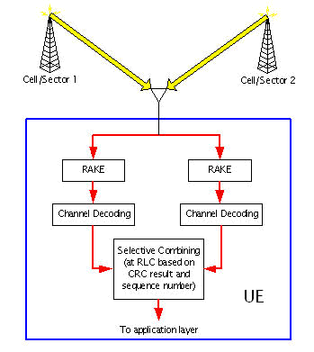
Multimedia Broadcast Multicast Service (MBMS) – Quality of Service (3/4)

Slide 63
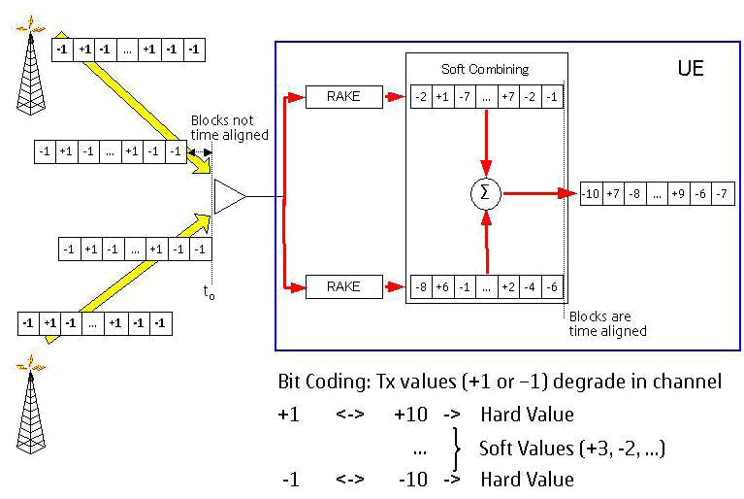
Multimedia Broadcast Multicast Service (MBMS) – Quality of Service (4/4)

Slide 64
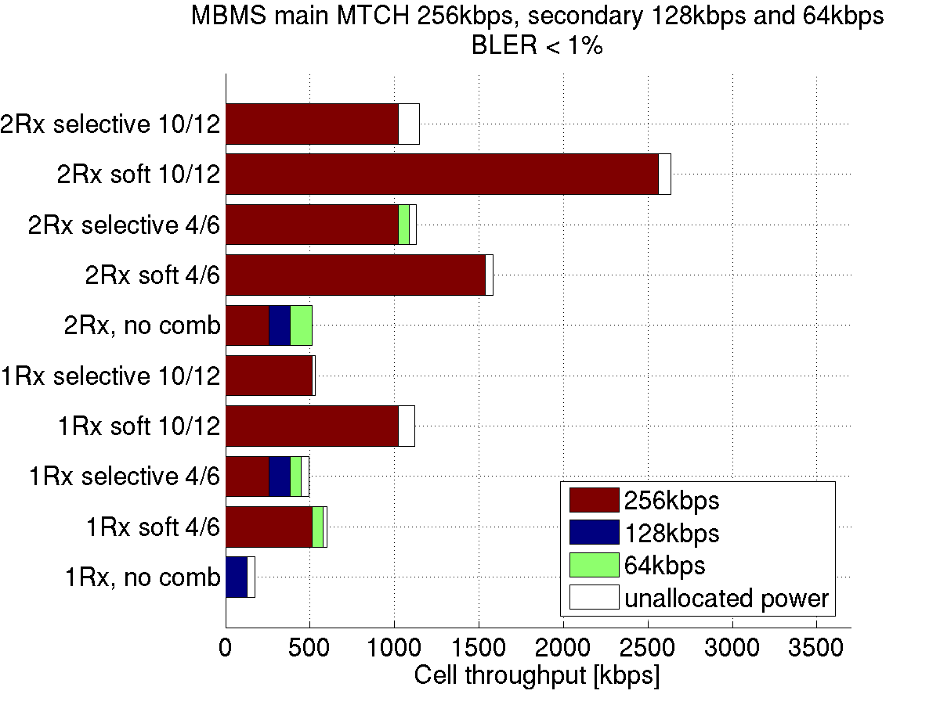
MBMS performance in WCDMA networks
Cell throughput with 2-antenna terminal and soft combining 1500-2500 kbps = 12-20 x 128 kbps TV channels
Cell throughput with 1-antenna terminal and soft combining 600-1000 kbps = 5-8 x 128 kbps TV channels

Slide 65
Femtocells
More and more consumers want to use their mobile devices at home, even when there’s a fixed line available
  Providing full or even adequate mobile residential coverage is a significant challenge for operators
  Mobile operators need to seize residential minutes from fixed line providers, and compete with fixed and emerging VoIP and WiFi services => There is trend in discussing very small indoor, home and campus NodeB layouts
Femtocells are cellular access points (for limited access group) that connect to a mobile operator’s network using residential DSL or cable broadband connections
Femtocells enable capacity equivalent to a full 3G network sector at very low transmit powers, dramatically increasing battery life of existing phones, without needing to introduce WiFi enabled handsets

Slide 66
Questions
What does multicast mean?
How the lack of uplink transmissions with MBMS can be compensated so that the QoS is improved?
What are femtocells?

Slide 67
Conclusions

Slide 68
Conclusions (1/4)
Need for universal standard and improved packet data capabilities were among the key factors towards a new radio network interface, Wideband Code Division Access (WCDMA)
3GPP is currently the main standardization body in charge of WCDMA and its evolutions
Market share for WCDMA is growing rapidly
  More than 340 million WCDMA subscribers
  Fueled by various services such as mobile-TV and VoIP

Slide 69
Conclusions (2/4)
Codes in WCDMA
  Channelization Codes
    Spreads the information signal
    Separates of downlink connections (DL) or data and control channels from same terminal (UL)
  Scrambling codes
    Does not spread the signal
    Separates different cells/sectors (DL) or different mobiles (UL)
UTRAN
  Needed mainly due to new radio access technology
  Node B (base station) responsible of handling connections to and from the UE
  RNC responsible of radio resource management
  Each of those fingers can receive individual multipath components

Slide 70
Conclusions (3/4)
Rake
  Receives, decodes and combines individual multipath components to improve the signal quality
Fast power control (PC)
  To ensure that each user receives and transmits with just enough energy
  Open loop PC for the connection setup and fast closed loop PC for the actual connection
WCDMA Handovers
  Intra-, interfrequency and intersystem handovers
  Soft(er) handover for seamless hand-off
  Hard handovers with small interruption time when HO is made

Slide 71
Conclusions (4/4)
WCDMA Channels
  Main data channels are DCH and FACH
  DCH is using dedicated resources while FACH relies on shared resources
MBMS was introduced to more efficient utilization of limited radio network resources with multimedia content provision
  Improved even further with macro diversity combining and diversity techniques
Femtocells were introduced to improve the mobile convergence and performance in small offices or at home, for instance

Slide 72
Next lecture

Slide 73
Outline
High Speed Downlink Packet Access
High Speed Uplink Packet Access
Continuous Packet Connectivity (VoIP)
Internet-HSPA
HSPA evolution

Slide 74
Thank you!

