Slide 1

Linux Network Servers
DHCP
(Dynamic Host configuration protocol)
Phong.nd- member's ez-net group
Ez-net.info

Slide 2
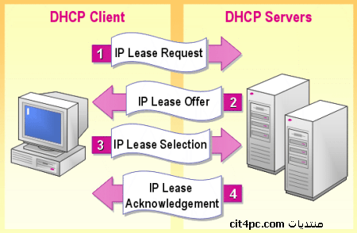
What is DHCP ?
DHCP-server

Slide 3
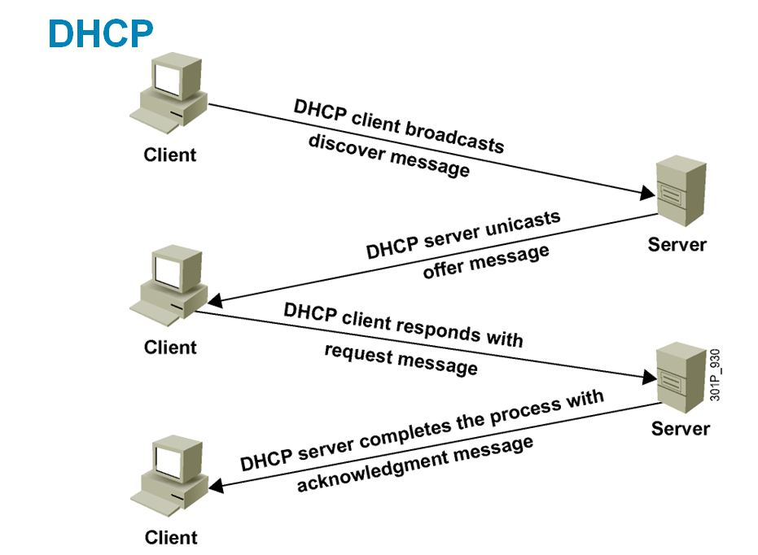

Slide 4
Installing DHCP
# yum -y install dhcp
# vi /etc/dhcp/dhcpd.conf
# specify domain name
option domain-name "ez-net.info";
# default lease time
Default-lease-time 600;
# max lease time
Max-lease-time 7200;
# this DHCP server to be declared valid
authoritative;

Slide 5
# specify network address and subnet mask
subnet 10.0.0.0 netmask 255.255.255.0 {
range dynamic-bootp 10.0.0.100 10.0.0.200;
option broadcast-address 10.0.0.255;
option routers 10.0.0.1;
option domain-name-servers 8.8.8.8;
}
Start dhcp service
# /etc/rc.d/init.d/dhcpd start
Starting dhcpd:[ OK ]
# chkconfig dhcpd on
Configure on client and Check.........

Slide 6
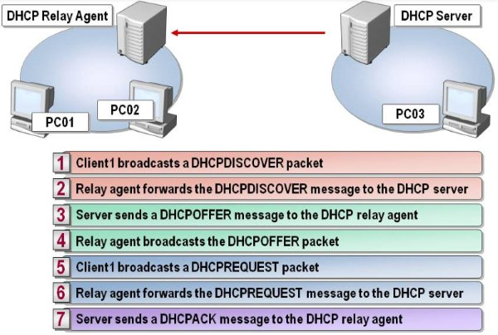
DHCP Relay Agent

Slide 7
+------------+ +------------+
+ + + +-----20.0.0.0/24---
+ DHCP + .1 .2 + DHCP +
+ server +<-------------->+ R-Agent +
+ + + +-----30.0.0.0/24---
+------------+ +------------+
10.0.0.0/24
Demo DHCP Relay Agent

Slide 8
Configure in DHCP server
vi /etc/dhcpd.conf
subnet 20.0.0.0 netmask 255.255.255.0 {
range dynamic-bootp 20.0.0.100 10.0.0.200;
option broadcast-address 10.0.0.255;
option routers 20.0.0.1;
option domain-name-servers 8.8.8.8;
default-lease-time 21600;
max-lease-time 43200
}

Slide 9
subnet 30.0.0.0 netmask 255.255.255.0 {
range dynamic-bootp 30.0.0.100 30.0.0.200;
option broadcast-address 30.0.0.255;
option routers 30.0.0.1;
option domain-name-servers 8.8.8.8;
default-lease-time 21600;
max-lease-time 43200
}
Restart dhcp service:
service dhcpd start

Slide 10
On the DHCP server, proceed to route the IP subnets should be granted.
#vi / etc/sysconfig/network-script/route-eth0
#add route infomation
20.0.0.0/24 via 10.0.0.2 dev eth0
30.0.0.0/24 via 10.0.0.2 dev eth0

Slide 11
Configure in DHCP Relay Agent server
#yum –y install dhcp
#vi /etc/sysconfig/dhcrelay
# add information
INTERFACES="eth0 eth1 eth2"
DHCPSERVERS="10.0.0.1"
INTERFACES: declare the network card connected to the DHCP Server and the need to obtain the IP Subnet.
DHCPSERVERS: report IP address of the DHCP Server.
Save the boot configuration and start service dhcrelay
#service dhcrelay start
Check with client....

Slide 12
Thank you !

