Slide 1

Linux Network Administrator
User, Group, Permission
Phong.nd- member's ez-net group
Ez-net.info

Slide 2
1.User
Config file: /etc/login.defs
User is able to access the system.
User have username and password.
There are two types of users: super user and regular user
Each user has a unique ID called a UID.
Identification of users use the starting value of 500.

Slide 3
2.Group
Config file: /etc/login.defs
Group is a set of the users.
Each user is a member of a group.
When creating a user, the default is creating a group.
Each group has a unique ID called a GID.
Identification of the group often uses the starting value of 500.

Slide 4
3.Command - User & Group
Create Group:
Syntax: #groupadd [-g groupid] <groupname>
EX: #groupadd eznet
Modify group:
Syntax: groupmod [New-n name] [-g new goupid] <group>
Change group password:
Syntax: gpasswd <groupname>
Delete group:
groupdel <groupname>

Slide 5
Create User:
Syntax: #useradd -[option] <username>
-c "User Information"
-d "Personal Folders"
-m "Creating a personal folder if not exist"
-g "user group“
-u “ user ID”
-G Secondary List can group separated by a comma ",“
-s shell: default bash shell will use
EX: #useradd –c “toi la ai” –g mygroup myname

Slide 6
Change User password:
Syntax: #passwd <groupname>
Change information of User:
Syntax: #usermod -[option] <username>
-[option] : the same useradd
EX: #usermode –c “toi la toi” –g eznet myname

Slide 7
Delete User:
Syntax: #usermod -[option] <username>
-r "remove the user's home directory pass the”
Lock/unlock users
Syntax:
passwd –l <username> / passwd –u <username>
usermod –L <username> / usermod –U <username>
EX: passwd –l myname / passwd –u myname
usermod –L myname / usermod –U myname

Slide 8
File information of User & Group:
/etc/passwd: This file contains information about the user.
/etc/shadow: Contains string password (encrypted) and information on Password.
/etc/groups: Contains information about the groups.
/etc/gshadows: Contains password information of groups.

Slide 9

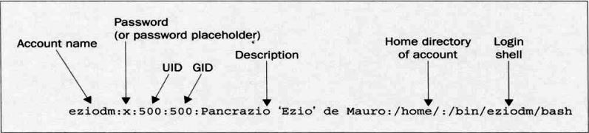
/etc/passwd: This file contains information about the user.
View: cat /etc/passwd

Slide 10

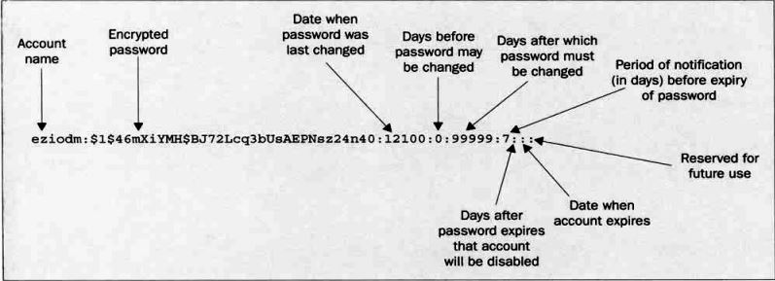
/etc/shadow: Contains string password (encrypted) and information on Password.

Slide 11

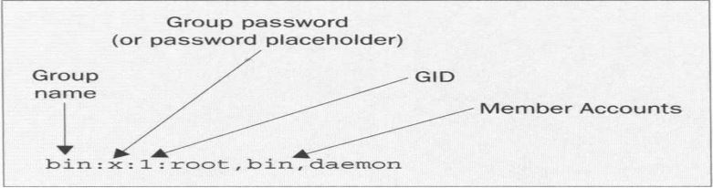

/etc/groups: Contains information about the groups.
/etc/gshadows: Contains password information of groups.

Slide 12
Thank you !

