Slide 1
Using the
Facebook ActionScript 3.0 API to integrate Facebook with your Flex/Flash application
Dan Shultz
Quick Solutions
twitter.com/dshultz

Slide 2
What is a Facebook app
Many different languages/technologies have Facebook APIs
PHP API documentation

Slide 3
Flash / AS Resource
20 part ActionScript tutorial at insideria - Mirza Hatipovic flash series:
www.insideria.com/series-facebook-dev.html
- good info on component architecture* using ActionScript.

Slide 4
API nuances / gotchas
Can’t send invites or requests
Autoplay always false, must supply placeholder image.
Security issues with accessing external xml files
Think about (if &) when to prompt to allow access
Inability to make Sessionless calls - ????
Security issues – options.

Slide 5
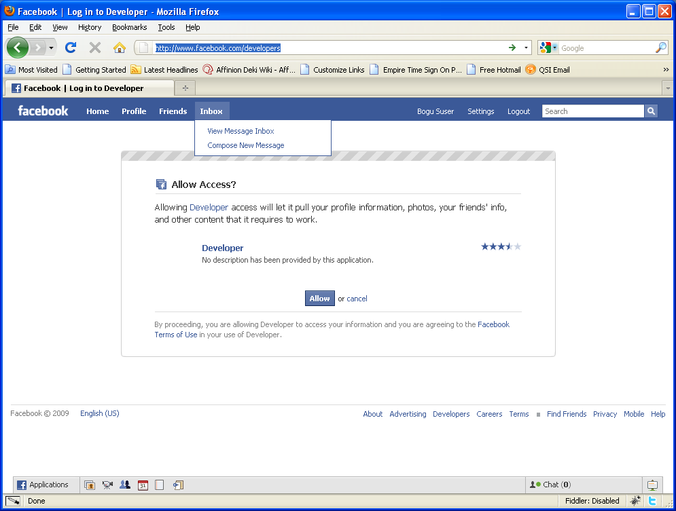

Slide 6
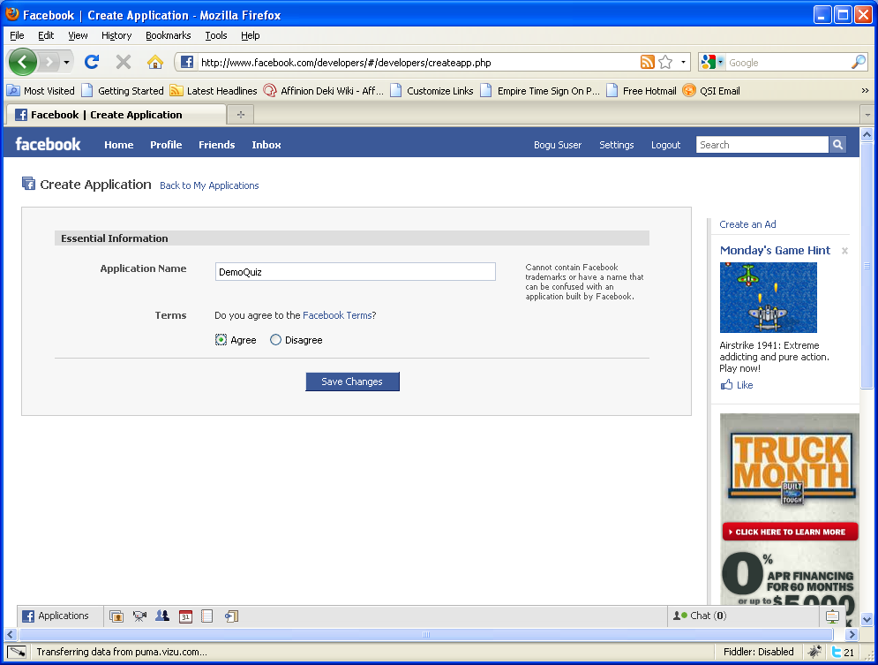

Slide 7
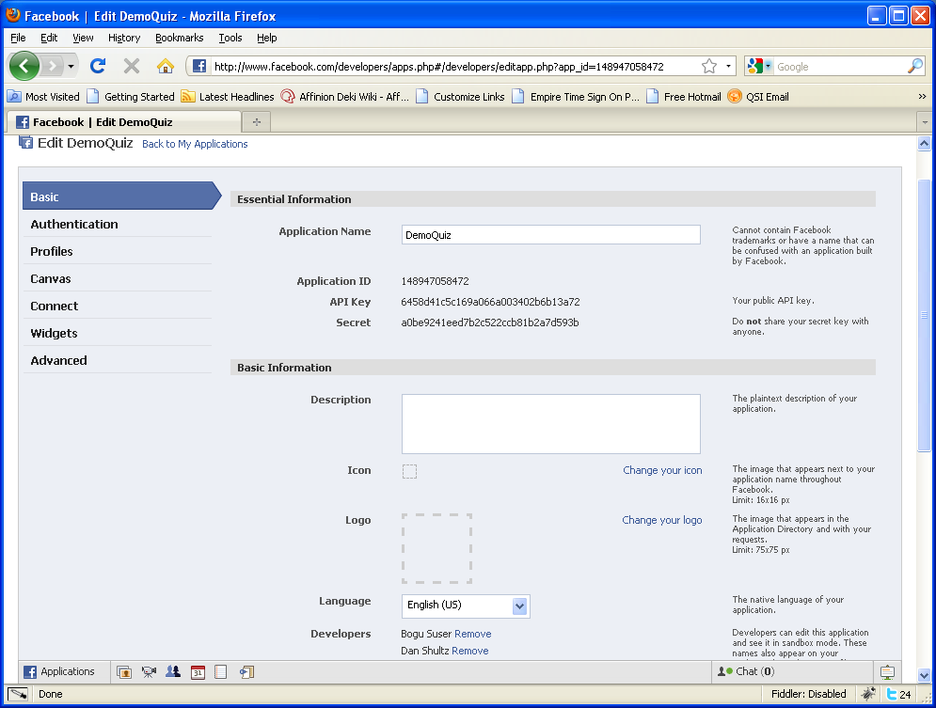

Slide 8
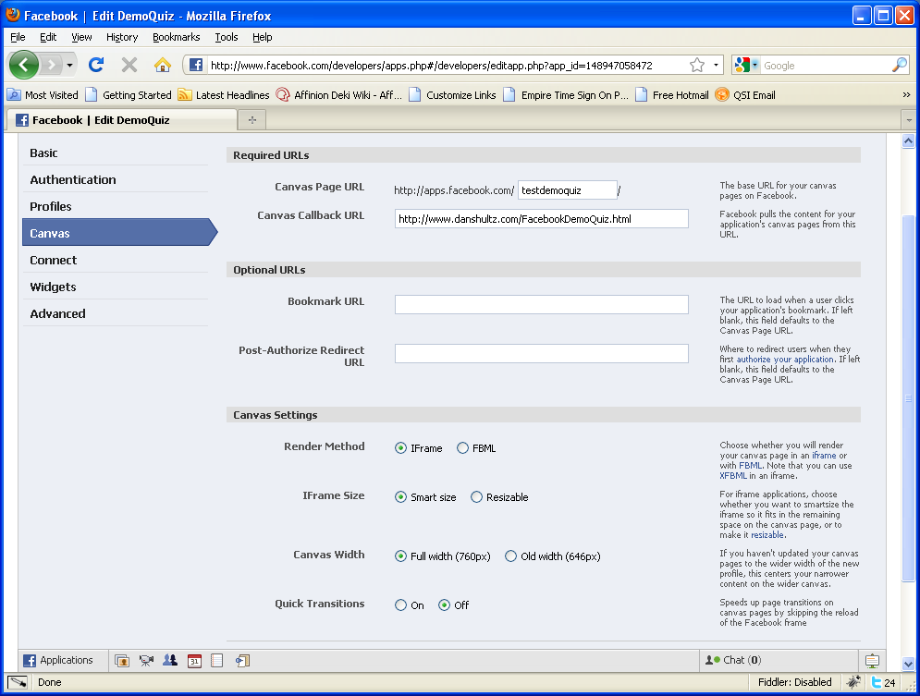
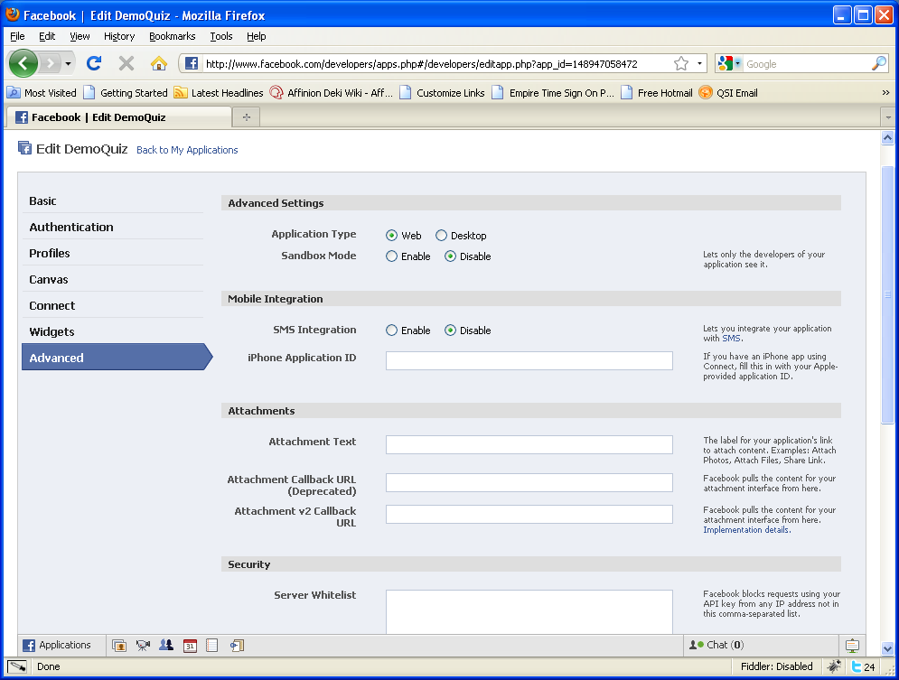

Slide 10
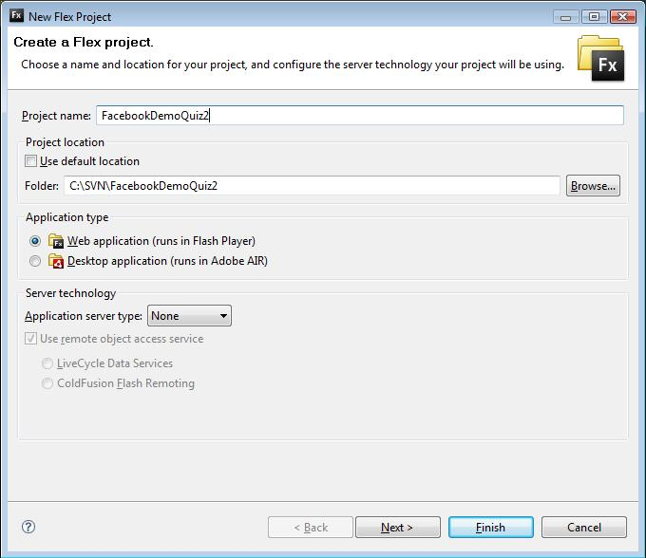

Slide 11
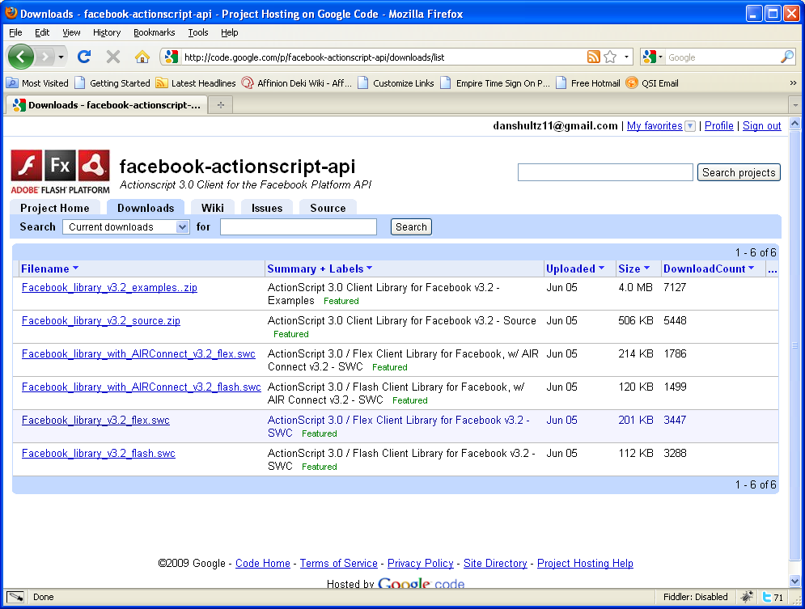

Slide 12
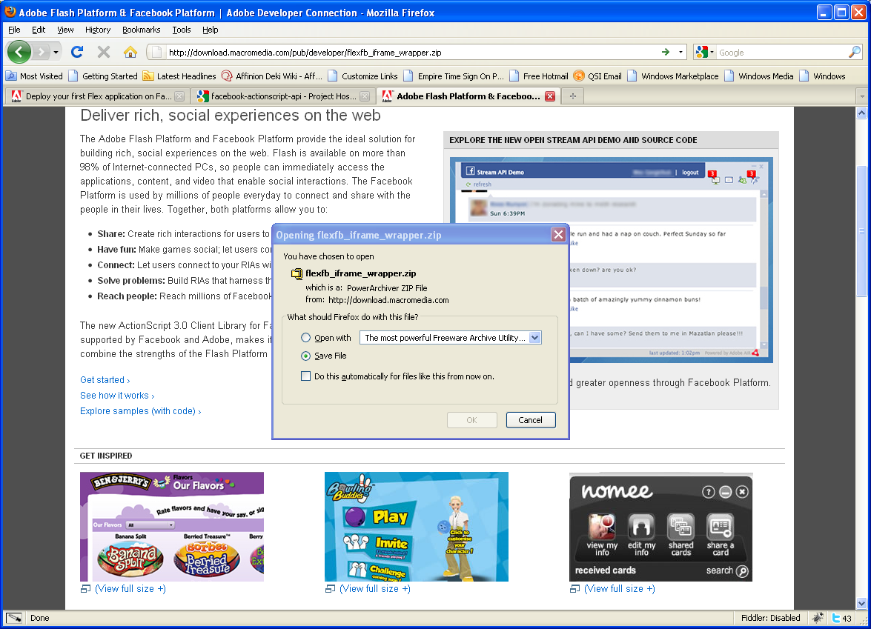

Slide 13
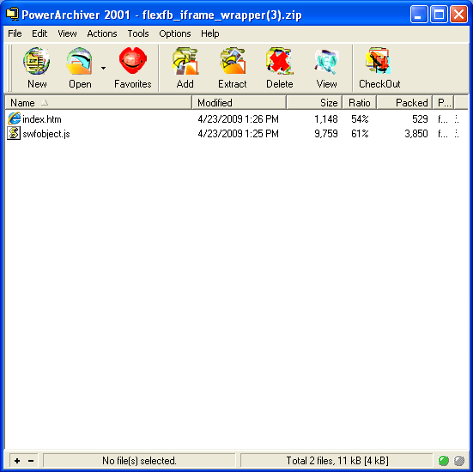

Slide 14
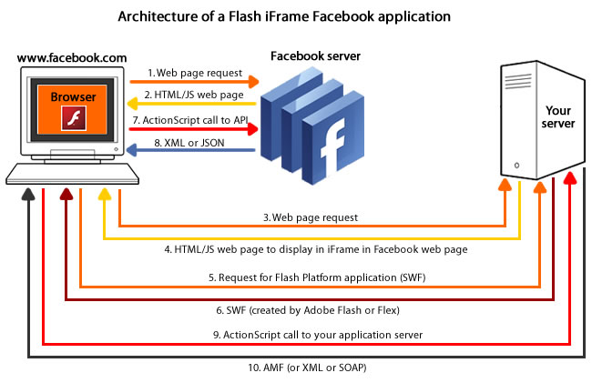

Slide 15
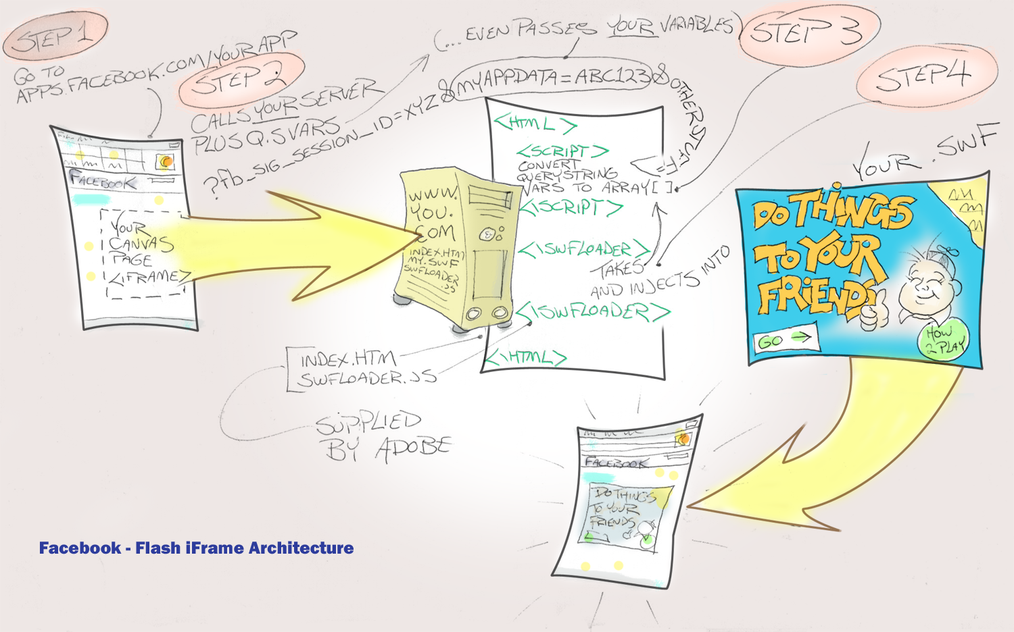

Slide 16
Levels of Facebook interaction
Accessed
Embedded
Interacts
Delayed Interaction

Slide 17
Simple Stuff
“Become a Fan”
Add to profile button - FBML.
Facebook Connect

Slide 18
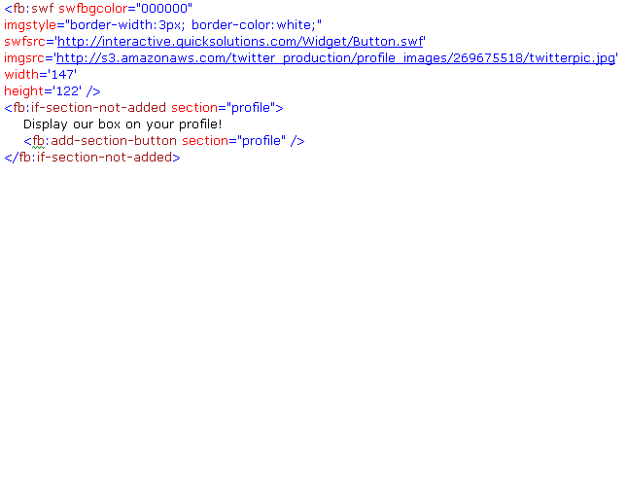
FBML Add to Profile code

Slide 19
ActionScript Code
Component architecture for Facebook objects – one main place for the session creation.
Possibility of making the objects mockable – can unit test without calls to Facebook.
Don’t create session(s) (Web, Desktop) directly, use FacebookSessionUtil to create session key.
Carefully parse all querystring variables.

Slide 20

References
www.adobe.com/devnet/facebook
Mirza Hatipovic flash series:
www.insideria.com/series-facebook-dev.html
www.adobe.com/go/facebooklibrary
Our application, code and slidedeck:
http://apps.facebook.com/flexdemotest
@dshultz
danshultz11@gmail.com

