Slide 1
Hardware

Slide 2
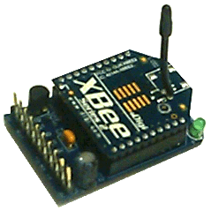
Xbee Module
Frequency: 2.4 GHz
Indoor range: Up to 30m
Outdoor: Up to 100m
Transmit Power: 1 mW (+1 dBm)
Transfer Rate: 250kbps
128bit AES Encryption
Implements a mesh network through ZigBee specification

Slide 3
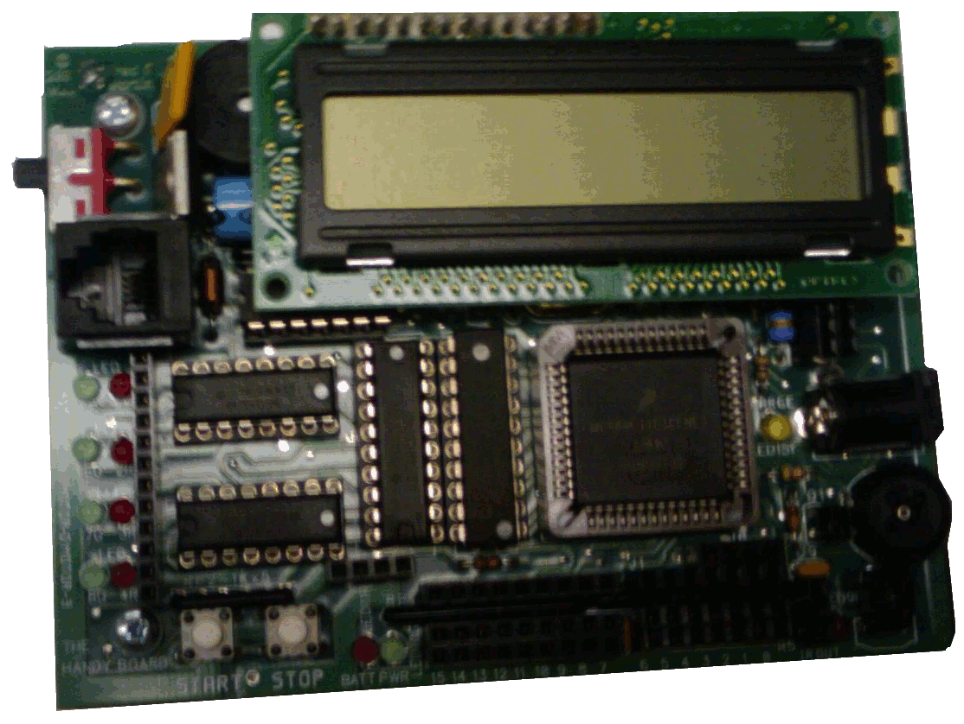
Handbyboard
Motorola 68HC11 @ 2 MHz system clock
8 Bit MCU
Four DC motor drivers
Supports SPI and UART
UART used for communicating with Xbee

Slide 4
Mesh Networks

Slide 5
If destination is out of range, packet is routed through “mesh”
Routed using distance vector algorithm, via least cost path
“Self-Healing”
If a node goes down, the network will route packets around the dead node
Ability to dynamically expand the network by adding new nodes

Slide 6
Specification built on IEEE 802.15.4 standard
Implements the mesh network on the Application and Network layers

Slide 7
ZigBee Coordinator:
The root of the network
Other ZigBee devices join the network formed by the coordinator
ZigBee Router:
Acts as an intermediate router to forward packets to destination nodes that are out of range
ZigBee End Device:
Most basic node; allows target devices to communicate with network
Cannot forward packets from other nodes

