Slide 1
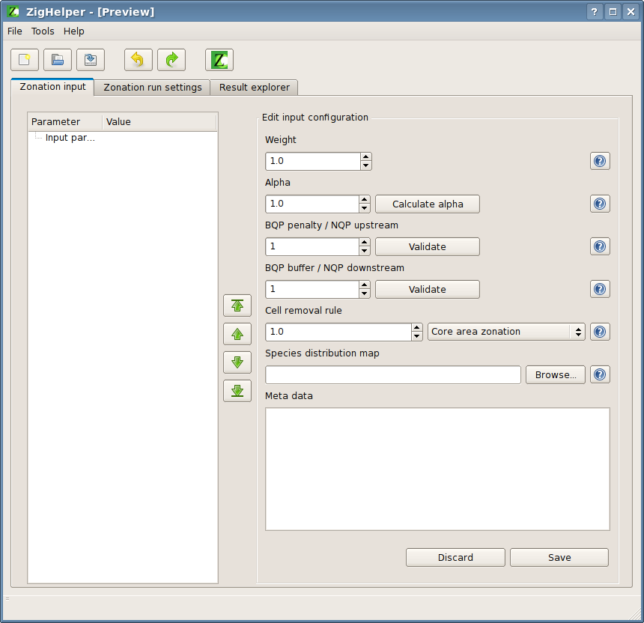
spbxweight
spbxweight
contenttree
spbxalpha

