Slide 1
Data Structure & Algorithm in Java
Adam Drozdek
Chen Peipei

Slide 2
Chapter 1
Introduction

Slide 3
The purpose and contents of the course
Introduce most used data structures and algorithms
Prerequisite of other courses
Introduce algorithm analysis
Review Java and C++

Slide 4
The purpose and contents of the course
1. Introduce most used data structures and algorithms.
Use proper data structures to solve different problems.
Example :
Game problem
Management of library catalogue by computer
Management of the traffic lights in intersections
The book : selection problem
solve a popular word puzzle

Slide 5
The purpose and contents of the course
Example 1:
Game problem:
Next step:
x has five choices.

Slide 6
The purpose and contents of the course
Example 1 uses a tree structure.

Slide 7
The purpose and contents of the course
Example 2: Management of library catalogue by computer
书名 作者名 登录号 分类 出版年月
D.S. Sartaj Sahni 000001 computer 2000.1
It is a linear list.

Slide 8
The purpose and contents of the course
Example 3:
Management of the traffic lights in intersections
C, E are one-way road, there are 13 path to go.
Can go at the same time :
A→B E→C
Cannot go at the same time:
E→B A→D
C
B
D
E
A
This is a graph

Slide 9
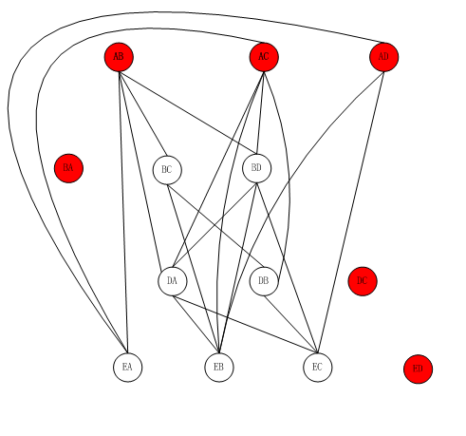
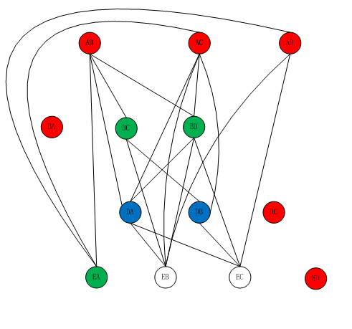
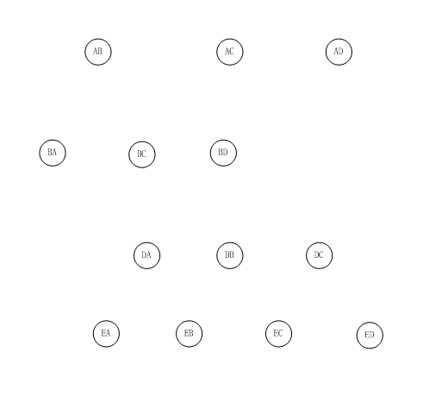
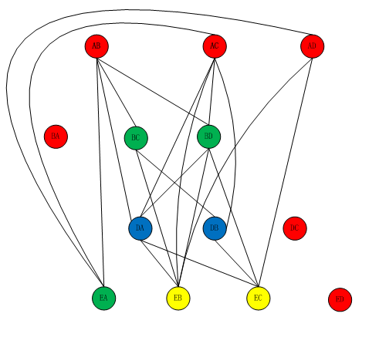
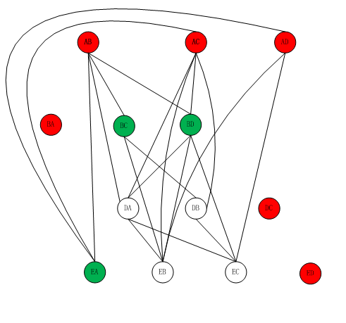
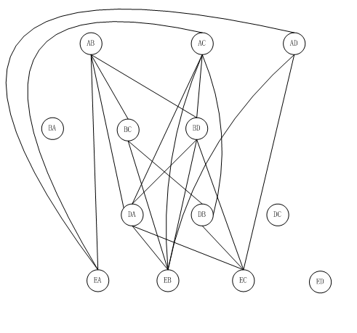

Slide 10
The purpose and contents of the course
Example 4:
The book : selection problem :
a group of N numbers and would like to
determine the kth largest
solve a popular word puzzle:
1 2 3 4
1 t h i s
2 w a t s
3 o a h g
4 f g d t

Slide 11
The purpose and contents of the course
2 . Prerequisite of other courses:
Principles of compiling : use stack to compute expression and implement recursive procedure
Operating System: use queue to implement job scheduling
Database: use B-tree,B⁺ tree to organize, store and load massive data in the hard memory.
...

Slide 12
The purpose and contents of the course
3. Basic methods of algorithm analysis
standards of the performance of an algorithm: time complexity, space complexity,
and accuracy
example: sorting
a₁,a₂,a₃,……,a_{n-1},a_{n}
n-1+n-2+….+2+1= n(n-1)/2=(n²-n)/2
O(n²)
O(n*log₂n)
4. Review Java and C++

Slide 13
What is Data Structure
1. Data
is the carrier of information.
Data is a set of numbers , characters,and other symbols
that can be used to describe the objective things.
These symbols can be input into computers , identified and processed by the computer program.

Slide 14
What is Data Structure
Data can divided into two classes:
numerical data: int, float, complex,……
non-numerical data: character, string,
graph, voice…

Slide 15
What is Data Structure
２. Data structure
A data structure is a data object together
with the relationships among the data
members that compose the object
Data_Structure={D,R}
Ｄ is a data object，
R is a limited set of relationships of all the data members in D.

Slide 16
What is Data Structure
Linear structure
Data structure
Non-linear structure

Slide 17
What is Data Structurem
数据结构涉及三个方面：
数据的逻辑结构-----从用户视图看，是面向问题的。
数据的物理结构-----从具体实现视图看，是面向计算机的。
相关的操作及其实现。
Example:
学生表：逻辑结构-----线性表
物理结构-----数组, 拉链
操作-----插入, 删除, 查找

Slide 18
ADT and OO
1. Data type
Definition: is a set of values together with a operation set that operate on these values.
Example:
int type
value set: {……,-2,-1,0,1,2,……}
operation set: {+, -, *, /, %, …}

Slide 19
ADT and OO
Most of the programming languages provide a group of predefined data type.
Atom data type — int, float, double……
Structure data type—array, struct,……

Slide 20
ADT and OO
2. ADTs: Abstract Data Types
是将类型和与这个类型有关的操作集合封装在一起的数据模型。
Abstract: is a method used to hide the information.
Example:
int x ;
:
x=735;
:
abstract of int data type
assignment
float x, y ;
:
x=x*y+3.0;
:
abstract of float data type
operation

Slide 21
ADT and OO
Abstract data type:
is a new programming method that
part the usage and implementation, in order to encapsulate and hide the information.
思想：
将数据类型的使用与它的表示（机内存储）、实现（机内操作的实现）分开。更确切的说，把一个数据类型的表示及在这个类型上的操作实现封装到一个程序模块中，用户不必知道它。

Slide 22
ADT NaturalNunber is
    objects: 一个整数的有序子集合,它开始于0,结束于机器能表示的最大整数(MAXINT)。
    Function:
    Zero( ):NaturalNumber
    IsZero(x):Boolean
    Add(x,y):NaturalNumber
    Equal(x,y):Boolean
    Successor(x):NaturalNumber
    Subtract(x,y):NaturalNumber
    end NaturalNumber

Slide 23
ADT and OO
3. OO:
object-oriented＝object＋class＋inherit＋ communicate
object: attribute values+ operates
example: rectangle: 一个几何对象
attribute values : 左上角坐标, 右下角坐标,边线颜色, 内部颜色
operates : move(x,y);
setEdgeColor( c );
setInterColor( c ) ;

Slide 24
ADT and OO
class: objects of same attributes and operates.
an instance is an object of the class.
different object has deferent attribute value

Slide 25
ADT and OO
Inherit:
base class—integrate the same part (including
attributes and operations) in all the
derived classes
derived class—add the specific attributes and
operations
Example: base class—polygon
derived class—quadrilateral,triangular

Slide 26
ADT and OO
Communication: each class object communicate with others using messages.
Message: instructions that one class object used in order to require another class object to perform some operation.

Slide 27
Algorithm definition
Algorithm : an operation sequence of soluting
a problem
Characteristic: 1.finite
2. deterministic
3. initial action
4. sequence ends

Slide 28
Algorithm definition
Program : is written by languages that can be performed by machine.
can’t satisfy the finiteness.
For example, OS.
Algorithm: has multiple descriptive methods,
such as language, graph, table.

Slide 29
Algorithm definition
void selectsort(int a[ ],int n)
{ for (int i = 0; i < n-1; i++)
{ int k = i;
for ( int j = i+1; j < n; j++)
if ( a[j] < a[k]) k = j;
int temp = a[i]; a[i] = a[k]; a[k] = temp;
}
}

Slide 30
Mathematics Review
Exponents
X^{A}X^{B} = X^{A+B}
X^{A}/X^{B} = X^{A-B}
(X^{A})^{B} = X^{AB}
X^{N} + X^{N} = 2X^{N}
2^{N} + 2^{N} = 2^{N+1}

Slide 31
Mathematics Review
2. Logarithms( all logarithms are to the base 2)
DEFINITION :
X^{A} = B if and only if log_{X}B = A
THEOREM 1.1
log_{A}B = log_{C}B/ log_{C}A ; A, B, C > 0, A != 1
THEOREM 1.2
logAB = log A + log B; A, B > 0
3. Series
∑ 2^{i} = 1 + 2¹ + 2² +……+2^{N} = 2^{N+1}-1
∑ i = 1 + 2 + 3+……+N = (N+1)*N/2
N
i=0
N
i=1

Slide 32
Mathematics Review
4. Modular Arithmetic
We say that A is congruent to B modular N,
written A ≡ B ( mod N), if N divides A-B.
Example : 81 ≡ 61 ≡ 1 (mod 10)

Slide 33
Mathematics Review
5. The P Word (证明方法)
1). Proof by Induction
The first step is proving a base case.
the Next stap an inductive hypothesis is assumed.
theorem is assumed to be true for all cases up to some limit k. Using this assumption, the theorem is then shown to be true for the next value, which is typically k + 1. This proves the theorem( as long as k is finite).
Example: 例如 等比级数的和以及整数平方和的证明等.

Slide 34
Mathematics Review
2). Proof by Contradiction
Proof by contradiction proceeds by assuming that the theorem is false and showing that this assumption implies that some known property is false, and hence the original assumption was erroneous.
Example: proof that there is an infinite number of primes

Slide 35
A Brief Introduction to Recursion
Recursive
example:
define a function f, valid on nonnegative integers
0 x = 0
2f(x-1) + x² x > 0
f(1) = 1, f(2) = 6, f(3) =21, f(4) = 58
public static int f ( int x)
{ if ( x = = 0) //base case
return 0;
else return 2*f(x-1) + x*x; //recursive call
}
f(x) =

Slide 36
A Brief Introduction to Recursion
two fundamental rules of recursion:
1) Base cases.
2) Making progress.
A nonterminating recursive method:
public static int bad( int n )
{ if ( n = = 0)
return 0;
else return bad( n/3 + 1) + n-1;
}

Slide 37
A Brief Introduction to Recursion
2. 1) direct recursive
2) indirect recursive
Example 1 factorial function f(n)=n!
1 n<=1 (base)
n*f(n-1) n>1 (recursive component)
f(5)=5f(4)=5*4f( 3)=5*4*3f(2)=5*4*3*2f(1)=120
static long factorial (int n)
{ if ( n <= 1)
return 1;
else return n* factorial( n-1 )
}
f(n)=

Slide 38
A Brief Introduction to Recursion
public class ComputeFactorial
{ public static void main( String[ ] args )
{ System.out. Println( “please enter a nonnegative integer” );
int n = MyInput.readInt( );
Syatem.out.println( “Factorial of “ + n + “ is “ + factorial( n ) );
}
static long factorial (int n)
{ if (n<=1) return 1;
else return n*factorial(n-1);
}
}

Slide 39
A Brief Introduction to Recursion
Example 2: Compute Fibonacci number
0, 1, 1, 2, 3, 5, 8, 13, 21, 34, ……
fib(0) = 0;
fib(1) = 1;
fib(n) = fib(n-2) + fib(n-1); n>=2
public static long fib(long n)
{ if ( ( n = = 0) || ( n = = 1 ) )
return n;
else
return fib(n-1) + fib(n-2);
}
Compute fib(4):

Slide 40
A Brief Introduction to Recursion
public class ComputeFibonacci
{ public static void main( String args[ ])
{ System.out.println( “Enter an index for the Fibonacci number “);
int n = MyInput.readInt( );
System.out.println( “Fibonacci number at index “ + n + “ is “ +
fib(n));
}
public static long fib(long n)
{ if (( n = = 0) || ( n = = 1))
return 1;
else
return fib( n-1) + fib(n-2);
}
}

Slide 41
A Brief Introduction to Recursion
Example 3:
computes the sum of the elements a[0] through a[n-1]
a[0], a[1], …, a[n-2], a[n-1]

Slide 42
A Brief Introduction to Recursion
public static int Rsum(int[] a , int n)
{ if (n>0)
return Rsum(a,n-1)+a[n-1];
return 0;
}
a₀ a₁ a₂ a₃
Rs(a,4)----->Rs(a,3)+a[3]
Rs(a,2)+a[2]
Rs(a,1)+a[1]
Rs(a,0)+a[0]
0

Slide 43
A Brief Introduction to Recursion
Example 4:
Permutation
{a,b,c} : abc, acb, bac, bca, cab, cba
permutation of n elements has n!

Slide 44
令 E={ e₁,e₂,….,e_{n}} 实例 E={ a,b,c }
E_{i}={e₁,e₂,..e_{i-1},e_{i+1},…e_{n}} E₁={b,c}
perm(E_{i}) perm(E₁)={ bc,cb }
表示集合E_{i}中的元素的排列方式
e_{i}. Perm(E_{i}) e₁.perm(E₁)={abc, acb}
表示在perm(E_{i})中的每个排列方式
前面均加上e_{i}后所得的排列
递归函数
perm(E)= {e} n=1 其中e是E中的唯一元素
perm(E)={ e₁.perm(E₁), e₂.perm(E₂),……, e_{n} . perm(E_{n})} n>1

Slide 45
对实例：
perm(E)={a. perm({ b,c}), b. perm({a,c}), c. perm({a,b})}
={ a. {b. perm({c}), c. perm({b})}, b.{ a.perm({c}), c.perm({a})},
c. { a.perm({b}), b.perm({a})}}
={ abc, acb, bac, bca, cab, cba }

Slide 46
A Brief Introduction to Recursion
public static void perm(Char[ ] list , int k, int m)
{ int i;
if (k= =m) { for (i=0; i<=m; i++) cout << list[i];
cout << endl; }
else{ for (i=k; i<=m; i++)
{ swap(list[k], list[i]);
perm(list, k+1, m);
swap(list[k], list[i]);
}
}
}
对实例的调用方式为：
perm( list, 0, 2 )

Slide 47
A Brief Introduction to Recursion
Example 5 : Hanoi tower problem
A
B
C
public void moveDISKs(int n, char fromTower, char
toTower, char auxTower)
if ( n= =1)
Move disk 1 from the fromTower to the toTower;
else
{ moveDISKs(n-1, fromTower, auxTower, toTower);
Move disk n from the fromTower to the toTower;
moveDISKs(n-1, auxTower, toTower, fromTower);
}

Slide 48
A Brief Introduction to Recursion
public class TowersOfHanoi
{ public static void main(String[ ] args)
{ System.out.printLn( “Enter number of disks” );
int n = MyInput.readInt( );
System.out.printLn( “The move are:”);
moveDISKs(n, ‘A’, ‘B’, ‘C’);
}
public static void moveDISKs(int n, char fromTower, char
toTower, char auxTower)
{ if ( n= =1)
System.out.printLn( “move disk “ + n + “from “+
fromTower +” to” + toTower);
else
{ moveDISKs(n-1, fromTower, auxTower, toTower);
System.out.printLn( “Move disk “ + n + “from “ +
fromTower + “ to “ + toTower );
moveDISKs(n-1, auxTower, toTower, fromTower);
}
} }

Slide 49
Generic Objects in Java
Throughout this text, we will describe algorithms and
data structures that are type independent.
IntCell nongeneric class
MomoryCell generic class

Slide 50
Generic Objects in Java
1. IntCell class
public class IntCell
{ public IntCell ( ){ this ( 0 ); }
public IntCell( int initialValue )
{ stoedValue = initialValue ; }
public int read ( ) { return storedValue; }
public void write ( int x ) { storedValue = x; }
private int storedValue;
}

Slide 51
Generic Objects in Java
1) public and private
memble of public : may be accessed by any method in any
class .
member of private : may only be accessed by methods in
its class.
specifier is omitted (package-friendly visibility) :
a data member whose visibility specifier is omitted is visible to other classes in the same package.

Slide 52
Generic Objects in Java
2) constructor
A class may define methods that describe how an instance of the class is constructed; these are called constructors.
If no constructor is explicitly defined, one that initializes the fields using language defaults is automatically generated.

Slide 53
Generic Objects in Java
3) This
In many cases,the zero-parameter constructor can be implemented by calling anather constructor.
By using this , we avoid replicating code logic in
separate constructors.
A different use of this is as a reference to the object being acted upon.

Slide 54
Generic Objects in Java
public class TestIntCell
{ public static void main ( String [ ] args )
{ IntCell m = new IntCell ( );
m. write( 5 );
System.out.println( “Cell contents: “ + m.read( ) );
}
}

Slide 55
Generic Objects in Java
1) static and main
The main method must be static , meanimg that it applies to the TestIntCell class instead of a single instance of the class.
Each class may declare a main method that will be used when the java interpreter is called for that class.
复习一下static
2) Object creation.
Objects are created by using new.

Slide 56
Generic Objects in Java
3) Method calls.
m.write(5);
m.read( )
m.storedValue //be illegal

Slide 57
Generic Objects in Java
2. MemoryCell class
design a class that works for any type of Object.
example: sorting of array a₀, a₁, a₂, a₃,……a_{n-1}
C++: use templete
program1.1: int Abc(int a,int b,int c) {return a+b+b*c+(a+b-c)/(a+b)+4; }
program1.2: float Abc(float a,float b,float c) {return a+b+b*c+(a+b-c)/(a+b)+4; }

Slide 58
Generic Objects in Java
program1.1 and 1.2 differ only in the data type of the formal parameters and of the value returned.
We can write a generic code in which the data type is a variable whose value is determined by the compiler.This generic code is written using the template statement in program1.3

Slide 59
Generic Objects in Java
Program1.3
template<class T> T Abc(T a,T b,T c) {return a+b+b*c+(a+b-c)/(a+b)+4; }
From this generic code the compiler can construct 1.1 by substituting int for T and 1.2 by substituting float for T.

Slide 60
Generic Objects in Java
Java:
1) use inheritance(pre-java 5)
all objects are subclasses of Object.
public class MemoryCell
{ public Object read( )
{ return storedValue; }
public void write( Object x )
{ storedValue = x; }
private Object storedValue;
}
1.5 A generic MemoryCell class (pre-java 5)

Slide 61
Generic Objects in Java
Two problem:
First problem: We must downcast to the correct type
public class TestMemoryCell
{ public static void main( String [ ] args )
{ MemoryCell m = new MemoryCell ( ) ;
m.write( “37 “ );
string val = ( String) m.read( );
System.out.println( “Contents are : “ + val )
}
}
Using the generic MemoryCell class (pre-Jave 5)
the read method for MemoryCell returns an Object.

Slide 62
Generic Objects in Java
Second problem Although all objects are subclasses of Object, the primitive types boolean, short, char, byte, int, long, float, double are not objects. Thus we cannot directly use MemoryCell to store a primitive value.
We must use wrapper class provide by Jave. Wrapper class store a single primitive value and can be used wherever an Object is need.
the wrapper class provides a method that can be used to access the primitive value it stores.
two example:
a) For the Integer wrapper, this method is named intValue.

Slide 63
Generic Objects in Java
public class Integer
{ public Integer( int x)
{ value = x; }
public int intValue( )
{ return value; }
private int value;
}

Slide 64
Generic Objects in Java
public class wrapperdemo
{ public static void main ( String [ ] args )
{ MemoryCell m = new Memorycell ( ) ;
m.write ( new Integer ( 37 ) ) ;
Integer wrapperVal = ( Integer ) m . Read ( ) ;
int val = wrapperVal . intValue ( ) ;
System . Out . Println ( “ Contents are : “ + val ) ;
}
}
1.7 An illustration of Integer wrapper class
To get the int value that is hidden inside the Integer object, we must convert the result of read back to an Integer , and then use mathod intValue access the value . This involves using a type conversion.

Slide 65
Generic Objects in Java
b) Implementing Generic findMax
The MemoryCell class required no special properties of Object ; the only operations performed were reference assignments, which are always available.
Finding the maximum item in an array of items does require a special property; we must be able to compare two items and decide which is larger.

Slide 66
Generic Objects in Java
Comparable findMax ( Comparable [ ] a )
{ Comparable maxValue = a[ 0 ];
for ( int i = 1; i < a.length; i++ )
if ( maxValue.lessThan ( a[i] ) )
maxValue = a[i];
return maxValue;
}
a generic findMax algorithm.
Notice that the objects that are manipulated are not Object,
But instead are Comparable.

Slide 67
Generic Objects in Java
Comparable is an interface.
In java, an interface declares a set of methods that must be implemented.
In this example, any class that is Comparable must
provide an implementation of lessThan
A class that is Comparable must also declare so by
using the implements clause.
public interface Comparable
{ int lessThan( Comparable rhs );
} compareTo

Slide 68
Generic Objects in Java
Comparable findMax ( Comparable [ ] a )
{ Comparable maxValue = a[ 0 ];
for ( int i = 1; i < a.length; i++ )
if ( maxValue.compareTo(a[i])<0 )
maxValue = a[i];
return maxValue;
}
a generic findMax algorithm.

Slide 69
Generic Objects in Java
In the book：
Class FindMaxDemo
{ public static comparable findMax( Comparable [ ] arr )
{ int maxIndex = 0;
for ( int i = 1; i < arr.length; i++ )
if ( arr[ i ] . compareTo( arr[ maxIndex ] ) > 0 )
maxIndex = i ;
return arr[ maxIndex ];
}
public static void main ( String [ ] args )
{ Shape [ ] sh1 = { new Circle( 2.0 ), new Square( 3.0 ),
new Rectangle( 3.0, 4.0 ) }
String [ ] sta = { “Joe”, “ Bob”, “Bill”, “Zeke” };
System.out.println( findMax( sh1 ) );
System.out.println( findMax( st1 ) );
}
}

Slide 70
Generic Objects in Java
//another Example:
public interface Comparable
{ public int compareTo(object o );
}
public class Max
{ public static Comparable max( comparable o1, comparable o2 )
{ if ( o1. compareTo( o2 ) > 0 )
return o1;
else return o2;
}
}

Slide 71
Generic Objects in Java
class Circle
{ private double radius;
public Circle( ) { radius = 1.0; }
public Circle( double r ) { radius = r ; }
public double getRadius ( ) { return radius; }
public void set Radius( double newRadius )
{ radius = newRadius; }
public double findArea( )
{ return radius * radius*3.14159; }
}

Slide 72
Generic Objects in Java
class ComparableCircle extends Circle implements Comparable
{ public ComparableCircle ( double r )
{ super ( r );
}
public int compareTo (object o )
{ if ( getRadius( ) > ( ( Circle ) o ) . Getradius ( ) )
return 1;
else if ( getRadius ( ) < ( ( Circle ) o ) . GetRadius ( ) )
return –1;
else return 0;
}
}

Slide 73
Generic Objects in Java
public class TestInterface
{ public static void main( String[ ] args )
{ ComparableCircle circle1 = new ComparableCircle( 5 );
ComparableCircle circle2 = new ComparableCircle( 4 );
Comparable circle = Max . max (circle1, circle2 );
System.out.println ( “ The max circle’s radius is “ +
( ( Circle ) circle ) . getRadius ( ) );
System.out.println ( circle );
}
} //another Example

Slide 74
Generic Objects in Java
2) Java 5 supports generic classes that are very easy to use
public class GenericMemoryCell <Any Type >
{ public AnyType read( )
{ return storedValue; }
public void write( AnyType x )
{ storedvalue = x; }
private AnyType storedvalue ;
}
1.9 Generic implementation of the MemoryCell class

Slide 75
Generic Objects in Java
When a generic class is specified, the class declaration includes one or more type parameters after the class name
User can create types such as GenericMemoryCell<String>
GenericMemoryCell<Integer>
but can not create GenericMemoryCell<int>
Inside the GenericMemoryCell class declaration,
we can declare fields of the generic type and
methods that use the generic type as a parameter or return type

Slide 76
Generic Objects in Java
Interfaces can also be declared as generic.
prior to Java 5, the Comparable interface was not generic.
In Java 5, the Comparable class is generic.
package java.lang;
public interface Comparable<AnyType>
{ public int compareTo ( AnyType other ) ;
}
1.10 Comparable interface, Java 5 version which is generic

Slide 77
Generic Objects in Java
class BoxingDemo
{ public static void main ( String [ ] args )
{ GenericMemoryCell<Integer> m =
new GenericMemoryCell<Integer> ( ) ;
insert a call to the Integer constructor behind the scenes
m . Write ( 37 ) ; insert a call to the intValue method behind the
int val = m . Read ( ) ; scenes
System . Out . Println ( “ contents are : “ + val ) ;
}
}
1.11 Autoboxing and unboxing
**编译程序在箭头处分别调用Integer构造函数与intValue方法

Slide 78
Exceptions
try
{
……
}
catch(Exception e)
{ System.out.println (e); }
main ( ) f ( ) g ( )
{ …. { … {
f ( ); g ( ) ;
…. .. .
} } }

Slide 79
Exceptions
Java的异常处理提供对运行时错误的语言级处理机制。
三类error
语法error, 语义error, 逻辑 error
1) 语法error
通常在编译时发现，又称编译错。
如：标识符未声明，类型不匹配，缺少分号等。
2) 语义error
只有到程序运行时才发现，又称运行错。
如：除数为0, 数组下标越界等。
打开的文件不存在，网络连接中断等。
3) 逻辑 error
运行结果与期望值不符。这类错误最难确定与排除。

Slide 80
Exceptions
2. 运行时的error又分为两类 (根据错误的性质)
1) 错误(error)------运行时遇到硬件或OS错误。
如，内存溢出(out of Memory)；
虚拟机错误。
2) 异常(exception)------硬件与OS都正常，程序遇到的运行错。
如，除数为0, 网络连接中断，打开文件发现文
件不存在等。
3. Java的异常处理
1) 异常处理语句
不可恢复的异常

Slide 81
Exceptions
try
{
语句1 //存在潜在异常的代码
}
catch(异常类 异常对象)
{
语句2 //捕获到异常并进行处理的代码
}
finally
{
语句3 //最后必须执行的代码，无论是否捕获到异常
}

Slide 82
Exceptions
public class Try2
{ public static void main( string args[ ])
{ int i = 0; int a[ ] = { 5,6,7,8};
for( i = 0; i < 5; i++)
{ try
{ system.out.print(“a[” + i + “]/” + i + “ = ” + (a[i]/i));
}
catch(ArrayIndexOutOfBoundsException e)
{ system.out.print(“捕获数组下标越界异常！”); }
catch( ArithmeticException e)
{ system.out.print(“捕获算术异常！”) }
catch(Exception e)
{ system.out.print(“捕获” + e.getMessage( ) + “异常!” );
//显示异常信息 }
finally
{ system.out.println(“ i = ” +i ); }
} //for
system.out.println( “ 继续！”） ；
}
}

Slide 83
Exceptions
运行结果为：
捕获算术异常！ i = 0
a[1]/1 = 6 i = 1
a[2]/2 = 3 i = 2
a[3]/3 = 2 i = 3
捕获数组下标越界异常！ i = 4
继续！

Slide 84
Exceptions
2) 抛出异常
抛出自定义异常对象
throw 异常对象
由throw语句抛出的异常也必须由try语句捕获并处理。
example
public void set(int age)
{ if(age > 0 && age < 100 )
this.age = age ;
else
throw new Exception ( “ IllegaAgeData” ) ; //抛出异常
}
抛出异常和处理可以在一个方法中，也可分别在不同的方法中。
一般而言，一个方法通过throw抛出异常，由方法的调用者捕获
并处理该异常对象。

Slide 85
Exceptions
public void set ( int age )
{ try
{ if ( age > 0 && age < 100 )
this . age = age ;
else throw new Exception ( “ IllegalAgeData “ ) ;
}
catch ( Exception e )
{ system . Out . Println ( e . toString ( ) ) ;
}
}

Slide 86
Exceptions
方法声明抛出异常的throws子句
example
public void removeAny( ) throws Underflow
{ if ( isEmpty( ) )
throw new Underflow( );
…….
}

Slide 87
Input and Output
import java.io.*
Basic Stream Operations
System.in standard input;
System.out standard output
System.err standard error
output in java :is done almost exclusively by String concatenation, with no built-in formatting.
use toString
input in java : reading formatted input
is to read a single line into a String object using readLine. The readLine method reads until it encounters a line terminator or end of file.
To use readLine, we must first construct a BufferedReader object from an InputStreamReader object that itself constructed from System.in.

Slide 88
Input and Output
import java.io.*;
public class DivideByTwo
{ public static void main( String [ ] args )
{ bufferedReader in = new BufferedReader( new
InputStreamReader ( System.in ) );
int x;
String oneLine;
System.out.println( “Enter an integer:” );
try
{ oneLine = in.readLine( ); // IOException
x = Integer.parseInt( oneLine ); //NumberFormatException
System.out.println( “Half of x is “ + ( x/2) );
}
catch( Exception e )
{ system.out.println( e ); }
}
}

Slide 89
Input and Output
Recall that to read a single primitive type, such as an int:
1) use readLine to read the line as a String.
2) then apply a method to generate the primitive type from
the String. For int , we can use parseInt.
2. The StringTokenizer Object
Sometimes we have several items on a line. For instance, suppose each line has two ints .
Java provides the StringTokenizer object to separate a String
into tokens.

Slide 90
Input and Output
import java.io.*
import java.util.*;
public class MaxTest
{ public static void main( String [ ] args )
{ BufferedReader in = new BufferedReader
( new InputStreamReader( System.in ) );
String oneLine;
StringTokenizer str;
int x; int y;
System.out.println( “Enter 2 ints on one line: “ );
try
{ oneLine = in.readLine( );
str = new StringTokenizer( oneLine );
if( str . countTokens( ) != 2 )
throw new NumberFormatException( );
x = Integer . parseInt( str . nextToken( ) );
y = Integer . parseInt( str . nextToken( ) );
System.out.println( “Max: “ + Math.max( x, y ) ) ;
}
catch ( Exception e )
{ System.err.println( “Error: need two ints” ); } } }

Slide 91
Input and Output
To use StringTokenizer , provide the Import directive
import java.util.*;
By default, tokens are separated by white space.
example:
“ I am learning Java now ”

Slide 92
Input and Output
Sequential Files
One of the basic rules of java is that what works for terminal I/O as works for files.
To deal with a file:
System.in-------> InputstringReader--------> BufferedReader
filename-------> FileReader --------> BufferedReader
construct
construct
construct
construct

Slide 93
Input and Output
import java.io.*;
public class ListFiles
{ public static void main( String [ ] args )
{ if( args.length = = 0 )
System.out.println( “No files specified” );
for( int i = 0; i < args.length; i++ )
listFile( args[ i ] );
}
public static void listFile( String fileName )
{ FileReader theFile;
BufferedReader fileIn = null;
String oneLine;
Systnm.out.println( “FILE: “ + fileName );

Slide 94
Input and Output
try
{ theFile = new FileReader( fileName );
fileIn = new BufferedReader( theFile );
while( ( oneLine = fineIn.readLine( ) ) != null )
System.out.println( oneLine );
}
catch( exception e )
{ System.out.println( e ); }
// close the stream
try
{ if( fileIn != null )
fileIn.close( );
}
catch( IOException e ) { }
}
}

Slide 95
Code Organization
Packages
package DataStructures;
Most of our classes will be found in a package named DataStructures. This includes the Overflow and Underflow exception classes.

Slide 96
Code Organization
The MyInteger Class
public class MyInteger implements Comparable
{ public MyInteger( int x ) { value = x; }
public int intValue( ) { return value; }
public int compareTo( comparable rhs )
{ return value < ( ( MyInteger ) rhs ) . value ? –1:
value = = ( ( MyInteger ) rhs ) . value ? 0 : 1;
}
private int value;
}
3 Efficiency Considerations

Slide 97
Chapter 1
Exercises:
1. Write a recursive method that returns the number of 1’s in the binary
representation of N. Use the fact that is equal to the number of 1’s in the
representation of N/2, plus 1, if N is odd.
2. Write the routines wise the following declarations:
public void permute( String str );
private void permute( char [ ] str, int low, int high )
The first routine is a driver that calls the second and prints all the
permutations of the characters in String str. If str is “abc”, then the strings that are output are abc, acb, bac, bca, cab,and cba. Use recursion for the second routine.
3. 已知a[n]为整型数组，试写出实现下列运算的递归算法。
1）求数组a中的最大整数。
2）求n个整数的平均值。

Slide 98
Chapter 1
4. 编写一个递归算法计算并返回一个链表的长度。
5. 递归地检查下面的对象是否是回文：
1）一个单词
2）一条语句（忽略空格、大小写区别及标点符号，这样检查 “Madam, I’ m Adam” 就是回文）

Slide 99
Chapter 1
实习题:
1. 找出从自然数 1, 2, …, n 中任取r个数的所有组合, 编一个递归算法.
例子: n = 5 1 2 3 4 5
r = 3 5 4 3
5 4 2
5 4 1
5 3 2
5 3 1
5 2 1
4 3 2
4 3 1
4 2 1
3 2 1
2. 实现Hanoi塔

