Slide 1
Island War
Group:
Duc Ho Quang
Truong Pham Son

Slide 2
Group
Full name | Mobile | Email
Duc Ho Quang |  | tintin1812@gmail.com
Truong Pham Son | 01218816208 | truonguit2010@gmail.com

Slide 3
Agenda
Intro my game – Island War.
Achievement.
System development.

Slide 4
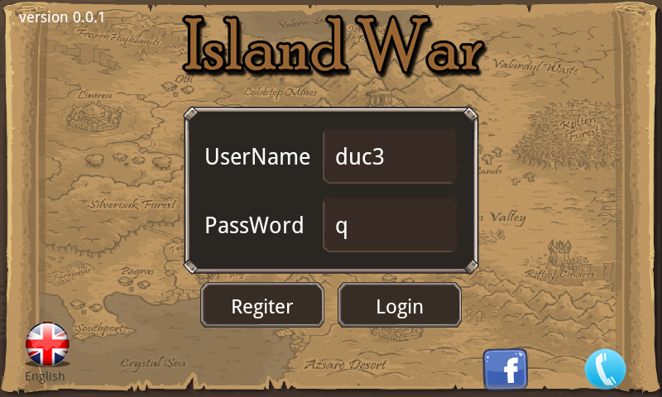
Login screen

Slide 5
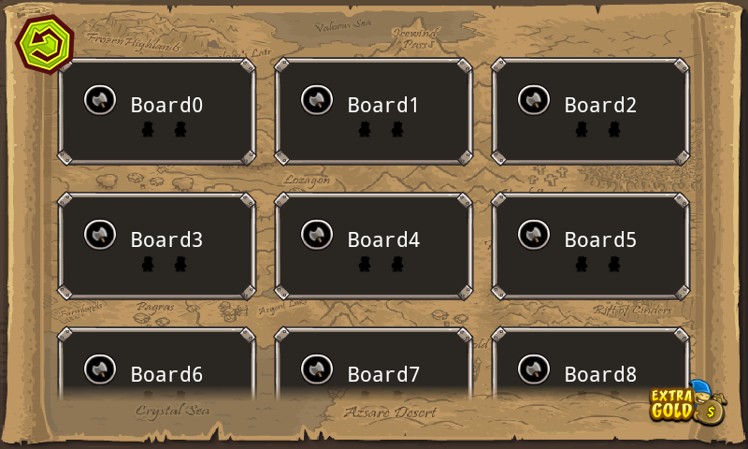
Selecting match screen

Slide 6
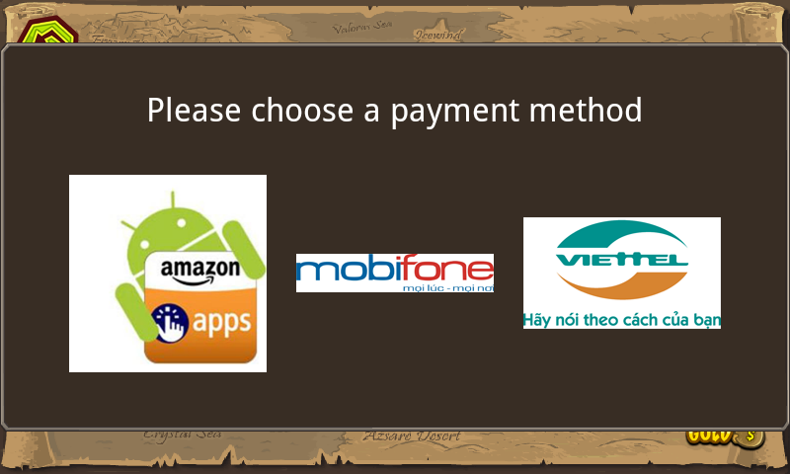
Top up screen

Slide 7
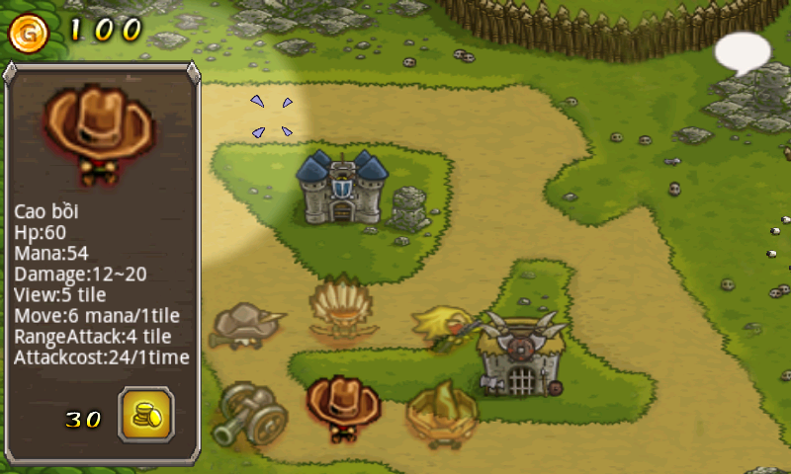
Beginning Screen

Slide 8
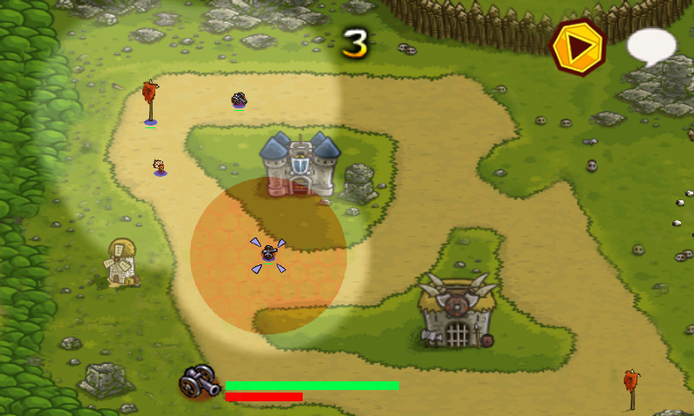
In game Screen

Slide 9
Achievements
Client-server communication is designed successfully.
Brief features are well developed.
Login
Register
Chat
Simple game – Island war.

Slide 10
System development
Functions that need to be developed:
Currency system.
Level system.
Update gameplay.
Joining match automatically.
Player invitation.
Friend relationship system.
Group and team system.
Instant messages system.
Merchandise shop.
Avatar system.

