Slide 1
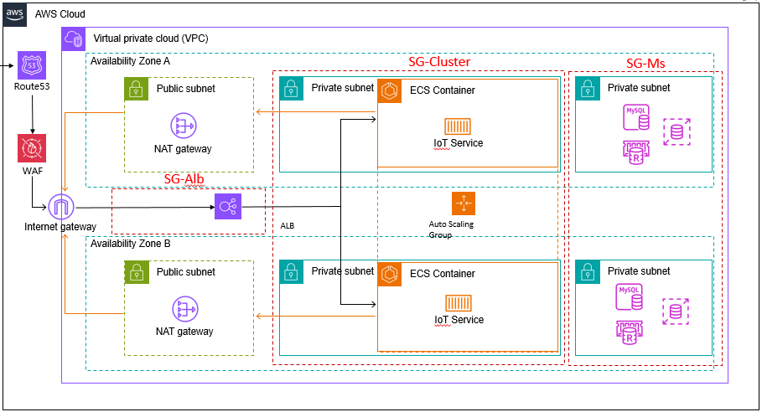

Slide 2
组件：
1.route 53
2.WAF
3.VPC(internet gateway,NAT gateway)
4.ALB
5.ECS(autoscaling)
6.SQL

