Slide 1
WIP2 : Another Bayesian package?
Notes:
Hey everyone, just a quick heads-up

Slide 2
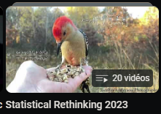

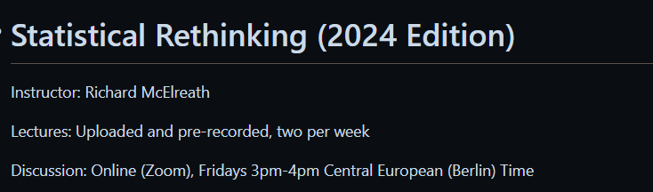
Learning process
September
November
January
WIP2
Notes:
I believe I've reached an interesting point that could be of interest to several of you, and I'd also like to have your feedback on this new project.

Slide 3
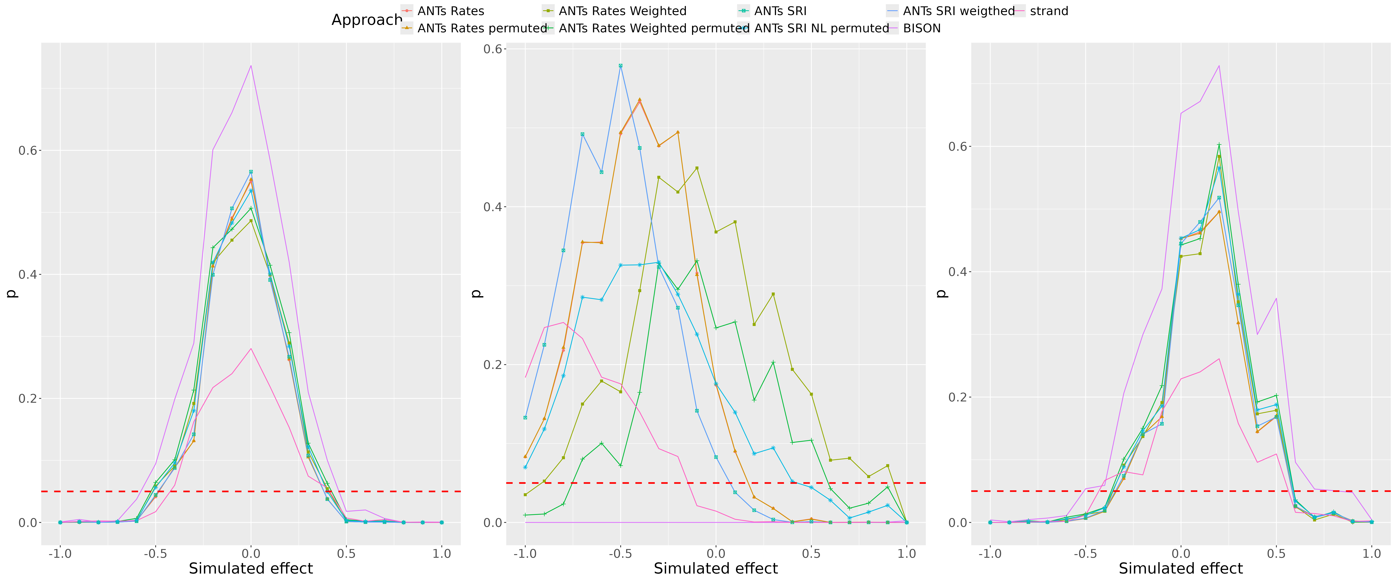
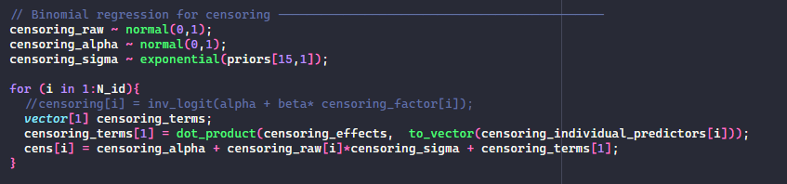
Work in progress 1
Notes:
Time

Slide 4
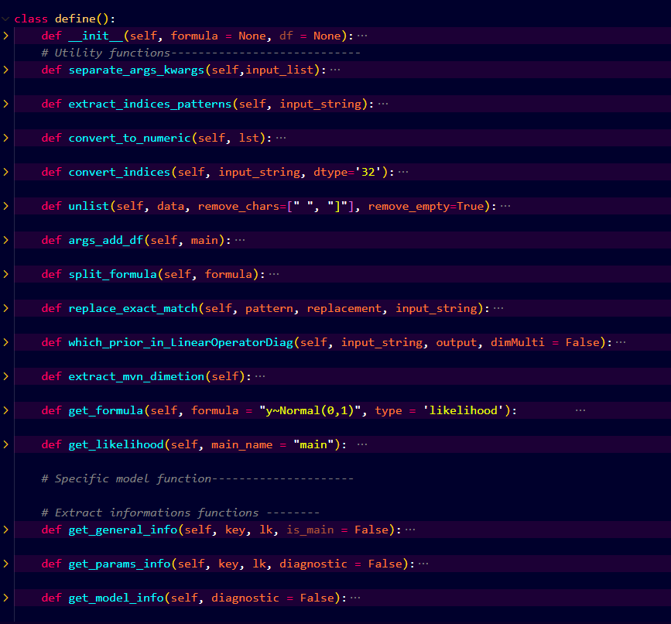
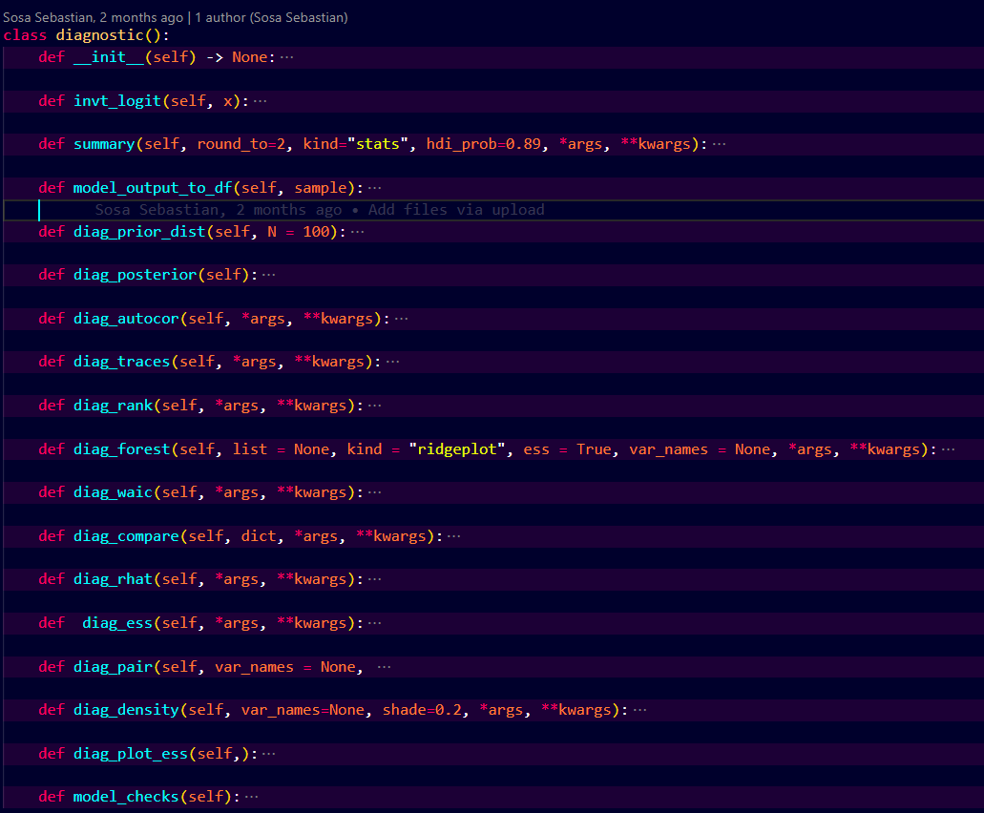
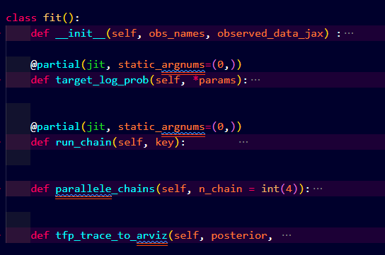
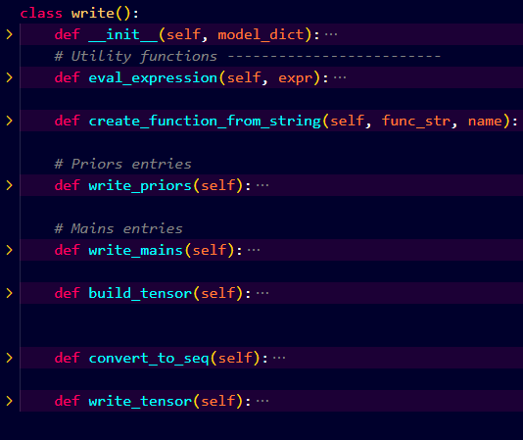
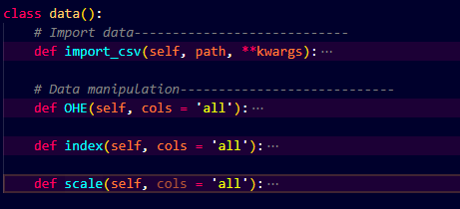
Bayesian Inference package WIP 2
Data manipulation
Model definition & building
Parameter optimization
Diagnosis
Notes:
I practice coding Bayesian model by reproducing rethinking models

Slide 5
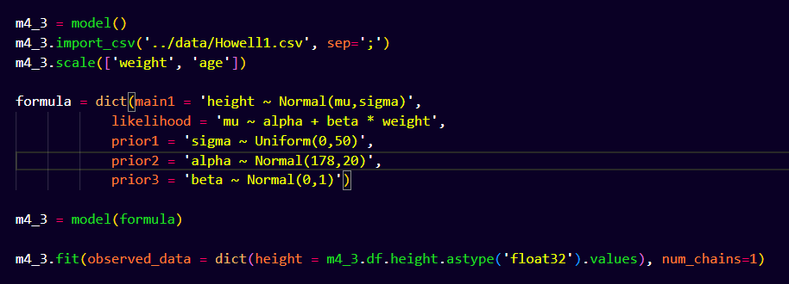
Model template

Slide 6
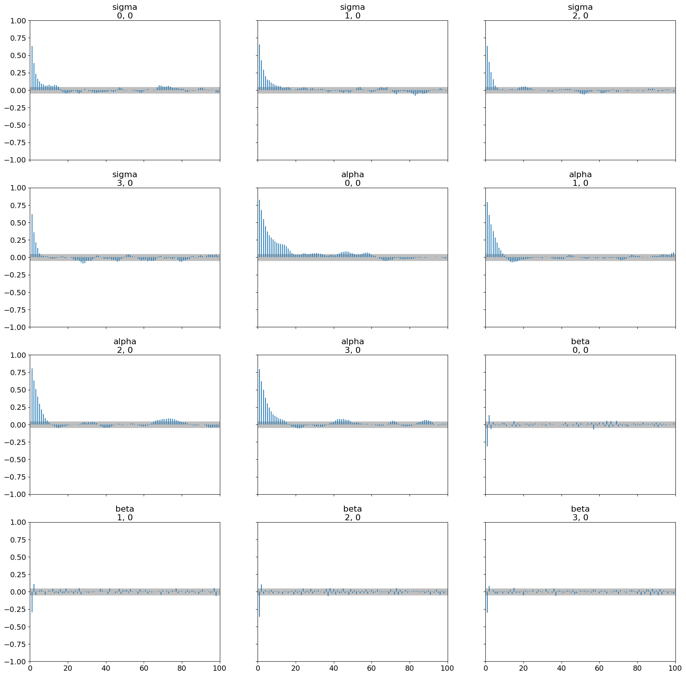
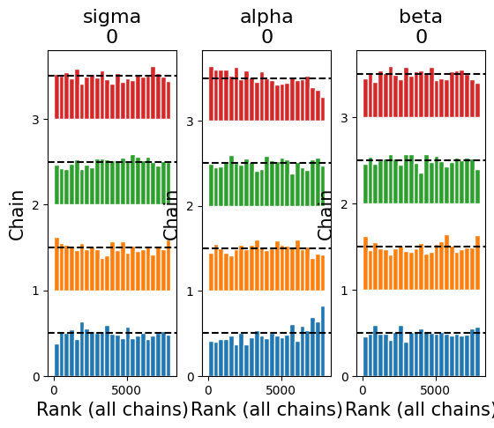
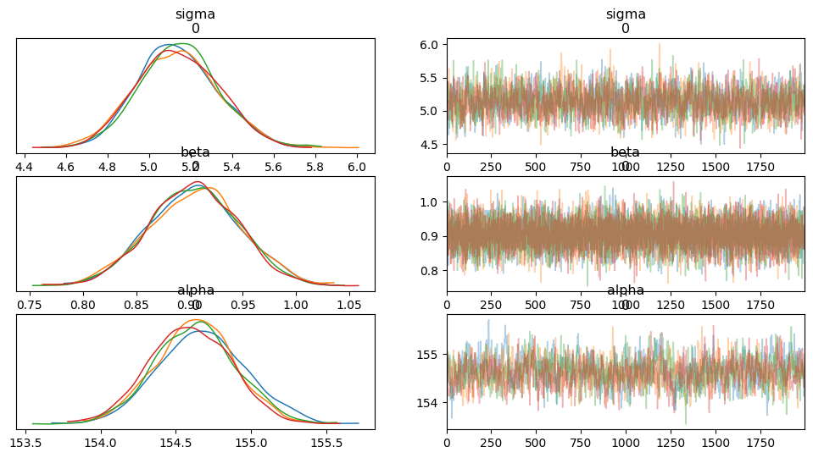
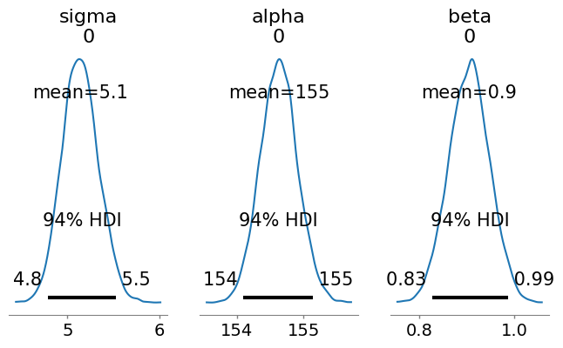
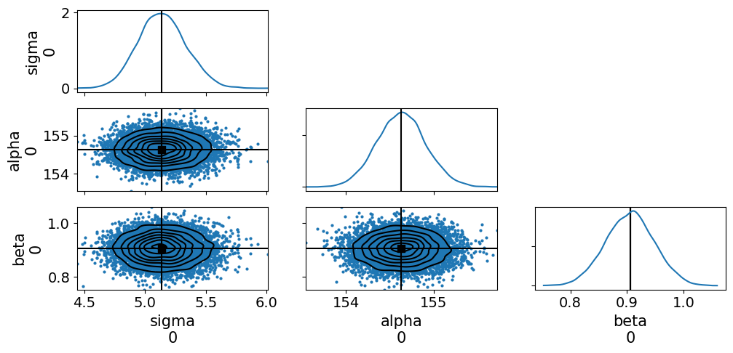
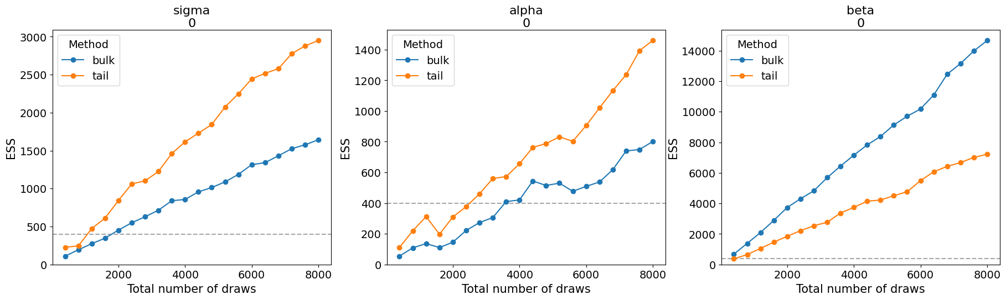
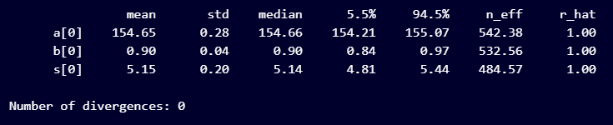






Model Diagnosis
Model comparison with AIC and WAIC
Matrix of scatter plots, kernel density estimation, and marginal plots
Rank order statistics of chains
Posterior distribution
Posterior summary
Trace plot
Auto-correlation
Evolution ESS plots

Slide 7

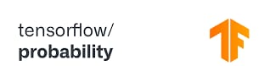

Under the wood
Data manipulation
Model definition and building
Parameter optimization
Diagnosis

Slide 8
Why tensorflow probability (TFP) ?
Bayesian Inference on
Structured Probabilistic Models
Integration with Other Libraries
TFP
Integration with TensorFlow
High Performance
Probabilistic Layers
Distributed computing
Vectorised operations
Parallelised operations
Scalability
Flexibility
CPU, GPU, TPU
Windows, Linux, Mac
Computer, tablet, phone,
Server
Notes:
Bayesian Inference on Structured Probabilistic Models:such as Bayesian neural networks, Gaussian processes, and hierarchical model, probabilistic inference, parameter estimation
High Performance: TensorFlow is optimized for high performance, with features such as automatic differentiation, GPU acceleration, and support for distributed computing, ensuring efficient execution of complex computational graphs.
Scalability and Performance: TFP is designed for scalability and high performance, with support for parallel computation, GPU acceleration, and distributed computing, enabling efficient inference in large-scale probabilistic models. So the same code can be deploy across multiple support CPUs, GPUs, TPU, it can be distributed.
Flexibility: It offers a flexible architecture that enables easy deployment across various platforms, including mobile devices, browsers, and servers.
Integration with TensorFlow: TFP seamlessly integrates with TensorFlow, leveraging its computational graph and automatic differentiation capabilities for efficient and scalable probabilistic inference.
Probabilistic Layers: TFP extends TensorFlow's neural network capabilities with probabilistic layers, allowing users to build neural networks that output probability distributions rather than deterministic predictions, facilitating uncertainty-aware predictions.
Integration with Other Libraries: TensorFlow seamlessly integrates with other popular libraries and frameworks like Keras, scikit-learn, and OpenCV, allowing users to leverage their existing knowledge and workflows.

Slide 9
Validation : testing different models
Continuous variable: Model (model 4.3)
Categorical variable: Model (model 5.9)
Continuous interactions terms (model 8.3)
Binomial (model 11.1)
Binomial with indices (model 11.4)
Poisson (model 11.10)
Negative binomial (model 11.12)
Multinomial (m11.13, m11.14)
Beta binomial (model m12.1)
Zero inflated outcomes (model m12.13, m12.14)
Ordered categorical outcomes
Ordered categorical predictors
Varying interceps (model m13.2)
Varying effects (model m14.1)
Multiple random effects
Networks
Gaussian process

Slide 10
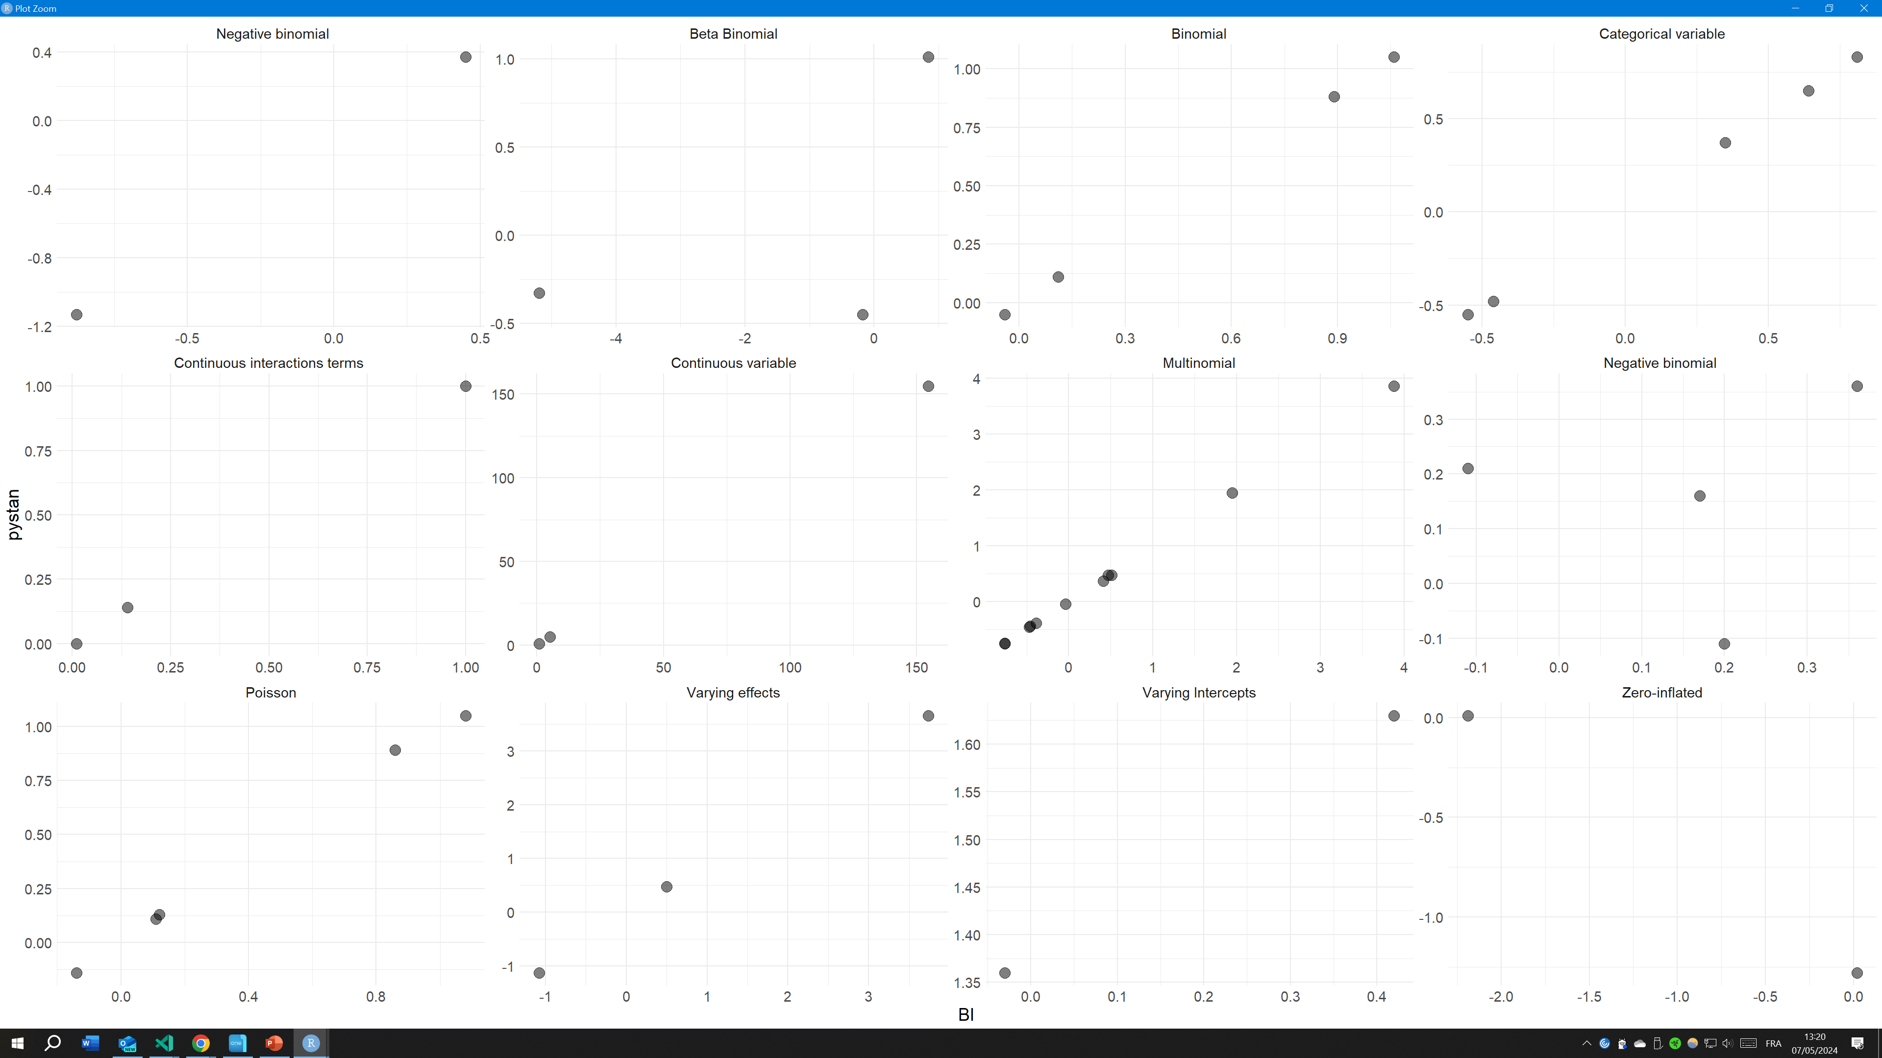
Validation: evaluating models’ estimations

Slide 11
Validation: Speed comparison
 | BI v1 | STAN (with compilation)
Continuous variable | 2.63 | 11.71
Categorical variable | 4.55 | 13.05
Continuous interactions terms | 7.87 | 11.31
Binomial | 1.8 | 10.81
Binomial with indices | 2.58 | 12.99
Poisson | 11.75 | 14.24
Negative binomial | 4.78 | 12.03
Multinomial | 5.26 | 12.79
Beta binomial | 4.26 | 12.89
Negative-binomial | 4.7 | 11.42
Zero inflated outcomes | 5.2 | 11.07
Varying interceps | 4.96 | 12.14
Varying effects | 13.63 | 24.6
 | BI v1 | STAN (with compilation) | STAN (without compilation)
Continuous variable | 2.63 | 11.71 | 0.41
Categorical variable | 4.55 | 13.05 | 0.45
Continuous interactions terms | 7.87 | 11.31 | 0.31
Binomial | 1.8 | 10.81 | 0.21
Binomial with indices | 2.58 | 12.99 | 1.19
Poisson | 11.75 | 14.24 | 0.8
Negative binomial | 4.78 | 12.03 | 0.23
Multinomial | 5.26 | 12.79 | 0.59
Beta binomial | 4.26 | 12.89 | 0.49
Negative-binomial | 4.7 | 11.42 | 0.42
Zero inflated outcomes | 5.2 | 11.07 | 0.57
Varying interceps | 4.96 | 12.14 | 0.54
Varying effects | 13.63 | 24.6 | 1

Slide 12

BI V2 :
With JAX
Automatic Differentiation
Why JAX?
Computing the derivatives:
grad(f)(x)
hessian(f)(x)
jacobian(g)(x)
Composable Function Transformations
Dispersed, vectored, and paralleled operations
JAX
Mathematical operations
Just-In-Time Compilation
Compiles parts of the program during its execution
Flexibility & scalability
Ecosystem Integration
Probabilistic Layers
Notes:
Where f is a scalar-valued function, g is a vector-valued function and x the Point at which to evaluate derivatives

Slide 13
Validation : testing different models
Continuous variable: Model (model 4.3)
Categorical variable: Model (model 5.9)
Continuous interactions terms (model 8.3)
Binomial (model 11.1)
Binomial with indices (model 11.4)
Poisson (model 11.10)
Negative binomial (model 11.12)
Multinomial (m11.13, m11.14)
Beta binomial (model m12.1)
Zero inflated outcomes (model m12.13, m12.14)
Ordered categorical outcomes
Ordered categorical predictors
Varying interceps (model m13.2)
Varying effects (model m14.1)
Multiple random effects
Networks
Gaussian process

Slide 14
Validation: evaluating models’ estimations
Notes:
No varying effect implementation

Slide 15
Validation: Speed comparison
 | BI v1 | BI v2 (JAX) | STAN (with compilation) | STAN (without compilation)
Continuous variable | 2.63 | 2.17 | 11.71 | 0.41
Categorical variable | 4.55 | 1.58 | 13.05 | 0.45
Continuous interactions terms | 7.87 | 1.58 | 11.31 | 0.31
Binomial | 1.8 | 1.17 | 10.81 | 0.21
Binomial with indices | 2.58 | 10.61 | 12.99 | 1.19
Poisson | 11.75 | 1.24 | 14.24 | 0.8
Negative binomial | 4.78 | 4.65 | 12.03 | 0.23
Multinomial | 5.26 | 4.6 | 12.79 | 0.59
Beta binomial | 4.26 | 5.61 | 12.89 | 0.49
Negative-binomial | 4.7 | 4.65 | 11.42 | 0.42
Zero inflated outcomes | 5.2 | 4.9 | 11.07 | 0.57
Varying interceps | 4.96 | 4.88 | 12.14 | 0.54
Varying effects | 13.63 | 8.2 | 24.6 | 1
Notes:
NE PAS parler de la troisime version

Slide 16
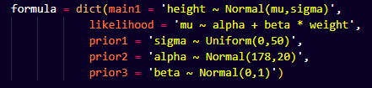
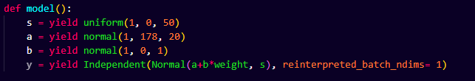

BI V3 : Why
?
Notes:
allow higher flexibility
easier maintenance

Slide 17
Validation : testing different models
Continuous variable: Model (model 4.3)
Categorical variable: Model (model 5.9)
Continuous interactions terms (model 8.3)
Binomial (model 11.1)
Binomial with indices (model 11.4)
Poisson (model 11.10)
Negative binomial (model 11.12)
Multinomial (m11.13, m11.14)
Beta binomial (model m12.1)
Zero inflated outcomes (model m12.13, m12.14)
Ordered categorical outcomes
Ordered categorical predictors
Varying interceps (model m13.2)
Varying effects (model m14.1)
Multiple random effects
Networks
Gaussian process

Slide 18
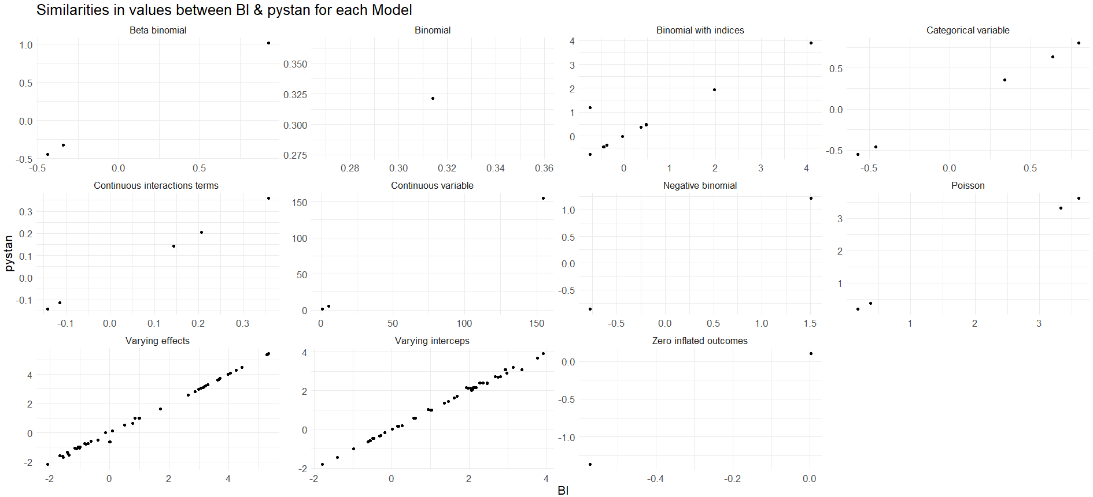
Validation: evaluating models’ estimations

Slide 19
Validation: Speed comparison
 | BI v1 | BI v2 (JAX) | BI v3 (JAX) | STAN (with compilation) | STAN (without compilation)
Continuous variable | 2.63 | 2.17 | 1.25 | 11.71 | 0.41
Categorical variable | 4.55 | 1.58 | 1.18 | 13.05 | 0.45
Continuous interactions terms | 7.87 | 1.58 | 1.11 | 11.31 | 0.31
Binomial | 1.8 | 1.17 | 0.85 | 10.81 | 0.21
Binomial with indices | 2.58 | 10.61 | 4.6 | 12.99 | 1.19
Poisson | 11.75 | 1.24 | 0.96 | 14.24 | 0.8
Negative binomial | 4.78 | 4.65 | 0.88 | 12.03 | 0.23
Multinomial | 5.26 | 4.6 | 1.45 | 12.79 | 0.59
Beta binomial | 4.26 | 5.61 | 2.6 | 12.89 | 0.49
Negative-binomial | 4.7 | 4.65 | 2.64 | 11.42 | 0.42
Zero inflated outcomes | 5.2 | 4.9 | 0.98 | 11.07 | 0.57
Varying interceps | 4.96 | 4.88 | 2.03 | 12.14 | 0.54
Varying effects | 13.63 | 8.2 | 2.33 | 24.6 | 1

Slide 20
Issue
Jax is a beta package in version v0.4.26
Jax integration in TensorFlow probability began this year.
Functions to transform constrained parameter spaces can lead to a loss of JAX speed.
However, it is supposed to be updated at an unknown future point.

Slide 21

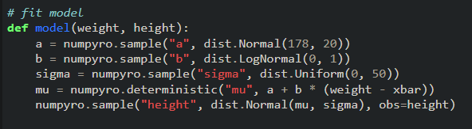

In the meantime…
…A fourth version of the package
NumPyro:
From Pyro team (Uber AI Labs & Stanford University)
Bayesian modeling framework
Also use JAX
Beta version: 0.14
Loose the ability to apply Bayesian layers in a neural network using TensorFlow's probability module.
Notes:
This does not reflect previous effort unfortunately. But, future additional fnctionality can by themselves justify a side package of numpyro

Slide 22
Validation : testing different models
Continuous variable: Model (model 4.3)
Categorical variable: Model (model 5.9)
Continuous interactions terms (model 8.3)
Binomial (model 11.1)
Binomial with indices (model 11.4)
Poisson (model 11.10)
Negative binomial (model 11.12)
Multinomial (m11.13, m11.14)
Beta binomial (model m12.1)
Zero inflated outcomes (model m12.13, m12.14)
Ordered categorical outcomes
Ordered categorical predictors
Varying interceps (model m13.2)
Varying effects (model m14.1)
Multiple random effects
Networks
Gaussian process
Notes:
This time I manage to implement gaussain process, Ordered categorical outcomes And network models, during week end but did not had time to check estimate accuracy

Slide 23
Validation: evaluating models’ estimations

Slide 24
Validation: Speed comparison
 | BI v1 | BI v2 (JAX) | BI v3 (JAX) | BI v4 (with compilation) | BI v4 (without compilation) | STAN (with compilation) | STAN (without compilation)
Continuous variable | 2.63 | 2.17 | 1.25 | 2.16 | 0.81 | 11.71 | 0.41
Categorical variable | 4.55 | 1.58 | 1.18 | 1.28 | 0.96 | 13.05 | 0.45
Continuous interactions terms | 7.87 | 1.58 | 1.11 | 1.6 | 0.92 | 11.31 | 0.31
Binomial | 1.8 | 1.17 | 0.85 | 0.8 | 0.68 | 10.81 | 0.21
Binomial with indices | 2.58 | 10.61 | 4.6 | 5.05 | 3.67 | 12.99 | 1.19
Poisson | 11.75 | 1.24 | 0.96 | 1.34 | 0.95 | 14.24 | 0.8
Negative binomial | 4.78 | 4.65 | 0.88 | 1.12 | 0.74 | 12.03 | 0.23
Multinomial | 5.26 | 4.6 | 1.45 | 2.23 | 1.08 | 12.79 | 0.59
Beta binomial | 4.26 | 5.61 | 2.6 | 2.25 | 1.37 | 12.89 | 0.49
Negative-binomial | 4.7 | 4.65 | 2.64 | 1.37 | 1.33 | 11.42 | 0.42
Zero inflated outcomes | 5.2 | 4.9 | 0.98 | 1.16 | 0.77 | 11.07 | 0.57
Varying interceps | 4.96 | 4.88 | 2.03 | 1.86 | 0.91 | 12.14 | 0.54
Varying effects | 13.63 | 8.2 | 2.33 | 4.51 | 1.69 | 24.6 | 1

Slide 25
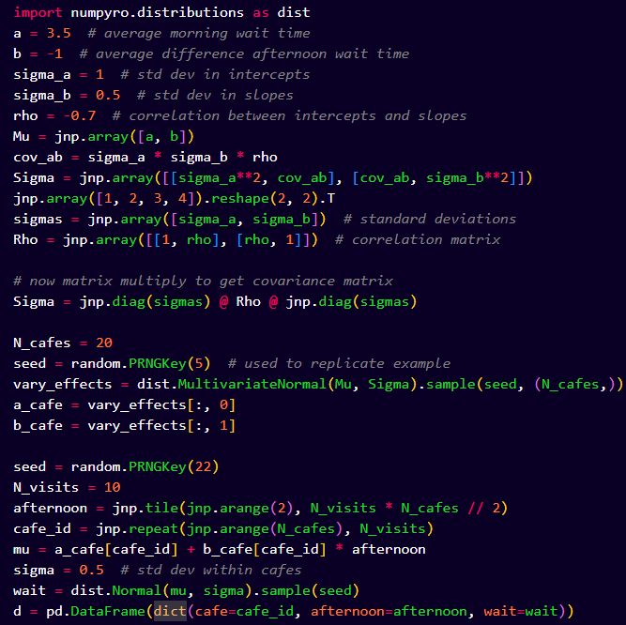
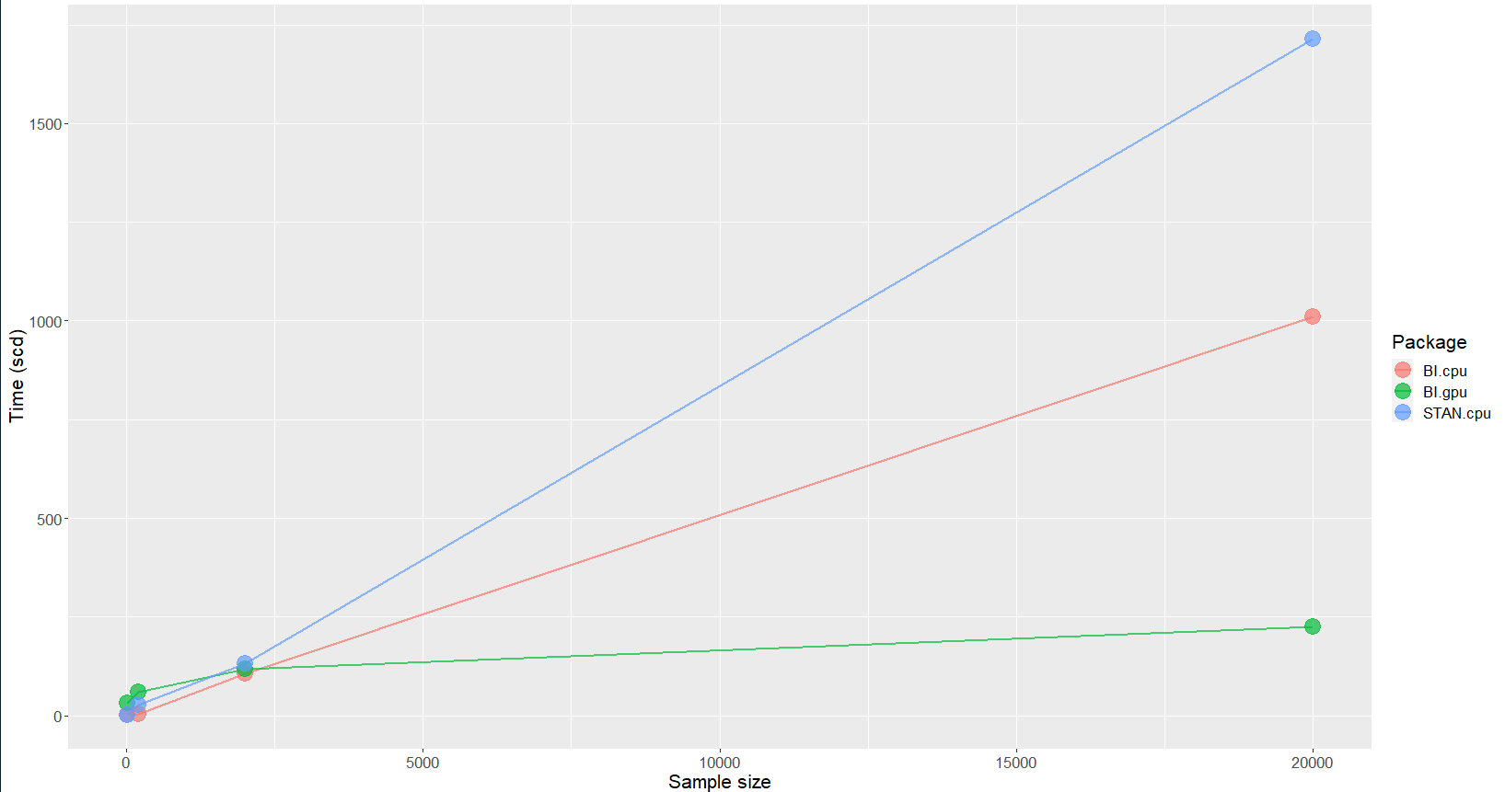

Validation: Large data & CPU V GPU
Notes:
CPU increase is not so big because single chain is vectorized complitelly autonomous
We reach a limit of gpu with memory limitation
NY = 4, NV = 8:
BI (GPU) took 35 minutes
BI (CPU) took : 1 seconds
STAN (CPU) took 2.1 secondes
GPU is x XX slower
NY = 40, NV = 80:
BI (GPU) took 35 minutes
BI (CPU) took 21 seconds
STAN (CPU) took 78 seconds
NY = 400, NV = 800:
BI (GPU) took 37min 23 scd
STAN (CPU) took 118 minutes
bi.gpu = c(2100, 2100, 2243)bi.cpu = c(1, 21, 1528)stan.cpu = c(2.1, 78, 7080)N = c(4*8,40*80,400*800)times = c(bi.gpu, bi.cpu, stan.cpu)Method = c(rep('BI gpu',3), rep('BI cpu',3), rep('stan cpu',3))N = rep(N, 3)d = data.frame(times, Method, N)library(ggplot2)ggplot(d, aes(x = N, y = times, group = Method, color = Method)) + geom_line() + geom_point(size = 4, alpha = 0.5) + xlab('Data size') + ylab('Computation time (s)') + scale_x_continuous(breaks = c(32, 3200, 320000), labels = c("32", "32e100", "320000")) + theme( axis.text.x = element_text(angle = 0, hjust = c(0.5, -0.05, 0)), panel.grid.major = element_blank(), panel.grid.minor = element_blank(), text = element_text(size = 18) )

Slide 26
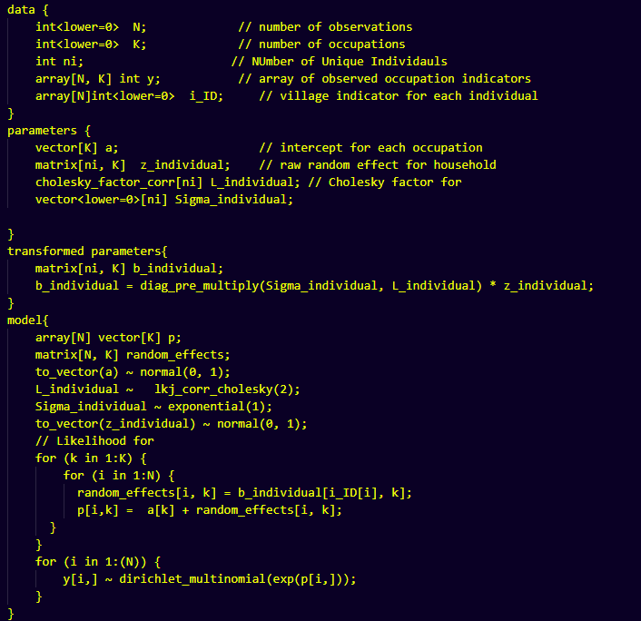
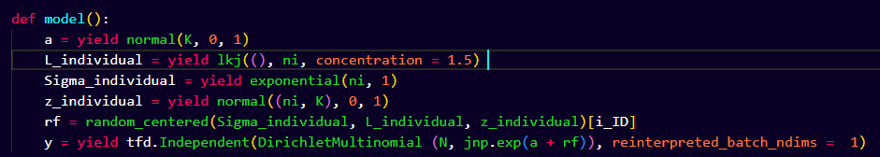
Application: Multinomial model
Random factors need to be setup in different parts of the model.
Models in logical and testable blocks
Notes:
We are generally interested in how the division of labour is shaped by market integration and underlying social networks.

Slide 27
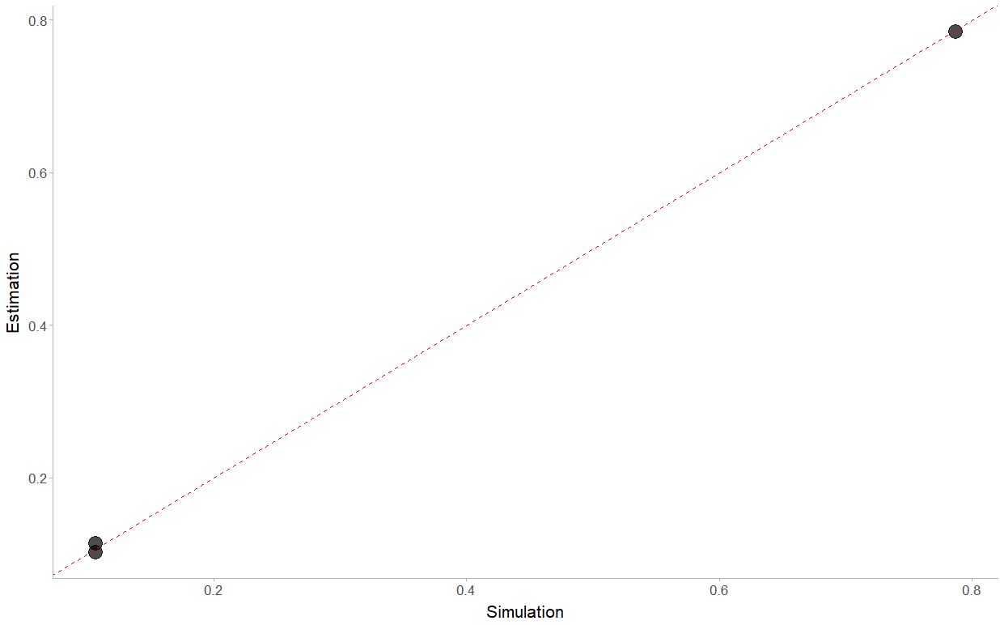
Application: Simulation to validate model

Slide 28
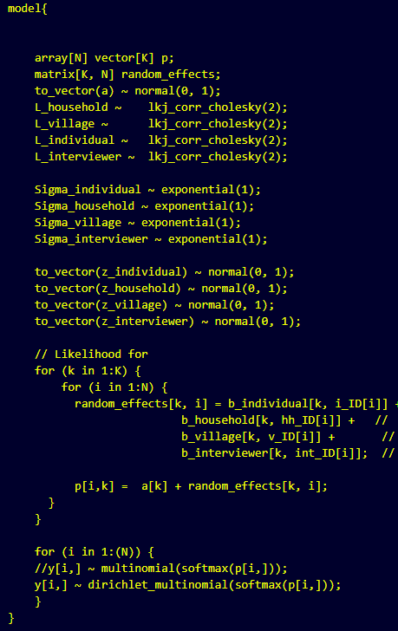
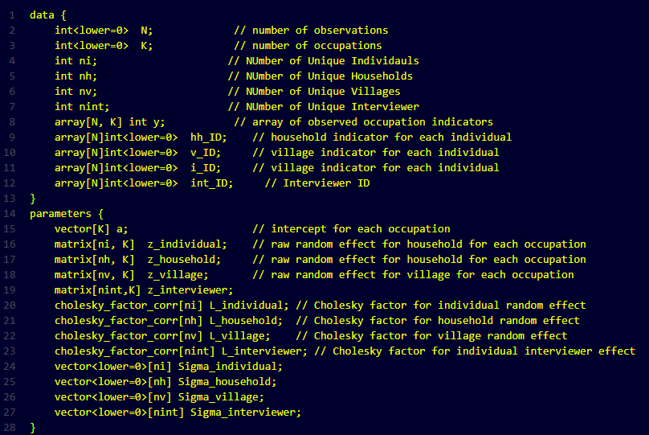
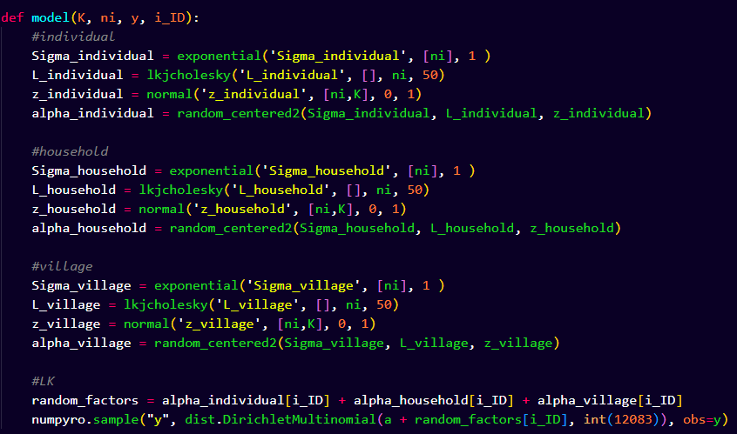
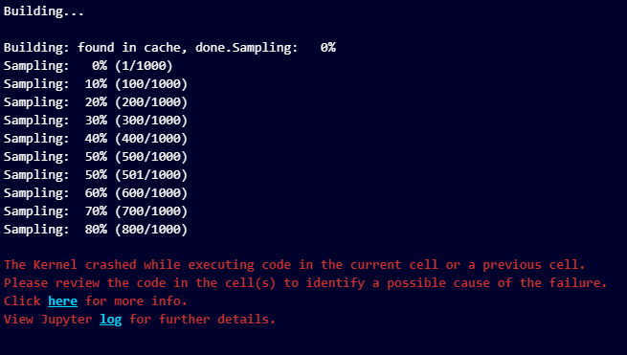
Application: Full model
15 lines
Models in logical and testable blocks
Large data (31506 x 62 matrix)
Notes:
Do the same but with smaller example

Slide 29
Application: Issue
GPU (8 GB) memory overload
Can run the model on GPU (8 GB) with memory deallocation: 38h12 min
CPU and use computer RAM of 63 GB : 24h53 min
Notes:
Do the same but with smaller example

Slide 30
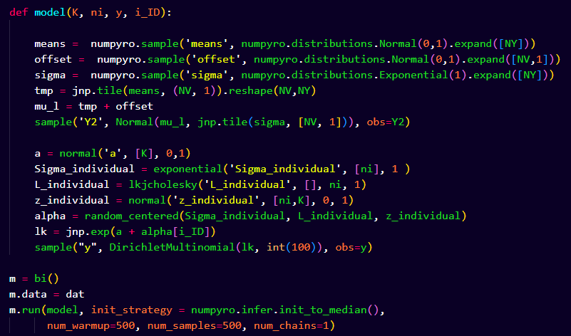
Application: Next step
Inclusion of latent variable
Notes:
Inclusion of a Latent variable model to asses effect of market integration in division of labor

Slide 31
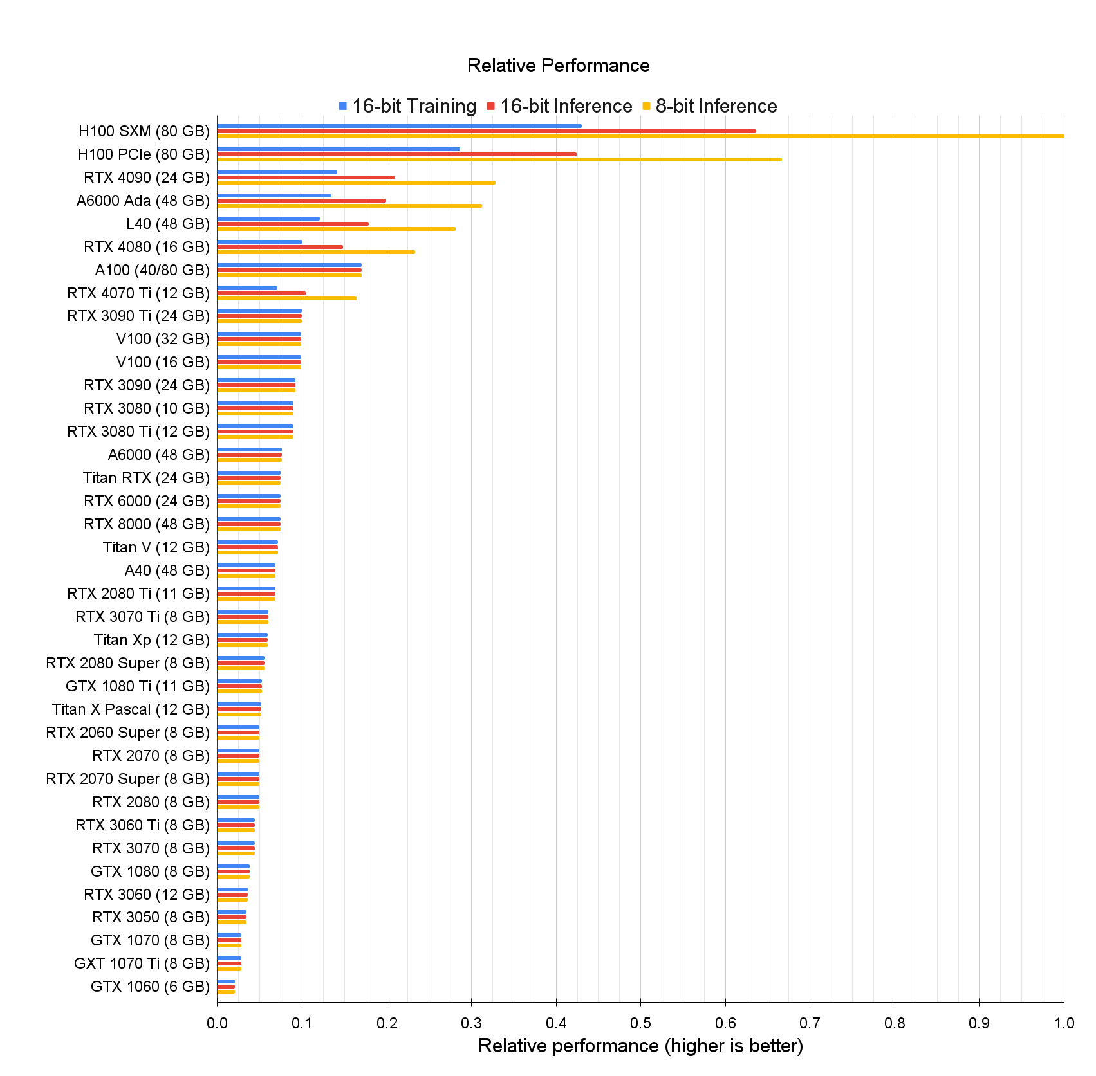
Price
$33,0001
$28,9992
$1,5993
$6,8004
$29,751
$1,0696
$18,240.00
$879
$1,3299

Slide 32
Pros & Cons
Pros | Cons
Faster for large datasets | Slower for smaller datasets
Dynamic programming | New advanced approach will take longer to be implemented
Modular | GPU does not always use the faster
Scalable | GPU memory/price is a limiting factor
Cross platform
Deallocation
Doesn't require to learn another language
Integration for deep learning

Slide 33
Future of the project
Redo STRAND with a modular approach
Redo BISON with a modular approach
By using the possibility to setup any mathematical operations within the model:
Build JAX functions to compute network measures (nodal, dyadic, global)
Build JAX functions for Multiplex :
Models with multiple likelihoods and parameter influence
JAX functions for multiplex metrics
Network-based diffusion approach
Collaborative department package:
Documentation of Different Models
Implementation of JAX Log probability computation with parameter space constraint.
For simulation models (Automatic Differentiation, Composable Function Transformations)
Agent Based Model?
Notes:
All codes are in private github repository but I can invite you
I hope I pique your interest in GPU computation, exploring Python packages like JAX, TensorFlow Probability, and Numpyro.
And please note I don’t have any stock market actions on Google.

