Slide 1
Merged Ontology exercise: INDL + NDL-OWL
Thijs Walcarius Wim Vandenberghe Brecht Vermeulen
October 25th 2013

Slide 2
Table of contents
Merging NDL-OWL and INDL
Matching similar concepts
between core concepts of NDL-OWL and NML-Base
between helper/util concepts of NDL-OWL and NML-Base
between NDL-OWL and INDL
Open questions

Slide 3
Merging NDL-OWL and INDL
Subject | NDL-OWL files | INDL files
Network | topology.owl domain.owl layer.owl | nml-base.owl
Computing | compute.owl storage.owl | indl.owl
Helpers | collections.owl location.owl | nml-base.owl
Files in bold were used as basis for this merge.
Further in this presentation, elements from NDL-OWL will be notated in blue and elements from INDL in red

Slide 4
Matching similar concepts between NDL-OWL and NML-Base: core concepts
NDL-OWL | NML-Base
NetworkElement | NetworkObject
ComputeElement | Node¹
ConnectionPoint / Interface | Port / BidirectionalPort
Link | Link
Service | Service
AdaptationProperty | AdaptationService / De-adaptationService
SwitchMatrix | SwitchingService
Layer | -
¹ Node is very generic in NML-Base: it can also be used for routers, switches,etc. A new subclass is needed.

Slide 5
Matching similar concepts between NDL-OWL and NML-Base: helper concepts
NDL-OWL | NML-Base
Bag (collections.owl) | -
(Thing element) Collection → Bag → List (collections.owl) | ListItem
Set (collections.owl) | -
Label (layer.owl) | Label
LabelSet (layer.owl) | LabelGroup
SpatialThing / Location (location.owl) | Location
NML-Base has only limited collections-support.
The helper classes in collections.owl are more extensive.
Label and Location-classes of NML-Base are sufficient

Slide 6
Matching similar concepts between NDL-OWL and INDL
NDL-OWL | INDL
ComputeElement | Node¹
ComputeElementComponent | NodeComponent
RAM / RAMInstance | MemoryComponent
CPU / CPUInstance | ProcessorComponent
Storage / StorageInstance | StorageComponent
- | GraphicsComponent
Feature? | Capability
CPUArchitecture | Architecture
- | InstructionSet
¹ Node is very generic in NML-Base: it can also be used for routers, switches. A new subclass is needed.

Slide 7
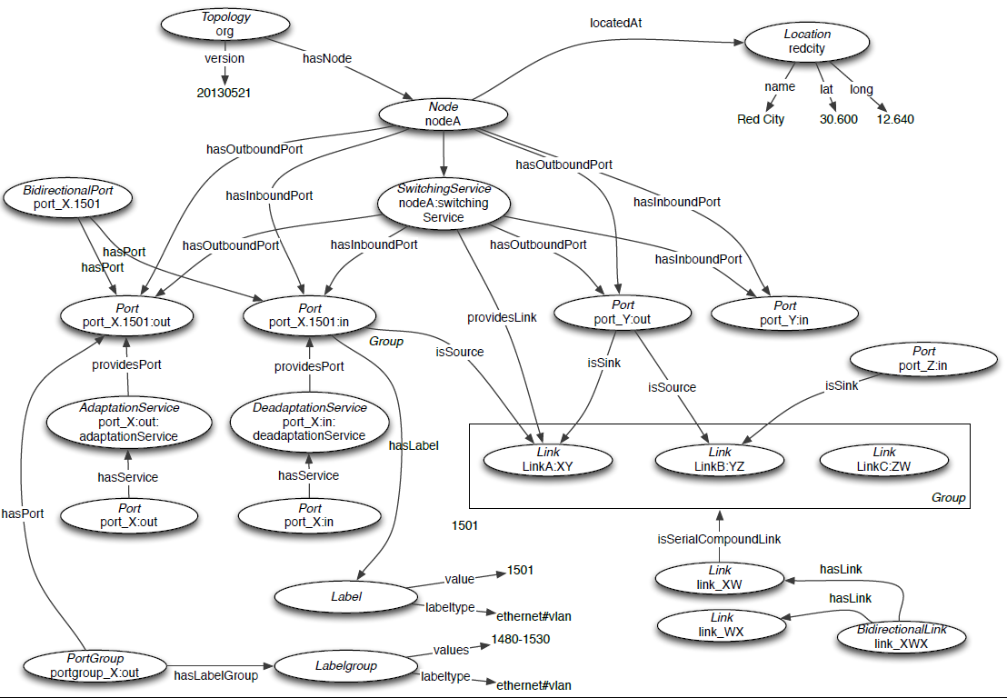
Overview of NML-Base

Slide 8
Coupling NDL-OWL and NML-Base
ComputeElement becomes a child of Node
ConnectionPoint → Interface becomes a child of ComputeElementComponent
A new object property “providesPort” is added to link Interface and Port / BidirectionalPort
Result can be found on: http://users.ugent.be/~twalcari/merged-ontology-draft.zip

Slide 9
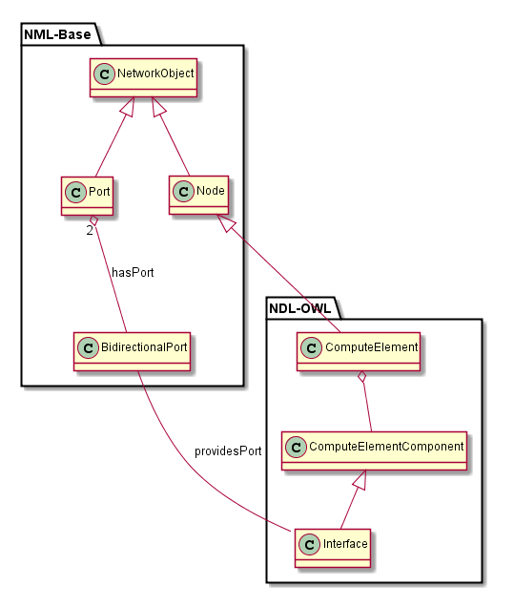
Coupling NDL-OWL and NML-Base

Slide 10

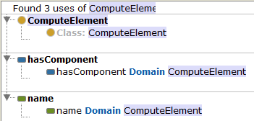
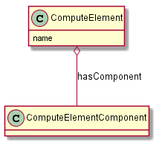
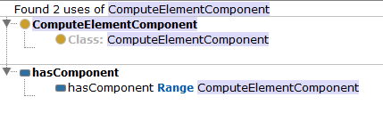
OWL to UML conversion tool
OWL | UML
Class | Class
Data Property | Field in domain-classes
Object Property | Relation between domain-classes and range-classes
Source: http://users.ugent.be/~twalcari/owl-to-uml.zip Executable: http://users.ugent.be/~twalcari/owl-to-uml.jar Usage: java –jar owl-to-uml.jar <OUTPUT> <INPUTFILES> Example: java –jar owl-to-uml.jar example.puml example.owl

Slide 11
Open questions
How do we cope with overlapping helper-classes? (eg. Label, LabelGroup, ListItem)
Are the classes ClassifiedServer / ClassifiedServerInstance relevant for Fed4FIRE/GENI?
What is the difference between ClassifiedServer(Instance) and ClassifiedComputer(Instance)?
Are there any other parts of NDL-OWL that must be part of the core ontology? (ex. ip4.owl)
Do we quantify metrics? (ex. clockFrequency is an int expressed in Hz)

Slide 12
Acknowledgement
This work was carried out with the support of the Fed4FIRE-project (“Federation for FIRE"), an Integrated project funded by the European Commission through the 7th ICT-Framework Programme. (318389). It does not necessarily reflect the views of the European Commission. The European Commission is not liable for any use that may be made of the information contained herein.
Notes:
THIS SLIDE SHOULD ALWAYS BE THE LAST SLIDE OF YOUR PRESENTATION!!!!

