Slide 1
May 17th 2017
JSON-LD “@include”
Implementation
for Thing Description Lifecycle
Kazuo Kajimoto
Panasonic

Slide 2
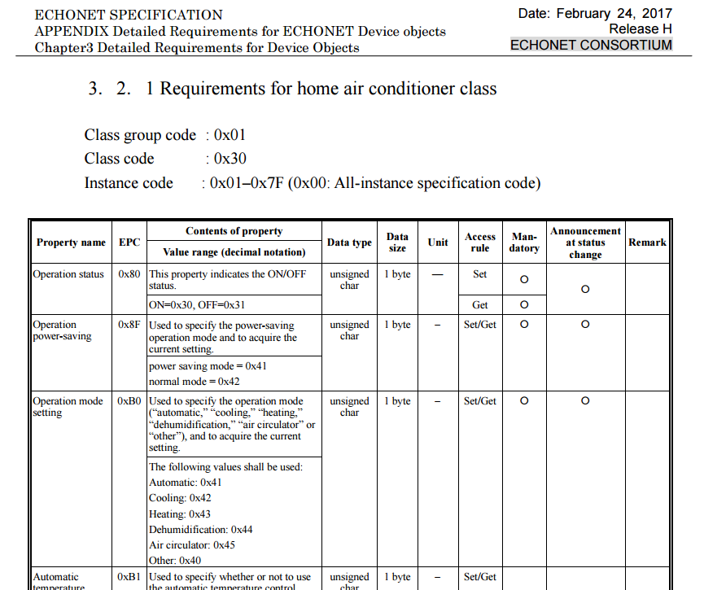
TD sample in Vertical Industry (1)
Some SDOs have defined Device Object Description.
Here is Echonet Consortium’s sample for “home air conditioner”.
https://echonet.jp/wp/wp-content/uploads/pdf/General/Standard/Release/Release_H_en/SpecAppendixH_e.pdf

Slide 3
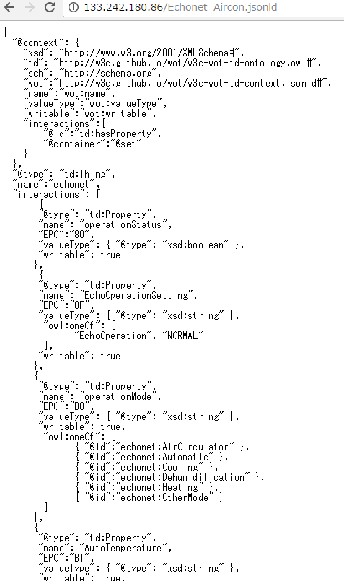
TD sample in Vertical Industry (2)
Echonet Consortium’s definition can be converted to JSON-LD format
according to Things Description syntax.
http://133.242.180.86/Echonet_Aircon.jsonld

Slide 4
Data Operator “@include”
As vertical industry, minimum set of APIs for home air conditioner could
be defined, e.g. Generic Home Air Conditioner.
This description can be created
Removing needless APIs from full set of APIs.
After that, including whole original JSON-LD as follows;
http://133.242.180.86/Generic_Aircon_context.jsonld
"interactions":{
"@id":"td:hasProperty",
"@container":"@set",
"@include": {
"@id":"eco:interactions",
"@remove":[
"UserRemoteControlTemperatureSettingValue",
"BlowoutTemperatureMeasurementValue",
"Non-priorityState",
"InstallationAirPurificationMethod",
"AirCleaningFunctionModeSetting",
"InstallationRefreshMethod",
"RefreshFunctionModeSetting",
"InstallationSelfCleaningMethod",
"SelfCleaningFunctionModeSetting",
"SpecialOperationModeSetting",
"ForcedThermalModeSetting",
"AirPurificationModeSetting"
]
}
}
},
Including whole
“echo:interactions”
APIs expected
to be removed

Slide 5
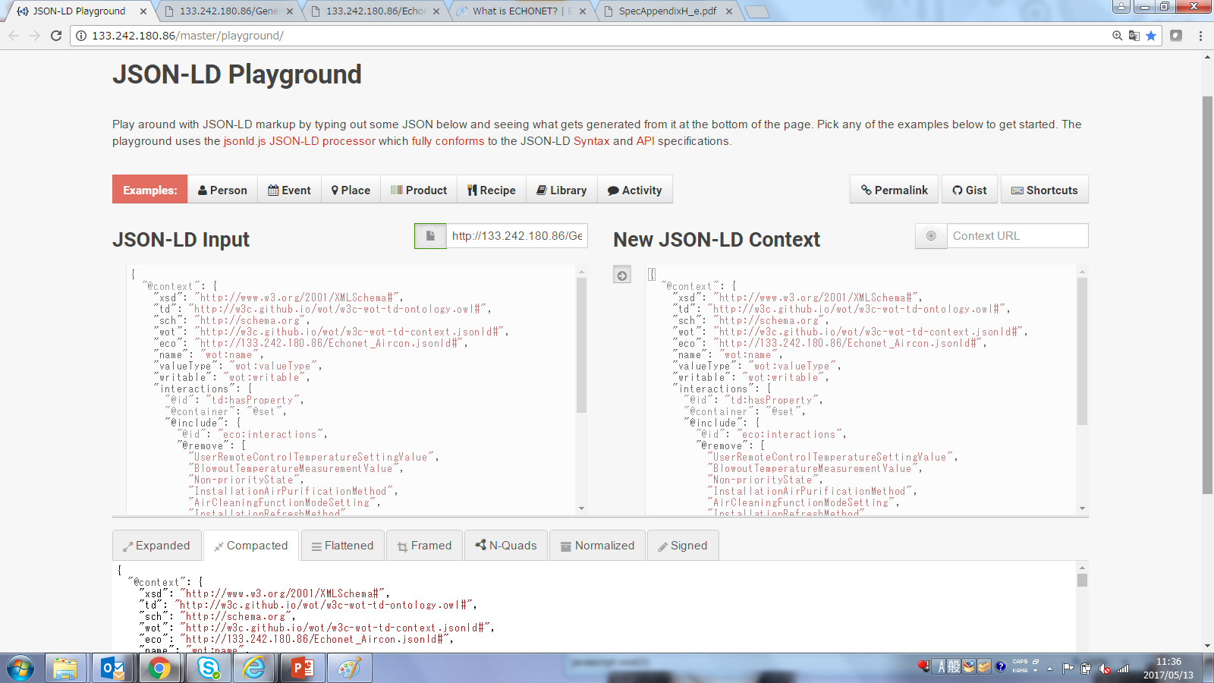
Customized JSON-LD Playground
As PoC, Panasonic customized JSON-LD playground.
http://133.242.180.86/master/playground/
Original JSON-LD TD with “@include”
Interpreted JSON-LD TD without “@include”

Slide 6
Interpretation in Playground
Included TD (Echonet_Aircon.jsonld)
Including TD (Generic_Aircon.jsonld)
{
"@type": "td:Property",
"name": "IndoorTemperatureMeasurementValue",
"EPC":"BB",
"valueType": {
"@type": "xsd:number",
"minValue": 16,
"maxValue": 30
},
"writable": false
},
{
"@type": "td:Property",
"name": "UserRemoteControlTemperatureSettingValue",
"EPC":"BC",
"valueType": {
"@type": "xsd:number",
"minValue": 16,
"maxValue": 30
},
"writable": false
},
{
"@type": "td:Property",
"name": "BlowoutTemperatureMeasurementValue",
"EPC":"BD",
"valueType": {
"@type": "xsd:number",
"minValue": 16,
"maxValue": 30
},
"writable": false
},
{
"@type": "td:Property",
"name": "OutsideTemperatureMeasurementValue",
"EPC":"BE",
"valueType": {
"@type": "xsd:number",
"minValue": 16,
"maxValue": 30
},
"writable": false
},
@include
w/@remove
"@include": {
"@id": "eco:interactions",
"@remove": [
"UserRemoteControlTemperatureSettingValue",
"BlowoutTemperatureMeasurementValue"
]
}
Include
Interpretation in Playground
Remove
Interpreted TD (Generic_Aircon.jsonld)
{
"@type": "td:Property",
"name": "IndoorTemperatureMeasurementValue",
"valueType": {
"@type": "xsd:number"
},
"writable": false
},
{
"@type": "td:Property",
"name": "OutsideTemperatureMeasurementValue",
"valueType": {
"@type": "xsd:number"
},
"writable": false
},
Remove
Include

Slide 7
The relationship example of organizations and TD
W3C/WoT-WG
- who maintains the style of TD
as semantics container type
definition for IoT
http://w3c.github.io/wot/w3c-wot-td-context.jsonld
refer
Refrigerator
Organization of each vertical industry
Washing machine
- who maintains the generic semantics
of things which belongs to the industry
"http://ce-semantics.github.io/wot/
generic-air-conditioner.jsonld"
refer
include
LGE
Mass production manufacturer
Samsung
- who maintains the specific semantics
of each product with reference to
generic semantics of its category thing
"http://panasonic.github.io/wot/
ce/air-conditioner/CS-WX407.jsonld"
refer
include
TD of WoT
Instances
Platform provider (Things aggregator)
"http://aggregater.github.io/wot/
ce/air-conditioner/CS-WX407/#0012.jsonld"
- who aggregates wide variety of things,
manages the relationship between things
and its context such as owner, location etc.
link
(3)refer
Owners DB
(4)URL of
WoT Servients
(1)Inquiry
by owner
(2)Accessible
TD list
Servient of
WoT Instances
Service provider
- who provides service to customers utilizing
TDs provided by platform provider(s)
Service App
(5)Request
(PUT,GET…)

Slide 8

Panasonic would like to lead the standardization on Consumer
Electronics semantics and open it for all stakeholders such as
Manufacturers, aggregators and servicers.

