Slide 1
TD Structure
Kazuo Kajimoto
22/9/2016
{
"@context": ["http://w3c.github.io/wot/w3c-wot-td-context.jsonld"],
"@type": "Thing",
"name": "MyTemperatureThing",
"uris": ["coap://mytemp.example.com:5683/"],
"encodings": ["JSON"],
"properties": [
{
"name": "temperature",
"valueType": { "type": "number" },
"writable": false,
"hrefs": ["temp"]
}
]
}
TD consists of 3 parts.
- (Red) Definition of terminology and vocabulary, Attribute of thing
- (Green) Method to access processing WoT servient
- (Blue) Definition of APIs (API Prototype definition except “hrefs” tag)

Slide 2
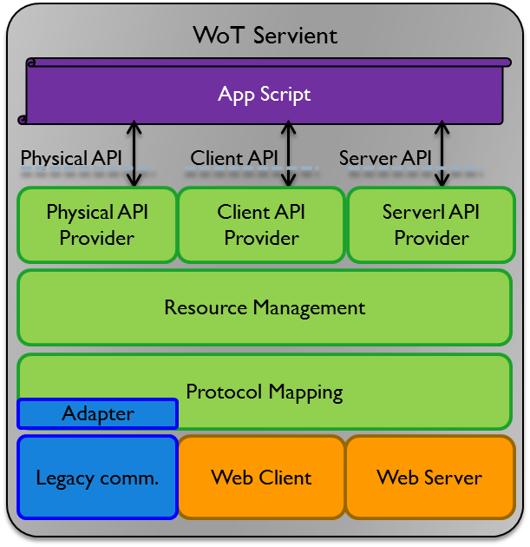
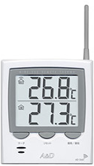


TD Template and Lifecycle Eco System
Kazuo Kajimoto
22/9/2016
Thing’s basic characteristics
Mass production manufacturer
TD Template
“@include”: “http:industry.org/CE.jsonld”
+Product Type Name
+Serial Number
http:industry.org/CE.jsonld
+Product specificl APIs
Common mandate APIs
WoT Servient Class
http:Panasonic/TS.jsonld
each vertical industry
Design and Manufacturing
Potential Promotion
Buy
“@include” “http:Panasonic/TS.jsonld”
+Additional Info
(if any)
Registration
WoT Servient Instance Link
WoT Servient Instance
Customer
http:Servicer/TS_Kajimoto.jsonld
WoT Service Provider
Set up and Operation

Slide 3
Implementation (Need to Help)
Kazuo Kajimoto
22/9/2016
1. How to implement “#include” in C language like functionality in JSON-LD ?
- New operation such as “@include” might be introduced for convenience for description.
2. How to {append, replace, delete} fields and/or APIs in child’s body ?
- Append will just add new fields and/or APIs.
- Replace will declare same name fields and/or APIs.
- Delete might introduce new operation such as “@delete”.
{
"@context": [
"http://w3c.github.io/wot/w3c-wot-td-context.jsonld",
{ "@base":"http://133.242.180.86/ThermoSensor.jsonld" }
],
"@id":"",
"@type":"td:Thing",
"name": “ThermoSensor",
……
{
"@context": [
"http://133.242.180.86/ThermoSensor.jsonld",
{ "@base":"http://133.242.180.86/PanasonicThermoSensor.jsonld" }
],
"@id":"",
"@type": "td:Thing",
"name": "PanasonicThermoSensor",
"rdfs:subClassOf": “ThermoSensor",
"metadata": {
"name": "PanasonicThermoSensor"
},
"child": {
"@id": “ThermoSensor"
},
….
"http://133.242.180.86/ThermoSensor.jsonld"
Current sample implementation on playground is parsed without errors but it might be incorrect from the #include concept point of view.
"http://133.242.180.86/PanasonicThermoSensor.jsonld”

