Slide 1
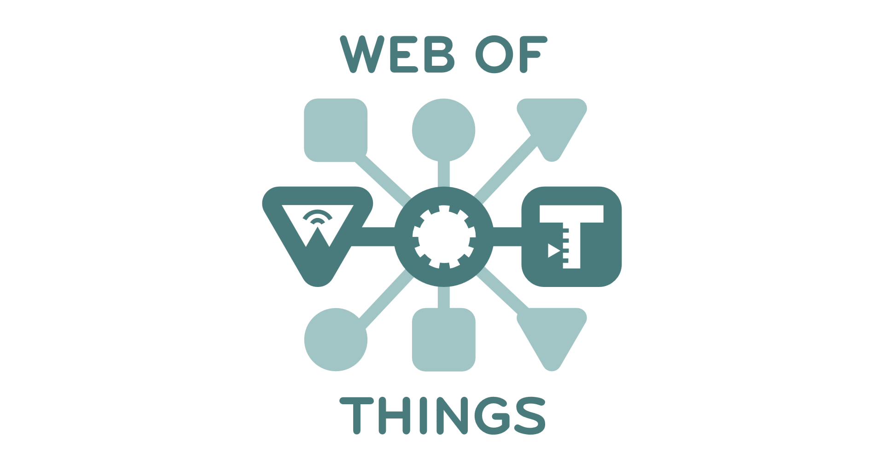
WoT IG/WG Face-to-Face Meeting
Santa Clara, February, 2017

Slide 2
W3C WoT
Interest Group (IG)
Working Group (WG)
https://www.w3.org/2016/07/wot-ig-charter.html
Started spring 2015
218 Members
Informal work
Use cases, explorative work
Liaisons and collaborations with other organizations and SDOs
PlugFests with running code
https://www.w3.org/2016/12/wot-wg-2016.html
Started December 2016
54 Members
Normative work
Standardization of four initial building blocks identified by the IG

Slide 3
W3C WoT Activities
Web of Things (WoT) Interest Group (IG) and Working Group (WG)
https://www.w3.org/WoT/

Slide 4





W3C WoT Mission
Not to be yet another standard
Web of Things
…
“enable easy integration across IoT platforms and application domains” “complementing available standards”

Slide 5
Semantic Metadata for Interoperability
Semantic
Metadata
Platform A
Platform B
Application
Application
Platform API
Platform API
Protocol
Protocol

Slide 6
Simple, Common Interaction Model
Platform A
Platform B
Semantic
Metadata
Application
Application
Platform API
Platform API
Interaction Model
Interaction Model
Protocol
Protocol
Properties
Actions
Events

Slide 7
HTML for Things: Thing Description (TD)
Thing
Thing
Application
Application
Platform API
Platform API
TD
TD
Interaction Model
Interaction Model
Protocol
Protocol
Properties
Actions
Events

Slide 8
Interoperability Across Platforms
Thing
Thing
Application
Application
Platform API
Platform API
TD
TD
Interaction Model
Interaction Model
Protocol
Protocol
HTTP
CoAP
OneM2M CoAP
OCF CoAP

Slide 9
Description of IoT Protocols within TD: Binding Templates
Thing
Thing
Application
Application
Platform API
Platform API
TD
TD
Interaction Model
Interaction Model
Binding Templates
Binding Templates
HTTP
CoAP
OneM2M CoAP
OCF CoAP

Slide 10
Simplify Application Development
Thing
Thing
Application
Application
Platform API
Platform API
TD
TD
Interaction Model
Interaction Model
Binding Templates
Binding Templates

Slide 11
Browser-like Runtime for IoT Apps: Scripting API
Thing
Thing
Runtime Environment
Runtime Environment
App Script
App Script
Scripting API
Scripting API
TD
TD
Interaction Model
Interaction Model
Binding Templates
Binding Templates

Slide 12
Portable Apps Across Vendors
Thing
Thing
Runtime Environment
Runtime Environment
App Script
Scripting API
Scripting API
TD
TD
Interaction Model
Interaction Model
Binding Templates
Binding Templates

Slide 13
Portable Apps Across Components
Gateway
Thing
Runtime Environment
Runtime Environment
App Script
Scripting API
Scripting API
TD
TD
Interaction Model
Interaction Model
Binding Templates
Binding Templates

Slide 14
Portable Apps Across Components
Gateway
Cloud
Runtime Environment
Runtime Environment
App Script
Scripting API
Scripting API
TD
TD
Interaction Model
Interaction Model
Binding Templates
Binding Templates

Slide 15
TD to Augment Existing Things
Thing
TD Repository
Cloud
Custom Firmware
Runtime Environment
App Script
Scripting API
TD
TD
Interaction Model
Interaction Model
Custom HTTP
Binding Templates

Slide 16
W3C WoT Building Blocks
WoT Scripting API:
A standardized API to simplify IoT application development and enable portable scripts across vendors and device, gateway, and cloud platforms. The API allows to expose and consume Things according to the TD Interaction Model.
WoT Servient
Runtime Environment
App Script
WoT Thing Description (TD):
Provides metadata of the interactions, data model, communication, as well as security mechanisms of the Thing. Using JSON-LD, the TD can be consumed by classic JSON parsers, but provides extension points for optional rich semantic tooling.
Scripting API
TD
Interaction Model
WoT Binding Templates:
The TD also describes the usage of protocols. A vanilla protocol stack can be configured at runtime to produce message that will be understood by the targeted Thing (cf. different HTTP APIs or OCF, oneM2M, and LWM2M dialects of CoAP).
Binding Templates
Server
Client
Security & Privacy:
W3C WoT does not invent new mechanisms, but ensures that all building blocks provide means to describe the security and privacy mechanisms used in a specific platform and provides adversary testing of Things.

