Slide 1

Getting Started with a W3C WoT Project
Eclipse Virtual IoT Meetup, 16 Jun 2016

Slide 2
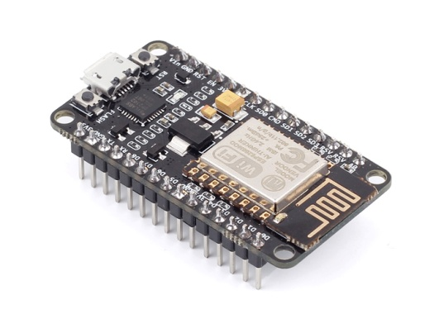
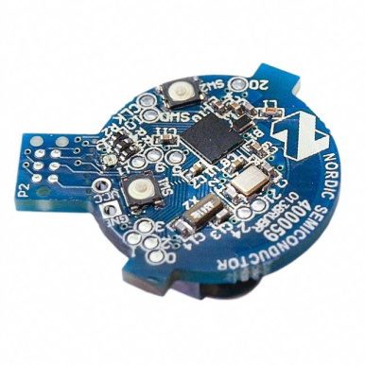
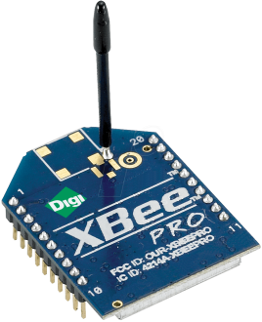
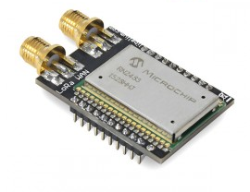
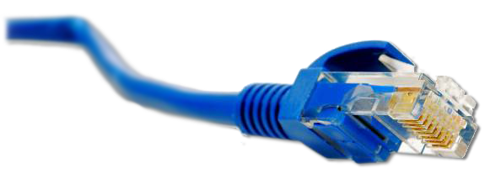
What is the Web of Things?
Application Layer
Internet of Things
: Connectivity
IEEE 802.15.4
Ethernet
Wi-Fi
Bluetooth
LoRa
…

Slide 3





What is the Web of Things?
Internet of Things
: Connectivity
IEEE 802.15.4
Ethernet
Wi-Fi
Bluetooth
LoRa
…

Slide 4
What is the Web of Things?
Web of Things
Internet of Things
: Connectivity
IEEE 802.15.4
Ethernet
Wi-Fi
Bluetooth
LoRa
…
Notes:
Connecting the physical world with the virtual world of our IT systems

Slide 5
W3C WoT Mission
Not to be yet another standard
Web of Things
…
“interconnecting existing Internet of Things platforms and complementing available standards”

Slide 6

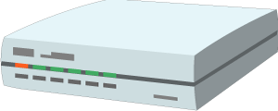

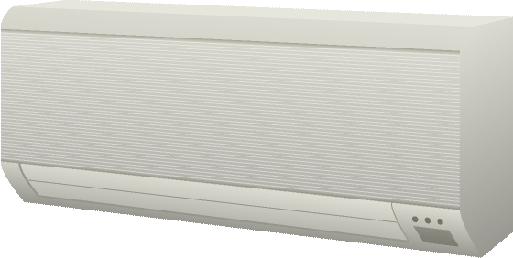


Overview of WoT Concepts
Cloud Mirror / Device Shadow
Integration Hubs
WoT Servient
App Script
Runtime Environment
WoT Servient
Resource Model
App Script
Protocol Bindings
Thing
Description
Runtime Environment
Resource Model
Standardized Scripting APIs
for Apps
Protocol Bindings
Semantic Models
Web Integration
Web Browser
WoT Servient
App Script
App Script
Runtime Environment
Thing
Description
Runtime Environment
Resource Model
Complementing
Existing Devices
and Platforms
Resource Model
Protocol Bindings
Protocol Bindings
Thing-to-Thing Interaction

Slide 7
Outline
Architecture
Things, Deployment Scenarios, and Servients
WoT Interface
Protocol Bindings and the Web
Thing Description (TD)
Metadata and Interactions
Scripting API
Runtime Environment and Portable Apps

Slide 8
WoT architecture
Things, Deployment Scenarios, and Servients
http://w3c.github.io/wot/architecture/wot-architecture.html

Slide 9
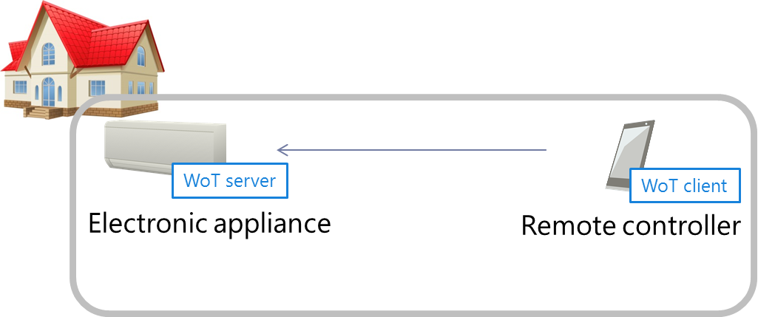

Local Thing-to-Thing
Local discovery
WoT server exposes “Interactions” through WoT Interface
WoT client (UI or other Thing) interacts with WoT Interface

Slide 10
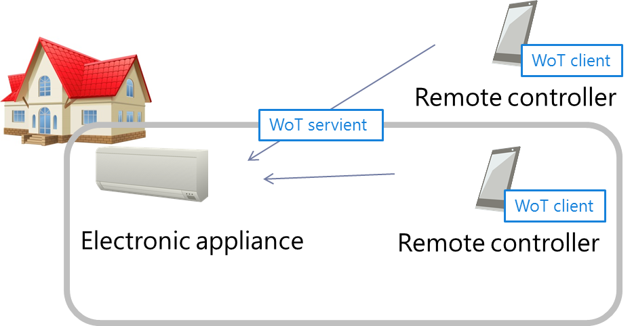
Remote Access
Local and remote discovery
Remote client gains access to local network (IPv6, NAT traversal, ...)

Slide 11
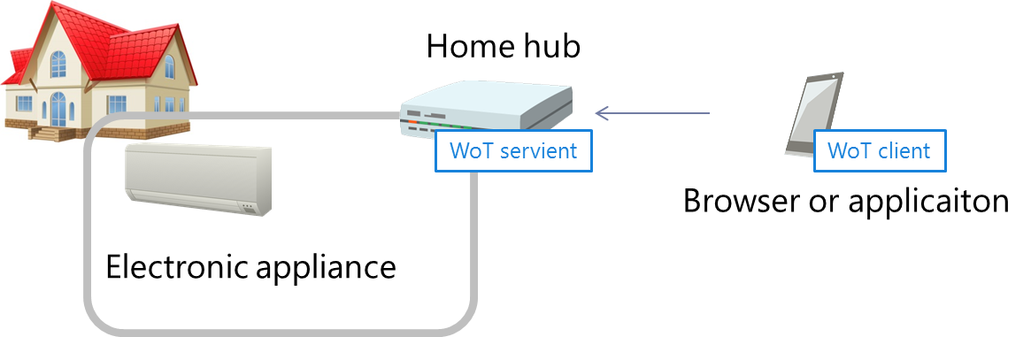
Remote Access: Integration Hubs
Hub does local discovery and exposes Things
Hub can provide virtual Things (e.g., rooms or sensor fusion)
Hub can integrate and augment legacy devices (gateway)

Slide 12
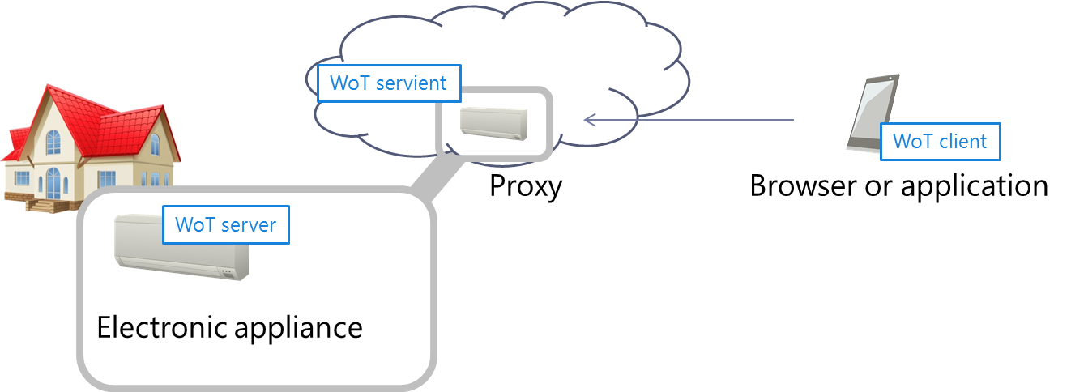
Remote Access: Cloud Mirror
WoT server is proxied in the cloud, which exposes Things
Cloud can provide virtual Things (e.g., buildings or sensor fusion)
Integrates with mobile app world and cloud-based IoT

Slide 13
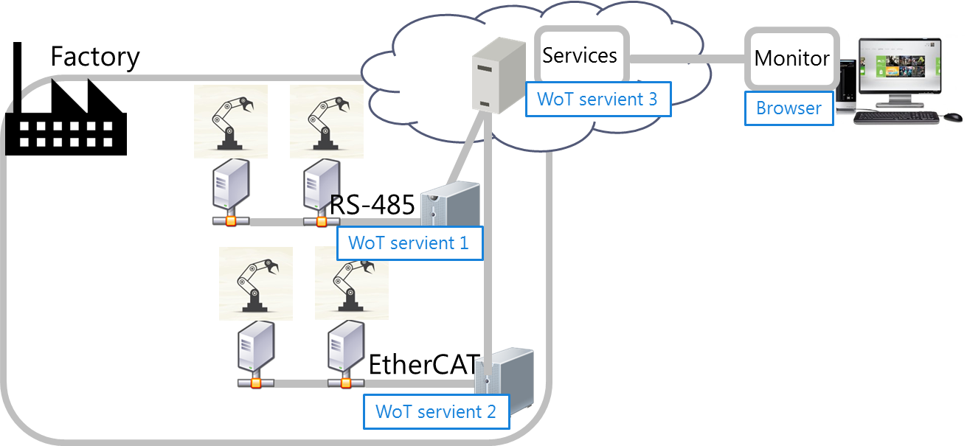
Smart Factory / Industrial
WoT also targets requirements from industrial applications

Slide 14
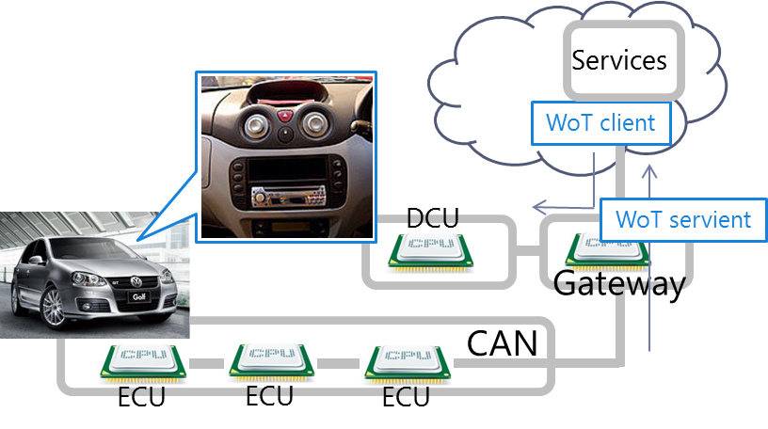
Automotive
WoT activity is in contact with W3C Automotive work

Slide 15
Thing Implementation: WoT Servient
WoT Servient
Application Logic:
It can access local hardware, locally connected legacy devices, and remote things through the WoT Interface. For this, the runtime environment must provide the Scripting API (Physical, Client, Server).
App Script
(Propr. API)
Discovery API
Server API
Client API
Runtime Environment
Thing Description (TD):
Declares WoT Interface for interaction and provides (semantic) metadata for the Thing. TD is used by WoT clients to instantiate local software object of the Thing.
Legacy comm-unication
Resource Model
Thing
Description
Protocol Binding
Resource Model:
Provides a common abstraction across the different protocols. Just like the Web, it allows to identify and address interaction points with URIs.
Server Connector
Client Connector
Protocol Binding:
Converts interactions with Things using information in TD in accordance with lower-layer protocols to have client and server connectors.
Proprietary interface
WoT Interface
Legacy
device
Web Server
Web Client
WoT Servient
WoT Servient

Slide 16
WoT Servient on Thing Itself
Native WoT Things host a servient directly
TD is provided by Thing directly
WoT Servient (Wot Device)
Browser
Script
Script
Runtime Env.
Runtime Environment
Resource Model
Thing
Description
Resource Model
Protocol
Binding
Protocol Binding
Client Connector
Server Connector
Client Connector

Slide 17
WoT Servient on Integration Hub
WoT servients can run on hubs (e.g., smartphone, gateway)
Can act as agent for legacy devices
Multiple servients can be instantiated through sandboxed apps
Smart HomeHub
Browser
WoT Servient
App Script
App Script
Runtime Env.
Runtime Environment
Resource Model
Things
Description
Legacy comm.
Resource Model
Protocol
Binding
Protocol Binding
Client Connector
Server Connector
Client Connector
Legacy
device

Slide 18
WoT Servient in the Cloud
A cloud mirror / device shadow can forward interactions
Cloud mirror is synchronized with local servient
Platform
Hub(GW)
Browser
WoT Servient
App Script
WoT Servient
App Script
App Script
Runtime Envi.
Runtime Environment
Resource Model
Thing
Description
Resource Model
Runtime Environment
Protocol Binding
Protocol Binding
Thing
Description
Legacy comm.
Resource Model
Client Connector
Server Connector
Client Connector
Protocol Binding
Server Connector
Client Connector
Cloud
Legacy
device

Slide 19
WoT Interface
Protocol Bindings and the Web
http://w3c.github.io/wot/current-practices/ wot-practices-beijing-2016.html#sec-wot-interface

Slide 20
WoT Interface
Interface exposed by servient to the network
WoT Servient
WoT Servient
WoT Interface
WoT Interface

Slide 21
WoT Interface
Interface exposed by servient to the network
WoT Servient
WoT Servient
WoT Interface
WoT Interface
Protocol

Slide 22
Protocol Bindings
Interface can be bound to various protocols
WoT Servient
WoT Servient
HTTP Binding
HTTP Binding
WoT Interface
WoT Interface
HTTP

Slide 23
Protocol Bindings
Interface can be bound to various protocols
WoT Servient
WoT Servient
CoAP Binding
CoAP Binding
WoT Interface
WoT Interface
CoAP

Slide 24
Protocol Bindings
Multiple bindings possible
WoT Servient
WoT Servient
HTTP Binding
WS Binding
WS Binding
WoT Interface
WoT Interface
WebSocket

Slide 25
Resource Model
Interaction points are Web resources
WoT Servient
WoT Servient
Resource Model
Resource Model
Protocol Binding(s)
Protocol Binding(s)
WoT Interface
WoT Interface

Slide 26
Servient Role
Servient can act as client or server
WoT Servient
WoT Servient
URIs
Resource Model
http://wot.example.com/res
Protocol Binding(s)
Protocol Binding(s)
Client Connector
Server Connector

Slide 27
Servient Role
… or both at the same time
WoT Servient
WoT Servient
WoT Servient
URIs
Resource Model
URIs
Resource Model
Protocol Binding(s)
Protocol Binding(s)
Protocol Binding(s)
Client Connector
Server Con.
Client Con.
Server Connector

Slide 28
Thing Description
Metadata and Interactions
http://w3c.github.io/wot/current-practices/ wot-practices-beijing-2016.html#thing-description

Slide 29

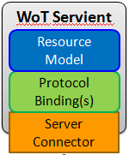
I Want to Use a WoT Servient
Who are you?
What kind of data do you serve?
How can I access the data/function?
What kind of functions do you have?
What kind of protocols/encodings do you support?
Are there some security constrains?
→ W3C Thing Description (TD)

Slide 30
Thing Description
Describes Thing metadata and interactions
WoT Servient
WoT Servient
Resource Model
Protocol Binding(s)
Protocol Binding(s)
Client Connector
Server Connector

Slide 31
Thing Description
Describes Thing metadata and interactions
WoT Servient
WoT Servient
Thing
Description
Resource Model
Protocol Binding(s)
Protocol Binding(s)
Client Connector
Server Connector

Slide 32
Thing Description
Machine clients can understand WoT Interface
WoT Servient
WoT Servient
Metadata, URIs
Thing
Description
Resource Model
Protocol Binding(s)
Protocol Binding(s)
Client Connector
Server Connector

Slide 33
Thing Description
Thing-to-thing communication
WoT Servient
WoT Servient
Metadata, URIs
Thing
Description
Resource Model
Protocol Binding(s)
Protocol Binding(s)
Client Connector
Server Connector

Slide 34
Describe your Thing based on JSON-LD
Reach interoperability by a semantic description language
based on well established JSON format
enables machine interoperability by using (standardized) vocabularies from given @context
JSON-LD is rooted in the RDF model
subject, predicate, object triples

Slide 35
TD Example
{
"@context": [
"http://w3c.github.io/wot/w3c-wot-td-context.jsonld",
{ "actuator": "http://example.org/actuator#" }
],
"@type": "Thing",
"name": "MyLEDThing",
"uris": [
"coap://myled.example.com:5683/",
"http://mything.example.com:8080/myled/"
],
"encodings": ["JSON", "EXI"],
"security": {
"cat": "token:jwt",
"alg": "HS256",
"as": "https://authority-issuing.example.org"
},
"properties": [
{
"@type": "actuator:onOffStatus",
"name": "status",
"valueType": { "type": "boolean" },
"writable": true,
"hrefs": [ "pwr", "status" ]
}
],
"actions": [
{
"@type": "actuator:fadeIn",
"name": "fadeIn",
"inputData": {
"valueType": { "type": "integer" },
"actuator:unit": "actuator:ms"
},
"hrefs": [ "in", "led/in" ]
},
{
"@type": "actuator:fadeOut",
"name": "fadeOut",
"inputData": {
"valueType": { "type": "integer" },
"actuator:unit": "actuator:ms"
},
"hrefs": [ "out", "led/out" ]
}
],
"events": [
{
"@type": "actuator:alert",
"name": "criticalCondition",
"valueType": { "type": "string" },
"hrefs": [ "ev", "alert" ]
}
]
}

Slide 36
{
"@context": [
"http://w3c.github.io/wot/w3c-wot-td-context.jsonld",
{ "actuator": "http://example.org/actuator#" }
],
"@type": "Thing",
"name": "MyLEDThing",
"uris": [
"coap://myled.example.com:5683/",
"http://mything.example.com:8080/myled/"
],
"encodings": ["JSON", "EXI"],
"security": {
"cat": "token:jwt",
"alg": "HS256",
"as": "https://authority-issuing.example.org"
},
"properties": [
{
"@type": "actuator:onOffStatus",
"name": "status",
"valueType": { "type": "boolean" },
"writable": true,
"hrefs": [ "pwr", "status" ]
}
],
"actions": [
{
"@type": "actuator:fadeIn",
"name": "fadeIn",
"inputData": {
"valueType": { "type": "integer" },
"actuator:unit": "actuator:ms"
},
"hrefs": [ "in", "led/in" ]
},
{
"@type": "actuator:fadeOut",
"name": "fadeOut",
"inputData": {
"valueType": { "type": "integer" },
"actuator:unit": "actuator:ms"
},
"hrefs": [ "out", "led/out" ]
}
],
"events": [
{
"@type": "actuator:alert",
"name": "criticalCondition",
"valueType": { "type": "string" },
"hrefs": [ "ev", "alert" ]
}
]
}

Slide 37
Type System
Default currently based on JSON Schema http://w3c.github.io/wot/current-practices/ wot-practices-beijing-2016.html#type-system
Best start with simple types
boolean
integer
number
String
Other systems can be plugged in under "valueType"

Slide 38
How to Create a TD?
Manually copy, paste, and modify
http://w3c.github.io/wot/current-practices/ wot-practices-beijing-2016.html#td-examples
or look into the TD repository http://vs0.inf.ethz.ch:8080 (might be offline from time to time)
Generate from development framework
Serialization based on the interactions provided

Slide 39
Scripting API
Runtime Environment and Portable Apps
http://w3c.github.io/wot/current-practices/ wot-practices-beijing-2016.html#scripting-api

Slide 40
Without Scripting API
Application logic often implemented natively
WoT Servient
Application Logic
C / C++ / Java / …
Resource Model
Protocol Binding(s)
Client Connector
Server Connector

Slide 41
Scripting API
Common runtime enables portable apps
WoT Servient
Runtime Environment
App Script
Disc. API
Server API
Client API
Resource Model
Protocol Binding(s)
Client Connector
Server Connector

Slide 42
Scripting API
Common runtime enables portable apps
WoT Servient Vendor A
WoT Servient Vendor B
Runtime Environment
Runtime Environment
App Script
Disc. API
Server API
Client API
Disc. API
Server API
Client API
Resource Model
Resource Model
Protocol Binding(s)
Protocol Binding(s)
Client Connector
Server Connector
Client Connector
Server Connector

Slide 43
Scripting API
Common runtime enables portable apps
WoT Servient Vendor A
WoT Servient Vendor B
Runtime Environment
Runtime Environment
App Script
Disc. API
Server API
Client API
Disc. API
Server API
Client API
Resource Model
Resource Model
Protocol Binding(s)
Protocol Binding(s)
Client Connector
Server Connector
Client Connector
Server Connector

Slide 44
Participation Howto
How to get started?
http://w3c.github.io/wot/current-practices/ wot-practices-beijing-2016.html#participation-howto

Slide 45
Pick Your Servient Role
Client Role
User interface
Machine agent
Server Role
Sensor/actuator
Device simulators
Both (“servient”)
Configurable client
Aggregator using other Things

Slide 46
Pick Your Platform
Client Role
User interface Angular.js and Web browser
Machine agent Python, Ruby, Java, C++, …
Server Role
Sensor/actuator Arduino, ESP8266, mbed, …
Device simulators Node.js, Java
Both
Hub Raspberry Pi, smartphone
Cloud proxy Java

Slide 47
Pick Your Protocol(s)
HTTP
Node.js, Jetty, RESTX.io, lighttpd, …
Platform-specific (Arduino, Contiki, NodeMCU, …)
CoAP
Californium, node-coap, libcoap
Platform-specific (Contiki, mbed, NodeMCU, …)
http://coap.technology/
Others? Design the binding!
e.g., MQTT: https://www.eclipse.org/paho/

Slide 48
Pick Your Logic Implementation
Start with native application logic
Once familiar, follow the Current Practices document for the Scripting API http://w3c.github.io/wot/current-practices/ wot-practices.html

Slide 49
Online Resources
Interest Group
https://www.w3.org/WoT/IG/
https://lists.w3.org/Archives/Public/public-wot-ig/ (subscribe to mailing list)
Documents (for implementers)
http://w3c.github.io/wot/architecture/wot-architecture.html
http://w3c.github.io/wot/current-practices/wot-practices.html (living document) Beijing 2016 Release: http://w3c.github.io/wot/current-practices/wot-practices-beijing-2016.html
GitHub (documents and proposals)
https://github.com/w3c/wot
Wiki (organizational information: WebConf calls, Face-to-Face meetings, …)
https://www.w3.org/WoT/IG/wiki/Main_Page
WoT Projects (implementing WoT Current Practices)
https://github.com/thingweb/
https://github.com/mkovatsc/wot-demo-devices
Please add yours!

