Slide 1

W3C Standards for the IoT
RIOT Summit, Berlin, Germany, 2016

Slide 2
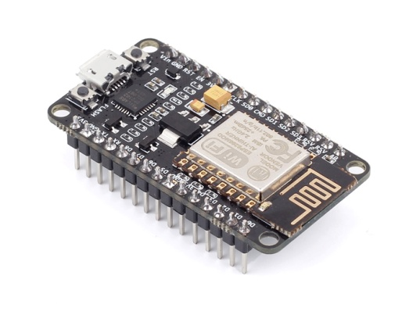
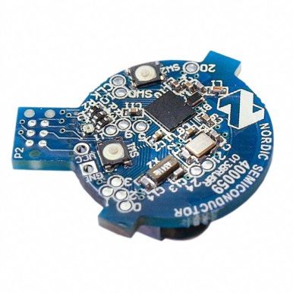
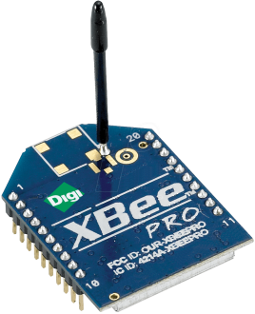
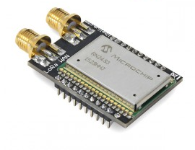
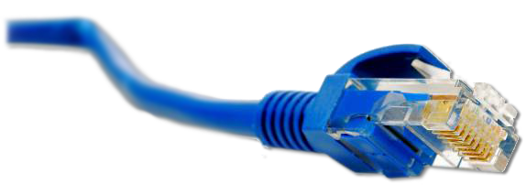
What is the Web of Things?
Application Layer
Internet of Things
: Connectivity
IEEE 802.15.4
Ethernet
Wi-Fi
Bluetooth
LoRa
…

Slide 3





What is the Web of Things?
Internet of Things
: Connectivity
IEEE 802.15.4
Ethernet
Wi-Fi
Bluetooth
LoRa
…

Slide 4
What is the Web of Things?
Web of Things: Applications
Internet of Things
: Connectivity
IEEE 802.15.4
Ethernet
Wi-Fi
Bluetooth
LoRa
…
Notes:
Connecting the physical world with the virtual world of our IT systems

Slide 5
W3C WoT Mission
Not to be yet another standard
Web of Things
…
“interconnecting existing Internet of Things platforms and complementing available standards”

Slide 6
Building Blocks
Need to Describe How to Interact with Things of Different IoT Platforms
http://w3c.github.io/wot/current-practices/ wot-practices.html#sec-concepts

Slide 7
Goals and Challenges
Goal: Web of Things Application Layer
need to program and deploy IoT applications like Web applications (outside embedded domain)
Goal: Complement existing standards
need to describe heterogeneous Thing, communication, and security metadata
Goal: Enable interoperability across platforms
need to support different protocols and communication patterns

Slide 8
WoT Interface
Let’s start bottom-up …
Need to Support Different Protocols and Communication Patterns
http://w3c.github.io/wot/current-practices/ wot-practices.html#wot-interface

Slide 9
WoT Interface
Interface of Things exposed to the network
“Thing”
“Thing”
WoT Interface
WoT Interface

Slide 10
WoT Interface
Interface of Things exposed to the network
“Thing”
“Thing”
WoT Interface
WoT Interface
Protocol

Slide 11
Protocol Bindings
Various protocols can implement the interface
“Thing”
“Thing”
Protocol Bindings
Protocol Bindings
WoT Interface
HTTP
WoT Interface
HTTP
HTTP

Slide 12
Protocol Bindings
Various protocols can implement the interface
“Thing”
“Thing”
Protocol Bindings
Protocol Bindings
WoT Interface
CoAP
WoT Interface
CoAP
CoAP

Slide 13
Protocol Bindings
Multiple bindings per Thing possible
“Thing”
“Thing”
Protocol Bindings
Protocol Bindings
WoT Interface
MQTT
WS
WoT Interface
WS
WebSocket

Slide 14
Resource Model
Interaction points are Web resources
“Thing”
“Thing”
Resource Model
Resource Model
Protocol Bindings
Protocol Bindings
WoT Interface
∙··
WoT Interface
∙··

Slide 15
Interaction Role
Consuming Things are in client role
Exposing Things are in server role
“Consuming Thing”
“Exposing Thing”
Web Links
Interaction Resources
http://wot.example.com/res
Protocol Bindings
Protocol Bindings
Client Role
∙··
Server Role
∙··

Slide 16
Interaction Role
Usually both roles at the same time → Servient
WoT Servient
WoT Servient
WoT Servient
Web Links
Interaction Resources
Web Links
Interaction Resources
Web Links
Protocol Bindings
Protocol Bindings
Protocol Bindings
Client Role
∙··
Both Roles
∙··
Both Roles
∙··

Slide 17
Thing Description
Need to Describe Heterogeneous Thing, Communication, and Security Metadata
http://w3c.github.io/wot/current-practices/ wot-practices.html#thing-description

Slide 18

How to Interact with Things?
Who are you?
What kind of data do you serve?
“Thing”
Resource Model
How can I interact with you?
Protocol Bindings
WoT Interface
What kind of functions do you have?
···
What kind of protocols/encodings do you support?
Are there some security constrains?
→ W3C Thing Description

Slide 19
Semantic Description
Reach semantic interoperability through Linked Data vocabularies
each individual Things is described by a set of triples
no fixed classes or types, but atomic vocabulary
W3C Thing Description
vocabulary for thing, communication, and security metadata
extensible with domain-specific vocabulary
can augment existing Things (e.g., host externally on Web)

Slide 20
Thing Description (TD)
Describes Thing metadata and interactions
WoT Servient
WoT Servient
Resource Model
Resource Model
Protocol Bindings
Protocol Bindings
WoT Interface
∙··
WoT Interface
∙··

Slide 21
Thing Description (TD)
Consuming Things are in client role
Exposing Things are in server role
WoT Servient
WoT Servient
Protocol Bindings
Protocol Bindings
Client Role
Server Role

Slide 22
Thing Description (TD)
Exposing Things provide Thing Description
WoT Servient
WoT Servient
Thing
Description
Interaction Resources
Protocol Bindings
Protocol Bindings
Client Role
Server Role
CoAP
HTTP

Slide 23
Thing Description (TD)
Consuming Things learn WoT Interface from TD
WoT Servient
WoT Servient
Metadata, Web Links
Thing
Description
Interaction Resources
Protocol Bindings
Protocol Bindings
Client Role
HTTP
Server Role
CoAP
HTTP

Slide 24
Thing Description (TD)
Bindings generate messages according to TD
WoT Servient
WoT Servient
Metadata, Web Links
Thing
Description
Interaction Resources
Protocol Bindings
Protocol Bindings
Client Role
HTTP
Server Role
CoAP
HTTP

Slide 25
Thing Description (TD)
Default serialization is JSON-LD
convenient for development time
based on well established JSON format
"@context" field defines vocabularies
different implementations and tools available; http://json-ld.org/
Other, also concise serializations possible
XML, EXI, CBOR, HDT, …

Slide 26
TD Example
{
"@context": [
"http://w3c.github.io/wot/w3c-wot-td-context.jsonld",
{ "actuator": "http://example.org/actuator#" }
],
"@type": "Thing",
"name": "MyLEDThing",
"uris": [
"coap://myled.example.com:5683/",
"http://mything.example.com:8080/myled/"
],
"encodings": ["JSON", "EXI"],
"security": {
"cat": "token:jwt",
"alg": "HS256",
"as": "https://authority-issuing.example.org"
},
"properties": [
{
"@type": "actuator:onOffStatus",
"name": "status",
"valueType": { "type": "boolean" },
"writable": true,
"hrefs": [ "pwr", "status" ]
}
],
"actions": [
{
"@type": "actuator:fadeIn",
"name": "fadeIn",
"inputData": {
"valueType": { "type": "integer" },
"actuator:unit": "actuator:ms"
},
"hrefs": [ "in", "led/in" ]
},
{
"@type": "actuator:fadeOut",
"name": "fadeOut",
"inputData": {
"valueType": { "type": "integer" },
"actuator:unit": "actuator:ms"
},
"hrefs": [ "out", "led/out" ]
}
],
"events": [
{
"@type": "actuator:alert",
"name": "criticalCondition",
"valueType": { "type": "string" },
"hrefs": [ "ev", "alert" ]
}
]
}

Slide 27
{
"@context": [
"http://w3c.github.io/wot/w3c-wot-td-context.jsonld",
{ "actuator": "http://example.org/actuator#" }
],
"@type": "Thing",
"name": "MyLEDThing",
"uris": [
"coap://myled.example.com:5683/",
"http://mything.example.com:8080/myled/"
],
"encodings": ["JSON", "EXI"],
"security": {
"cat": "token:jwt",
"alg": "HS256",
"as": "https://authority-issuing.example.org"
},
"properties": [
{
"@type": "actuator:onOffStatus",
"name": "status",
"valueType": { "type": "boolean" },
"writable": true,
"hrefs": [ "pwr", "status" ]
}
],
"actions": [
{
"@type": "actuator:fadeIn",
"name": "fadeIn",
"inputData": {
"valueType": { "type": "integer" },
"actuator:unit": "actuator:ms"
},
"hrefs": [ "in", "led/in" ]
},
{
"@type": "actuator:fadeOut",
"name": "fadeOut",
"inputData": {
"valueType": { "type": "integer" },
"actuator:unit": "actuator:ms"
},
"hrefs": [ "out", "led/out" ]
}
],
"events": [
{
"@type": "actuator:alert",
"name": "criticalCondition",
"valueType": { "type": "string" },
"hrefs": [ "ev", "alert" ]
}
]
}
Property
Interaction resources
Action
Action
Events^{(work in progress)}

Slide 28
Scripting API
Need to Program and Deploy IoT Applications like Web Applications
http://w3c.github.io/wot/current-practices/ wot-practices.html#scripting-api

Slide 29
Without Scripting API
Application logic often implemented natively
WoT Servient
Application Logic
C / C++ / Java / …
Resource Model
Protocol Bindings
WoT Interface
∙··

Slide 30
Scripting API
Web-like development and deployment
WoT Servient
Runtime Environment
App Script
Disc. API
Client API
Server API
Resource Model
Protocol Bindings
WoT Interface
∙··

Slide 31
Scripting API
Common runtime enables portable apps
WoT Servient Vendor A
WoT Servient Vendor B
Runtime Environment
Runtime Environment
App Script
Disc. API
Client API
Server API
Disc. API
Client API
Server API
Resource Model
Resource Model
Protocol Bindings
Protocol Bindings
WoT Interface
∙··
WoT Interface
∙··

Slide 32
Script Example (Expose Thing)
// create software object to represent local Thing
WoT.newThing("counter")
.then(function(thing) {
thing
// programmatically add interactions
.addProperty("count", {"type": "integer"})
.addAction("increment")
.onInvokeAction("increment", function() {
console.log("incrementing counter");
// persistent state is managed by runtime environment
var value = thing.getProperty("count") + 1;
thing.setProperty("count", value);
return value;
})
// initialize state (no builder pattern anymore)
thing.setProperty("count", 0);
})
._catch(console.err);

Slide 33
Script Example (Consume Thing)
// create software object to represent remote Thing based on TD URI
WoT.consumeDescriptionUri("http://servient.example.com/things/counter")
// use promise to handle asynchronous creation
.then(function(counter) {
counter
// invoke an Action without arguments
.invokeAction("increment", {})
// which is an asynchronous call -> promise
.then(function() {
console.log("incremented");
counter
// read Property (async.) to confirm increment
.getProperty("count").then(function(count) {
console.log("new count state is " + count);
});
})._catch(console.error);
})
._catch(console.error);

Slide 34
SUmmary
W3C Web of Things

Slide 35
Thing Implementation: WoT Servient
Application Logic:
Can consume remote Things through the Client API, local hardware and connected legacy devices through a Physical API (t.b.d.), and expose Things through the Server API. To allow portable app scripts, the Servient must povide a runtime environment.
WoT Servient
App Script
(Physic. API)
Discovery API
Client API
Server API
Runtime Environment
Resource Model:
Provides a common abstraction with uniform interface across the different protocols. Like the Web, it allows to identify and address interaction points through URIs.
Legacy comm-unication
Resource Model
Thing
Description
Protocol Bindings
Thing Description (TD):
Declares WoT Interface for interaction and provides (semantic) metadata for the Thing. TD is used by WoT clients to instantiate local software object of the Thing.
Client Role
Server Role
Proprietary interface
WoT Interface
Protocol Binding:
Converts abstract interactions with Things to different protocols using the information from TD.
Legacy
device
Web Server
Web Client
WoT Servient
WoT Servient

Slide 36



WoT Servient on Thing Itself
Native WoT Things host a Servient directly
TD is provided by Thing or supporting host on the Web
WoT Servient (Wot Device)
Browser
App Script
Script
Runtime Env.
Runtime Environment
Thing
Description
Resource Model
Resource Model
Protocol
Bindings
Protocol Bindings
Client Role
Server Role
Client Role

Slide 37
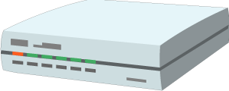
WoT Servient on Integration Hub
WoT Servients can run on hubs (e.g., smartphone, gateway)
Multiple Servients can be instantiated through sandboxed apps
Apps can act as agents/proxies for legacy devices
Hub Platform
Browser
WoT Servient
App Script
App Script
Runtime Env.
Runtime Environment
Thing
Description
Resource Model
Resource Model
Legacy comm.
Protocol
Bindings
Protocol Bindings
Client Role
Server Role
Client Role
Legacy
device

Slide 38
WoT Servient in the Cloud
A cloud mirror (device shadow) enables scalable remote access
Is synchronized with local Servient
Can forward interactions and cache data
Cloud Platform
Hub
Browser
WoT Servient
App Script
WoT Servient
App Script
App Script
Runtime Envi.
Runtime Environment
Resource Model
Thing
Description
Resource Model
Runtime Environment
Thing
Description
Resource Model
Legacy comm.
Protocol Binding
Protocol Binding
Client Role
Server Role
Client Role
Protocol Binding
Server Role
Client Role
Legacy
device
Anywhere
Cloud
Local

Slide 39
Online Resources
Interest Group
https://www.w3.org/WoT/IG/
https://lists.w3.org/Archives/Public/public-wot-ig/ (subscribe to mailing list)
Documents (for implementers)
http://w3c.github.io/wot/architecture/wot-architecture.html
http://w3c.github.io/wot/current-practices/wot-practices.html (living document) Beijing 2016 Release: http://w3c.github.io/wot/current-practices/wot-practices-beijing-2016.html
GitHub (documents and proposals)
https://github.com/w3c/wot
Wiki (organizational information: WebConf calls, Face-to-Face meetings, …)
https://www.w3.org/WoT/IG/wiki/Main_Page
WoT Projects (implementing WoT Current Practices)
https://github.com/thingweb/
https://github.com/mkovatsc/wot-demo-devices
Please add yours!

Slide 40
PlugFest
W3C WoT F2F Beijing 2016

Slide 41

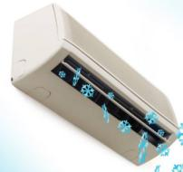
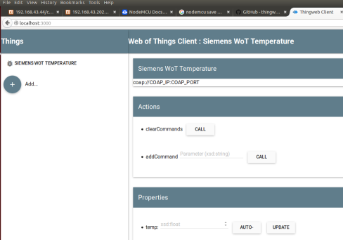




Scenario 1: Hello WoT
TD Web UI for human interaction
Servient platform with scripted apps
Servient connected to legacy devices
/voteTooHot
/on
Open Source

Slide 42

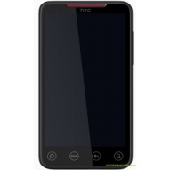



Scenario 2: Full WoT
Web Browser Scripting API
WoT Servient providing voter script and voting Servient
WoT Servient connected to legacy devices
/voteTooHot
/on
/voteTooHot
TD Repository
WoT Servient searching for a voting Servient
Search for Action @type=“tooHot“

Slide 43


Scenario 3: Mini Automation
Consume brightness sensor to control curtain

Slide 44
PlugFest Online Resources
Current Practices (Beijing Release)
http://w3c.github.io/wot/current-practices/wot-practices-beijing-2016.html
Organization Wiki
https://www.w3.org/WoT/IG/wiki/F2F_meeting,_July_2016,_China,_Beijing#PlugFest
Test Cases
https://github.com/w3c/wot/blob/master/plugfest/2016-beijing/plugfest-test-cases-beijing-2016.md
Report Template
https://github.com/w3c/wot/blob/master/plugfest/2016-beijing/TestCaseCoverage.xlsx (t.b.d.)

