Slide 1

Getting Started with a W3C WoT Project
WoT F2F, Beijing, China, Jul 2016
Unrestricted

Slide 2
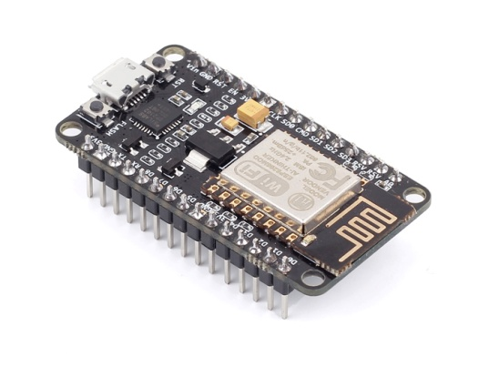
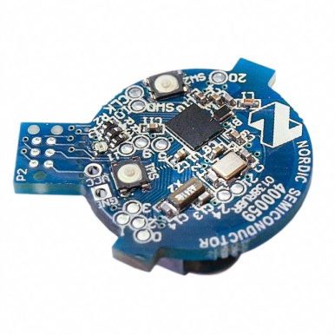
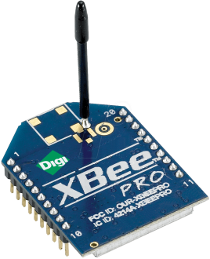
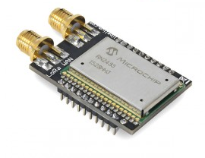

What is the Web of Things?
Application Layer
Internet of Things
: Connectivity
IEEE 802.15.4
Ethernet
Wi-Fi
Bluetooth
LoRa
…

Slide 3





What is the Web of Things?
Internet of Things
: Connectivity
IEEE 802.15.4
Ethernet
Wi-Fi
Bluetooth
LoRa
…

Slide 4
What is the Web of Things?
Web of Things
Internet of Things
: Connectivity
IEEE 802.15.4
Ethernet
Wi-Fi
Bluetooth
LoRa
…
Notes:
Connecting the physical world with the virtual world of our IT systems

Slide 5
W3C WoT Mission
Not to be yet another standard
Web of Things
…
“interconnecting existing Internet of Things platforms and complementing available standards”

Slide 6
Outline
Architecture
Things, Deployment Scenarios, and Servients
WoT Interface
Protocol Bindings and the Web
Thing Description (TD)
Metadata and Interactions
Scripting API
Runtime Environment and Portable Apps

Slide 7
WoT architecture
Things, Deployment Scenarios, and Servients
http://w3c.github.io/wot/architecture/wot-architecture.html

Slide 8
Thing Implementation: WoT Servient
WoT Servient
Application Logic:
It can access local hardware, locally connected legacy devices, and remote things through the WoT Interface. For this, the runtime environment must provide the Scripting API (Physical, Client, Server).
App Script
(Propr. API)
Discovery API
Server API
Client API
Runtime Environment
Thing Description (TD):
Declares WoT Interface for interaction and provides (semantic) metadata for the Thing. TD is used by WoT clients to instantiate local software object of the Thing.
Legacy comm-unication
Resource Model
Thing
Description
Protocol Binding
Resource Model:
Provides a common abstraction across the different protocols. Just like the Web, it allows to identify and address interaction points with URIs.
Server Connector
Client Connector
Protocol Binding:
Converts interactions with Things using information in TD in accordance with lower-layer protocols to have client and server connectors.
Proprietary interface
WoT Interface
Legacy
device
Web Server
Web Client
WoT Servient
WoT Servient

Slide 9



WoT Servient on Thing Itself
Native WoT Things host a servient directly
TD is provided by Thing directly
WoT Servient (Wot Device)
Browser
Script
Script
Runtime Env.
Runtime Environment
Resource Model
Thing
Description
Resource Model
Protocol
Binding
Protocol Binding
Client Connector
Server Connector
Client Connector

Slide 10
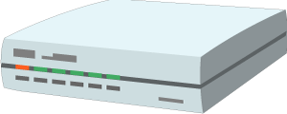
WoT Servient on Integration Hub
WoT servients can run on hubs (e.g., smartphone, gateway)
Can act as agent for legacy devices
Multiple servients can be instantiated through sandboxed apps
Smart HomeHub
Browser
WoT Servient
App Script
App Script
Runtime Env.
Runtime Environment
Resource Model
Things
Description
Legacy comm.
Resource Model
Protocol
Binding
Protocol Binding
Client Connector
Server Connector
Client Connector
Legacy
device

Slide 11
WoT Servient in the Cloud
A cloud mirror / device shadow can forward interactions
Cloud mirror is synchronized with local servient
Platform
Hub(GW)
Browser
WoT Servient
App Script
WoT Servient
App Script
App Script
Runtime Envi.
Runtime Environment
Resource Model
Thing
Description
Resource Model
Runtime Environment
Protocol Binding
Protocol Binding
Thing
Description
Legacy comm.
Resource Model
Client Connector
Server Connector
Client Connector
Protocol Binding
Server Connector
Client Connector
Cloud
Legacy
device

Slide 12
WoT Interface
Protocol Bindings and the Web
http://w3c.github.io/wot/current-practices/ wot-practices-beijing-2016.html#sec-wot-interface

Slide 13
WoT Interface
Interface exposed by servient to the network
WoT Servient
WoT Servient
WoT Interface
WoT Interface

Slide 14
WoT Interface
Interface exposed by servient to the network
WoT Servient
WoT Servient
WoT Interface
WoT Interface
Protocol

Slide 15
Protocol Bindings
Interface can be bound to various protocols
WoT Servient
WoT Servient
Protocol Binding(s)
Protocol Binding(s)
WoT Interface
HTTP
WoT Interface
HTTP
HTTP

Slide 16
Protocol Bindings
Interface can be bound to various protocols
WoT Servient
WoT Servient
Protocol Binding(s)
Protocol Binding(s)
WoT Interface
CoAP
WoT Interface
CoAP
CoAP

Slide 17
Protocol Bindings
Multiple bindings possible
WoT Servient
WoT Servient
Protocol Bindings
Protocol Binding
WoT Interface
HTTP
WS
WoT Interface
WS
WebSocket

Slide 18
Resource Model
Interaction points are Web resources
WoT Servient
WoT Servient
Resource Model
Resource Model
Protocol Binding(s)
Protocol Binding(s)
WoT Interface
WoT Interface

Slide 19
Servient Role
Servient can act as client or server
WoT Servient
WoT Servient
Web Links (URIs)
Resource Model
http://wot.example.com/res
Protocol Binding(s)
Protocol Binding(s)
Client Role
Server Role

Slide 20
Servient Role
… or both at the same time
WoT Servient
WoT Servient
WoT Servient
Web Links
Resource Model
Web Links
Resource Model
Protocol Binding(s)
Protocol Binding(s)
Protocol Binding(s)
Client Role
Both Roles
Server Role

Slide 21
Thing Description
Metadata and Interactions
http://w3c.github.io/wot/current-practices/ wot-practices-beijing-2016.html#thing-description

Slide 22

How to Interact with WoT Servients?
Who are you?
What kind of data do you serve?
WoT Servient
Resource Model
How can I access the data/function?
Protocol Binding(s)
WoT Interface
What kind of functions do you have?
What kind of protocols/encodings do you support?
Are there some security constrains?
→ W3C Thing Description

Slide 23
Semantic Description
Reach interoperability through Linked Data vocabularies
subject, predicate, object triples
rooted in the RDF model
W3C Thing Description
describes WoT Interface to interact with Things
extensible with domain-specific vocabulary
different serializations possible

Slide 24
Thing Description (TD)
Describes Thing metadata and interactions
WoT Servient
WoT Servient
Resource Model
Resource Model
Protocol Binding(s)
Protocol Binding(s)
WoT Interface
WoT Interface

Slide 25
Thing Description (TD)
Consuming Things are in client role
Exposed Things are in server role
WoT Servient
WoT Servient
Protocol Binding(s)
Protocol Binding(s)
Client Role
Server Role

Slide 26
Thing Description (TD)
Exposed Things provide Thing Description
WoT Servient
WoT Servient
Thing
Description
Interaction Resources
Protocol Binding(s)
Protocol Bindings
Client Role
Server Role
CoAP
HTTP

Slide 27
Thing Description (TD)
Consuming Things learn WoT Interface from TD
WoT Servient
WoT Servient
Metadata, Web Links
Thing
Description
Interaction Resources
Protocol Binding(s)
Protocol Bindings
Client Role
HTTP
Server Role
CoAP
HTTP

Slide 28
Thing Description (TD)
Thing-to-thing communication
WoT Servient
WoT Servient
Metadata, Web Links
Thing
Description
Interaction Resources
Protocol Binding(s)
Protocol Bindings
Client Role
HTTP
Server Role
CoAP
HTTP

Slide 29
Thing Description (TD)
Default serialization is JSON-LD
based on well established JSON format
different implementations and tools available
@context defines vocabularies
See TD example

Slide 30
TD Example
{
"@context": [
"http://w3c.github.io/wot/w3c-wot-td-context.jsonld",
{ "actuator": "http://example.org/actuator#" }
],
"@type": "Thing",
"name": "MyLEDThing",
"uris": [
"coap://myled.example.com:5683/",
"http://mything.example.com:8080/myled/"
],
"encodings": ["JSON", "EXI"],
"security": {
"cat": "token:jwt",
"alg": "HS256",
"as": "https://authority-issuing.example.org"
},
"properties": [
{
"@type": "actuator:onOffStatus",
"name": "status",
"valueType": { "type": "boolean" },
"writable": true,
"hrefs": [ "pwr", "status" ]
}
],
"actions": [
{
"@type": "actuator:fadeIn",
"name": "fadeIn",
"inputData": {
"valueType": { "type": "integer" },
"actuator:unit": "actuator:ms"
},
"hrefs": [ "in", "led/in" ]
},
{
"@type": "actuator:fadeOut",
"name": "fadeOut",
"inputData": {
"valueType": { "type": "integer" },
"actuator:unit": "actuator:ms"
},
"hrefs": [ "out", "led/out" ]
}
],
"events": [
{
"@type": "actuator:alert",
"name": "criticalCondition",
"valueType": { "type": "string" },
"hrefs": [ "ev", "alert" ]
}
]
}

Slide 31
{
"@context": [
"http://w3c.github.io/wot/w3c-wot-td-context.jsonld",
{ "actuator": "http://example.org/actuator#" }
],
"@type": "Thing",
"name": "MyLEDThing",
"uris": [
"coap://myled.example.com:5683/",
"http://mything.example.com:8080/myled/"
],
"encodings": ["JSON", "EXI"],
"security": {
"cat": "token:jwt",
"alg": "HS256",
"as": "https://authority-issuing.example.org"
},
"properties": [
{
"@type": "actuator:onOffStatus",
"name": "status",
"valueType": { "type": "boolean" },
"writable": true,
"hrefs": [ "pwr", "status" ]
}
],
"actions": [
{
"@type": "actuator:fadeIn",
"name": "fadeIn",
"inputData": {
"valueType": { "type": "integer" },
"actuator:unit": "actuator:ms"
},
"hrefs": [ "in", "led/in" ]
},
{
"@type": "actuator:fadeOut",
"name": "fadeOut",
"inputData": {
"valueType": { "type": "integer" },
"actuator:unit": "actuator:ms"
},
"hrefs": [ "out", "led/out" ]
}
],
"events": [
{
"@type": "actuator:alert",
"name": "criticalCondition",
"valueType": { "type": "string" },
"hrefs": [ "ev", "alert" ]
}
]
}
Property
Interaction resources
Action
Action
Events^{(work in progress)}

Slide 32
Type System
Default currently based on JSON Schema http://w3c.github.io/wot/current-practices/ wot-practices-beijing-2016.html#type-system
Best start with simple types
boolean
integer
number
string
Other systems can be plugged in under "valueType„ field

Slide 33
How to Create a TD?
Manually copy, paste, and modify
http://w3c.github.io/wot/current-practices/ wot-practices-beijing-2016.html#td-examples
or look into the TD repository http://vs0.inf.ethz.ch:8080 (development repository, sometimes offline)
Generate from development framework
Serialization based on the interactions provided

Slide 34
Scripting API
Runtime Environment and Portable Apps
http://w3c.github.io/wot/current-practices/ wot-practices-beijing-2016.html#scripting-api

Slide 35
Without Scripting API
Application logic often implemented natively
WoT Servient
Application Logic
C / C++ / Java / …
Resource Model
Protocol Binding(s)
WoT Interface

Slide 36
Scripting API
Common runtime enables portable apps
WoT Servient
Runtime Environment
App Script
Disc. API
Server API
Client API
Resource Model
Protocol Binding(s)
WoT Interface

Slide 37
Scripting API
Common runtime enables portable apps
WoT Servient Vendor A
WoT Servient Vendor B
Runtime Environment
Runtime Environment
App Script
Disc. API
Server API
Client API
Disc. API
Server API
Client API
Resource Model
Resource Model
Protocol Binding(s)
Protocol Binding(s)
WoT Interface
WoT Interface

Slide 38
Scripting API
Common runtime enables portable apps
WoT Servient Vendor A
WoT Servient Vendor B
Runtime Environment
Runtime Environment
App Script
Disc. API
Server API
Client API
Disc. API
Server API
Client API
Resource Model
Resource Model
Protocol Binding(s)
Protocol Binding(s)
WoT Interface
WoT Interface

Slide 39
WoT Root Element
interface WoT {
Promise<sequence<ConsumedThing>> discover(ThingFilter filter);
Promise<ConsumedThing> consumeDescription(Object td);
Promise<ConsumedThing> consumeDescriptionUri(DOMString uri);
Promise<ExposedThing> createThing(DOMString name);
Promise<ExposedThing> createFromDescription(Object td);
Promise<ExposedThing> createFromDescriptionUri(DOMString uri);
};

Slide 40
ConsumedThing
interface ConsumedThing {
readonly attribute DOMString name;
Promise<any> getProperty(DOMString propertyName);
Promise<any> setProperty(DOMString propertyName, any newValue);
Promise<any> invokeAction(DOMString actionName, any parameter);
ConsumedThing addListener(DOMString eventName,
ThingEventListener listener);
ConsumedThing removeListener(DOMString eventName,
ThingEventListener listener);
ConsumedThing removeAllListeners(DOMString eventName);
Object getDescription();
};

Slide 41
ExposedThing
interface ExposedThing {
readonly attribute DOMString name;
ExposedThing addProperty(DOMString name, object type);
ExposedThing addAction(DOMString name, Object input, Object output);
ExposedThing addEvent(DOMString name, Object output);
Promise<any> getProperty(DOMString propertyName);
Promise<any> setProperty(DOMString propertyName, any newValue);
Promise<any> emitEvent(DOMString eventName, any payload);
ExposedThing onUpdateProperty(DOMString n, PropertyChangeListener cb);
ExposedThing onInvokeAction(DOMString actionName, ActionHandler cb);
Object getDescription();
};

Slide 42
Script Example (Client API)
WoT.consumeDescriptionUri("http://servient.example.com/things/counter")
.then(function(counter) {
counter
.invokeAction("increment", {}).then(function() {
console.log("incremented");
counter
.getProperty("count").then(function(count) {
console.log("count state is now " + count);
});
})._catch(console.error);
})
._catch(function(err) {
console.error(err);
});

Slide 43
Script Example (Server API)
WoT.newThing("counter")
.then(function(thing) {
thing
.addProperty("count", {"type" : "integer" })
.setProperty("count", 0);
thing
.addAction("increment")
.onInvokeAction("increment", function() {
console.log("incrementing counter");
var value = thing.getProperty("count") + 1;
thing.setProperty("count", value);
return value;
});
});

Slide 44
PlugFest
Beijing 2016

Slide 45
Online Resources
Current Practices (Beijing Release)
http://w3c.github.io/wot/current-practices/wot-practices-beijing-2016.html
Organization Wiki
https://www.w3.org/WoT/IG/wiki/F2F_meeting,_July_2016,_China,_Beijing#PlugFest
Test Cases
https://github.com/w3c/wot/blob/master/plugfest/2016-beijing/plugfest-test-cases-beijing-2016.md
Report Template
https://github.com/w3c/wot/blob/master/plugfest/2016-beijing/TestCaseCoverage.xlsx

