Slide 1

W3C Standards for the IoT
OPC Foundation TCB, December, 2016

Slide 2
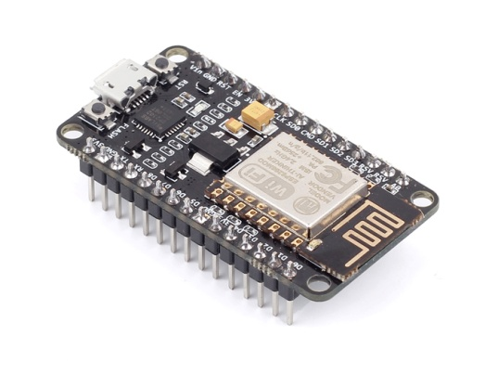
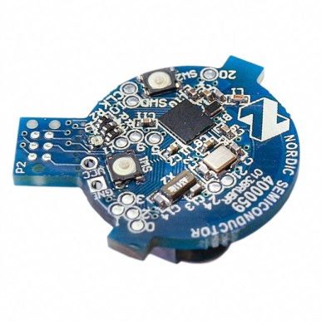
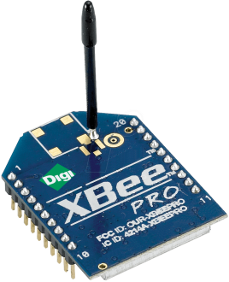
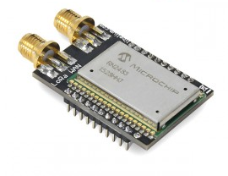

What is the Web of Things?
Internet of Things
: Connectivity
IEEE 802.15.4
Ethernet
Wi-Fi
Bluetooth
LoRa
…

Slide 3





What is the Web of Things?
Internet of Things
: Connectivity
IEEE 802.15.4
Ethernet
Wi-Fi
Bluetooth
LoRa
…

Slide 4
What is the Web of Things?
Web of Things: Application Layer
Internet of Things
: Connectivity
IEEE 802.15.4
Ethernet
Wi-Fi
Bluetooth
LoRa
…

Slide 5
W3C WoT Activities
Web of Things (WoT) Interest Group (IG) and Working Group (WG)
https://www.w3.org/WoT/

Slide 6
W3C WoT Mission
Not to be yet another standard
Web of Things
…
“enable easy integration across IoT platforms and application domains” “complementing available standards”

Slide 7
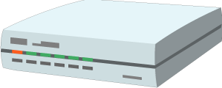


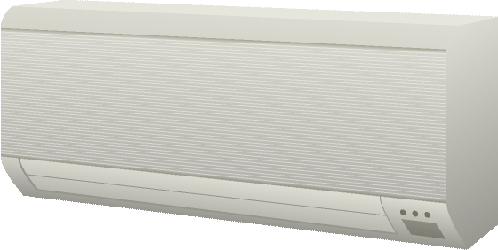
W3C WoT Architecture
Local Hubs
Cloud Mirrors
Device Shadow
Remote access
Virtual Thing
Standardized APIs for portable application logic
(Scripting API)
Semantic metadata
(Thing Description)
Application
Application
Scripting API
Scripting API
Interaction Model
Interaction Model
Binding Templates
Binding Templates
Web integration
Direct Thing-to-Thing interaction
Complementing
existing devices
and platforms
Web Browser
Existing Device
Thing
Application
Application
Scripting API
+
Scripting API
Interaction Model
(Thing Description, Binding Templates)
⇒
Interaction Model
Binding Templates
Thing
Binding Templates
Powerful and constrained Things

Slide 8
W3C WoT
Interest Group (IG)
Working Group (WG)
https://www.w3.org/2016/07/wot-ig-charter.html
Started spring 2015
210 Members
Informal work
Use cases, explorative work
Liaisons and collaborations with other organizations and SDOs
PlugFests with running code
https://www.w3.org/2016/12/wot-wg-2016.html
In charter process
Expected beginning of 2016
Normative work
Standardization of four initial building blocks identified by the IG

Slide 9
WoT Building Blocks
Complementing technological building blocks to mix and match
http://w3c.github.io/wot/current-practices/ wot-practices.html#sec-concepts

Slide 10
Semantic Metadata for Interoperability
Semantic
Metadata
Platform A
Platform B
Application
Application
Platform API
Platform API
Protocol
Protocol

Slide 11
Simple, Common Interaction Model
Platform A
Platform B
Semantic
Metadata
Application
Application
Platform API
Platform API
Interaction Model
Interaction Model
Protocol
Protocol
Properties
Actions
Events

Slide 12
HTML for Things: Thing Description (TD)
Thing
Thing
Application
Application
Platform API
Platform API
TD
TD
Interaction Model
Interaction Model
Protocol
Protocol
Properties
Actions
Events

Slide 13
Interoperability Across Platforms
Thing
Thing
Application
Application
Platform API
Platform API
TD
TD
Interaction Model
Interaction Model
Protocol
Protocol
HTTP
CoAP
OneM2M CoAP
OCF CoAP

Slide 14
Description of IoT Protocols: Binding Templates
Thing
Thing
Application
Application
Platform API
Platform API
TD
TD
Interaction Model
Interaction Model
Binding Template
Binding Template
HTTP
CoAP
OneM2M CoAP
OCF CoAP

Slide 15
Harmonize Gateway Implementation
Thing
Thing
Application
Application
Platform API
Platform API
TD
TD
Interaction Model
Interaction Model
Binding Template
Binding Template
HTTP
CoAP
OneM2M CoAP
OCF CoAP
Generic Gateway
BACnet

Slide 16
Simplify Application Development
Thing
Thing
Application
Application
Platform API
Platform API
TD
TD
Interaction Model
Interaction Model
Binding Template
Binding Template

Slide 17
Browser-like Runtime for IoT Apps: Scripting API
Thing
Thing
Runtime Environment
Runtime Environment
App Script
App Script
Scripting API
Scripting API
TD
TD
Interaction Model
Interaction Model
Binding Template
Binding Template

Slide 18
Portable Apps Across Vendors
Thing
Thing
Runtime Environment
Runtime Environment
App Script
Scripting API
Scripting API
TD
TD
Interaction Model
Interaction Model
Binding Template
Binding Template

Slide 19
Portable Apps Across Components
Gateway
Thing
Runtime Environment
Runtime Environment
App Script
Scripting API
Scripting API
TD
TD
Interaction Model
Interaction Model
Binding Templates
Binding Template

Slide 20
Portable Apps Across Components
Gateway
Cloud
Runtime Environment
Runtime Environment
App Script
Scripting API
Scripting API
TD
TD
Interaction Model
Interaction Model
Binding Templates
Binding Templates

Slide 21
TD to Augment Existing Things
Thing
TD Repository
Cloud
Custom Firmware
Runtime Environment
App Script
Scripting API
TD
TD
Interaction Model
Interaction Model
Custom HTTP
Binding Templates

Slide 22
Servient Reference Architecture
WoT Servient
Runtime Environment
App Script
Scripting API
TD
Interaction Model
Binding Templates
Server
Client

Slide 23
W3C WoT Building Blocks
WoT Scripting API:
A standardized API to simplify IoT application development and enable portable scripts across vendors and device, gateway, and cloud platforms. The API allows to expose and consume Things according to the TD Interaction Model.
WoT Servient
Runtime Environment
App Script
WoT Thing Description (TD):
Provides metadata of the interactions, data model, communication, as well as security mechanisms of the Thing. Using JSON-LD, the TD can be consumed by classic JSON parsers, but provides extension points for optional rich semantic tooling.
Scripting API
TD
Interaction Model
WoT Binding Templates:
The TD also describes the usage of protocols. A vanilla protocol stack can be configured at runtime to produce message that will be understood by the targeted Thing (cf. different HTTP APIs or OCF, oneM2M, and LWM2M dialects of CoAP).
Binding Templates
Server
Client
Security & Privacy:
W3C WoT does not invent new mechanisms, but ensures that all building blocks provide means to describe the security and privacy mechanisms used in a specific platform and provides adversary testing of Things.

Slide 24
W3C WoT Online Resources
W3C WoT Interest Group
https://www.w3.org/2016/07/wot-ig-charter.html
https://lists.w3.org/Archives/Public/public-wot-ig/ (subscribe to mailing list)
https://www.w3.org/WoT/IG/
W3C WoT Working Group about to be chartered
https://www.w3.org/2016/12/wot-wg-2016.html
W3C WoT Documents (for implementers)
http://w3c.github.io/wot/architecture/wot-architecture.html
http://w3c.github.io/wot/current-practices/wot-practices.html
W3C WoT GitHub (technical work)
https://github.com/w3c/wot
W3C WoT Wiki (organizational information)
https://www.w3.org/WoT/IG/wiki/Main_Page

Slide 25
Backup Slides

Slide 26
Thing Description
Describe Thing, communication, and security metadata
http://w3c.github.io/wot/current-practices/ wot-practices.html#thing-description

Slide 27
TD Example
{
"@context": [
"http://w3c.github.io/wot/w3c-wot-td-context.jsonld",
{ "actuator": "http://example.org/actuator#" }
],
"@type": "Thing",
"name": "MyLEDThing",
"uris": [
"coap://myled.example.com:5683/",
"http://mything.example.com:8080/myled/"
],
"encodings": ["JSON", "EXI"],
"security": {
"cat": "token:jwt",
"alg": "HS256",
"as": "https://authority-issuing.example.org"
},
"properties": [
{
"@type": "actuator:onOffStatus",
"name": "status",
"valueType": { "type": "boolean" },
"writable": true,
"hrefs": [ "pwr", "status" ]
}
],
"actions": [
{
"@type": "actuator:fadeIn",
"name": "fadeIn",
"inputData": {
"valueType": { "type": "integer" },
"actuator:unit": "actuator:ms"
},
"hrefs": [ "in", "led/in" ]
},
{
"@type": "actuator:fadeOut",
"name": "fadeOut",
"inputData": {
"valueType": { "type": "integer" },
"actuator:unit": "actuator:ms"
},
"hrefs": [ "out", "led/out" ]
}
],
"events": [
{
"@type": "actuator:alert",
"name": "criticalCondition",
"valueType": { "type": "string" },
"hrefs": [ "ev", "alert" ]
}
]
}

Slide 28
{
"@context": [
"http://w3c.github.io/wot/w3c-wot-td-context.jsonld",
{ "actuator": "http://example.org/actuator#" }
],
"@type": "Thing",
"name": "MyLEDThing",
"uris": [
"coap://myled.example.com:5683/",
"http://mything.example.com:8080/myled/"
],
"encodings": ["JSON", "EXI"],
"security": {
"cat": "token:jwt",
"alg": "HS256",
"as": "https://authority-issuing.example.org"
},
"properties": [
{
"@type": "actuator:onOffStatus",
"name": "status",
"valueType": { "type": "boolean" },
"writable": true,
"hrefs": [ "pwr", "status" ]
}
],
"actions": [
{
"@type": "actuator:fadeIn",
"name": "fadeIn",
"inputData": {
"valueType": { "type": "integer" },
"actuator:unit": "actuator:ms"
},
"hrefs": [ "in", "led/in" ]
},
{
"@type": "actuator:fadeOut",
"name": "fadeOut",
"inputData": {
"valueType": { "type": "integer" },
"actuator:unit": "actuator:ms"
},
"hrefs": [ "out", "led/out" ]
}
],
"events": [
{
"@type": "actuator:alert",
"name": "criticalCondition",
"valueType": { "type": "string" },
"hrefs": [ "ev", "alert" ]
}
]
}
Property
Interaction resources
Action
Action
Events^{(work in progress)}

Slide 29
Scripting API
Program and deploy IoT applications like Web applications
http://w3c.github.io/wot/current-practices/ wot-practices.html#scripting-api

Slide 30
Script Example (Expose Thing)
// create software object to represent local Thing
WoT.newThing("counter")
.then(function(thing) {
thing
// programmatically add interactions
.addProperty("count", {"type": "integer"})
.addAction("increment")
.onInvokeAction("increment", function() {
console.log("incrementing counter");
// persistent state is managed by runtime environment
var value = thing.getProperty("count") + 1;
thing.setProperty("count", value);
return value;
})
// initialize state (no builder pattern anymore)
thing.setProperty("count", 0);
})
._catch(console.err);

Slide 31
Script Example (Consume Thing)
// create software object to represent remote Thing based on TD URI
WoT.consumeDescriptionUri("http://servient.example.com/things/counter")
// use promise to handle asynchronous creation
.then(function(counter) {
counter
// invoke an Action without arguments
.invokeAction("increment", {})
// which is an asynchronous call -> promise
.then(function() {
console.log("incremented");
counter
// read Property (async.) to confirm increment
.getProperty("count").then(function(count) {
console.log("new count state is " + count);
});
})._catch(console.error);
})
._catch(console.error);

