Slide 1


1st International Workshop on Semantic Interoperability for the IoT
Joint Workshop with WoT 2016 Stuttgart, Germany, 2016

Slide 2
Semantic Interoperability
Internet Architecture Board
IAB Workshop, Santa Clara, March 2016
https://tools.ietf.org/html/draft-iab-iotsi-workshop
Problems to solve (based on position papers)
Formal languages for documentation purposes
Formal languages for code generation
Debugging support
Runtime discovery
Translation between models
Notes:
Ericsson
Intel
Arm
Google
Microsoft
Oracle
Qualcomm
Verizon
Huawei
Siemens

Slide 3
Semantic Interoperability
SIFI Workshop, here, now
https://sifi-workshop.github.io/
Problems to solve
Semantic description of data models = machine-understandable information model?
Explicitly described communication patterns = machine-understandable interaction model?
Goal
Build academic community (IoT + Semantic Web)
Support W3C and IRTF/IETF groups

Slide 4


Slide 5
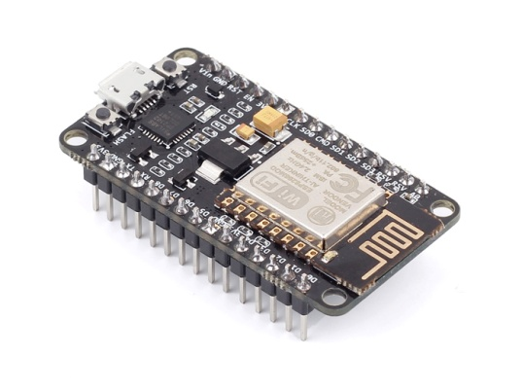
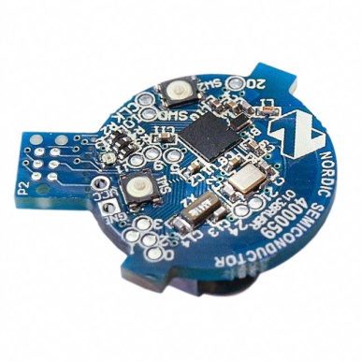
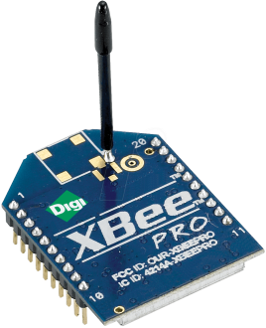
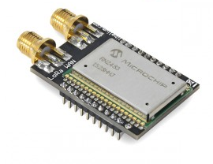

What is the Web of Things?
Internet of Things
: Connectivity
IEEE 802.15.4
Ethernet
Wi-Fi
Bluetooth
LoRa
…

Slide 6





What is the Web of Things?
Internet of Things
: Connectivity
IEEE 802.15.4
Ethernet
Wi-Fi
Bluetooth
LoRa
…

Slide 7
What is the Web of Things?
Web of Things: Application Layer
Internet of Things
: Connectivity
IEEE 802.15.4
Ethernet
Wi-Fi
Bluetooth
LoRa
…

Slide 8
W3C WoT Mission
Not to be yet another standard
Web of Things
…
“enable easy integration across IoT platforms and application domains” “complementing available standards”

Slide 9
Building Blocks
Technological building blocks to pick and complement existing standards
http://w3c.github.io/wot/current-practices/ wot-practices.html#sec-concepts

Slide 10
Semantic Metadata for Interoperability
Semantic
Metadata
Platform A
Platform B
Applications
Applications
API A
API B

Slide 11
Simple, Common Interaction Model
Platform A
Platform B
Semantic
Metadata
Applications
Applications
API A
API B
Interaction Model
Interaction Model

Slide 12
HTML for Things: Thing Description (TD)
Thing
Thing
Thing Description
Applications
Applications
API A
API B
Interaction Model
Interaction Model

Slide 13
Description of IoT Protocols: Protocol Mappings (a.k.a. Bindings)
Thing
Thing
Thing Description
Applications
Applications
API A
API B
Interaction Model
Interaction Model
Protocol Mappings
Protocol Mappings
HTTP
CoAP
OneM2M CoAP
OCF CoAP

Slide 14
Harmonize Gateway Implementation
Thing
Thing
Thing Description
Applications
Applications
API A
API B
Interaction Model
Interaction Model
Protocol Mappings
Protocol Mappings
HTTP
CoAP
OneM2M CoAP
OCF CoAP
Bridging Gateway
BACnet

Slide 15
Simplify Application Development
Thing
Thing
Thing Description
Applications
Applications
API A
API B
Interaction Model
Interaction Model
Protocol Mappings
Protocol Mappings

Slide 16
Browser-like Runtime for IoT Apps: Scripting API
Thing
Thing
Runtime Environment
Runtime Environment
Thing Description
App Scripts
App Scripts
Scripting API
Scripting API
Interaction Model
Interaction Model
Protocol Mappings
Protocol Mappings

Slide 17
Portable Apps Across Vendors
Thing
Thing
Runtime Environment
Runtime Environment
Thing Description
App Script
Scripting API
Scripting API
Interaction Model
Interaction Model
Protocol Mappings
Protocol Mappings

Slide 18
Portable Apps Across Components
Gateway
Thing
Runtime Environment
Runtime Environment
Thing Description
App Script
Scripting API
Scripting API
Interaction Model
Interaction Model
Protocol Mappings
Protocol Mappings

Slide 19
Portable Apps Across Components
Gateway
Cloud
Runtime Environment
Runtime Environment
Thing Description
App Script
Scripting API
Scripting API
Interaction Model
Interaction Model
Protocol Mappings
Protocol Mappings

Slide 20
TD to Augment Existing Things
Thing
Cloud
Custom Firmware
Runtime Environment
Thing Description
App Script
Scripting API
Interaction Model
Interaction Model
Custom HTTP
Protocol Mappings

Slide 21
Servient Reference Architecture
WoT Servient
Runtime Environment
App Script
Scripting API
TD
Interaction Model
Protocol Mappings
Server
Client

Slide 22
W3C WoT Building Blocks
WoT Scripting API:
A standardized API to simplify IoT application development and enable portable scripts across vendors and device, gateway, and cloud platforms. The API allows to expose and consume Things according to the TD Interaction Model.
WoT Servient
Runtime Environment
App Script
WoT Thing Description (TD):
Provides metadata of the interactions, data model, communication, as well as security mechanisms of the Thing. Using JSON-LD, the TD can be consumed by classic JSON parsers, but provides extension points for optional rich semantic tooling.
Scripting API
TD
Interaction Model
WoT Protocol Mappings:
The TD also describes the usage of protocols. A vanilla protocol stack can be configured at runtime to produce message that will be understood by the targeted Thing (cf. different HTTP APIs or OCF, oneM2M, and LWM2M dialects of CoAP).
Protocol Mappings
Server
Client
Security & Privacy:
W3C WoT does not invent new mechanisms, but ensures that all building blocks provide means to describe the security and privacy mechanisms used in a specific platform and provides adversary testing of Things.

Slide 23


Slide 24



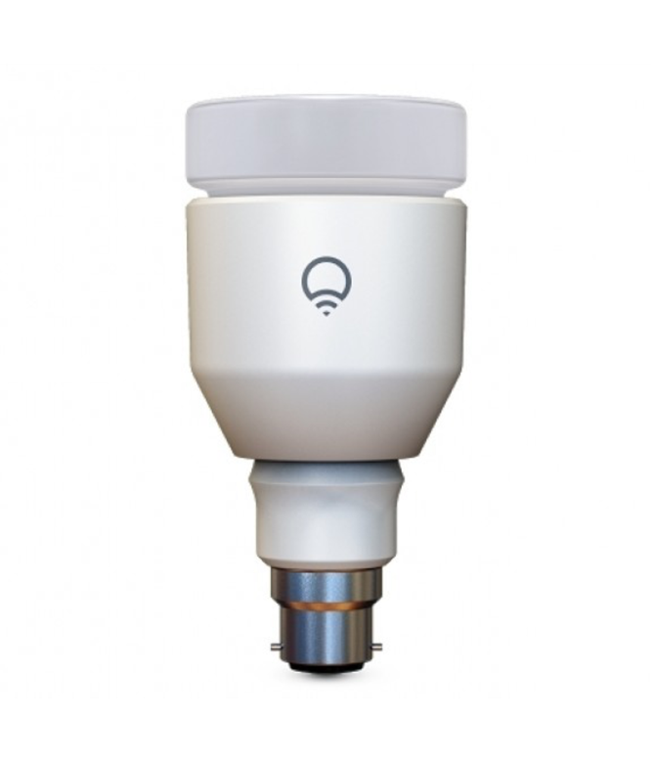
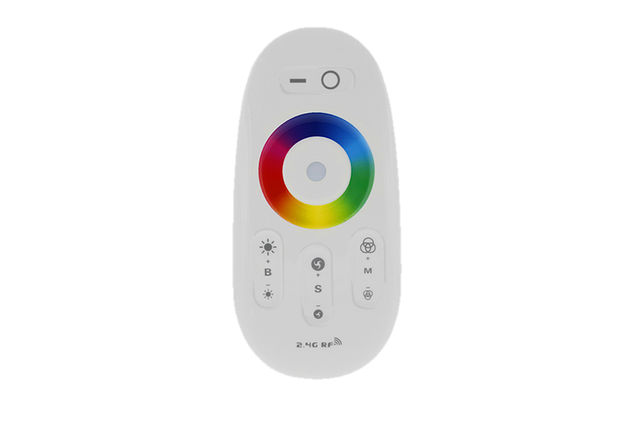
Handle Change in the IoT
Control alternative things
Also control future things
Still control old things
Add new things

Slide 25

Idea
Client
Action Result
Thing C
Entry URI
Submit forms
Resource Directory
Follow links
Thing A
Choice &
redundancy
Thing B
Thing D
Dynamically extend process flow
Auth-Server

Slide 26
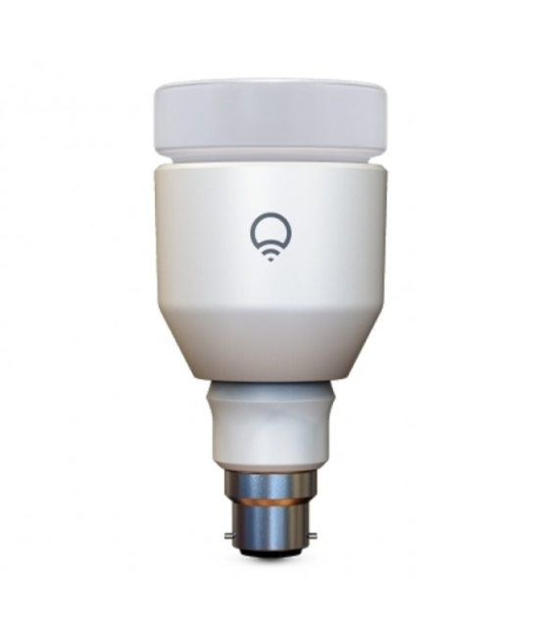
Hypermedia As The Engine Of Application State
Description on the server side is straight-forward
Missing IoT-related hypermedia formats
Thing Description

Slide 27
Representation Formats
Coral (CBOR-based) https://tools.ietf.org/html/draft-hartke-t2trg-coral-01
HSML (SenML-based) https://tools.ietf.org/html/draft-koster-t2trg-hsml-00
Thing Description (W3C work) https://w3c.github.io/wot/current-practices/wot-practices.html

Slide 28
Hypermedia As The Engine Of Application State
Description on the server side is straight-forward
Missing IoT-related hypermedia formats
Consumption on the client side is challenging
Missing abstractions have led to hard-coded clients
Thing Description

Slide 29
Hypermedia Clients
High-level path description to resource based on link/form relation types
Actual (dynamic) URIs are retrieved from representations when used
entry = new HypermediaClient("coap://home.local");
light = entry.follow("lighting"); // returns Future
state = light.follow("state"); // returns Future
representation = state.get(); // lazy evaluation (not a GET)

Slide 30
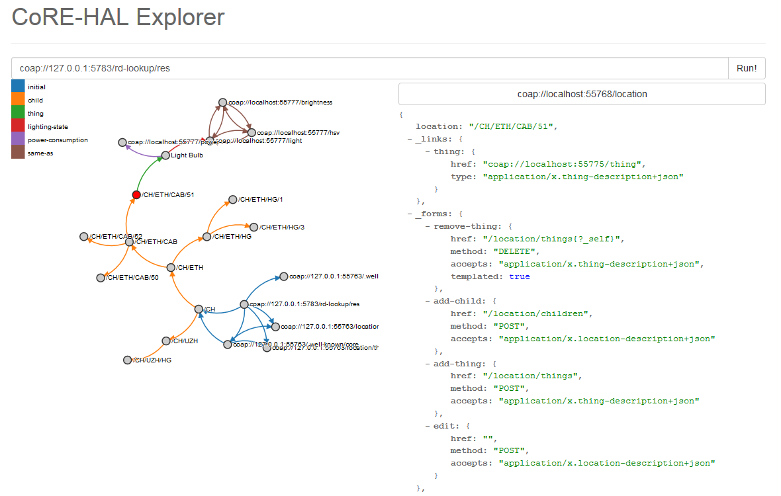
http://mkovatsc.github.io/core-hal-explorer/

Slide 31
W3C and IRTF Online Resources
W3C WoT Interest Group
https://www.w3.org/WoT/IG/
https://lists.w3.org/Archives/Public/public-wot-ig/ (subscribe to mailing list)
W3C WoT Working Group about to be chartered
W3C WoT Documents (for implementers)
http://w3c.github.io/wot/architecture/wot-architecture.html
http://w3c.github.io/wot/current-practices/wot-practices.html
W3C WoT GitHub (technical work)
https://github.com/w3c/wot
W3C WoT Wiki (organizational information)
https://www.w3.org/WoT/IG/wiki/Main_Page
IRTF Thing-to-Thing Research Group
https://github.com/t2trg/

Slide 32
Backup Slides

Slide 33
Thing Description
Describe Thing, communication, and security metadata
http://w3c.github.io/wot/current-practices/ wot-practices.html#thing-description

Slide 34
TD Example
{
"@context": [
"http://w3c.github.io/wot/w3c-wot-td-context.jsonld",
{ "actuator": "http://example.org/actuator#" }
],
"@type": "Thing",
"name": "MyLEDThing",
"uris": [
"coap://myled.example.com:5683/",
"http://mything.example.com:8080/myled/"
],
"encodings": ["JSON", "EXI"],
"security": {
"cat": "token:jwt",
"alg": "HS256",
"as": "https://authority-issuing.example.org"
},
"properties": [
{
"@type": "actuator:onOffStatus",
"name": "status",
"valueType": { "type": "boolean" },
"writable": true,
"hrefs": [ "pwr", "status" ]
}
],
"actions": [
{
"@type": "actuator:fadeIn",
"name": "fadeIn",
"inputData": {
"valueType": { "type": "integer" },
"actuator:unit": "actuator:ms"
},
"hrefs": [ "in", "led/in" ]
},
{
"@type": "actuator:fadeOut",
"name": "fadeOut",
"inputData": {
"valueType": { "type": "integer" },
"actuator:unit": "actuator:ms"
},
"hrefs": [ "out", "led/out" ]
}
],
"events": [
{
"@type": "actuator:alert",
"name": "criticalCondition",
"valueType": { "type": "string" },
"hrefs": [ "ev", "alert" ]
}
]
}

Slide 35
{
"@context": [
"http://w3c.github.io/wot/w3c-wot-td-context.jsonld",
{ "actuator": "http://example.org/actuator#" }
],
"@type": "Thing",
"name": "MyLEDThing",
"uris": [
"coap://myled.example.com:5683/",
"http://mything.example.com:8080/myled/"
],
"encodings": ["JSON", "EXI"],
"security": {
"cat": "token:jwt",
"alg": "HS256",
"as": "https://authority-issuing.example.org"
},
"properties": [
{
"@type": "actuator:onOffStatus",
"name": "status",
"valueType": { "type": "boolean" },
"writable": true,
"hrefs": [ "pwr", "status" ]
}
],
"actions": [
{
"@type": "actuator:fadeIn",
"name": "fadeIn",
"inputData": {
"valueType": { "type": "integer" },
"actuator:unit": "actuator:ms"
},
"hrefs": [ "in", "led/in" ]
},
{
"@type": "actuator:fadeOut",
"name": "fadeOut",
"inputData": {
"valueType": { "type": "integer" },
"actuator:unit": "actuator:ms"
},
"hrefs": [ "out", "led/out" ]
}
],
"events": [
{
"@type": "actuator:alert",
"name": "criticalCondition",
"valueType": { "type": "string" },
"hrefs": [ "ev", "alert" ]
}
]
}
Property
Interaction resources
Action
Action
Events^{(work in progress)}

Slide 36
Scripting API
Program and deploy IoT applications like Web applications
http://w3c.github.io/wot/current-practices/ wot-practices.html#scripting-api

Slide 37
Script Example (Expose Thing)
// create software object to represent local Thing
WoT.newThing("counter")
.then(function(thing) {
thing
// programmatically add interactions
.addProperty("count", {"type": "integer"})
.addAction("increment")
.onInvokeAction("increment", function() {
console.log("incrementing counter");
// persistent state is managed by runtime environment
var value = thing.getProperty("count") + 1;
thing.setProperty("count", value);
return value;
})
// initialize state (no builder pattern anymore)
thing.setProperty("count", 0);
})
._catch(console.err);

Slide 38
Script Example (Consume Thing)
// create software object to represent remote Thing based on TD URI
WoT.consumeDescriptionUri("http://servient.example.com/things/counter")
// use promise to handle asynchronous creation
.then(function(counter) {
counter
// invoke an Action without arguments
.invokeAction("increment", {})
// which is an asynchronous call -> promise
.then(function() {
console.log("incremented");
counter
// read Property (async.) to confirm increment
.getProperty("count").then(function(count) {
console.log("new count state is " + count);
});
})._catch(console.error);
})
._catch(console.error);

