Slide 1

W3C Standards for the IoT
OPC Foundation Meeting Eggelsberg, Austria. March 2017

Slide 2
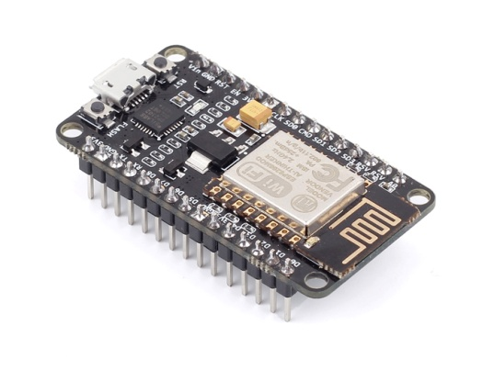
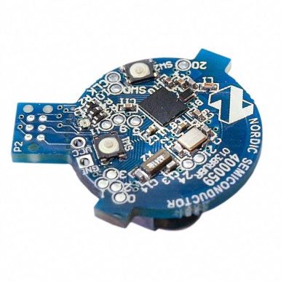
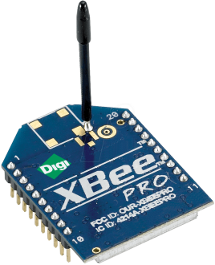
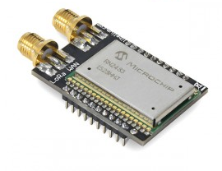
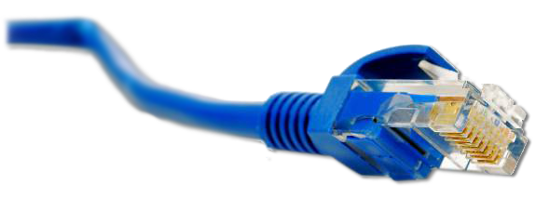
What is the Web of Things?
Internet of Things
: Connectivity
IEEE 802.15.4
Ethernet
Wi-Fi
Bluetooth
LoRa
…

Slide 3





What is the Web of Things?
Internet of Things
: Connectivity
IEEE 802.15.4
Ethernet
Wi-Fi
Bluetooth
LoRa
…

Slide 4
What is the Web of Things?
Web of Things: Application Layer
Internet of Things
: Connectivity
IEEE 802.15.4
Ethernet
Wi-Fi
Bluetooth
LoRa
…

Slide 5
W3C WoT Activities
Web of Things (WoT) Interest Group (IG) and Working Group (WG)
https://www.w3.org/WoT/

Slide 6
W3C WoT Mission
Not to be yet another standard
Web of Things
…
“enable easy integration across IoT platforms and application domains” “complementing available standards”

Slide 7
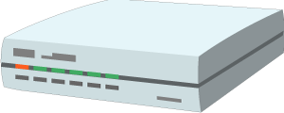


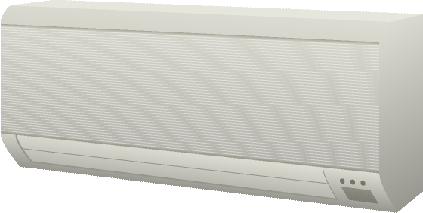
W3C WoT Architecture
Local Hubs
Cloud Mirrors
Device Shadow
Remote access
Virtual Thing
Standardized APIs for portable application logic
(Scripting API)
Semantic metadata
(Thing Description)
Application
Application
Scripting API
Scripting API
Interaction Model
Interaction Model
Binding Templates
Binding Templates
Web integration
Direct Thing-to-Thing
Complementing
existing devices
and platforms
Web Browser
Existing Device
Thing
Application
Application
Scripting API
+
Scripting API
Interaction Model
(Thing Description, Binding Templates)
⇒
Interaction Model
Binding Templates
Thing
Binding Templates
Powerful and constrained Things

Slide 8
W3C WoT
Interest Group (IG)
Working Group (WG)
https://www.w3.org/2016/07/wot-ig-charter.html
Started spring 2015
218 participants
Informal work, outreach
Use cases, explorative work
Liaisons and collaborations with other organizations and SDOs
PlugFests with running code
https://www.w3.org/2016/12/wot-wg-2016.html
Started December 2016
71 participants
Normative work
Standardization of four initial building blocks identified by the IG

Slide 9
WoT Building Blocks
Complementing technological building blocks to mix and match

Slide 10
Semantic Metadata for Interoperability
Semantic
Metadata
Platform A
Platform B
Application
Application
Platform API
Platform API
Protocol
Protocol

Slide 11
Simple, Common Interaction Model
Platform A
Platform B
Semantic
Metadata
Application
Application
Platform API
Platform API
Interaction Model
Interaction Model
Protocol
Protocol
Properties
Actions
Events

Slide 12
HTML for Things: Thing Description (TD)
Thing
Thing
Application
Application
Platform API
Platform API
TD
TD
Interaction Model
Interaction Model
Protocol
Protocol
Properties
Actions
Events

Slide 13
Interoperability Across Platforms
Thing
Thing
Application
Application
Platform API
Platform API
TD
TD
Interaction Model
Interaction Model
Protocol
Protocol
HTTP
CoAP
OneM2M CoAP
OCF CoAP

Slide 14
Description of IoT Protocols: Binding Templates
Thing
Thing
Application
Application
Platform API
Platform API
TD
TD
Interaction Model
Interaction Model
Binding Templates
Binding Templates
HTTP
CoAP
OneM2M CoAP
OCF CoAP

Slide 15
Gateways Can Automatically Adapt to New Devices/Resources/Application
Thing
Thing
Application
Application
Platform API
Platform API
TD
TD
Interaction Model
Interaction Model
Binding Templates
Binding Templates
HTTP
CoAP
OneM2M CoAP
OCF CoAP
Generic Gateway
BACnet

Slide 16
Simplify Application Development
Thing
Thing
Application
Application
Platform API
Platform API
TD
TD
Interaction Model
Interaction Model
Binding Templates
Binding Templates

Slide 17
Browser-like Runtime for IoT Apps: Scripting API
Thing
Thing
Runtime Environment
Runtime Environment
App Script
App Script
Scripting API
Scripting API
TD
TD
Interaction Model
Interaction Model
Binding Templates
Binding Templates

Slide 18
Portable Apps Across Vendors
Thing
Thing
Runtime Environment
Runtime Environment
App Script
Scripting API
Scripting API
TD
TD
Interaction Model
Interaction Model
Binding Templates
Binding Templates

Slide 19
Portable Apps Across Components
Gateway
Thing
Runtime Environment
Runtime Environment
App Script
Scripting API
Scripting API
TD
TD
Interaction Model
Interaction Model
Binding Templates
Binding Templates

Slide 20
Portable Apps Across Components
Gateway
Cloud
Runtime Environment
Runtime Environment
App Script
Scripting API
Scripting API
TD
TD
Interaction Model
Interaction Model
Binding Templates
Binding Templates

Slide 21
TD to Augment Existing Things
Existing Device
TD Repository
Cloud
Custom Firmware
Runtime Environment
App Script
Scripting API
TD
TD
Interaction Model
Interaction Model
Custom HTTP
Binding Templates

Slide 22
Servient Reference Architecture
WoT Servient
Runtime Environment
App Script
Scripting API
TD
Interaction Model
Binding Templates
Server
Client

Slide 23
W3C WoT Building Blocks
WoT Scripting API:
A standardized API to simplify IoT application development and enable portable scripts across vendors and device, gateway, and cloud platforms. The API allows to expose and consume Things according to the TD Interaction Model.
WoT Servient
Runtime Environment
App Script
WoT Thing Description (TD):
Provides metadata of the interactions, data model, communication, as well as security mechanisms of the Thing. Using JSON-LD, the TD can be consumed by classic JSON parsers, but provides extension points for optional rich semantic tooling.
Scripting API
TD
Interaction Model
WoT Binding Templates:
The TD also describes the usage of protocols. A vanilla protocol stack can be configured at runtime to produce message that will be understood by the targeted Thing (cf. different HTTP APIs or OCF, oneM2M, and LWM2M dialects of CoAP).
Binding Templates
Server
Client
Security & Privacy:
W3C WoT does not invent new mechanisms, but ensures that all building blocks provide means to describe the security and privacy mechanisms used in a specific platform and provides adversary testing of Things.

Slide 24
WoT Thing Description
Describe Thing, communication, and security metadata
https://w3c.github.io/wot-thing-description/

Slide 25
TD Example
JSON-LD (Linked Data)
W3C WoT TD vocabulary
{
"@context": [
"http://w3c.github.io/wot/w3c-wot-td-context.jsonld",
{ "domain": "http://example.org/actuator#" }
],
"@type": "Thing",
"name": "MyLEDThing",
"base": "coap://myled.example.com:5683/",
"security": {
"cat": "token:jwt",
"alg": "HS256",
"as": "https://authority-issuing.example.org"
},
"interactions": [
{
"@type": ["Property", "domain:onOffStatus"],
"name": "status",
"outputData": {"valueType": {"type": "boolean"}},
"writable": true,
"links": [
{
"href": "pwr",
"mediaType": "application/exi"
},
{
"href": "http://mytemp.example.com:8080/status",
"mediaType": "application/json"
}
]
},
{
"@type": ["Action", "domain:fadeIn"],
"name": "fadeIn",
"inputData": {
"valueType": {"type": "integer"},
"domain:unit": "domain:ms"
},
"links": [
{
"href": "in",
"mediaType": "application/exi"
},
{
"href": "http://mytemp.example.com:8080/in",
"mediaType": "application/json"
}
]
},
{
"@type": ["Action", "domain:fadeOut"],
"name": "fadeOut",
"inputData": {
"valueType": {"type": "integer"},
"domain:unit": "domain:ms"
},
"links": [
{
"href": "out",
"mediaType": "application/exi"
},
{
"href": "http://mytemp.example.com:8080/out",
"mediaType": "application/json"
}
]
},
{
"@type": ["Event", "domain:alert"],
"name": "criticalCondition",
"outputData": {"valueType": {"type": "string"}},
"links": [
{
"href": "ev",
"mediaType": "application/exi"
}
]
}
]
}
domain-specific vocabulary
JSON Schema

Slide 26
{
"@context": [
"http://w3c.github.io/wot/w3c-wot-td-context.jsonld",
{ "domain": "http://example.org/actuator#" }
],
"@type": "Thing",
"name": "MyLEDThing",
"base": "coap://myled.example.com:5683/",
"security": {
"cat": "token:jwt",
"alg": "HS256",
"as": "https://authority-issuing.example.org"
},
"interactions": [
{
"@type": ["Property", "domain:onOffStatus"],
"name": "status",
"outputData": {"valueType": {"type": "boolean"}},
"writable": true,
"links": [
{
"href": "pwr",
"mediaType": "application/exi"
},
{
"href": "http://mytemp.example.com:8080/status",
"mediaType": "application/json"
}
]
},
{
"@type": ["Action", "domain:fadeIn"],
"name": "fadeIn",
"inputData": {
"valueType": {"type": "integer"},
"domain:unit": "domain:ms"
},
"links": [
{
"href": "in",
"mediaType": "application/exi"
},
{
"href": "http://mytemp.example.com:8080/in",
"mediaType": "application/json"
}
]
},
{
"@type": ["Action", "domain:fadeOut"],
"name": "fadeOut",
"inputData": {
"valueType": {"type": "integer"},
"domain:unit": "domain:ms"
},
"links": [
{
"href": "out",
"mediaType": "application/exi"
},
{
"href": "http://mytemp.example.com:8080/out",
"mediaType": "application/json"
}
]
},
{
"@type": ["Event", "domain:alert"],
"name": "criticalCondition",
"outputData": {"valueType": {"type": "string"}},
"links": [
{
"href": "ev",
"mediaType": "application/exi"
}
]
}
]
}
Property
Action

Slide 27
{
"@context": [
"http://w3c.github.io/wot/w3c-wot-td-context.jsonld",
{ "domain": "http://example.org/actuator#" }
],
"@type": "Thing",
"name": "MyLEDThing",
"base": "coap://myled.example.com:5683/",
"security": {
"cat": "token:jwt",
"alg": "HS256",
"as": "https://authority-issuing.example.org"
},
"interactions": [
{
"@type": ["Property", "domain:onOffStatus"],
"name": "status",
"outputData": {"valueType": {"type": "boolean"}},
"writable": true,
"links": [
{
"href": "pwr",
"mediaType": "application/exi"
},
{
"href": "http://mytemp.example.com:8080/status",
"mediaType": "application/json"
}
]
},
{
"@type": ["Action", "domain:fadeIn"],
"name": "fadeIn",
"inputData": {
"valueType": {"type": "integer"},
"domain:unit": "domain:ms"
},
"links": [
{
"href": "in",
"mediaType": "application/exi"
},
{
"href": "http://mytemp.example.com:8080/in",
"mediaType": "application/json"
}
]
},
{
"@type": ["Action", "domain:fadeOut"],
"name": "fadeOut",
"inputData": {
"valueType": {"type": "integer"},
"domain:unit": "domain:ms"
},
"links": [
{
"href": "out",
"mediaType": "application/exi"
},
{
"href": "http://mytemp.example.com:8080/out",
"mediaType": "application/json"
}
]
},
{
"@type": ["Event", "domain:alert"],
"name": "criticalCondition",
"outputData": {"valueType": {"type": "string"}},
"links": [
{
"href": "ev",
"mediaType": "application/exi"
}
]
}
]
}
Event (under construction, sources, sinks, …)

Slide 28
WoT Thing Description
JSON-LD just one representation
Good for discussion, accepted by Web people
TD is a semantic model
Backed by RDF and Linked Data vocabularies
Yet complexity of Semantic Web can be ignored
Other formats possible
EXI, CBOR, … for machines
Custom application/wot-td+json for developers
Just serializations of the semantic model

Slide 29
WoT Scripting API
Program and deploy IoT applications like Web applications
https://w3c.github.io/wot-scripting-api/

Slide 30
Script Example (Expose Thing)
// create software object to represent local Thing
WoT.newThing("counter")
.then( (thing) => {
thing
// programmatically add interactions (builder pattern)
.addProperty("count", {"type": "integer"}) // JSON Schema
.addAction("increment")
.onInvokeAction("increment", () => {
console.log("incrementing counter");
// persistent state is managed by runtime environment
let value = thing.getProperty("count") + 1;
thing.setProperty("count", value);
return value;
});
// initialize state (transparent if local or remote Thing)
thing.setProperty("count", 0);
})
.catch(console.err);

Slide 31
Script Example (Consume Thing)
// create software object to represent remote Thing based on TD URI
WoT.consumeDescriptionUri("http://servient.example.com/things/counter")
// use promise to handle asynchronous creation
.then( (counter) => {
counter
// invoke an Action without arguments
.invokeAction("increment")
// which is an asynchronous call -> promise
.then( () => {
console.log("incremented");
counter
// read Property (async.) to confirm increment
.getProperty("count").then( (count) => {
console.log("new state is " + count);
});
}).catch(console.error);
})
.catch(console.error);

Slide 32
WoT Scripting API
Standard API for IoT applications (cf. Web browser)
Discovery with different mechanisms
Client to remote Things and local hardware
Server for remote Things
Hiding state management and asynchronicity
Initial focus on JavaScript (Web of Things)
Aiming to keep API definition language-agnostic
Possible other APIs in the future (e.g., Lua)

Slide 33
W3C WOT Roadmap
https://www.w3.org/WoT/IG/wiki/Roadmap

Slide 34
W3C WoT Task Forces
WG
Architecture (has deliverable)
Thing Description (has deliverable)
Type System (JSON Schema Extensions)
Hypermedia (Actions, error handling, …)
Scripting API (has deliverable)
Binding Templates (has deliverable)
Security & Privacy
IG
Current Practices (has deliverable)
Testing (PlugFest scenarios)
Thing Lifecycle
Synchronization of Servients
Linked Data and Semantic Processing
Demonstrators

Slide 35
W3C WoT Liaisons
IETF / IRTF
Established, joint meetings since Nov 2015
Open Connectivity Foundation (OCF)
Established, active alignment and joint PlugFest coming up
oneM2M
Established, commonality identified and preparing input
OPC Foundation
Established, need to agree on strategy etc.
Plattform Industrie 4.0
Initial conference calls
OpenFog
Initial outreach

Slide 36
WG Roadmap
2017-02 (Santa Clara F2F)
Create GitHub repos
2017-05 (Osaka F2F)
Graphical and RDF model of TD
Editor’s Drafts
RC for WoT Architecture First Public Working Draft (FPWD)
Start security review for WoT Architecture
2017-07 (Düsseldof F2F)
Finish security review for WoT Arch. with Internet Drafts (“security concepts”) for internal security review and IETF outreach
Draft for test suite (Servient emulator with automatic checks)
Release First Public Working Draft (FPWD) of WoT Architecture
2017-11 (TPAC 2017, Burlingame, CA, USA)
RCs for First Public Working Drafts
RC Implementations and Test Suite
Start security review
2018-03 (London? F2F)
Finish security review
Release First Public Working Drafts (FPWDs)
2018-05 (F2F at sec conf, Santa Clara?)
Aggressive testing / adverse security testing?
2018-07 (China? F2F)
2018-10
RCs for Candidate Recommendations
Start security review
2018-11 (TPAC 2018, Asia?)
Finish security review
Start release process
2018-12 (end of current charter)
Release Candidate Recommendations (CRs)

Slide 37
W3C WoT Online Resources
W3C WoT Interest Group
https://www.w3.org/WoT/IG/ (blog)
https://www.w3.org/2016/07/wot-ig-charter.html (charter)
https://lists.w3.org/Archives/Public/public-wot-ig/ (subscribe to mailing list)
W3C WoT Working Group
https://www.w3.org/WoT/WG/ (dashboard)
https://www.w3.org/2016/12/wot-wg-2016.html (charter)
W3C WoT Wiki (IG+WG organizational information)
https://www.w3.org/WoT/IG/wiki/Main_Page
W3C WoT GitHub (IG technical proposals)
https://github.com/w3c/wot
W3C WoT WG Documents
https://w3c.github.io/wot-architecture/
https://w3c.github.io/wot-thing-description/
https://w3c.github.io/wot-scripting-api/
https://w3c.github.io/wot-binding-templates/

Slide 38
OPC Foundation and W3C WoT
https://opcfoundation.org/

Slide 39
Liaison Goals
Agree on strategy
Share example UA models
Roadmap for PlugFest contributions

Slide 40
Strategy
Assumption / idea
OPC UA interaction will be about sharing data, not necessarily control/interaction
Cf. Apache Avro Containers
Thing Description to describe data sources
Consequences
Ensure TD maps bijectively to OPC UA
Convert OPC UA Information Models to Linked Data vocabularies
Enable “abstract” TD flavor without concrete links

Slide 41
Example UA Models
Boiler model from spec example
DI (Device Integration) as guideline about the automation hardware model
Application model is very individual
Find demonstrator
Use views to model application

Slide 42
PlugFest Roadmap
Need to find demonstrator first

