Slide 1

W3C Standards for the IoT
Fairhair Alliance Meeting Vienna, Austria. April 2017

Slide 2
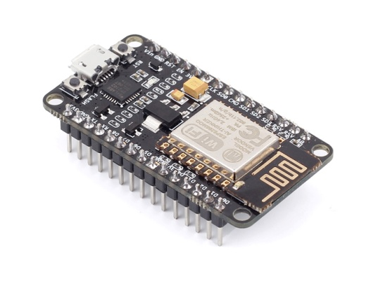
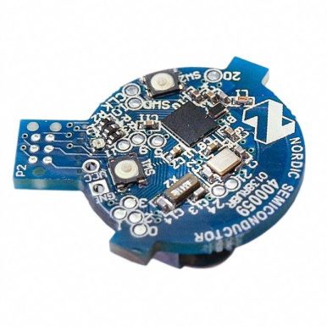
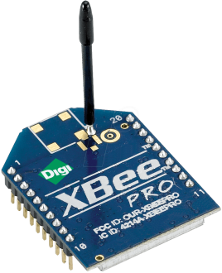
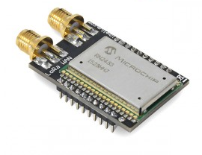
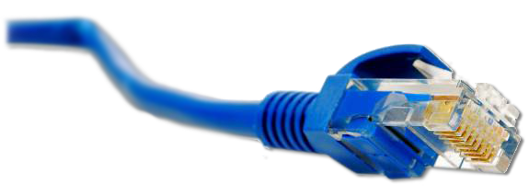
What is the Web of Things?
Internet of Things
: Connectivity
IEEE 802.15.4
Ethernet
Wi-Fi
Bluetooth
LoRa
…

Slide 3





What is the Web of Things?
Internet of Things
: Connectivity
IEEE 802.15.4
Ethernet
Wi-Fi
Bluetooth
LoRa
…

Slide 4
What is the Web of Things?
Web of Things: Application Layer
Internet of Things
: Connectivity
IEEE 802.15.4
Ethernet
Wi-Fi
Bluetooth
LoRa
…

Slide 5
W3C WoT Activities
Web of Things (WoT) Interest Group (IG) and Working Group (WG)
https://www.w3.org/WoT/

Slide 6
W3C WoT Mission
Not to be yet another standard
Web of Things
…
“enable easy integration across IoT platforms and application domains” “complementing available standards”

Slide 7
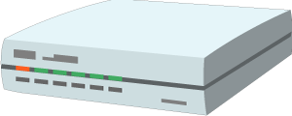


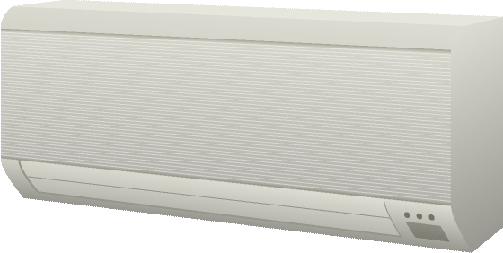
W3C WoT Architecture
Local Hubs
Cloud Mirrors
Device Shadow
Remote access
Virtual Thing
Standardized APIs for portable application logic
(Scripting API)
Semantic metadata
(Thing Description)
Application
Application
Scripting API
Scripting API
Interaction Model
Interaction Model
Binding Templates
Binding Templates
Web integration
Direct Thing-to-Thing
Complementing
existing devices
and platforms
Web Browser
Existing Device
Thing
Application
Application
Scripting API
+
Scripting API
Interaction Model
(Thing Description, Binding Templates)
⇒
Interaction Model
Binding Templates
Thing
Binding Templates
Powerful and constrained Things

Slide 8
W3C WoT
Interest Group (IG)
Working Group (WG)
https://www.w3.org/2016/07/wot-ig-charter.html
Started spring 2015
220 participants
Informal work, outreach
Use cases, explorative work
Liaisons and collaborations with other organizations and SDOs
PlugFests with running code
https://www.w3.org/2016/12/wot-wg-2016.html
Started December 2016
84 participants
Normative work
Standardization of four initial building blocks identified by the IG

Slide 9
WoT Building Blocks
Complementing technological building blocks to mix and match

Slide 10
Semantic Metadata for Interoperability
Semantic
Metadata
Platform A
Platform B
Application
Application
Platform API
Platform API
Protocol
Protocol

Slide 11
Simple, Common Interaction Model
Platform A
Platform B
Semantic
Metadata
Application
Application
Platform API
Platform API
Interaction Model
Interaction Model
Protocol
Protocol
Properties
Actions
Events

Slide 12
HTML for Things: Thing Description (TD)
Thing
Thing
Application
Application
Platform API
Platform API
TD
TD
Interaction Model
Interaction Model
Protocol
Protocol
Properties
Actions
Events

Slide 13
Interoperability Across Platforms
Thing
Thing
Application
Application
Platform API
Platform API
TD
TD
Interaction Model
Interaction Model
Protocol
Protocol
HTTP
CoAP
OneM2M CoAP
OCF CoAP

Slide 14
Description of IoT Protocols: Binding Templates
Thing
Thing
Application
Application
Platform API
Platform API
TD
TD
Interaction Model
Interaction Model
Binding Templates
Binding Templates
HTTP
CoAP
OneM2M CoAP
OCF CoAP

Slide 15
Gateways Can Automatically Adapt to New Devices/Resources/Application
Thing
Thing
Application
Application
Platform API
Platform API
TD
TD
Interaction Model
Interaction Model
Binding Templates
Binding Templates
HTTP
CoAP
OneM2M CoAP
OCF CoAP
Generic Gateway
BACnet

Slide 16
Simplify Application Development
Thing
Thing
Application
Application
Platform API
Platform API
TD
TD
Interaction Model
Interaction Model
Binding Templates
Binding Templates

Slide 17
Browser-like Runtime for IoT Apps: Scripting API
Thing
Thing
Runtime Environment
Runtime Environment
App Script
App Script
Scripting API
Scripting API
TD
TD
Interaction Model
Interaction Model
Binding Templates
Binding Templates

Slide 18
Portable Apps Across Vendors
Thing
Thing
Runtime Environment
Runtime Environment
App Script
Scripting API
Scripting API
TD
TD
Interaction Model
Interaction Model
Binding Templates
Binding Templates

Slide 19
Portable Apps Across Components
Gateway
Thing
Runtime Environment
Runtime Environment
App Script
Scripting API
Scripting API
TD
TD
Interaction Model
Interaction Model
Binding Templates
Binding Templates

Slide 20
Portable Apps Across Components
Gateway
Cloud
Runtime Environment
Runtime Environment
App Script
Scripting API
Scripting API
TD
TD
Interaction Model
Interaction Model
Binding Templates
Binding Templates

Slide 21
TD to Augment Existing Things
Existing Device
TD Repository
Cloud
Custom Firmware
Runtime Environment
App Script
Scripting API
TD
TD
Interaction Model
Interaction Model
Custom HTTP
Binding Templates

Slide 22
Servient Reference Architecture
Most building blocks are optional (e.g., WoT Scripting API)
Minimum requirement is is to provide a valid WoT TD for the implemented protocols and data/interaction model
WoT Servient
Runtime Environment
App Script
Scripting API
TD
Interaction Model
Binding Templates
Server
Client

Slide 23
W3C WoT Building Blocks
Cross-cutting Security & Privacy
WoT Scripting API:
A standardized API to simplify IoT application development and enable portable scripts across vendors and device, gateway, and cloud platforms. The API allows to expose and consume Things according to the TD Interaction Model.
WoT Servient
Runtime Environment
App Script
WoT Thing Description (TD):
Provides metadata of the interactions, data model, communication, as well as security mechanisms of the Thing. Using JSON-LD, the TD can be consumed by classic JSON parsers, but provides extension points for optional rich semantic tooling.
Scripting API
TD
Interaction Model
WoT Binding Templates:
The TD also describes the usage of protocols. A vanilla protocol stack can be configured at runtime to produce message that will be understood by the targeted Thing (cf. different HTTP APIs or OCF, oneM2M, and LWM2M dialects of CoAP).
Binding Templates
Server
Client
Security & Privacy:
W3C WoT does not invent new mechanisms, but ensures that all building blocks provide means to describe the security and privacy mechanisms used in a specific platform and provides adversary testing of Things.

Slide 24
WoT Thing Description
Describe Thing, communication, and security metadata
https://w3c.github.io/wot-thing-description/

Slide 25
TD Example
JSON-LD (Linked Data)
W3C WoT TD vocabulary
{
"@context": [
"http://w3c.github.io/wot/w3c-wot-td-context.jsonld",
{ "domain": "http://example.org/actuator#" }
],
"@type": "Thing",
"name": "MyLEDThing",
"base": "coap://myled.example.com:5683/",
"security": {
"cat": "token:jwt",
"alg": "HS256",
"as": "https://authority-issuing.example.org"
},
"interactions": [
{
"@type": ["Property", "domain:onOffStatus"],
"name": "status",
"outputData": {"valueType": {"type": "boolean"}},
"writable": true,
"links": [
{
"href": "pwr",
"mediaType": "application/exi"
},
{
"href": "http://mytemp.example.com:8080/status",
"mediaType": "application/json"
}
]
},
{
"@type": ["Action", "domain:fadeIn"],
"name": "fadeIn",
"inputData": {
"valueType": {"type": "integer"},
"domain:unit": "domain:ms"
},
"links": [
{
"href": "in",
"mediaType": "application/exi"
},
{
"href": "http://mytemp.example.com:8080/in",
"mediaType": "application/json"
}
]
},
{
"@type": ["Action", "domain:fadeOut"],
"name": "fadeOut",
"inputData": {
"valueType": {"type": "integer"},
"domain:unit": "domain:ms"
},
"links": [
{
"href": "out",
"mediaType": "application/exi"
},
{
"href": "http://mytemp.example.com:8080/out",
"mediaType": "application/json"
}
]
},
{
"@type": ["Event", "domain:alert"],
"name": "criticalCondition",
"outputData": {"valueType": {"type": "string"}},
"links": [
{
"href": "ev",
"mediaType": "application/exi"
}
]
}
]
}
domain-specific vocabulary
JSON Schema

Slide 26
{
"@context": [
"http://w3c.github.io/wot/w3c-wot-td-context.jsonld",
{ "domain": "http://example.org/actuator#" }
],
"@type": "Thing",
"name": "MyLEDThing",
"base": "coap://myled.example.com:5683/",
"security": {
"cat": "token:jwt",
"alg": "HS256",
"as": "https://authority-issuing.example.org"
},
"interactions": [
{
"@type": ["Property", "domain:onOffStatus"],
"name": "status",
"outputData": {"valueType": {"type": "boolean"}},
"writable": true,
"links": [
{
"href": "pwr",
"mediaType": "application/exi"
},
{
"href": "http://mytemp.example.com:8080/status",
"mediaType": "application/json"
}
]
},
{
"@type": ["Action", "domain:fadeIn"],
"name": "fadeIn",
"inputData": {
"valueType": {"type": "integer"},
"domain:unit": "domain:ms"
},
"links": [
{
"href": "in",
"mediaType": "application/exi"
},
{
"href": "http://mytemp.example.com:8080/in",
"mediaType": "application/json"
}
]
},
{
"@type": ["Action", "domain:fadeOut"],
"name": "fadeOut",
"inputData": {
"valueType": {"type": "integer"},
"domain:unit": "domain:ms"
},
"links": [
{
"href": "out",
"mediaType": "application/exi"
},
{
"href": "http://mytemp.example.com:8080/out",
"mediaType": "application/json"
}
]
},
{
"@type": ["Event", "domain:alert"],
"name": "criticalCondition",
"outputData": {"valueType": {"type": "string"}},
"links": [
{
"href": "ev",
"mediaType": "application/exi"
}
]
}
]
}
Property
Action

Slide 27
{
"@context": [
"http://w3c.github.io/wot/w3c-wot-td-context.jsonld",
{ "domain": "http://example.org/actuator#" }
],
"@type": "Thing",
"name": "MyLEDThing",
"base": "coap://myled.example.com:5683/",
"security": {
"cat": "token:jwt",
"alg": "HS256",
"as": "https://authority-issuing.example.org"
},
"interactions": [
{
"@type": ["Property", "domain:onOffStatus"],
"name": "status",
"outputData": {"valueType": {"type": "boolean"}},
"writable": true,
"links": [
{
"href": "pwr",
"mediaType": "application/exi"
},
{
"href": "http://mytemp.example.com:8080/status",
"mediaType": "application/json"
}
]
},
{
"@type": ["Action", "domain:fadeIn"],
"name": "fadeIn",
"inputData": {
"valueType": {"type": "integer"},
"domain:unit": "domain:ms"
},
"links": [
{
"href": "in",
"mediaType": "application/exi"
},
{
"href": "http://mytemp.example.com:8080/in",
"mediaType": "application/json"
}
]
},
{
"@type": ["Action", "domain:fadeOut"],
"name": "fadeOut",
"inputData": {
"valueType": {"type": "integer"},
"domain:unit": "domain:ms"
},
"links": [
{
"href": "out",
"mediaType": "application/exi"
},
{
"href": "http://mytemp.example.com:8080/out",
"mediaType": "application/json"
}
]
},
{
"@type": ["Event", "domain:alert"],
"name": "criticalCondition",
"outputData": {"valueType": {"type": "string"}},
"links": [
{
"href": "ev",
"mediaType": "application/exi"
}
]
}
]
}
Event (under construction, sources, sinks, …)

Slide 28
WoT Thing Description
JSON-LD just one representation
Good for discussion, accepted by Web people
TD is a semantic model
Backed by RDF and Linked Data vocabularies
Yet complexity of Semantic Web can be ignored (cf. hard-coded vocabulary, no triple handling)
Other formats possible
EXI, CBOR, … for machines
Custom application/wot-td+json for developers
… just serializations of the semantic model

Slide 29
WoT Scripting API
Program and deploy IoT applications like Web applications
https://w3c.github.io/wot-scripting-api/

Slide 30
Script Example (Expose Thing)
// create software object to represent local Thing
WoT.newThing("counter")
.then( (thing) => {
thing
// programmatically add interactions (builder pattern)
.addProperty("count", {"type": "integer"}) // JSON Schema
.addAction("increment")
.onInvokeAction("increment", () => {
console.log("incrementing counter");
// persistent state is managed by runtime environment
let value = thing.getProperty("count") + 1;
thing.setProperty("count", value);
return value;
});
// initialize state (transparent if local or remote Thing)
thing.setProperty("count", 0);
})
.catch(console.err);

Slide 31
Script Example (Consume Thing)
// create software object to represent remote Thing based on TD URI
WoT.consumeDescriptionUri("http://servient.example.com/things/counter")
// use promise to handle asynchronous creation
.then( (counter) => {
counter
// invoke an Action without arguments
.invokeAction("increment")
// which is an asynchronous call -> promise
.then( () => {
console.log("incremented");
counter
// read Property (async.) to confirm increment
.getProperty("count").then( (count) => {
console.log("new state is " + count);
});
}).catch(console.error);
})
.catch(console.error);

Slide 32
WoT Scripting API
Standard API for IoT applications (cf. Web browser)
Discovery with different mechanisms (hidden from script)
Client for remote Things and local hardware
Server for remote Things
Hiding state management and asynchronicity
Initial focus on JavaScript (Web of Things)
Aiming to keep API definition language-agnostic
Possible other APIs in the future (e.g., Lua, Python)

Slide 33
W3C WOT Roadmap
https://www.w3.org/WoT/IG/wiki/Roadmap

Slide 34
W3C WoT Task Forces
WG
Architecture (has deliverable)
Thing Description (has deliverable)
Type System (JSON Schema Extensions)
Hypermedia (Actions, error handling, …)
Scripting API (has deliverable)
Binding Templates (has deliverable)
Security & Privacy
IG
Current Practices (has deliverable)
Testing (PlugFest scenarios)
Thing Lifecycle
Synchronization of Servients
Linked Data and Semantic Processing
Demonstrators

Slide 35
W3C WoT Liaisons
IETF / IRTF
Established, joint meetings since Nov 2015
Open Connectivity Foundation (OCF)
Established, active alignment and joint PlugFest coming up
oneM2M
Established, commonality identified and preparing input
OPC Foundation
Established, need to agree on strategy etc.
Plattform Industrie 4.0
Initial conference calls
OpenFog, Fairhair Alliance, …
Initial outreach

Slide 36
WG Roadmap
2017-02 (Santa Clara F2F)
Create GitHub repos
2017-05 (Osaka F2F)
Graphical and RDF model of TD
Editor’s Drafts
RC for WoT Architecture First Public Working Draft (FPWD)
Start security review for WoT Architecture
2017-07 (Düsseldof F2F)
Finish security review for WoT Arch. with Internet Drafts (“security concepts”) for internal security review and IETF outreach
Draft for test suite (Servient emulator with automatic checks)
Release First Public Working Draft (FPWD) of WoT Architecture
2017-11 (TPAC 2017, Burlingame, CA, USA)
RCs for First Public Working Drafts
RC Implementations and Test Suite
Start security review
2018-03 (London? F2F)
Finish security review
Release First Public Working Drafts (FPWDs)
2018-05 (F2F at sec conf, Santa Clara?)
Aggressive testing / adverse security testing?
2018-07 (China? F2F)
2018-10
RCs for Candidate Recommendations
Start security review
2018-11 (TPAC 2018, Asia?)
Finish security review
Start release process
2018-12 (end of current charter)
Release Candidate Recommendations (CRs)

Slide 37
W3C WoT Online Resources
W3C WoT Interest Group
https://www.w3.org/WoT/IG/ (blog)
https://www.w3.org/2016/07/wot-ig-charter.html (charter)
https://lists.w3.org/Archives/Public/public-wot-ig/ (subscribe to mailing list)
W3C WoT Working Group
https://www.w3.org/WoT/WG/ (dashboard)
https://www.w3.org/2016/12/wot-wg-2016.html (charter)
W3C WoT Wiki (IG+WG organizational information)
https://www.w3.org/WoT/IG/wiki/Main_Page
W3C WoT GitHub (IG technical proposals)
https://github.com/w3c/wot
W3C WoT WG Documents
https://w3c.github.io/wot-architecture/
https://w3c.github.io/wot-thing-description/
https://w3c.github.io/wot-scripting-api/
https://w3c.github.io/wot-binding-templates/

Slide 38
Fairhair Alliance and W3C WoT
https://www.fairhair-alliance.org/

Slide 39
Possible Collaborations
Common compact CBOR representation
Work on Tags etc. in cborbis
CBOR-LD an option?
JSON Schema for CBOR?
Check for place to maintain Fairhair vocabulary
GitHub vs IANA registry vs iot.schema.org
W3C WoT TD as semantic framework
Exercise: Model Fairhair with TD
Harmonize common vocabularies
W3C WoT for cross-domain integration
Alignment of design decisions across IoT alliances (happens automatically…)

Slide 40
Strategy
Assumption / idea
…
Consequences
…
Notes
Locales currently not in scope of WoT (T2T comm.)
So far no filtering of complex type payloads

Slide 41
Roadmap
Short summary through Matthias at Osaka F2F
Fairhair presentation at Düsseldorf F2F

Slide 42
Issues
Bitstrings
uint64 vs JSON Number vs ECMA Number
CBOR solution?
JSON Schema model?
Semantic model?
Home for publicly maintained vocabularies
e.g., Fairhair defines vocabulary, but shuts down when standardization is done
iot.schema.org?

