Slide 1
May 16th 2017
Getting Started with WoT project
@ Osaka F2F
W3C WoT WG
Co-chair: Kazuo Kajimoto
(Panasonic)

Slide 2
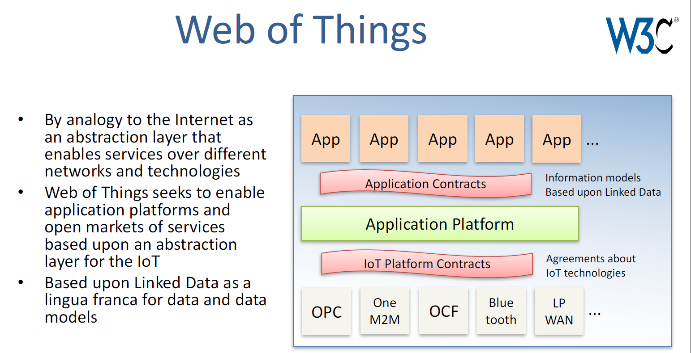
Conceptual Architecture and Objective
(Source: Dave Raggett’s slide)
WoT would enhance IoT business by enabling open market across
whole Things even which run on different conventional IoT standards.

Slide 3

Practical viewpoint of Silo vs WoT
Current Silo Architecture
WoT Architecture
- No one stop universal PF
- No eco system
- No third party’s service
- But services has been launched
- One stop universal PF by Web on IoT
- Ecosystem with third party servicers
- Coexist with other SDO’s APIs
- Maintain current services as well as
new services on WoT
Cross Apps on IoT Market
Cross Apps on IoT Market
Cross AI PF
AI PF
REST
API
AI PF
Web of Things (WoT) Servient
AI PF
AI PF
IoT
API
IoT PF
(Echonet)
IoT PF
(oneM2M)
IoT PF
(OCF)
IoT PF
(Echonet)
IoT PF
(oneM2M)
IoT PF
(OCF)
IoT PF
(BLE)
IoT PF
(BLE)
Device
a
Device
b
Device
c
Device
d
Device
a
Device
b
Device
c
Device
d
A Co.
B Co.
C Co.
D Co.
A Co.
B Co.
C Co.
D Co.

Slide 4
WoT Framework example
Browser
(WoT Client)
WoT Server
Legacy
device
There are following 3 entities in this example.
1) Legacy device which is accessible thru local network.
2) WoT server on internet which can access to legacy device. (WoT resource exposer)
3) WoT client such as browser which is application service software by controlling
legacy device thru internet. (WoT resource consumer)

Slide 5
WoT Framework example
Browser
(WoT Client)
WoT Server
Thing
Description
Legacy
device
WoT server opens “Thing Description“ as semantics of WoT
such as “Vocabulary of Things category”, “Attribute for Discovery”, “API declaration”
and link URI to WoT server instance for each protocol.

Slide 6

Usage of Semantics on WoT
Vocabulary of Things Category
Panasonic: “Home Air Conditioner”
Daikin : “Room Air Conditioner”
Mitsubishi: “エアコン”
LG :”에어컨”
“Home Air Conditioner”
Identical name should be defined.
Synonym can be bound with
“same as” operator.
Attribute for Discovery
Attribute is important for key of discovery.
e.g.) How hot my living room ?
Which thing is owned by Kajimoto ?
Which thing is located in living room ?
Which thing has temperature sensor ?
API Declaration
For client Apps, knowing what functionalities the thing provides is
important to implement services.
e.g.) set_temperature (from 20 to 29 degrees Celcius at cooling mode)

Slide 7
TD Syntax based on JSON-LD
{
"@context": {wot-td : http://w3c.github.io/wot/w3c-wot-td-context.jsonld},
"@type": “wot-td : Thing",
"name": "MyTemperatureThing",
"uris": ["coap://mytemp.example.com:5683/"],
"encodings": ["JSON"],
"properties": [
{
"name": "temperature",
"valueType": { "type": "number" },
"writable": false,
"hrefs": ["temp"]
}
]
}
TD consists of 3 parts.
- (Red) Definition of terminology and vocabulary, Attribute of thing
- (Green) Method to access processing WoT servient
- (Blue) Definition of APIs (API Prototype definition except “hrefs” tag)

Slide 8
WoT Framework example
Browser
(WoT Client)
WoT Server
Thing
Description
Legacy
device
WoT server opens “Thing Description“ as semantics of WoT
such as “Vocabulary of Things category”, “Attribute for Discovery”, “API declaration”
and link URI to WoT server instance for each protocol.

Slide 9
WoT Framework example
Browser
(WoT Client)
WoT Server
App Script
Scripting API
Runtime Environment
Thing
Description
Legacy
device
WoT client service is implemented by App Script calling WoT scripting API provided
in runtime environment.

Slide 10
WoT Framework example
Browser
(WoT Client)
WoT Server
App Script
Scripting API
Runtime Environment
Thing
Description
Protocol Binding
Protocol Binding
Binding Template
Binding Template
HTTP
CoAP
HTTP
CoAP
WebSocket
MQTT
WebSocket
MQTT
Legacy
device
WoT client runtime environment calls protocol binding block and the requests are
bound with internet protocols such as HTTP, CoAP and so on.
And with such protocol, the requests are transferred to WoT server.
Response from WoT server is processed in the same way.

Slide 11
WoT Framework example
Browser
(WoT Client)
WoT Server
App Script
App Script
Scripting API
Scripting API
Runtime Environment
Runtime Environment
Thing
Description
Protocol Binding
Protocol Binding
Binding Template
Binding Template
HTTP
CoAP
HTTP
CoAP
WebSocket
MQTT
WebSocket
MQTT
Legacy
device
Transferred requests are interpreted in WoT server runtime environment.
After that, WoT server logic, that is, App script recognizes the requests thru
scripting API and processes the requests.

Slide 12
WoT Framework example
Browser
(WoT Client)
WoT Server
App Script
App Script
Scripting API
Scripting API
Runtime Environment
Runtime Environment
Thing
Description
Protocol Binding
Proprietary
API
Protocol Binding
Binding Template
Legacy comm-unication
Binding Template
HTTP
CoAP
HTTP
CoAP
WebSocket
MQTT
WebSocket
MQTT
Legacy
device
App script calls proprietary APIs and thru legacy communication block, transferred
requests are sent to legacy device as proprietary command.
Then legacy device is actuated.

Slide 13
WoT Framework example
Security
and
Privacy
Browser
(WoT Client)
WoT Server
App Script
App Script
Scripting API
Runtime Environment
Scripting API
Security Option
Runtime Environment
Security Option
Thing
Description
Protocol Binding
Proprietary
API
Protocol Binding
Binding Template
Legacy comm-unication
Binding Template
HTTP
CoAP
HTTP
CoAP
WebSocket
MQTT
WebSocket
MQTT
Legacy
device
Source: https://w3c.github.io/wot-architecture/
And all of web and internet related communication is built of security and
privacy mechanism.
This mechanism is not included in the deliverable of WoT WG but it will be
mentioned as some kind of guideline and/or a set of requirements.

Slide 14
WoT Servient building block
Source: https://w3c.github.io/wot-architecture/
WoT Servient
Security
and
Privacy
App Script
Client
API
Server
API
Discovery
API
Scripting API
Runtime Environment
Security Option
Thing
Description
Proprietary API
Protocol Binding
Legacy comm-unication
Local
Hardware
Binding Template
HTTP
CoAP
WebSocket
MQTT
Proprietary Protocol
Legacy
device
Web Client
Web Server
WoT Servient
WoT Servient
WoT server would be cascaded to other WoT servers, then WoT server plays a role
of WoT client. So we call “WoT Servient” which is conbined by server and client.

Slide 15



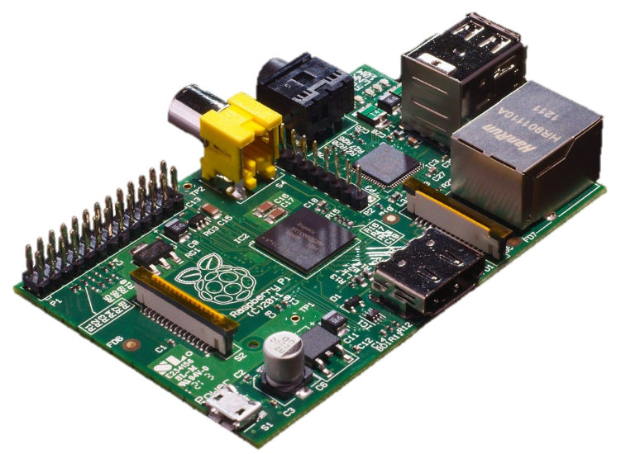
WoT server in device itself
Source: https://w3c.github.io/wot-architecture/
Security
and
Privacy
Browser
(WoT Client)
WoT Server/Servient
App Script
App Script
Scripting API
Runtime Environment
Scripting API
Security Option
Runtime Environment
Security Option
Thing
Description
Protocol Binding
Proprietary
API
Protocol Binding
Binding Template
Local
Hardware
Binding Template
HTTP
CoAP
HTTP
CoAP
WebSocket
MQTT
WebSocket
MQTT
In the future, almost all devices could be connected to internet directly
and every device provides WoT server functionality individually.
KDDI’s CHIRIMEN is one of trials of this type implementation.

Slide 16
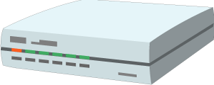
WoT server for constraint device
Source: https://w3c.github.io/wot-architecture/
Security
and
Privacy
Browser
(WoT Client)
WoT Server/Servient
App Script
App Script
Scripting API
Runtime Environment
Scripting API
Security Option
Runtime Environment
Security Option
Thing
Description
Protocol Binding
Proprietary
API
Protocol Binding
Binding Template
Legacy comm-unication
Binding Template
HTTP
CoAP
HTTP
CoAP
WebSocket
MQTT
WebSocket
MQTT
Legacy
device
Smart Home Hub
Constraint device such as sensors, cheap actuators has no resource to provide
internet connectivity nor WoT server. Then some hardware such as smart home hub
and/or cloud software provide WoT server functionality on behalf of constraint device.

Slide 17


















WoT interoperability PoC in Panasonic
Smart Home
TD Repository Service
SmartApps-PF
Toshiba LED
Prop. API
Panasonic
Echonet GW
Panasonic, Toshiba
Air Conditioner
Sma@home-PF
Use Case
Scenario Server
Prop. API
WoT extended
Browser
DECT GW
Human
Sensor
WoT API
DECT
Camera
IRKit-PF
Prop. API
WiFi GW
IRKit + Rulo
Talking to “Echo” as “I’m
home!”, then all CEs are
turned on.
Hue-PF
Prop. API
Hue
Adapter
DECT Camera detects
man’s going out, then all
CEs are turned off.
Hue
Alexa-PF
Prop. API
Dash
Button
Echo

Slide 18
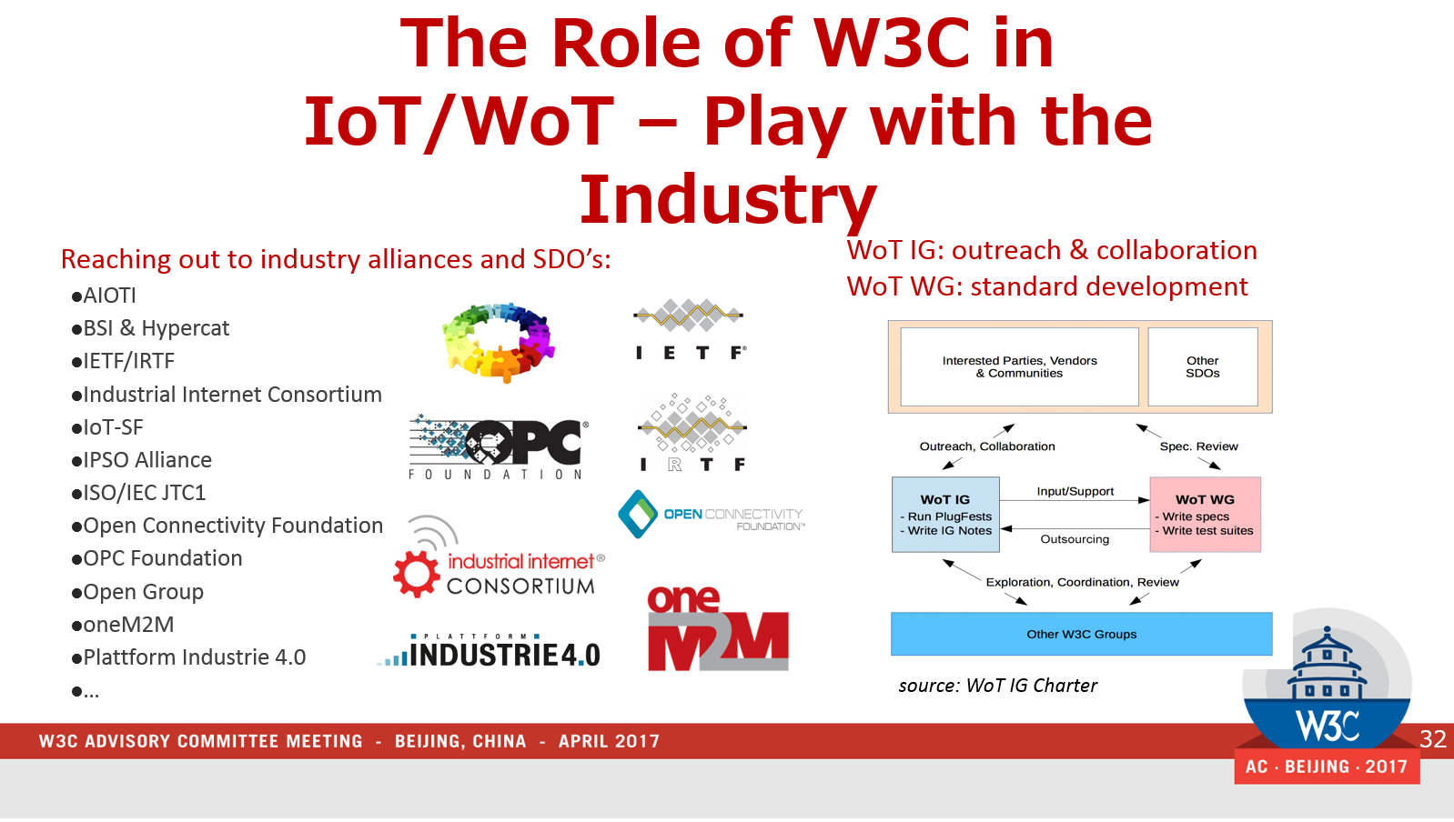
Standardization Process in WoT
Source: Yongjing’s W3C AC meeting material
Please join WoT IG/WG to enhance IoT business market together!

Slide 19


