Slide 1

Web Standards for the IoT
IRTF T2TRG WISHI
Prague, Czech Republic, July 2017

Slide 2





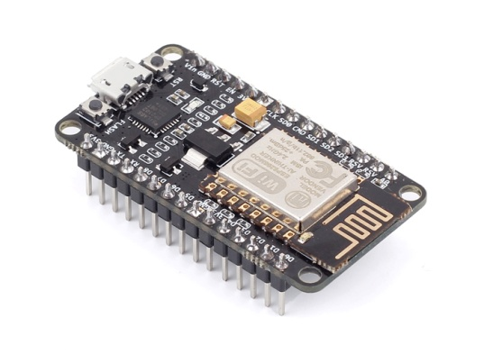
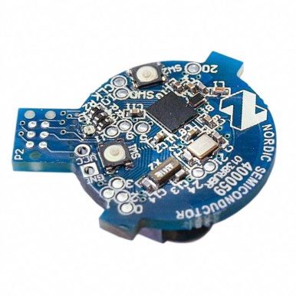
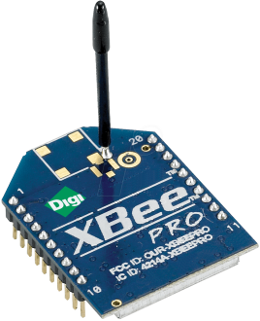
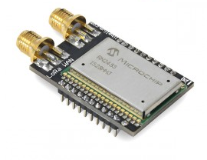

Problem: Application/Platform Silos
…
Internet of Things
: Connectivity
IEEE 802.15.4
Ethernet
Wi-Fi
Bluetooth
LoRa
…

Slide 3
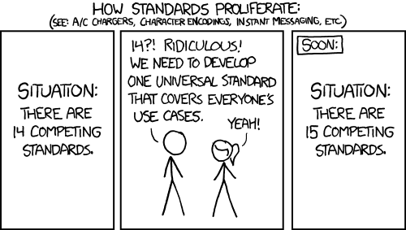
W3C WoT Mission
Not to be yet another standard

Slide 4
W3C WoT Mission
Not to be yet another standard
Web of Things: “glue in-between”
…
Extend Web technologies to the IoT to complement IoT standards by being descriptive instead of prescriptive

Slide 5

























W3C WoT Scope
WoT: cross-platform, cross-domain
…

Slide 6
W3C WoT Approach
learn how to interact with Thing
Semantic
Metadata
describe Thing
Platform A
Platform B
easy integration across platforms
Application
Application
Platform API
Platform API
Re-usable Technological Building Blocks
Data Model
Data Model
Protocol
Protocol
complement
“WoT Interface”

Slide 7
Describe: Machine-understandable Model
Properties
Linked Data vocabularies
Simple interaction model
Generic data model (JSON-like)
Semantic Web ontology
Extension points
Domain-specific vocabularies
New interaction patterns
Multiple serializations
JSON-LD (first CR release)
JSON, CBOR, EXI, …
Actions
Events
Semantic
Metadata
Start with versatile core and evolve like the Web
*CR: W3C Candidate Recommendation

Slide 8
JSON-LD Serialization
Linked Data
W3C WoT TD vocabulary
{
"@context": [
"http://w3c.github.io/wot/w3c-wot-td-context.jsonld",
{ "domain": "http://example.org/actuator#" }
],
"@type": "Thing",
"name": "MyLEDThing",
"security": {
"cat": "token:jwt",
"alg": "HS256",
"as": "https://authority-issuing.example.org"
},
"interaction": [
{
"@type": ["Action", "domain:fadeIn"],
"name": "fadeIn",
"inputData": {
"type": "integer",
"minimum": "0",
"domain:unit": "domain:ms"
},
"link": [
{
"href": "coaps://myled.example.com:5684/in",
"mediaType": "application/exi"
},
{
"href": "https://mytemp.example.com:8080/in",
"mediaType": "application/json"
}
]
},
{
"@type": ["Action", "domain:fadeOut"],
"name": "fadeOut",
"inputData": {
"valueType": {"type": "integer"},
"domain:unit": "domain:ms"
},
"links": [
{
"href": "out",
"mediaType": "application/exi"
},
{
"href": "https://mytemp.example.com:8080/out",
"mediaType": "application/json"
}
]
},
{
"@type": ["Event", "domain:alert"],
"name": "criticalCondition",
"outputData": {"valueType": {"type": "string"}},
"links": [
{
"href": "ev",
"mediaType": "application/exi"
}
]
}
]
}
domain-specific vocabulary
JSON Schema base types plus semantics

Slide 9
Complement: Building Blocks
WoT Thing Description (TD)
Machine-understandable format
Uniform documentation
WoT Binding Templates
Descriptions for specific protocols and platforms
Used in Thing Description
Re-usable binding “drivers”
WoT Scripting API
Browser-like runtime for platform-independent IoT applications
Re-usable Technological Building Blocks

Slide 10
W3C WoT Building Blocks
Platform A
Application
Platform API
Data Model
Protocol

Slide 11
W3C WoT Building Blocks
WoT Thing Description (TD) with simple interaction model
WoT Servient
JavaScript
Runtime Environment
Lua
Properties
App Script 2
WoT Scripting API for browser-like runtime environment
Actions
Events
App Script 1
Scripting API
Thing Description
Interaction Model
Local Hardware
Binding Templates
WoT Binding Templates to connect to different platforms and ecosystems
Things can be in client and/or server role: “Servient”
Server
Client
HTTP
OCF
BACnet
Expose
Consume
CoAP
OneM2M
…

Slide 12
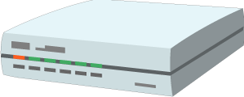



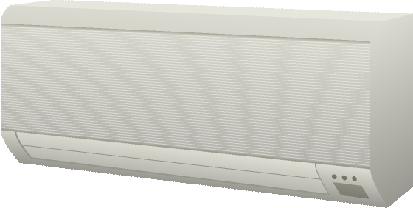
W3C WoT Architecture Patterns
Cloud
Edge Hubs
Servient
Digital Twiin
Orchestr. Client
Servient
Digital Twiin
Virtual Thing
Scripting API
Orchestr. Client
Interaction Model
Proxy Thing
Binding Templates
Scripting API
Interaction Model
Binding Templates
Web Browser
Direct Thing-to-Thing
Interaction
App Script
Scripting API
Thing
Thing
Existing Device
Interaction Model
App Script
Classic Firmware
Binding Templates
Scripting API
+
Web Integration
Interaction Model
Interaction Model
⇒
Thing
Protocol
Protocol
Complement Existing Devices

Slide 13
W3C WoT Process
Interest Group (IG)
Working Group (WG)
https://www.w3.org/2016/07/wot-ig-charter.html
Started spring 2015
220 participants
Informal work, outreach
Explorative work, validation
PlugFests with running code
Liaisons and collaborations with other organizations and SDOs (+ “OpenDays”)
https://www.w3.org/2016/12/wot-wg-2016.html
Started December 2016
92 participants
Normative standardization
Work on deliverables
W3C Patent Policy for royalty-free standards
Member organizations and Invited Experts

Slide 14


W3C WoT Process
IG: https://github.com/w3c/wot/
WG:
https://github.com/w3c/wot-architecture
https://github.com/w3c/wot-thing-description
https://github.com/w3c/wot-scripting-api/
https://github.com/w3c/wot-binding-templates
Open Issues to comment, Pull Requests to contribute

Slide 15
W3C WoT Progress
2014: Stakeholders identified at W3C Workshop
2015: IG started to identify initial building blocks
Current Practices documented (http://w3c.github.io/wot/current-practices/wot-practices.html)
Practical evaluation in “PlugFests”
2016/17: WG chartered until end of 2018
Editor’s Drafts available
First Public Working Drafts expected August 2017
Candidate Recommendations end of 2018…
2019: WG re-chartering for next building blocks
IG is continuously exploring and identifying

Slide 16
Opportunities for Reuse/Integration
Royalty-free Web standards
Technological building blocks
Non-prescriptive: take what you need
Open source reference implementation https://github.com/thingweb/node-wot
Extension points
Semantic vocabulary → iot.schema.org, oneM2M, …
Binding Templates → Web, CoRE, OCF, oneM2M, …
Libraries on top of Scripting API → individual Members

Slide 17
Opportunities for Collaboration
OpenDay at W3C WoT Face-to-Face
Proposed and invited talks for awareness
W3C WoT Call invites
Opportunity for more detailed discussions
Liaisons as formal collaboration
Chance for mutual alignment
Liaison inputs taken into account for WoT design
W3C WoT Group Member
Organization needs to be W3C Member
Invited Expert status
Note W3C Patent Policy for WG contributions (https://www.w3.org/Consortium/Patent-Policy-20040205/)

Slide 18
Opportunities for Research
Machine-understandable interaction models
Hypermedia controls → IRTF T2TRG
Programming abstractions for orchestration
Recovery from errors
Semantic Web beyond knowledge management
Dynamic graphs
Privacy preservation
Reasoning in constrained environments
Security in loosely-coupled systems
Object signing and encryption

Slide 19
W3C WoT Online Resources
W3C WoT Wiki (IG+WG organizational information)
https://www.w3.org/WoT/IG/wiki/Main_Page
W3C WoT Interest Group
https://www.w3.org/2016/07/wot-ig-charter.html (charter)
https://lists.w3.org/Archives/Public/public-wot-ig/ (subscribe to mailing list)
https://github.com/w3c/wot (technical proposals)
W3C WoT Working Group
https://www.w3.org/2016/12/wot-wg-2016.html (charter)
https://www.w3.org/WoT/WG/ (dashboard)
W3C WoT Editor’s Drafts
https://w3c.github.io/wot-architecture/
https://w3c.github.io/wot-thing-description/
https://w3c.github.io/wot-scripting-api/
https://w3c.github.io/wot-binding-templates/

