Slide 1
Web of Things
Linked Data & Semantic Processing Task Force Osaka Face to Face, May 2017
Dave Raggett <dsr@w3.org>

Slide 2
Semantic Interoperability
Semantic Interoperability is increasingly a priority to enable open markets of services
Ensuring communicating parties share the same meaning for the data that they exchange
Existing IoT standards suites focus on the protocols and interaction patterns, and only informally describe the semantics in the prose text of the specifications
Some background on semantic models
OneM2M ontologies
http://www.onem2m.org/technical/developers-corner/tools/onem2m-ontologies
IEEE IEEE Standard Ontologies for Robotics and Automation,
https://standards.ieee.org/findstds/standard/1872-2015.html
W3C Semantic Sensor Network
https://www.w3.org/TR/vocab-ssn/

Slide 3
Semantic Interoperability
Interaction model for things expressed in term of the software object properties, actions and events
Data types and constraints, e.g. min/max
Units of measure, e.g. degrees Celsius
Links to semantic models
Support for discovery, composition, validation, and adaptation to variations across devices
We now need to work on how to realise this!

Slide 4
Let’s get practical …
OCF, oneM2M and ECHOnet all specify devices for smart homes, but they vary in the details of the interaction models and capabilities
Let’s look at some specific examples and discuss ideas for how to express the corresponding semantic models

Slide 5
Same devices, different capabilities
Let’s compare the different interaction models for OCF and oneM2M devices
OCF devices: air conditioner, air purifier, window blind, camera, dishwasher, door open status, dryer, fan, garage door, on/off light, oven, printer, printer multi-function, receiver, refrigerator
oneM2M devices: air conditioner, clothes washer, electric vehicle charger, smart light, electrical generator, oven, refrigerator, robot cleaner, electric meter, storage battery, television, thermostat, water heater.
The definition of an air conditioner is very different between the two platforms. OCF just defines an on/off switch and a temperature range. oneM2M, however, also defines the step interval for temperature, a turbo mode, a run mode with a set of states, a timer, and a wind speed setting expressed via an enumeration.

Slide 6
More details
Full details of OIC 1.1 and oneM2M Home Appliances:
https://www.w3.org/WoT/demos/td2ttl/oic.html
https://www.w3.org/WoT/demos/td2ttl/m2m.html
These include simple JSON representations of the interaction models that have been reverse engineered from the OCF and oneM2M specs
The demos include scripts that map the JSON to RDF as either Turtle, JSON-LD or a graphical representation
The demos don’t yet include the semantic models …

Slide 7
Example: Motion Sensor
OCF: a read-only Boolean property
This resource describes whether motion has been sensed or not. The value is a Boolean. A value of 'true' means that motion has been sensed. A value of 'false' means that motion not been sensed.
oneM2M: further properties
Wait time in case of continuous motion
Integer value for detection accuracy

Slide 8
Semantic Model
Thing is an instance of a motion sensor class
Instances of this class may have a wait time
Instance of this class may have an adjustable sensitivity
Thing descriptions from different vendors may use different names for the properties, actions and events, and moreover, there will be variations in the capabilities available
Vendors want to differentiate their products from their rivals
OCF, oneM2M, ECHOnet, etc. all define smart home devices differently
The Web of things needs to support such variations
How to cope with different property names for essentially the same concept?
One idea is to assert that the property is an instance of the motion sensor class
The wait time and sensitivity would then need to be exposed in the interaction model as read/write metadata for that property
Another idea is to assert the semantic role of each property
The thing is declared as an instance of the motion sensor class
The oneM2M alarm, silentTime and sensitivity properties are declared with their respective semantic roles

Slide 9
Defining a Mapping
Interaction Model
Semantic Model
sensor
Mapping
Thing
Subclass
Instance
motionSensor
Sensor123
The mapping may not be isomorphic
Properties
Attributes
alarm
silentTime
sensitivity
value
minInterval
sensitivity

Slide 10
Interaction Model
Semantic Model
sensor
Thing
Mapping
Subclass
Instance
motionSensor
Sensor123
The mapping may not be isomorphic
Properties
Attributes
alarm
silentTime
sensitivity
value
minInterval
sensitivity
9

Slide 11
Some Comments
If the interaction model is represented in JSON we can use @context to map strings to URIs
This allows us to translate JSON to RDF
But interaction model is not same as semantic model, so conflating the two is likely to cause problems
e.g. when risk of invalid reasoning when mapping several different interaction models to the same semantic model
Thus need for explicit mapping, hence “semantic role”

Slide 12
Can Defaults Help?
Opportunity to simplify thing descriptions via the use of defaults in the semantic models
Units of measure
Where the same units are used in majority of instances of a particular semantic class
“standard” property names
Using standard name for a property avoids need to explicitly declare its “role” in interaction model
Inheritance from super classes
e.g. declarations on the generic “sensor” class

Slide 13
Linked Data Technologies
Keeping it simple with RDF Schema together with additional predicates
OWL ontologies
Increased sophistication and complexity
Validation with Linked Data Shape rules
Potential for simple graphical rules
SHACL, ShEx, SHRL as different flavours of shape rule languages
Other tools
Semantic Data annotating tools
Storage and query engines
Reasoners
…
But we shouldn’t be scared of introducing new approaches where these make obvious sense

Slide 14
Semantic Models
We need to win over people who are suspicious of semantic technologies!
Widespread use in research projects
But comparatively little commercial adoption
We need to show that semantic interoperability is easy and solves commercially important challenges

Slide 15
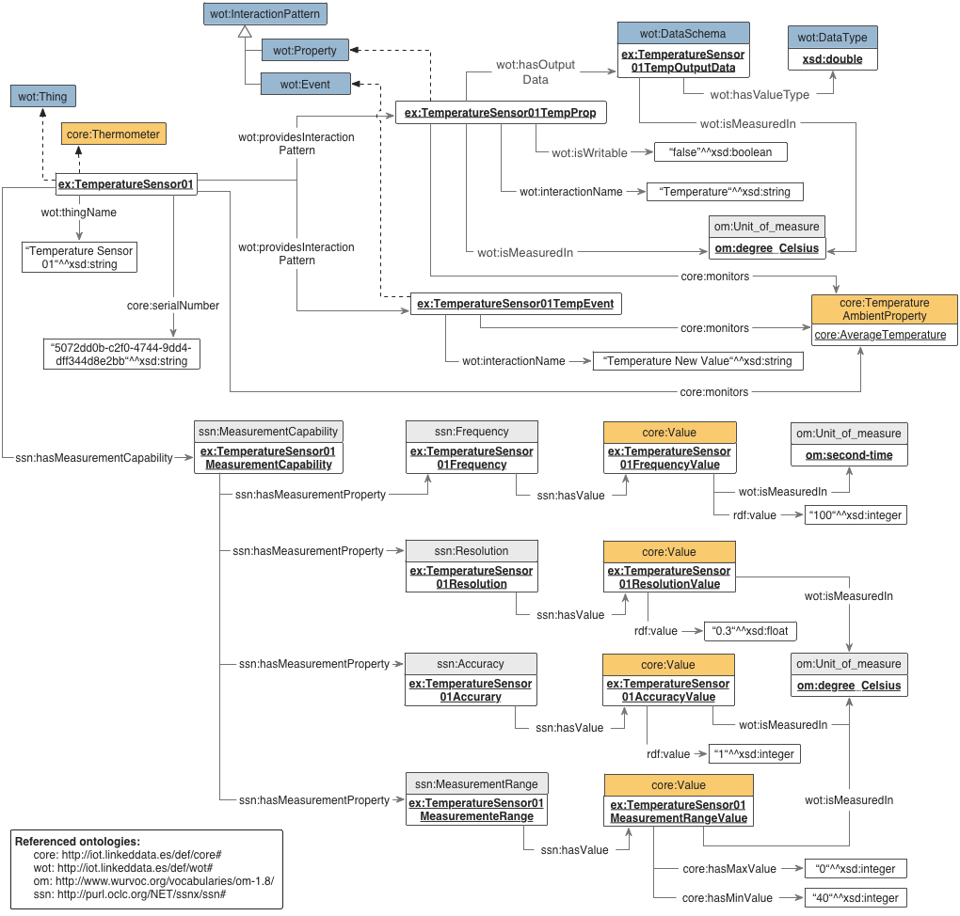
Simple?

Slide 16
Roadmap?
Could we define a roadmap for demonstrating benefits of semantic technologies?
NodeJS implementation on Web of Things with access to simulations of OCF, oneM2M and ECHOnet devices?
Smart services that adapt to variations in the interaction models based upon inspecting their semantic models
Validation of interaction models are consistent with their linked semantic models
Virtual things as dynamic compositions of other things based upon a registry of services
Practical way to explore different approaches to representing semantic models

Slide 17
Requirements for Semantic Models
The means to declare semantic classes
Taxonomies of semantic classes
Constraints on interaction models
Properties, actions, events, metadata
Whether optional or required
Use of roles for identifying properties, actions and events independent of the name used in specific interaction models
Default names for properties, actions and events
Defaults for units of measure
Don’t forget the overriding need to keep it simple!
Even if this implies the need for new standards

Slide 18
Challenge!
Discuss how to address the requirements for semantic models of things for the oneM2M motion sensor
How to represent the semantic model?
e.g. the need for a property with a given role, and the means to express defaults
Whether current standards support the kinds of reasoning required?

Slide 19
Different Communities Different Semantic Models
When different communities work on defining semantic models we can expect differences
This is already the case in the research community, and can be expected to be the case for Standards Development Organisations
Evidence from comparing OCF, oneM2M and ECHOnet
Tools relating to mappings between models
What social and technical factors can encourage reuse and convergence?

Slide 20
Some ideas for discussion
:motionSensor rdfs:subClassOf :sensor .
:motionSensor td:hasInteractlonModel _:23 .
_:23 td:hasProperty _:31 , _:32 , _:33 .
_:31 td:role “value” ;
rdfs:comment “true if motion has been detected” ;
td:type td:boolean ;
td:writeable false .
_:32 td:role “minInterval” ;
rdfs:comment “minimum interval between alarms” ;
td:type td:integer ;
td:optional true .
_:32 td:role “sensitivity” ;
rdfs:comment “detector sensitivity” ;
td:type td:integer ;
td:optional true .
Importance of graphical representation
As a tree of nodes and attributes
motionSensor is a sub-class of “sensor”
motionSensor has an interaction model
Each property is identified by a role
A string literal
Properties may be required or optional
Properties may have metadata
Properties may have default names
This example needs extending to declare the units for minInterval and sensitivity
The semantic model can be validated against a specific interaction model
Using a simple script and Linked Data library
Questions
Would OWL be simpler or more complex?
Which requirements would OWL leave unfulfilled?

Slide 21
Units of Measure
JSON context maps names to RDF concepts
Local context to disambiguate short names
mA for milliamperes
Grouping by domain and system (e.g. SI vs Imperial)
RDF concept for combination of unit of measure and scale factor, e.g. milliamperes (amperes x 1000)
Concept acts as link to further triples that identify
the base unit (amperes)
the scale factor (1000)
the property being measured (electrical current)
Conversion formulae between different units
Questions, e.g. relationship to QUDT, and whether the WoT IG should survey the needs for common domains, e.g. smart homes and make some recommendations for standardisation

Slide 22


Epilogue – Cognitive Web
Semantic models for the Web of Things are the starting point for the Cognitive Web
Extension to Linked Data to support reasoning more like we humans do
Synthesis of AI and Cognitive Science (ACT-R)
Based upon statistics of prior experience
Link strengths and exponentially decaying activation levels
What-when, what-if and semantic knowledge
Cognitive rule language for procedural knowledge
Reasoning at multiple levels (Minsky)
Trained and assessed using lessons
Self aware cognitive agents

Slide 23
Summary of TF-LD session
We focused on relationship between interaction models and semantic models, and a scalable approach based upon commercial reality
SDO’s won’t fully converge
Vendors need to differentiate
Thus need for bridging ontologies
W3C to define framework for linking to semantic models, and building a shared mindset across SDOs and IoT communities
Looking forward to exploring greater use of semantic technologies in future plugfests
We had a valuable discussion and the task force chairs will now work on a plan for a roadmap with clearly defined short term goals in the run up to the next Face to Face
This includes a study of existing work, draft ontologies* for OCF, ECHOnet & OPC, tooling, and opportunities for W3C to define APIs for accessing semantic context
Interaction Model
Semantic Model
sensor
Thing
Mapping
Subclass
Instance
motionSensor
Sensor123
The mapping may not be isomorphic
Properties
Attributes
alarm
silentTime
sensitivity
value
minInterval
sensitivity
* oneM2M has already defined their ontologies

Slide 24
Thanks

