Slide 1

for Semantic Interoperability
27 July 2017

Slide 2
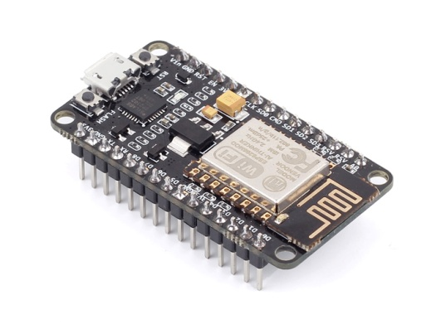
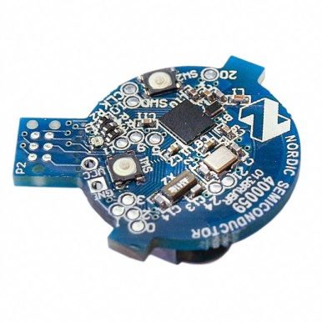
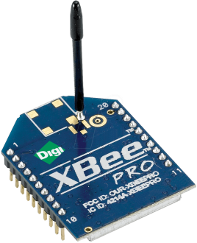
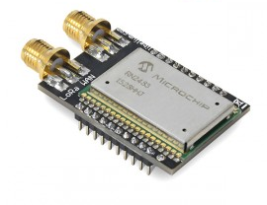
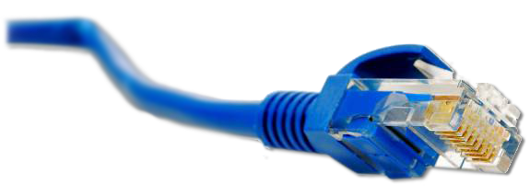
What is the Web of Things?
Internet of Things
: Connectivity
IEEE 802.15.4
Ethernet
Wi-Fi
Bluetooth
LoRa
…

Slide 3





What is the Web of Things?
Internet of Things
: Connectivity
IEEE 802.15.4
Ethernet
Wi-Fi
Bluetooth
LoRa
…

Slide 4
What is the Web of Things?
Web of Things: Application Layer
Internet of Things
: Connectivity
IEEE 802.15.4
Ethernet
Wi-Fi
Bluetooth
LoRa
…

Slide 5
W3C WoT Activities
Web of Things (WoT) Interest Group (IG) and Working Group (WG)
https://www.w3.org/WoT/

Slide 6
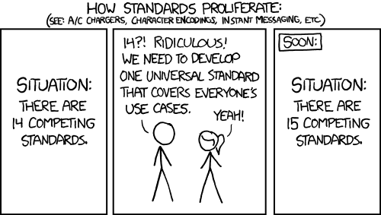
W3C WoT Mission
Not to be yet another standard

Slide 7
W3C WoT Mission
Not to be yet another standard
Web of Things: “glue in between”
…
Complement existing standards by being descriptive instead of prescriptive

Slide 8





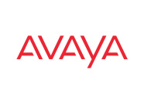



















W3C WoT Scope
cross-platform, cross-domain
…

Slide 9
W3C WoT Approach
learn how to interact with Thing
Semantic
Metadata
describe Thing
Platform A
Platform B
easy integration across platforms
Application
Application
Platform API
Platform API
Re-usable Technological Building Blocks
Data Model
Data Model
Protocol
Protocol
complement
“WoT Interface”

Slide 10
WoT Building Blocks
Complementing technological building blocks to choose from

Slide 11
Semantic Interoperability
Semantic
Metadata
Platform A
Platform B
Application
Application
Platform API
Platform API
Data Model
Data Model
Protocol
Protocol

Slide 12
How to Exchange (Described) Data
Semantic
Metadata
Platform A
Platform B
Application
Application
Platform API
Platform API
Interaction Model
Interaction Model
Protocol
Protocol
Properties
Actions
Events

Slide 13
“HTML for Things”: WoT Thing Description (TD)
Thing
Interations
+
generic data model
+ domain-specific vocabularies
Thing
Application
Application
Platform API
Platform API
TD
Interaction Model
Interaction Model
Protocol
Protocol
Properties
Actions
Events

Slide 14
Various IoT Protocols
Thing
Thing
Application
Application
Platform API
Platform API
TD
Interaction Model
Interaction Model
Protocol
Protocol
HTTP
CoAP
OCF CoAP
oneM2M CoAP

Slide 15
Description of IoT Protocols: WoT Binding Templates
Thing
Thing
Application
Application
Platform API
Platform API
TD
Interaction Model
Interaction Model
Binding Templates
Binding Templates
HTTP
CoAP
OCF CoAP

Slide 16
Binding Template Drivers and/or Configurable Protocol Stacks
Thing
Thing
Application
Application
Platform API
Platform API
TD
Interaction Model
Interaction Model
Binding Templates
Binding Templates
URI, method, options, payload
HTTP
CoAP
OneM2M CoAP
Generate and Parse Messages

Slide 17
Simplify Application Development
Thing
Thing
Application
Application
Platform API
Platform API
TD
Interaction Model
Interaction Model
Binding Templates
Binding Templates

Slide 18
Browser-like Runtime for IoT Apps: WoT Scripting API
Thing
Thing
Runtime Environment
Runtime Environment
App Script
App Script
Scripting API
Scripting API
TD
Interaction Model
Interaction Model
Binding Templates
Binding Templates

Slide 19
Portable Apps Across Vendors
Thing
Thing
Runtime Environment
Runtime Environment
App Script
Scripting API
Scripting API
TD
Interaction Model
Interaction Model
Binding Templates
Binding Templates

Slide 20
Portable Apps Across Components
Cloud
Thing
Runtime Environment
Runtime Environment
App Script
Scripting API
Scripting API
TD
TD
Interaction Model
Interaction Model
Binding Templates
Binding Templates

Slide 21
Portable Apps Across Components
Gateway
Edge Hub
Runtime Environment
Runtime Environment
App Script
Scripting API
Scripting API
TD
TD
Interaction Model
Interaction Model
Binding Templates
Binding Templates

Slide 22
TD to Augment Existing Things
Existing Device
TD Repository
Edge Hub
Custom Firmware
Runtime Environment
App Script
Scripting API
TD
TD
Interaction Model
Interaction Model
Custom HTTP
Binding Templates

Slide 23
W3C WoT Building Blocks
WoT Thing Description (TD) with simple interaction model
WoT Servient
JavaScript
Runtime Environment
Lua?
Properties
App Script 2
WoT Scripting API for browser-like runtime environment
Actions
Events
App Script 1
Scripting API
Thing Description
Interaction Model
Local Hardware
Binding Templates
WoT Binding Templates to connect to different platforms and ecosystems
Things can be in client and/or server role: “Servient”
Server
Client
HTTP
OCF
BACnet
Expose
Consume
CoAP
OneM2M
…

Slide 24
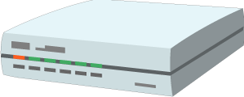


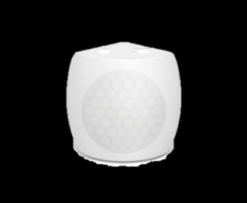
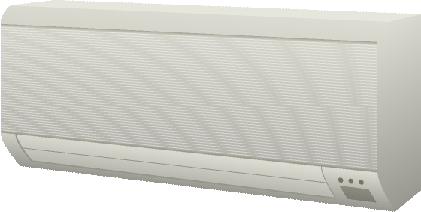
W3C WoT Architecture Patterns
Cloud
Edge Hubs
Servient
Digital Twiin
Orchestr. Client
Servient
Digital Twiin
Virtual Thing
Scripting API
Orchestr. Client
Interaction Model
Proxy Thing
Binding Templates
Scripting API
Interaction Model
Binding Templates
Web Browser
Direct Thing-to-Thing
Interaction
App Script
Scripting API
Thing
Thing
Existing Device
Interaction Model
App Script
Classic Firmware
Binding Templates
Scripting API
+
Web Integration
Interaction Model
Interaction Model
⇒
Thing
Protocol
Protocol
Complement Existing Devices

Slide 25
WoT Thing Description
Describe Thing, communication, and security metadata
https://w3c.github.io/wot-thing-description/

Slide 26
TD Example
JSON-LD (Linked Data)
W3C WoT TD vocabulary
{
"@context": [
"http://w3c.github.io/wot/w3c-wot-td-context.jsonld",
{ "domain": "http://example.org/actuator#" }
],
"@type": ["Thing"],
"name": "MyLEDThing",
"security": {
"cat": "token:jwt",
"alg": "HS256",
"as": "https://authority-issuing.example.org"
},
"interaction": [
{
"@type": ["Property", "domain:onOffStatus"],
"name": "status",
"outputData": {
"type": "boolean",
"@type": ["domain:switchable"]
},
"writable": true,
"link": [
{
"href": "coaps://myled.example.com:5684/pwr",
"mediaType": "application/cbor"
},
{
"href": "https://myled.example.com:8080/power",
"mediaType": "application/json"
}
]
},
{
"@type": ["Action", "domain:fadeIn"],
"name": "fadeIn",
"inputData": {
"type": "integer",
"@type": ["domain:duration"],
"domain:unit": "domain:ms"
},
"link": [
{
"href": "coaps://myled.example.com:5684/in",
"mediaType": "application/exi",
"rest:method": "POST"
},
{
"href": "https://myled.example.com:8080/fade-in",
"mediaType": "application/json",
"rest:method": "POST"
}
]
},
{
"@type": ["Action", "domain:fadeOut"],
"name": "fadeOut",
"inputData": {
"type": "integer",
"@type": ["domain:duration"],
"domain:unit": "domain:ms"
},
"link": [
{
"href": "out",
"mediaType": "application/exi",
"rest:method": "POST"
},
{
"href": "https://mytemp.example.com:8080/out",
"mediaType": "application/json",
"rest:method": "POST"
}
]
},
{
"@type": ["Event", "domain:alert"],
"name": "criticalCondition",
"outputData": {"type": "string"},
"link": [
{
"href": "coaps://myled.example.com:5684/ev",
"mediaType": "application/json",
"rest:method": "GET"
"coap:option": {"number": 6, "value": 1 }
}
]
}
]
}
domain-specific vocabulary
JSON Schema
vocabulary + extension

Slide 27
{
"@context": [
"http://w3c.github.io/wot/w3c-wot-td-context.jsonld",
{ "domain": "http://example.org/actuator#" }
],
"@type": ["Thing"],
"name": "MyLEDThing",
"security": {
"cat": "token:jwt",
"alg": "HS256",
"as": "https://authority-issuing.example.org"
},
"interaction": [
{
"@type": ["Property", "domain:onOffStatus"],
"name": "status",
"outputData": {
"type": "boolean",
"@type": ["domain:switchable"]
},
"writable": true,
"link": [
{
"href": "coaps://myled.example.com:5684/pwr",
"mediaType": "application/cbor"
},
{
"href": "https://myled.example.com:8080/power",
"mediaType": "application/json"
}
]
},
{
"@type": ["Action", "domain:fadeIn"],
"name": "fadeIn",
"inputData": {
"type": "integer",
"@type": ["domain:duration"],
"domain:unit": "domain:ms"
},
"link": [
{
"href": "coaps://myled.example.com:5684/in",
"mediaType": "application/exi",
"rest:method": "POST"
},
{
"href": "https://myled.example.com:8080/fade-in",
"mediaType": "application/json",
"rest:method": "POST"
}
]
},
{
"@type": ["Action", "domain:fadeOut"],
"name": "fadeOut",
"inputData": {
"type": "integer",
"@type": ["domain:duration"],
"domain:unit": "domain:ms"
},
"link": [
{
"href": "out",
"mediaType": "application/exi",
"rest:method": "POST"
},
{
"href": "https://mytemp.example.com:8080/out",
"mediaType": "application/json",
"rest:method": "POST"
}
]
},
{
"@type": ["Event", "domain:alert"],
"name": "criticalCondition",
"outputData": {"type": "string"},
"link": [
{
"href": "coaps://myled.example.com:5684/ev",
"mediaType": "application/json",
"rest:method": "GET"
"coap:option": {"number": 6, "value": 1 }
}
]
}
]
}
Property

Slide 28
{
"@context": [
"http://w3c.github.io/wot/w3c-wot-td-context.jsonld",
{ "domain": "http://example.org/actuator#" }
],
"@type": ["Thing"],
"name": "MyLEDThing",
"security": {
"cat": "token:jwt",
"alg": "HS256",
"as": "https://authority-issuing.example.org"
},
"interaction": [
{
"@type": ["Property", "domain:onOffStatus"],
"name": "status",
"outputData": {
"type": "boolean",
"@type": ["domain:switchable"]
},
"writable": true,
"link": [
{
"href": "coaps://myled.example.com:5684/pwr",
"mediaType": "application/cbor"
},
{
"href": "https://myled.example.com:8080/power",
"mediaType": "application/json"
}
]
},
{
"@type": ["Action", "domain:fadeIn"],
"name": "fadeIn",
"inputData": {
"type": "integer",
"@type": ["domain:duration"],
"domain:unit": "domain:ms"
},
"link": [
{
"href": "coaps://myled.example.com:5684/in",
"mediaType": "application/exi",
"rest:method": "POST"
},
{
"href": "https://myled.example.com:8080/fade-in",
"mediaType": "application/json",
"rest:method": "POST"
}
]
},
{
"@type": ["Action", "domain:fadeOut"],
"name": "fadeOut",
"inputData": {
"type": "integer",
"@type": ["domain:duration"],
"domain:unit": "domain:ms"
},
"link": [
{
"href": "out",
"mediaType": "application/exi",
"rest:method": "POST"
},
{
"href": "https://mytemp.example.com:8080/out",
"mediaType": "application/json",
"rest:method": "POST"
}
]
},
{
"@type": ["Event", "domain:alert"],
"name": "criticalCondition",
"outputData": {"type": "string"},
"link": [
{
"href": "coaps://myled.example.com:5684/ev",
"mediaType": "application/json",
"rest:method": "GET"
"coap:option": {"number": 6, "value": 1 }
}
]
}
]
}
Action

Slide 29
{
"@context": [
"http://w3c.github.io/wot/w3c-wot-td-context.jsonld",
{ "domain": "http://example.org/actuator#" }
],
"@type": ["Thing"],
"name": "MyLEDThing",
"security": {
"cat": "token:jwt",
"alg": "HS256",
"as": "https://authority-issuing.example.org"
},
"interaction": [
{
"@type": ["Property", "domain:onOffStatus"],
"name": "status",
"outputData": {
"type": "boolean",
"@type": ["domain:switchable"]
},
"writable": true,
"link": [
{
"href": "coaps://myled.example.com:5684/pwr",
"mediaType": "application/cbor"
},
{
"href": "https://myled.example.com:8080/power",
"mediaType": "application/json"
}
]
},
{
"@type": ["Action", "domain:fadeIn"],
"name": "fadeIn",
"inputData": {
"type": "integer",
"@type": ["domain:duration"],
"domain:unit": "domain:ms"
},
"link": [
{
"href": "coaps://myled.example.com:5684/in",
"mediaType": "application/exi",
"rest:method": "POST"
},
{
"href": "https://myled.example.com:8080/fade-in",
"mediaType": "application/json",
"rest:method": "POST"
}
]
},
{
"@type": ["Action", "domain:fadeOut"],
"name": "fadeOut",
"inputData": {
"type": "integer",
"@type": ["domain:duration"],
"domain:unit": "domain:ms"
},
"link": [
{
"href": "out",
"mediaType": "application/exi",
"rest:method": "POST"
},
{
"href": "https://mytemp.example.com:8080/out",
"mediaType": "application/json",
"rest:method": "POST"
}
]
},
{
"@type": ["Event", "domain:alert"],
"name": "criticalCondition",
"outputData": {"type": "string"},
"link": [
{
"href": "coaps://myled.example.com:5684/a",
"mediaType": "application/json",
"rest:method": "GET"
"coap:option": {"number": 6, "value": 1}
}
]
}
]
}
Event (under construction)

Slide 30
WoT Thing Description
JSON-LD just one representation
Good for discussion, accepted by Web people
TD is a formal, machine-understandable model
Backed by RDF and Linked Data vocabularies
Yet complexity of Semantic Web can be ignored (cf. string-based vocabulary, no triple handling)
Other representations possible
Custom application/wot-td+json for developers
EXI, CBOR, … for machines
… just serializations of the semantic model

Slide 31
WoT Scripting API
Program and deploy IoT applications like Web applications
https://w3c.github.io/wot-scripting-api/

Slide 32
Script Example (Expose Thing)
// create software object to represent local Thing
WoT.newThing("counter")
.then( (thing) => {
thing
// programmatically add interactions (builder pattern)
.addProperty("count", {"type": "integer"}) // JSON Schema
.addAction("increment")
.onInvokeAction("increment", () => {
console.log("incrementing counter");
// persistent state is managed by runtime environment
let value = thing.getProperty("count") + 1;
thing.setProperty("count", value);
return value;
});
// initialize state (transparent if local or remote Thing)
thing.setProperty("count", 0);
})
.catch(console.error);

Slide 33
Script Example (Consume Thing)
// create software object to represent remote Thing based on TD URI
WoT.consumeDescriptionUri("http://servient.example.com/things/counter")
// use promise to handle asynchronous creation
.then( (counter) => {
counter
// invoke an Action without arguments
.invokeAction("increment")
// which is an asynchronous call -> promise
.then( () => {
console.log("incremented");
counter
// read Property (async.) to confirm increment
.getProperty("count").then( (count) => {
console.log("new state is " + count);
});
}).catch(console.error);
})
.catch(console.error);

Slide 34
WoT Scripting API
Standard API for IoT applications (cf. Web browser)
Client to consume remote Things and local hardware
Server to expose as Thing
Discovery with different mechanisms (hidden from script)
Hiding state management and asynchronicity
Initial focus on JavaScript (Web of Things)
Aiming to keep API definition language-agnostic
Other APIs possible in the future (e.g., Lua, Python)

Slide 35
W3C WOT Organization
https://www.w3.org/WoT/

Slide 36
W3C WoT Process
Interest Group (IG)
Working Group (WG)
https://www.w3.org/2016/07/wot-ig-charter.html
Started spring 2015
213 participants
Informal work, outreach
Exploration, validation
PlugFests with running code
Liaisons and collaborations with other organizations and SDOs (+ “OpenDays”)
https://www.w3.org/2016/12/wot-wg-2016.html
Started December 2016
94 participants
Normative standardization
Work on deliverables
W3C Patent Policy for royalty-free standards
Member organizations and Invited Experts

Slide 37


W3C WoT Process
IG: https://github.com/w3c/wot/
WG:
https://github.com/w3c/wot-architecture
https://github.com/w3c/wot-thing-description
https://github.com/w3c/wot-scripting-api/
https://github.com/w3c/wot-binding-templates
Open Issues to comment, Pull Requests to contribute

Slide 38
W3C WoT Progress
2014: Stakeholders identified at W3C Workshop
2015: IG started to identify initial building blocks
Current Practices documented (http://w3c.github.io/wot/current-practices/wot-practices.html)
Practical evaluation in “PlugFests”
2016/17: WG chartered until end of 2018
Editor’s Drafts available
First Public Working Drafts expected August 2017
Candidate Recommendations end of 2018…
2019: WG re-chartering for next building blocks
IG is continuously exploring and identifying

Slide 39
Opportunities for Reuse/Integration
Royalty-free Web standards
Technological building blocks
Non-prescriptive: take what you need
Open source reference implementation https://github.com/thingweb/node-wot
Extension points
Semantic vocabulary → iot.schema.org, oneM2M, …
Binding Templates → Web, CoRE, OCF, oneM2M, …
Libraries on top of Scripting API → individual Members

Slide 40
Opportunities for Collaboration
OpenDay at W3C WoT Face-to-Face
Proposed and invited talks for awareness
W3C WoT Call invites
Opportunity for more detailed discussions
Liaisons as formal collaboration
Chance for mutual alignment
Liaison inputs taken into account for WoT design
W3C WoT Group Member
Organization needs to be W3C Member
Invited Expert status
Note W3C Patent Policy for WG contributions (https://www.w3.org/Consortium/Patent-Policy-20040205/)

Slide 41
W3C WoT Liaisons
Active
OCF
OneM2M
OPC Foundation
Potential
OpenFog
OMA LWM2M / IPSO Alliance
EchoNet
Fairhair Alliance

Slide 42


Example: WoT Interworking – WoT Interface
Exposing the WoT interface (described in TD) to oneM2M systems
Benefit: WoT services/data can be consumed by oneM2M applications
Actuator
provides
Thing Description
provides
Sensor
oneM2M Application (AE)
uses
WoT i/f
uses
WoT i/f
uses
Inter-working Proxy (AE)
Inter-working Proxy (AE)
encapsulate & map
WoT TD
mapping
Mca
Mca
Mca
oneM2M Resource Model
CSE
CSE
MN
Mcc
Infrastructure Node

Slide 43
Example: WoT Interworking – SDT Mapping
Conceptual alignment observed between oneM2M/HGI SDT and W3C WoT information models
It implies promising semantic interoperability.
Technical study is progressing on both sides

Slide 44
Example: WoT Interworking – Home Automation
Device Model
Device properties
‘@type’
Module Class
‘@type’
Module Classes
‘property’
Data Point
‘property’ or ‘action’
‘action’
Action
‘event’
SDT concepts
WoT concepts

Slide 45
Opportunities for Research
Machine-understandable interaction models
Hypermedia controls → IRTF T2TRG
Programming abstractions for orchestration
Recovery from errors
Semantic Web beyond knowledge management
Dynamic graphs
Privacy preservation
Reasoning in constrained environments
Security in loosely-coupled systems
Object signing and encryption

Slide 46
W3C WoT Online Resources
W3C WoT Wiki (IG+WG organizational information)
https://www.w3.org/WoT/IG/wiki/Main_Page
W3C WoT Interest Group
https://www.w3.org/2016/07/wot-ig-charter.html (charter)
https://lists.w3.org/Archives/Public/public-wot-ig/ (subscribe to mailing list)
https://github.com/w3c/wot (technical proposals)
W3C WoT Working Group
https://www.w3.org/2016/12/wot-wg-2016.html (charter)
https://www.w3.org/WoT/WG/ (dashboard)
W3C WoT Editor’s Drafts
https://w3c.github.io/wot-architecture/
https://w3c.github.io/wot-thing-description/
https://w3c.github.io/wot-scripting-api/
https://w3c.github.io/wot-binding-templates/

Slide 47
WG Roadmap
2017-02 (Santa Clara F2F)
Create GitHub repos
2017-05 (Osaka F2F)
Graphical and RDF model of TD
Editor’s Drafts
RC for WoT Architecture First Public Working Draft (FPWD)
Start security review for WoT Architecture
2017-07 (Düsseldof F2F)
Finish security review for WoT Arch. with Internet Drafts (“security concepts”) for internal security review and IETF outreach
Draft for test suite (Servient emulator with automatic checks)
Release First Public Working Draft (FPWD) of WoT Architecture
2017-11 (TPAC 2017, Burlingame, CA, USA)
RCs for First Public Working Drafts
RC Implementations and Test Suite
Start external security review
2018-03 (London? F2F)
Finish external security review
Release First Public Working Drafts (FPWDs)
2018-05 (F2F at sec conf, Santa Clara?)
Aggressive testing / adverse security testing?
2018-07 (China? F2F)
2018-10
RCs for Candidate Recommendations
Start security review
2018-11 (TPAC 2018, Asia?)
Finish security review
Start release process
2018-12 (end of current charter)
Release Candidate Recommendations (CRs)

