Slide 1

A Bridge to Broader IoT Ecosystems
ETSI IoT Week
Sophia Antipolis, France, Oct 2017

Slide 2
Where is the value potential of the IoT?
McKinsey, June 2015 – “The Internet of Things: mapping the value beyond the hype”
Aggregated value - $3.9 trillion to $11.1 trillion per year in 2025
Interoperability is required to capture 40% of total value
Less than 1% of data is currently used, mostly for alarms or real-time control
More can be used for optimisation and prediction
Twice as much value from B2B applications than from consumer
40% of value in developing countries, 60% in developed countries
Home $200B to $350B
Offices $70B to $150B
Vehicles $210B to $740B
Cities – public health and transportation $930B to $1.7T
Factories – operations and equipment optimisation $1.2T to $3.7T
Outside – logistics and navigation $560B to $850B
Retail $170B to $1.6T
Health & Fitness $200B to $350B
Worksites $160B to $930B
Most of the potential value is in the data and value added services rather than the IoT devices and IoT communication technologies.
Open standards are needed to overcome fragmentation, connect the silos and unlock the network effect for exponential growth
Notes:
value hides in the data and services, the way to capture the value is interoperability
Overcoming barriers to interoperability
Many choices for communication technologies and standards
Lack of shared approaches to interoperability
Existing IoT standards focus on particular technologies and use cases
This makes it challenging (hard, expensive, risky) to create services across a heterogeneous set of technologies and standards

Slide 3





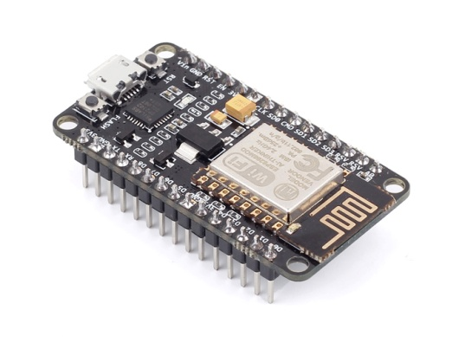
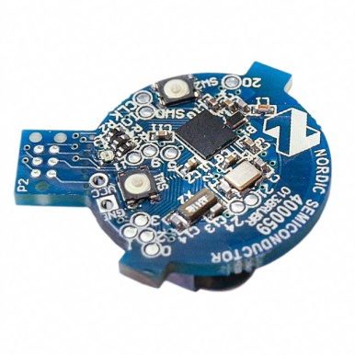
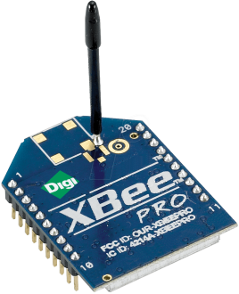
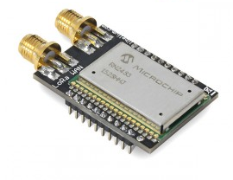
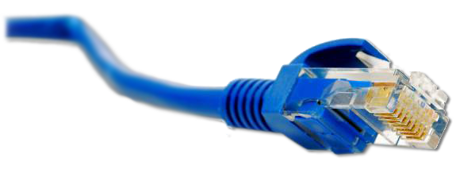
Problem: Application/Platform Silos
…
Internet of Things
: Connectivity
IEEE 802.15.4
Ethernet
Wi-Fi
Bluetooth
LoRa
…
Notes:
Open standards are not sufficient, the interoperability between them are indispensable.
The problem space that WoT is addressing is the fragmented silos of IoT ecosystems, where too many choices exist when it comes to the IoT technologies and standards.
Although some standards like oneM2M are trying to provide interworking means in technology specific ways, there is still a need and room for common means of interworking especially at the semantic level.
Non-interoperable cloud platforms that lock you into their platform
It’s hard to create services that span multiple IoT technologies and standards
Open standards are needed to overcome fragmentation, connect the silos and unlock the network effect for exponential growth
This needs to happen in a way that complements work in IoT alliances and standards development organizations
We know oneM2M is also trying to interconnect with different ecosystems, WoT may provide a useful tool for that.

Slide 4
W3C WoT Mission
Not to be yet another standard
Web of Things: “glue in-between”
…
Extend Web technologies to the IoT to complement IoT standards by being descriptive instead of prescriptive
Notes:
WoT is not like other IoT standards that try to define specific ways of communicating and interaction (e.g. interfaces, protocols, primitives), rather, it provides a tool set to be able to describe what those interfaces are, and how to interact.
W3C’s Value Proposition:
Our standards are critical for Web browsers and semantic technologies for linked data
Semantic technologies have huge importance for the IoT
The Web of Things as a means for simplifying application development and enabling integration across devices from different vendors and using different technology stacks, e.g.
Apple HomeKit, Android Things, OCF, oneM2M, OPC, LPWAN, Bluetooth, …

Slide 5





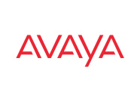



















W3C WoT Scope
WoT: cross-platform, cross-domain
…
Notes:
The vision is to support cross-xx interoperability, and bridge the ecosystems in a harmonized way.

Slide 6
Where is WoT Positioned?
Web of Things: Application Layer
Internet of Things
: Connectivity
IEEE 802.15.4
Ethernet
Wi-Fi
Bluetooth
LoRa
…
Notes:
let’s say above IP layer, describing the transport means and data model (interaction pattern)

Slide 7
W3C WoT Approach
learn how to interact with Thing
Semantic
Metadata
describe Thing
Platform A
Platform B
easy integration across platforms
Application
Application
Platform API
Platform API
Re-usable Technological Building Blocks
Data Model
Data Model
Protocol
Protocol
complement
“WoT Interface”
Notes:
the services a producing-thing exposes can be described in semantic metadata so that the consuming thing can understand and learn to interact with.

Slide 8
W3C WoT Building Blocks
WoT Thing Description (TD) with simple interaction model
WoT Servient
JavaScript
Runtime Environment
Lua
Properties
App Script 2
WoT Scripting API for browser-like runtime environment
Actions
Events
App Script 1
Scripting API
Thing Description
Interaction Model
Local Hardware
Binding Templates
WoT Binding Templates to connect to different platforms and ecosystems
Things can be in client and/or server role: “Servient”
Server
Client
HTTP
OCF
BACnet
Expose
Consume
CoAP
OneM2M
…
Notes:
WoT Thing Description (TD)
Machine-understandable format
Uniform documentation
Linked Data vocabularies
Simple interaction model
Generic data model (JSON-like)
Semantic Web ontology
Extension points
Domain-specific vocabularies
New interaction patterns
Multiple serializations
JSON-LD (first CR release)
JSON, CBOR, EXI, …
WoT Binding Templates
Descriptions for specific protocols and platforms
Used in Thing Description
Re-usable binding “drivers”
WoT Scripting API
Browser-like runtime for platform-independent IoT applications

Slide 9
JSON-LD Serialization
Linked Data
W3C WoT TD vocabulary
{
"@context": [
"http://w3c.github.io/wot/w3c-wot-td-context.jsonld",
{ "domain": "http://example.org/actuator#" }
],
"@type": "Thing",
"name": "MyLEDThing",
"security": {
"cat": "token:jwt",
"alg": "HS256",
"as": "https://authority-issuing.example.org"
},
"interaction": [
{ "@type": ["Action", "domain:fadeIn"],
"name": "fadeIn",
"inputData": {
"type": "integer",
"minimum": "0",
"domain:unit": "domain:ms"
},
"link": [
{ "href": "coaps://myled.example.com:5684/in",
"mediaType": "application/exi",
"REST:method": "POST"
},
{ "href": "https://mytemp.example.com:8080/in",
"mediaType": "application/json",
"REST:method": "POST"
}
]
},
{
"@type": ["Action", "domain:fadeOut"],
"name": "fadeOut",
"inputData": {
"valueType": {"type": "integer"},
"domain:unit": "domain:ms"
},
"links": [
{
"href": "out",
"mediaType": "application/exi"
},
{
"href": "https://mytemp.example.com:8080/out",
"mediaType": "application/json"
}
]
},
{
"@type": ["Event", "domain:alert"],
"name": "criticalCondition",
"outputData": {"valueType": {"type": "string"}},
"links": [
{
"href": "ev",
"mediaType": "application/exi"
}
]
}
]
}
domain-specific vocabulary
JSON Schema base types plus semantics
protocol binding specifics

Slide 10
Things as Objects with Descriptions
exposes
Synchronisation across the Internet using Web protocols
consumes
Application Script that abstracts the device as a Thing
Properties
Produced Thing as software object
Consumed Thing as software object
Properties
Application Script that interacts with a consumed Thing
Actions
Actions
Events
Events
IoT technology standard
Application publishes
Every Thing has a URL that identifies the Thing, and links to its description.
The URL is used as an RDF node for semantic descriptions of Things and their relationships
RDF: knowledge representation using binary graphs with labelled links between RDF nodes
Thing Description
Device
Sensors and actuators
Application platforms use Thing Descriptions to automatically create the objects for exposed and consumed Things

Slide 11
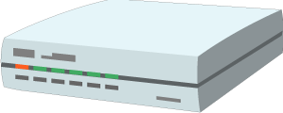



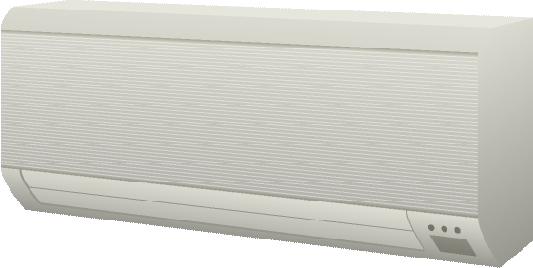
W3C WoT Architecture Patterns
Cloud
Gateway
Servient
Digital Twiin
Orchestr. Client
Servient
Digital Twiin
Virtual Thing
Scripting API
Orchestr. Client
Interaction Model
Proxy Thing
Binding Templates
Scripting API
Interaction Model
Binding Templates
Web Browser
Direct Thing-to-Thing
Interaction
App Script
Scripting API
Thing
Thing
Existing Device
Interaction Model
App Script
Classic Firmware
Binding Templates
Scripting API
+
Web Integration
Interaction Model
Interaction Model
⇒
Thing
Protocol
Protocol
Complement Existing Devices

Slide 12
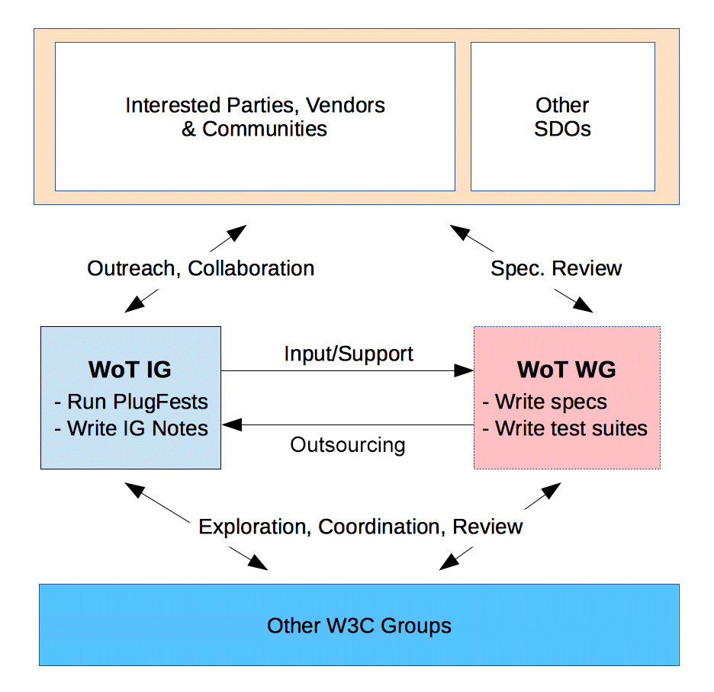
W3C WoT Process
Interest Group (IG)
Working Group (WG)
https://www.w3.org/2016/07/wot-ig-charter.html
https://www.w3.org/2016/12/wot-wg-2016.html
Started spring 2015
199 participants
Informal work, outreach
Explorative work, validation
PlugFests with running code
Liaisons and collaborations with other organizations and SDOs (+ “OpenDays”)
Started December 2016
100 participants
Normative standardization
Work on deliverables
W3C Patent Policy for royalty-free standards
Member organizations and Invited Experts

Slide 13
W3C WoT Progress
2014: Stakeholders identified at W3C Workshop
2015: IG started to identify initial building blocks
Current Practices documented (http://w3c.github.io/wot/current-practices/wot-practices.html)
Practical evaluation in “PlugFests”
2016/17: WG chartered until end of 2018
Editor’s Drafts available
3 First Public Working Drafts published in Sep. 2017
Candidate Recommendations end of 2018…
2019: WG re-chartering for next building blocks
IG is continuously exploring and identifying

Slide 14
W3C WoT Online Resources
W3C WoT Wiki (IG+WG organizational information)
https://www.w3.org/WoT/IG/wiki/Main_Page
W3C WoT Interest Group
https://www.w3.org/2016/07/wot-ig-charter.html (charter)
https://lists.w3.org/Archives/Public/public-wot-ig/ (subscribe to mailing list)
https://github.com/w3c/wot (technical proposals)
W3C WoT Working Group
https://www.w3.org/2016/12/wot-wg-2016.html (charter)
https://www.w3.org/WoT/WG/ (dashboard)
W3C WoT Editor’s Drafts
https://w3c.github.io/wot-architecture/
https://w3c.github.io/wot-thing-description/
https://w3c.github.io/wot-scripting-api/
https://w3c.github.io/wot-binding-templates/
FPWD!
FPWD!
FPWD!

Slide 15
Opportunities for Reuse/Integration
Royalty-free Web standards
Technological building blocks
Non-prescriptive: take what you need
Open source reference implementation https://github.com/thingweb/node-wot
Extension points
Semantic vocabulary → iot.schema.org, oneM2M, …
Binding Templates → Web, CoRE, OCF, oneM2M, …
Libraries on top of Scripting API → individual Members

Slide 16





W3C WoT Liaisons
Active
OCF
OneM2M
OPC Foundation
Potential
OpenFog
OMA LWM2M / IPSO Alliance
EchoNet
Fairhair Alliance

Slide 17
W3C - oneM2M Collaboration
Common ground of Semantic Interoperability for IoT
Standards, tools and expertise on Semantic Web (RDF/OWL/SPARQL) as the building blocks of oneM2M semantic features (ontology management, semantic query/discovery, …)
Importance of machine interpretable descriptions rather than relying on informal documentation that may diverge over time
Discovering Things based upon their capabilities and context of use
Inferring knowledge of Things and environments
Designing compositions of services that can be proven to interoperate
Addressing inevitability of change, especially across uncoupled or weakly coupled communities
Well-aligned semantic models between WoT and oneM2M Base Ontology and Smart Device Template as the solid base of interoperability (see next pages)
Ongoing Work Item “oneM2M-WoT Interworking”
Notes:
both organizations have recognized the importance of semantic technology for the IoT interoperability. Especially useful to make machines/things to understand each other with normalized machine languages.
W3C’s suite of standards for semantic technologies and linked data
Importance of machine interpretable descriptions rather than relying on informal documentation that may diverge over time
Discovering things based upon their capabilities and context of use
Adaptation of user interfaces and application logic to match a chosen device or service
Designing compositions of services that can be proven to interoperate
Balancing expressivity with complexity given different requirements
Challenges in addressing inevitability of change, especially across uncoupled or weakly coupled communities
Tuning standardisation processes to the needs of vocabulary development
Opportunities for collaboration?

Slide 18
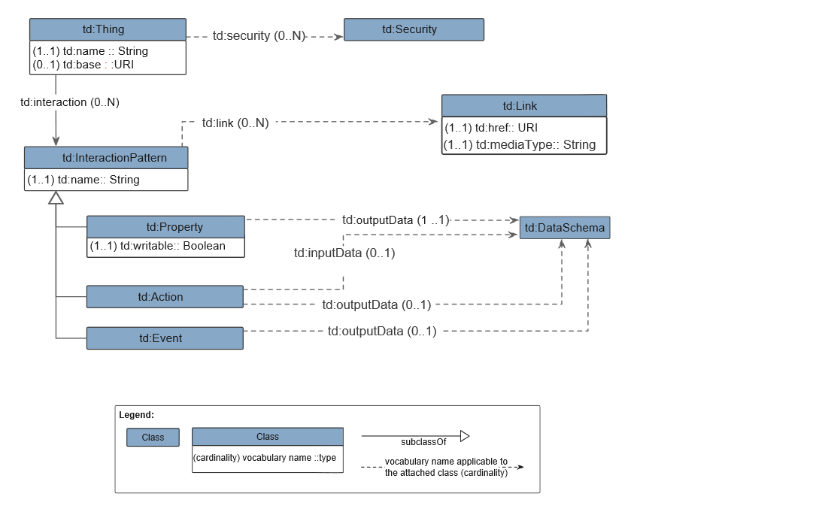
Well-aligned base of Semantic Interoperability
WoT TD & oneM2M BO Mapping
The WoT TD Core Model
The core concepts in each model are well mapped.

Slide 19
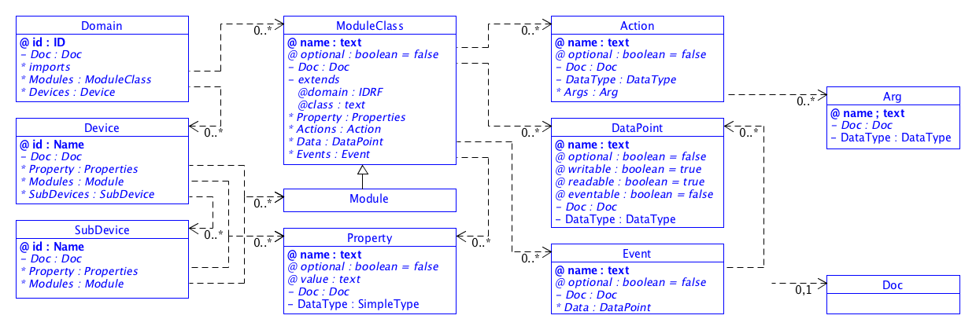
Well-aligned base of Semantic Interoperability
WoT TD & oneM2M/HGI SDT Mapping
The WoT TD Core Model
oneM2M SDT
Event more direct mapping observed.

Slide 20



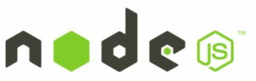

Added value of WoT to oneM2M
A descriptive & semantic framework (TD) bridging with many other IoT ecosystems in an easier way
A close and natural engagement with Web developers who are more familiar with Web technologies like the Scripting API
Scripting API
TD
Device Ecosystems
Web developers

Slide 21


Bridging to Broader IoT Ecosystems
Exposing the “WoT i/f” to oneM2M systems
WoT services/data (described in WoT TD) can be consumed by oneM2M applications
oneM2M IPE design can be simplified based on the common description of TD (works as BO but more generic)
Actuator
provides
Thing Description
provides
Sensor
oneM2M Application (AE)
uses
“WoT i/f”
uses
“WoT i/f”
uses
Inter-working Proxy (AE)
Inter-working Proxy (AE)
encapsulate & map
WoT TD
mapping
Mca
Mca
Mca
oneM2M Resource Model
CSE
CSE
MN
Mcc
Infrastructure Node

Slide 22
Bridging to Broader IoT Ecosystems
Exposing the oneM2M i/f to WoT-compatible systems
oneM2M services/data can be consumed by WoT Servients (as if they “speak” oneM2M protocol according to TD )
oneM2M protocol bindings can be described in a machine-understandable way using WoT TD Binding Template (automated interworking becomes possible)
WoT Servient
WoT Servient
Links (URIs), Metadata
Thing Description
Application(s)
Logic + Data
Interaction Model
Interaction Model
Binding Templates
Binding Templates
Server
Server
Client
Cient

Slide 23
Take-away
WoT is not yet another prescriptive standard but a descriptive tool for bridging the IoT ecosystems
TD is the heart of WoT
Common ground of semantic interoperability shows promising interworking solution between WoT and oneM2M
Work to be further progressed on both sides via closer collaboration

Slide 24
Thank you!!!

